Slide 1
Things Theory

Slide 2
Things and Artifacts
Processual - Human actors and things as active entities in the production of order
Things shape temporal structures – stabilise and reproduce social order
Sociology of culture – people focused, institutional characteristics, social position of the audience
Material culture – object focussed, symbols of culture
Material qualities of objects – do objects have agency?
Objects as mechanisms of power

Slide 3
Jean Baudrillard
System of objects circulates sign value within a society
Material things can be signs of social status and cultural location
Consumption of material stuff may locate individual identities within a culture
‘Co-evolves’ with human practices and systems of action
Embodied ‘material interaction’ between humans and stuff releases the cultural meanings and practices embedded in the materiality of that stuff.

Slide 4
Clifford Geertz
Thick Description (1973)
‘pervasive nervousness’ caused by profound changes in the world
Crisis of cultural representation
Anthropology as interpretive activity over grand comparison
Hermeneutics –ethnography is a kind of writing
Ricoeur, Burke and Wittgenstein prepared ground for ‘literary turn’
Writing Culture (1986)

Slide 5
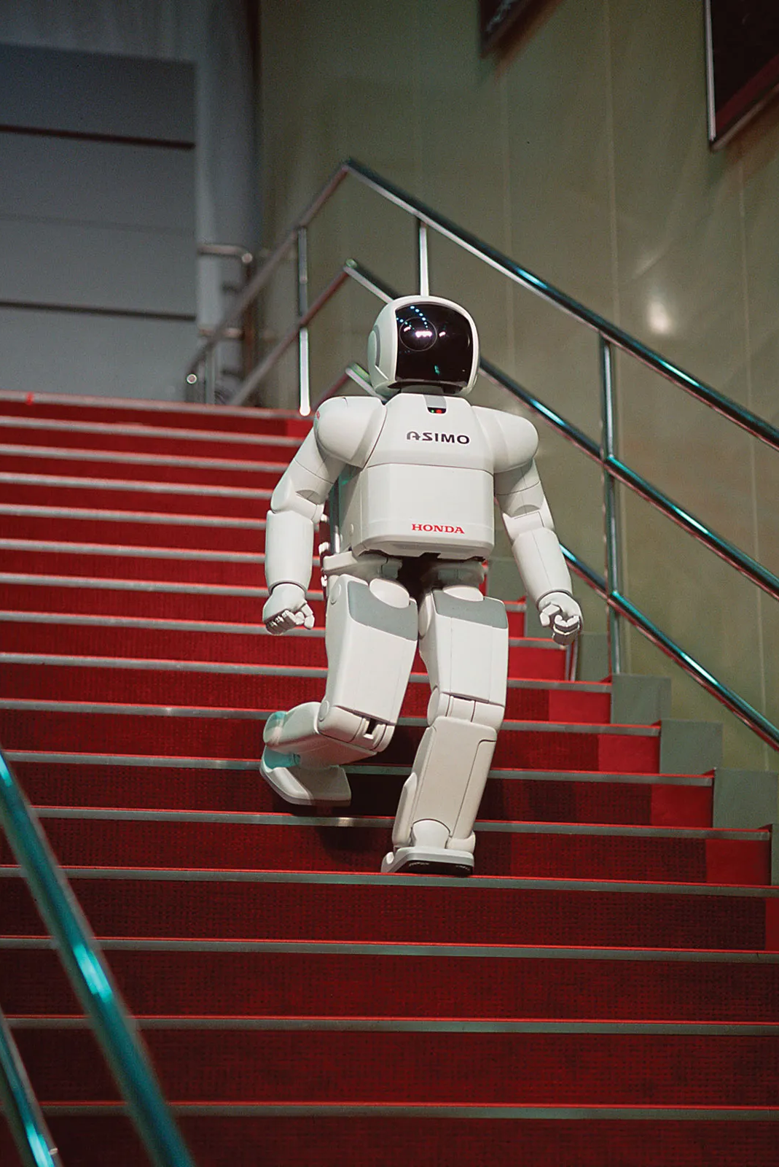
Technology
Mauss- ‘natural’ technical actions vary from culture to culture
Technique is social production learned by tradition
Techniques have 5 elements: matter, energy, artefacts, gestures and specific knowledge
All interact and many are interrelated
Every artefact has two related dimensions or functions: physical and communicative
Techniques as constraints – ecological and Marxist anthropology

Slide 6
Technology cont.
Study of processes by material culture becoming part of culture
Results from and participates in socio-cultural characteristics
Social representations of action on the material world link technology, culture and society
Technique as physical manifestation of mental schematic of things
Social representations of technology embedded in broader symbolic systems

Slide 7
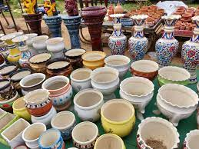
Technology cont.
Free creativity in material culture
Paradox: particular society may have ‘irrational’ or ‘inefficient’ technique whilst long-term evolution of systems is considered ‘progress’
Lerois-Gourhan (1943) ‘tendance’ to perform similar actions and processes
Are the social relations and meanings linked to technology the decisive element in its social production, or are they such a marginal aspect of innovation that at any moment technology has only a few possible lines of evolution open?
Technical actions and changes are determined by social relations beyond action on matter

Slide 8
Technology cont.
Technological choices may well bear on material culture which produce real effects and communication
Non-technical representations of technology participate in systems of meaning through their physical characteristics
Technical borrowing: adapting or dismissing an existing technical feature

Slide 9
Marcel Mauss The Gift
Systems of exchange and obligation
Gifts must be reciprocated
“forms the framework for a whole series of other exchanges, extremely diverse in scope”
Kula in the Triobriand Islands Potlatch in American NW
Create and maintain social ties, reinforce laws and rights, and keep the society function in a certain way

Slide 10
Questions: Tim Dant Material Civilization
Why is civilization's ascribing meaning to materials an important research topic?
What is technization? According to Elias, what is the relation beween civilizing process and technization? What kind of de-civilizing effects can technization cause? Can you give some examples?

Slide 11
Questions: Csikszentmihalyi and Rochberg-Halton
How is Durkheims theory of morbid disturbance is related to thing theory in present time?
Of many examples that Csikszentmihalyi and Rochberg-Halton gave (such as japanese trees, Nuer spears, etc.) what examples can you give from your own cultures that carry a symbolic meaning?

