Slide 1
Power of Images
Methodological approaches

Slide 2
„All art is in part about the world in which it emerged.“
–– Terry Barrett, Criticizing Art: Understanding the Contemporary.

Slide 3
Pre-conditions:
Social and historical context
Source criticism, critical thinking
Correct format for describing a piece of art!
Artist, Title, date
Artist, Title, date. Artistic technique, dimensions, deposition, location.
Criticism - description - analysis - interpretation - conclusions
Content - context - meaning
Readings:
Methods for evaluating information sources: An annotated catalogue
Useful links:
Source criticism
The Need for Source Criticism: A Letter from Alexander to Aristotle?
Video:
Understanding source criticism: the basics
Source criticism
Don’t forget that any piece f art has different levels of expression and meaning (expressive, gestural, thematic, symbolic, etc.)

Slide 4
Bibliography
Bazerman, Charles (1995). The Informed Writer: Using Sources in the Disciplines. 5th ed. Houghton Mifflin.
Beecher-Monas, Erica (2007). Evaluating scientific evidence : an interdisciplinary framework for intellectual due process. Cambridge; New York: Cambridge University Press.
Brundage, Anthony (2007). Going to the Sources: A Guide to Historical Research and Writing, 4th Ed. Wheeling, Illinois: Harlan Davidson, Inc. (3rd edition, 1989 cited in text above).
Fritch, J. W., & Cromwell, R. L. (2001). Evaluating Internet resources: Identity, affiliation, and cognitive authority in a networked world. Journal of the American Society for Information Science and Technology, 52, 499–507.
Howell, Martha & Prevenier, Walter (2001). From Reliable Sources: An Introduction to Historical Methods. Ithaca: Cornell University Press.
Müller, Philipp (2009). Understanding history: Hermeneutics and source-criticism in historical scholarship. IN: Dobson, Miriam & Ziemann, Benjamin (eds): Reading primary sources. The interpretation of texts from nineteenth and twentieth-century history. London: Routledge (pp. 21–36).

Slide 5
Formalism
Biography
Semiotics
Iconography and Iconology
Critical approaches - Social art historical methods
(Post)Marxism and Materialist Perspectives on Art
Feminism(S)
Cultural Studies and Postcolonialism
LGBTI Studies and Queer Theory
Psychoanalysis
Literary studies methods
Topological analysis
Intertextuality

Slide 6
Formalism
= study of the form (abstract/representational - realistic, figurative), composition (rhythm, balance, repetition, contrast), identification, description, analysis and/or comparison of visual aspect and elements (color, light, line, pictorial space, shape, tone, texture, pattern, etc.), identification of the period and artistic style
formalist description usually makes part of introductions
Vienna School of Art History (A. Riegel, F. Wickhoff), later Cl. Greenberg, M. Fried
Useful links:
Visual elements of art
Formal analysis of photographs
Formalism in modern art
Video:
Introducing formal analysis: Landscape
Introducing formal analysis: still lifes
How to do visual (formal) analysis in art history

Slide 7
„…a formal analysis – the result of looking closely – is an analysis of the form that the artist produces; that is, an analysis of the work of art, which is made up of such things as line, shape, color, texture, mass, composition. These things give the stone or canvas its form, its expression, its content, its meaning.“
– Sylvan Barnet, A Short Guide to Writing About Art.

Slide 8
Bibliography
ADAMS, Laurie. The methodologies of art: an introduction. Second edition. Boulder: Westview Press, a member of the Perseus Books Group, [2010], ©2010. xviii, 286 stran, 8 nečíslovaných stran obrazových příloh. ISBN 978-0-8133-4450-8.
GERRITSEN, Anne, ed. a RIELLO, Giorgio, ed. Writing material culture history. First published. London: Bloomsbury Academic, an imprint of Bloomsbury Publishing Plc, 2015. xiv, 338 stran. Writing history. ISBN 978-1-4725-1857-6.
JORDANOVA, L. J. The look of the past: visual and material evidence in historical practice. 1st pub. Cambridge: Cambridge University Press, 2012. xxii, 244 s. ISBN 978-0-521-88242-2.
POOKE, Grant a NEWALL, Diana. Art history: the basics. 1st pub. London: Routledge, 2008. xxi, 263 s. The basics. ISBN 978-0-415-37308-1
Useful links:
A guide for Analyzing Works of Art; Sculpture and Painting, Durantas
A Short Guide to Writing About Art, Sylvan Barnet (Amazon affiliate link)
Analysing Paintings, Matthew Treherne, University of Leeds
Art and Art History Tips, The University of Vermont
Art History: A Preliminary Handbook, Dr. Robert J. Belton, The University of British Columbia
Criticizing Art: Understanding the Contemporary, Terry Barrett (Amazon affiliate link)
How to Look at Art, Susie Hodge (Amazon affiliate link)
How to Look at a Painting, Françoise Barbe-Gall
Imaginative Realism, James Gurney (Amazon affiliate link)
Universal Principles of Art: 100 Key Concepts for Understanding, Analyzing and Practicing Art, John A. Parks (Amazon affiliate link)

Slide 9
Biography and autobiography
G. Vasari: Lives of the most eminent painters, sculptors & architects
= life and time of the artist
Video:
Rembrandt: the power of his self-portrait, National Gallery
Useful link:
Writing About Art: The Biography

Slide 10
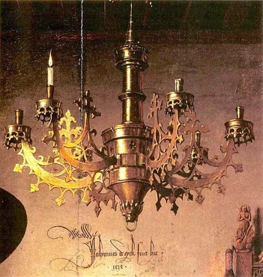
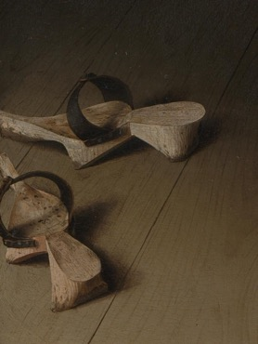
Semiotics
Semiotics (F. de Saussure, Ch.S. Pierce) = study of signs, piece of art as a symbolical communication, Semiotic in art (M. Bal, L. Marin, N. Bryson)
Useful tools:
Semiotics for Beginners
Readings
Semiotics and Visual Representation
Semiotics and Art History
Iconography and Iconology (A. Warburg, E. Panofsky, E. de Jongh) = the meaning of the piece of art at the time it was made, analysis of iconographic themes, symbols, attributes of social status
Useful links:
Iconographic analysis
Video:
Arnolfini portrait
Semiotics for beginners
Readings:
Iconography, iconology and style analysis
Market Value(s)
Iconology: An Alternate Form of Writing

Slide 11
Bibliography
• E.H. Gombrich, Reflections on the History of Art: Views and Reviews, ed. Richard Woodfield. Oxford 1987, p.246.
GOTTDIENER, Mark, ed., BOKLUND-LAGOPOULOU, Karin, ed. a LAGOPOULOS, Alexandros Ph., ed. Semiotics. 1st pub. London: Sage, 2003. 4 sv. (xxxviii, 358, 403, 383, 341 s.). Sage benchmarks in social research methods. ISBN 0-7619-7416-4.• W.J.T. Mitchell, Iconology: Images, Text, Ideology. University of Chicago Press, 1986.
Erwin Panofsky, Studies in Iconology: Humanistic Themes in the Art of the Renaissance. Oxford 1939.
• Roelof van Straten, An Introduction to Iconography: Symbols, Allusions and Meaning in the Visual Arts. Abingdon and New York 1994.

Slide 12
„An iconography is a particular range or system of types of image used by an artist or artists to convey particular meanings. For example in Christian religious painting there is an iconography of images such as the lamb which represents Christ, or the dove which represents the Holy Spirit.“
–– Tate.org.uk.

Slide 13
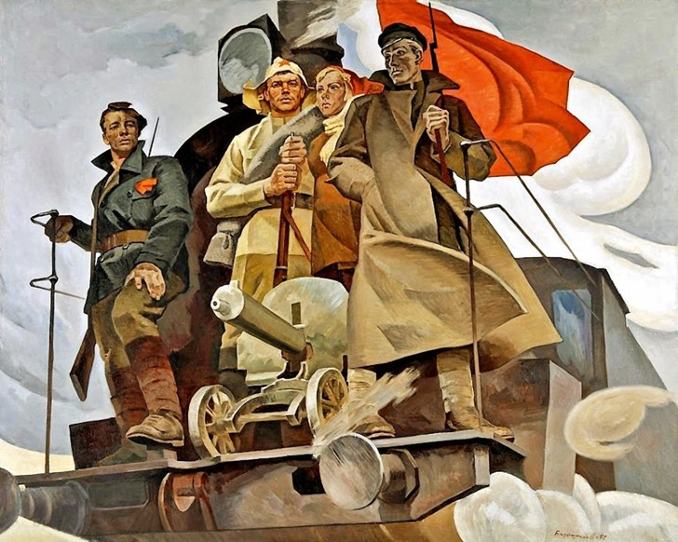
Critical (social-historical) approaches
“New” history of art, the social history of art - the role of art in society/iconography or formalism = analysis of artworks in terms of economy, class, culture, society, etc. and institutions (museums, galleries, academies, etc.)
a rich variety of methodologies
= study of social structures and pressures that influence the art
history of ideas (I. Berlin) in art (J. Pollit, L. Henderson)
Marxism and Materialist Perspectives on Art
Feminism(s)
LGBTI Studies and Queer Theory
Cultural Studies and Postcolonialism
Art is part of culture, because art emerges from a larger social, economic, gender, religious, ethnic context and so on, it reflects its own time and place!!!

Slide 14
Bibliography
Alper, Svetlana, Rembrandt’s Enterprise: The Studio and The Market, 1988
Baxandall, Michael, Painting and Experience in Fifteenth-Century Italy, 1988
Camille, Michael, The Gothic Idol: Ideology and Image-making in Medieval Art, 1989
T.J. Clark, Image of the People: Gustave Courbet and the 1848 Revolution, 1973
Hauser, Arnold, The Social History of Art, 1951
TAYLOR, Victor E., ed. a WINQUIST, Charles E., ed. Postmodernism: critical concepts. Vol. 1, Foundational Essays. 1st pub. London: Routledge, 1998. xxxii, 795 s. Routledge critical concepts. ISBN 0-415-15484-7.
TAYLOR, Victor E., ed. a WINQUIST, Charles E., ed. Postmodernism: critical concepts. Vol. 4, Legal studies, psychoanalytic studies, visual arts and architecture. 1st pub. London: Routledge, 1998. 433 s. ISBN 0-415-15484-7.

Slide 15
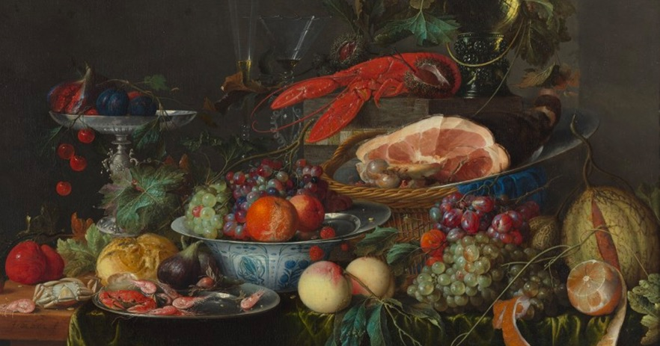
(Post)Marxism Marxism and Materialist Perspectives on Art
G. Lukácz, G. Debord, W. Benjamin, Th. Adorno, M. Shapiro, M. Solomon
= study of art based on economic factors related to Marx’s theory and social conditions
critic of capitalism and historical materialism, theory of class, mass-production, distribution of power, commoditization and fetishization of art, art as an ideological form
Useful links:
The problem of art. Marxism as methodology
A quick discussion on Marxism and Art
Video:
A Brief Introduction to Marxism
John Berger on Ways of Seeing, being an artist, and Marxism
Readings:
W. Benjamin, The Work of Art in the Age of Mechanical Reproduction
G. Debord. Society of the Spectacle

Slide 16
„Marxism is a whole world view.“
–Georgi Plekhanov

Slide 18
Bibliography
ALPERS, Svetlana. Rembrandt's Enterprise: The Studio and the Market. Chicago: University of Chicago Press, 1988.
ALTHUSSER, Louis. Lenin and Philosophy, and Other Essays. Transl. Ben Brewster. New York: 1972.
BEAUMONT, Matthew, ed. et al. As radical as reality Itself: essays on Marxism and art for the 21st century. Oxford: Peter Lang, 2007. 473 s. ISBN 978-3-03910-938-8.
Dave Beech,, Art’s Economic Exceptionalism in Classical, Neoclassical and Marxist Economics.
BENJAMIN, Walter. llluminations, ed. Hannah Arendt. New York: schocken Rooks, 1985.
Stephen F. Eeisenman and Thomas Crow, Nineteenth Century Art: Critical History, 2002.
GRAMSCI, Antonio. Selections from the Prison Notebooks, transl. Geoffrey Nowell Smith and Quintin Hoare. New York: International Publishers Co., 1971.
KANG, Berel, ed. a WILLIAMS, Forrest, ed. Marxism and Art: Writings in Aesthetics and Criticism. New York: David McKay Comp., 1972. 8, 470 s.
MARX, Karl. Selected Writings, ed. David McLellan. Oxford and New York: Oxford University Press, 1977.
MARX, Karl, and Friedrich Engels. On Literature and Art: A Selection of Writings. Edited by Lee Baxandall and Stefan Morawski. New York: International General, 1974.
Anthony Lee, Painting on the Left: Diego Rivera, Radical Politics, and San Francisco’s Public Murals, 1999
Rose, Margaret A. Marx’s Lost Aesthetic: Karl Marx and the Visual Arts. Cambridge, UK: Cambridge University Press, 1984.
Solomon, Maynard, ed. Marxism and Art: Essays Classic and Contemporary. New York: Knopf, 1973.

Slide 19
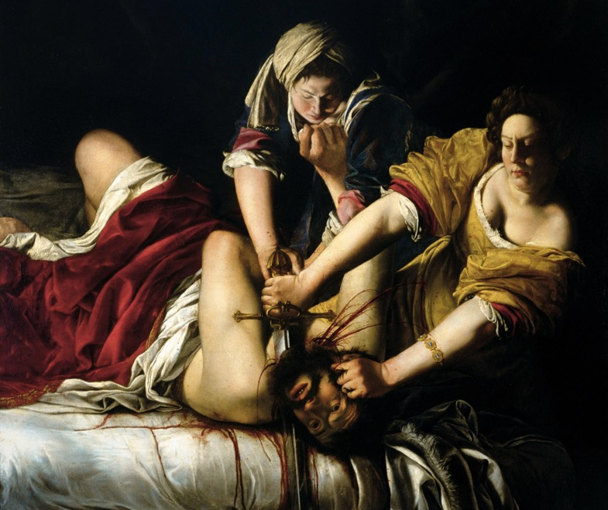
Feminism(s)
M. Wollstoncraft, S. de Beauvoir, B. Friedan, in art (L. Nochlin, Gr. Pollock, R. Parker, P. Mathews, P. Mainardi, N. Broude, M. Garrard, B.Hooks, F. High Tesfagiorgis, A. Jones, J. Frueh)
= study of the socio-economic and cultural position of women (represented, implied or viewing the piece of art), distribution of power in relation to the author/s, depicted figures or viewers (female patrons, reception of female viewers, construction of gender and sexuality),
an attempt to broad art theory past he male-centric perspective
art/craft (high/low art)
the body, the gaze (“male gaze”), the social construction of felinity
Female artists (Artemesia Gentileschi)
Useful links:
Women, Art, and Art History: Gender and Feminist Analyses
12 Step Guide to Feminist Art, Art History and Criticism
Video:
The Art of Feminism: Does a feminist aesthetic exist?
"Feminism and Art theory now" with Griselda Pollock and Angela Dimitrakaki
Readings:
L. Nochlin, Why Have There Been No Great Women Artists?

Slide 21
Bibliography
AMELIA, Jones. The Feminism and Visual Culture Reader. New York: Routledge, 2003.
HOOKS, bell. Talking Back: Thinking Feminist, Thinking Black. Boston: South End Press, 1989.
DEKEL, Tal. Gendered: art and feminist theory [online]. Newcastle upon Tyne, England: Cambridge Scholars Publishing, 2013, KORSMEYER, Carolyn. Gender and aesthetics: an introduction [online]. New York: Routledge, 2004.
Female beauty in art: history, feminism, women artists [online]. Newcastle upon Tyne, England: Cambridge Scholars Publishing, 2014.
Foucault, Michel. The History of Sexuality. New York: Vintage books. 1990
Gender, sexuality, and museums: a Routledge reader [online]. Milton Park, Abingdon, Oxon: Routledge, 2010
ISAAK, Jo Anna. Feminism and contemporary art: the revolutionary power of women's laughter [online]. London: Routledge, 1996. Re visions: critical studies in the history and theory of art [cit. 2020-11-24].
LISS, Andrea. Feminist art and the maternal [online]. Minneapolis: University of Minnesota Press, 2009
LOVELL, Terry, ed. Feminist cultural studies. Aldershot: Edward Elgar, 1995.
MATHEWS, Patricia. The Subjects of Art History, 1998.
MESKIMMON, Marsha. Women making art: history, subjectivity, aesthetics. London: Routledge, 2003
MARDER, Herbert. Feminism and art: a study of Virginia Woolf. Chicago: University of Chicago Press, 1968. 9, 190 s.
NOCHLIN, Linda. Women, Art, and Power and Other Essays. New York: Harper and Row, 1988.
POLLOCK, Griselda. Differencing the Canon: Feminist Desire and the Writings of Art’s Histories. New York and London: Routledge, 1999.
POLLOCK, Griselda. Vision and difference: feminism, femininity and the histories of art. London: Routledge, 2003
POLLOCK, Griselda and PARKER, Rozsika, Old Mistresses: Women, Art and Ideology, 1981
ROBINSON, Hilary, ed. Feminism-art-theory: an anthology 1968-2014. Second Edition. Chichester, West Sussex: Wiley Blackwell, 2015. xix, 524 stran.
WILLIS, Deborah and WILLIAMS, Carla, The Black Female Body: A Photographic History, 2002

Slide 22
LGBTI Studies and Queer Theory
E. Kosofsky Sedgwick, D. Halperin, J. Butler, in art (J. Weinberg, L. Cottingham)
normativity, gender performativity (citation and iteration, J. Butler) - against the predominant art discourse of heteronormativity (sexuality as a cultural construct), homophobia and sexism
= an attempt to include queer artist and queer artwork and reevaluate art history including marginalized sexualities (transgender, intersex, gender-blending, bisexuality, pansexuality)
Useful links:
Queer art
Readings
Sex and the (art history) academy
The Art Story: Queer Art
Video:
Queer Theory and Gender Performativity
100 years of gay art history, from repression to liberation

Slide 24
„femininity is thus not the product of a choice, but the forcible citation of a norm.“
–Josef Novák

Slide 25
Bibliography
BUTLER, Judith. Gender Trouble. New York: Routledge, 1999· DAVIS, Whitney, ed. Gay and lesbian Studies in Art History. New York: Hawthorne Press, 1994.
FOUCAULT, Michel. History of Sexuality, 1978
FOSTER, David William. Argentine, Mexican, and Guatemalan photography: feminist, queer, and post-masculinist perspectives [online]. First edition. Austin, Texas: University of Texas Press, 2014.
HAMMOND, Harmony. Lesbian Art in America: A Contemporary History. NewYork: Rizzoli, 2000.
HUMPHREY, Daniel. Queer Bergman: sexuality, gender, and the European art cinema. 1st ed. Austin: University of Texas Press, 2013.
KAMPEN, Natalie. Sexuality in Ancient Art. 1996.
LAURETIS, Teresa de. ”Queer Theory: Lesbian and Gay Sexualities." Differences: A Journal of Feminist Cultural Studies 3/2 (1991).
LEUNG, Helen Hok-Sze. Undercurrents: queer culture and postcolonial Hong Kong [online]. Vancouver: UBC Press, 2008.
MENON, Madhavi. Indifference to difference: on queer universalism [online]. Minneapolis, Minnesota: University of Minnesota Press, 2015
RAND, Erica. Barbie’s Queer Accessories. 1995.
ZIKMUND-LENDER, Ladislav. What a material!: queer art from Central Europe. Prague: L. Zikmund, 2012. 56 s.Jonathan
WEINENBERG, Jonathan. Speaking forVice: Homosexuality in the Art of Charles Demuth, Marsden Hartley, and the First American Avant-Garde. 1993.

Slide 26
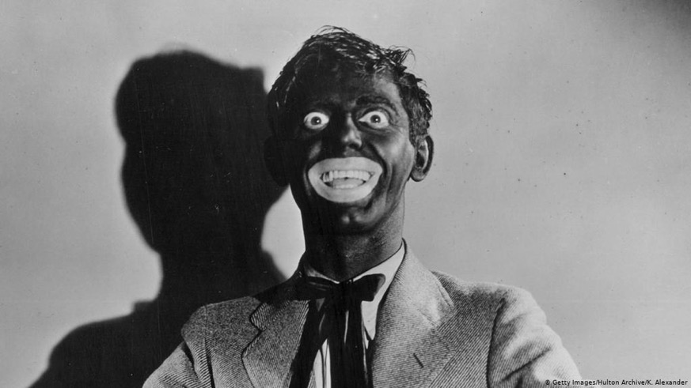
Cultural Studies and Postcolonial Theory
Cultural Studies (ideology and power): S. Hall (“self-othering”), R. Wiliams; Postcolonial Theory (shaping of new identities, race, political and cultural practices in former colonies, body of theory): E. Said, H. Bhabha (mimicry and hybridity in relations colonizer - colonized), G. Spivak, F. Fanon, in art (B. Smith, D. Driskell, Sh. Patten)
= study of impact of colonialism and imperialism on art (canon, representation of colonized people)
an eye to the control and exploitation of native people, politic of knowledge, construction of political power sustaining colonialism
“imperial gaze”
repatriation - institutional practices
stereotyped visions of “others” (auto- and hetero/xenostereotypes - Identity Theory - H. Tajfel)
orientalism, occidentalism, borealism, etc.
whitewashing and black face
Useful links:
What is postcolonial thinking
A Milestone for Postcolonial Thought: Examining Art and Race in Florence and Venice
Decolonizing art history
Readings:
Colonial Encounters, Body Politics, and Flows of Desire
Video:
Postcolonialism: WTF? An Intro to Postcolonial Theory
Frances Gouda - How the colonial past influences the way we see the world today

Slide 27
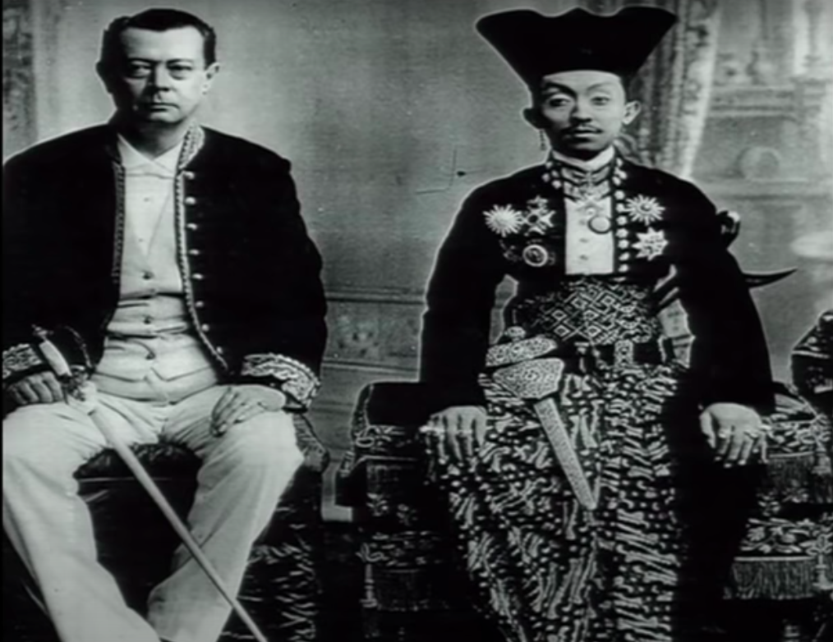

Slide 28
The canon is: „discursive strategy for the production and reproduction of sexual difference and its complex configurations with gender and related modes of power.“
–Griselda Pollock

Slide 29
Bibliography
BHABHA, Homi. The Location of Culture. 1994.
CÉSAIRE, Aimé. Culture and colonization. 1956.
COOMBES, Annie E. In Reinventing Aftica: Museums, Material Culture and Popular Imagination in Late Victorian and Edwardian England. 1997
HIGHT, Eleanor M. and SAMPSON, Gary D. Colonialist Photography: Imag(in)ing Race and Place. Routledge, 2013.
Images and empires: visuality in colonial and postcolonial Africa. Berkeley: University of California Press, 2002
SAID, Edward. Orientalism. 1978
SEE, Sarita Echavez. The decolonized eye: Filipino American art and performance [online]. Minneapolis: University of Minnesota Press, 2009

Slide 30
Psychoanalysis
S. Freud, C.G. Jung, J. Lacan, M. Klein, J. Kristeva, L. Irigaray, H. Cisnoux, in art (R. Wollheim, S. Preston Blier, R. Krauss, M. Bal, L. Mulvey)
psychoanalytic theory (the reality/pleasure principle - repressed desire, unconscious, sublimation, neurosis, the childhood development - libido, id - ego - superego, projection, rationalization), archetypes, theories of reception and gaze
= study of unconscious of traumatic experiences in the life of the artist - viewer - contemporary society (the content of the piece of art, the relationship between artworks and authors or viewers, personality of the artist, the nature of creativity and art)
Useful links:
Oxford Bibliographes: Art and Psychoanalysis
Readings:
An Analysis of Psychoanalytic Interpretation in Modern Art
Video:
Metamorphosis of Narcissus: When Salvador Dalí met Sigmund Freud

Slide 31
„Only in art does it still happen that a man who is
consumed by desires performs something resembling the accomplishment of those desires and that what he does in play produces emotional effects-thanks to artistic illusion-just as though it were something real..“
– Sigmund Freud, Totem and Taboo

Slide 32
The Male Gaze
male gaze (patriarchal) in Holywood cinema (L. Mulvey): reflect and reinforce the patriarchal society, the pleasures looking is split between active/male and passive/female
Video:
In Conversation With Laura Mulvey (Interview)
Understand The Male Gaze theory in 3 minutes

Slide 33
Reception Theory: The Psychology of Art
“beholder’s share” = the stop of images in the viewer mind, idea that the viewer actively complete the works of art, E. Gombrich
reader-response Theory = active participation of the reader
R. Arnheim, W. Kemp
perspective, focalizers
the psychic and physiological aspects of viewing works of art
interdisciplinary, the conjunction of art history, psychoanalysis and Gestalt psychology (E. Kris)

Slide 34
„ The text is a tissue of quotations drawn from the innumerable centres of
culture ... The reader is the space on which all the quotations that make
up a writing are inscribed without any of them being lost; a text's unity
lies not in its origin but in its destination. Yet this destination cannot any longer be personal: the reader is without history, biography,
psychology; ... the reader} is simply that someone who holds together in
a single field all the traces by which the written text is constituted..“
– Roland Barthes, The Pleasure of the Text (1973)

Slide 35
Bibliography
Adams, Laurie Schneider. Art and Psychoanalysis. New York: Icon Editions, 1993.
Arnheim, Rudolf, Art and Visual Perception, 1954
———, Visual Thinking, 1969
———,The Power of the Center, 1982
———, The Dynamics of Architectural Form, 1977
Bryson, Norman, Visual Theory, 1991
———, Tradition and Desire, 1984
Davis, Whitney. Replications: Archaeology, Art History, Psychoanalysis. University Park: Pennsylvania State University Press, 1996.
Gombrich, Ernst, Art and Illusion, 1961
Freedberg, David, The Power of lmages: Studies in the History and Theory of Response, Chicago: University ofChicago Press, 1991
Freud, Sigmund. Writings on Art and literature. Palo Alto: Stanford University Press, 1997·
Haskell, Francis, Taste and the Antique: The Lure of Classical Sculpture, 1500-1900, 1981
Howard, Seymour. “Eros, Empathy, Expectation, Ascription, and Breasts of Michelangelo (A Prolegomenon on Polymorphism and Creativity).” Artibus et Historiae 22.44 (2001): 79–118.
Iversen, Margaret, ed. Psychoanalysis in Art History, a special issue of Art History 17:3 (September 1994)·
Jung, Karl. Man and his symbols. 1964.
Krauss, Rosalind, The Optical Unconscious, 1994
Kris, Ernst. Psychoanalytic Explorations in Art. Madison, CT: International Universities, 1952.
Mulvey, Laura, Visual Pleasure and Narrative Cinema, 1975
Spitz, Ellen Handler. Art and Psyche. New Haven, CT: Yale University Press, 1989.
Walsh, Maria. Art and Psychoanalysis. London: I. B. Taurus, 2013.
Wollheim, Richard, Painting as an Art, 1984
——-, Art and its Object, 1980

Slide 36
Literary Studies Approaches

Slide 37
Topological analysis
TOPOS (place, common place), locus (communis)
= a motif commonly found in literary
locus amoenus (pleasent place) = idealized place
Chronotope (M.M. Bakhtin): representation of time and space in language and discourse
Archetype
Formulae and themes (see the presentation PofI_Photographes) or schemata (predictable and usual patterns) - literary critics W. Iser, R. Ingarden
Stock characters and figures

Slide 38
Bibliography
Bakhtin, M. (1981). "Forms of time and of the chronotope in the novel". In The Dialogic Imagination. Austin: Univ. Texas Press. pp. 84–258.
Caroll, Jane S. Landscape in Children's Literature, Routeldge 2011
Louise Smith, Susan. The Power of Women: A Topos in Medieval Art and Literature, University of Pennsylvania Press, 1995
Salstad, M. Louise. Text as Topos in Religious Literature of the Spanish Golden Age, U.N.C. Department of Romance Languages, 1995
Sobecki, Sebastian I. The Sea and Medieval English Literature, 2008
Terentowicz-Fotyga, Urszula.Space in Literature: Method, Genre, Topos, Lang, Peter GmbH, 2018
Od autorů: Jane Suzanne Carroll

Slide 39
Postmodernism/Intertextuality
Palimpsest
Parody / satire - Appropriation (art) - traviation - juxtaposition - intertextuality
Video:
Contemporary Art Theme: Palimpsests
The Meaning of Appropriation in Art
WHAT IS INTERTEXTUALITY?

Slide 41
„Parody: mimicking the appearance and/or manner of something or someone, but with a twist for comic effect or critical comment, as in Saturday Night Live’s political satires.“
–Dr. Robert J. Belton, Art History: A Preliminary Handbook, The University of British Columbia.

Slide 43
Bibliography
ASHCROFT, Bill, Gareth GRIFFITHS, and Helen TIFFIN, eds. The post-colonial Studies Reader. New York and London: Routledge, 1995.
HALL, Stuart, ed. Culture, Media, language: Working Papers in Cultural Studies, 19972-79. London: Hutehinson, 1980.
HALL, Stuart and Jessica EVANS, eds., Visual Cu ltu re: The Reader. London: Sage, 1999.
REBBELMUND, Romana. Appropriation Art: die Kopie als Kunstform im 20. Jahrhundert. Frankfurt am Main: Peter Lang, 1999. 246 s.
SAID, Edward W. Orientalism. New York: Random House, 1979.
SCHNEIDER, Arnd. Appropriation as practice: art and identity in Argentina [online]. 1st ed. New York: Palgrave Macmillan, 2006.
TAYLOR, Victor E., ed. a WINQUIST, Charles E., ed. Postmodernism: critical concepts. Vol. 1, Foundational Essays. 1st pub. London: Routledge, 1998.
WELCHMAN, John C. Art after appropriation: essays on art in the 1990s [online]. New York: Routledge, 2003.
WILLIAMS, Raymond. Culture and Society, 1780-1950. Harmondsworth: Penguin, 1963

Slide 44
And other perspectives
Cultural transfers (Michel Espagne): migration of stereotypes, circulation of art and forms (art markets, patterns of influence)
Readings:
Cultural Transfer: An Introduction
Globalization, Identity and Migration
Video:
Art and Globalisation 4: Migration
Contemporary Art of Today: Migration
Art about Migration

Slide 45
Bibliography
Essays in migratory aesthetics: cultural practices between migration and art-making [online]. Amsterdam: Rodopi, 2007.
Michel ESPAGNE – Michael WERNER (edd.), Transferts: Les Relations interculturelles dans l’espace franco-allemand (XVIIIe et XIXe siècle), Paris 1988
SCHOLTEN, Frits, ed., WOODALL, Joanna, ed. a MEIJERS, Dulcia, ed. Art and migration: Netherlandish artists on the move, 1400-1750. Leiden: Brill, 2014. 383 stran. Netherlands yearbook for history of art = Nederlands kunsthistorisch jaarboek, volume 63, 2013

Slide 46
„There can be different, competing, and contradictory interpretations of the same artwork.”
–Terry Barrett, Criticizing Art: Understanding the Contemporary

