Slide 1
Art and Politics
Critical theory III

Slide 2
Adorno‘s Aesthetic Theory
What place art has in society?
How does art achieve its social and political significance?
How does art succeed in not succumbing the oppresive social order?
The aesthetic character of art

Slide 3
Artworks
Emphasis on the production of art – artworks are specific object with a specific value in the world where exchange principle dominates
This pecularity of art is its autonomy, i.e. freedom from any other (political, religious, moral etc.) social roles
Artworks are free and autonomous objects in the world where nothing gains freedom and autonomy
Autonomy of art has a social character and the social character of art is itself autonomous

Slide 4
Why is the autonomy of art significant?
Social character
Artworks are products hiding the labour that has gone into them and appear to have life of their own
Artworks appear to be superior cultural entities detached from the conditions of economic production, i.e. they conceal the problematic division of labour that makes them possible
Artworks serve no other purpose beyond their own existence, therefore they seem to be irrational and their appreciation superficial

Slide 5
Society‘s social antithesis
By appearing to have life of its own, art calls into question a society where nothing is allowed to be itself and everything is dominated by the exchange principle
By appearing to be detached from the conditions of economic production, art suggests changed conditions
By appearing to be useless, art recalls parts of human nature that are otherwise forgotten or suppresed

Slide 6
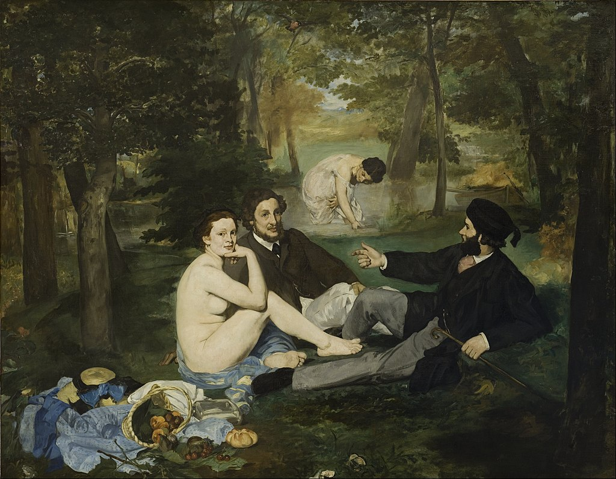
Édouard Manet: Luncheon on the Grass

Slide 7
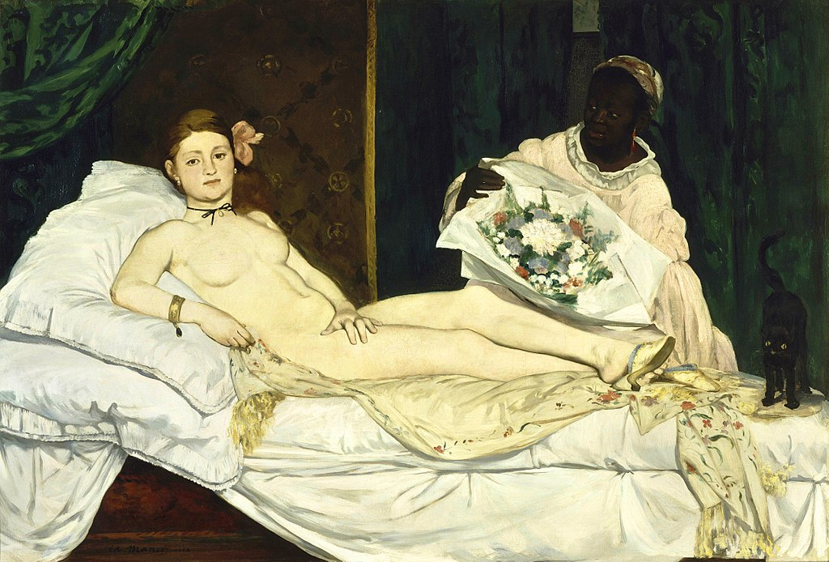
Édouard Manet: Olympia

Slide 8
Aesthetic Synthesis
Aesthetic form, aesthetic rightness
Principle of organization
Non-violent unity of elements, preserving their particularity and contradictions amongst them
Integration of the heterogeneous and non-identical
Emergence of the meaning of artworks
Openness of the forms of modern art, destruction of the false and violent unity
Inherently present in all great works of art

Slide 9
Critique of Social Order
Art is by virtue of its character opposed to society
Disclosure of the oppresive, violent character of the social order, the prevailing system of categorization and relations towards the others and objects
art is therefore critical towards the prevailing social order by its very existence
Domain of reconciliation (or utopia)
art prefigures the model for non-violent society

Slide 10
Art as Redemption
The critical and utopian aspect of art is the truth of art (or the truth content of the works of art)
Art is not a tool of social change, but only an illusion or promise – as such, it has to bear the guilt
Art can have only indirect and mediated effect on the social reality
Art has an enigmatic character
Art has a power to intervene in the conciousness of the recipient

Slide 11
Political Significance of Art
Art consistently blurs the boundaries between what is representable and unrepresentable, intelligible and unintelligible, imaginable and unimaginable
Art transforms the conditions of thought, experience and action

Slide 12
Jay Bernstein, Andrew Bowie, Espen Hammer, Peter Uwe Hohendahl, Owen Hullatt, Tom Huhn, Robert Hullot-Kentor, Fredric Jameson, Martin Jay, Christoph Menke, Peter Osborne, Gillian Rose, Nathan Ross, Albrecht Wellmer, Lambert Zuidervaart

