Slide 1
Intercultural marketing

Slide 3
Communication
From Latin communicare
social (interpersonal) communication is usually described using communication models. Laswell's communication model contains five basic questions and answers:

Slide 4
Communication

Slide 5
Communication
Coding and decoding
The communication process is affected by the communication noise and the context.
4 types of communication context - physical, cultural, socio-psychological and temporal. The cultural context includes the lifestyle, beliefs, values, behaviors

Slide 6
Intercultural communication
Intercultural communication refers to the communication between people from two different cultures (Chen & Starosta, 1998:28)
Intercultural communication is a symbolic, interpretive, transactional, contextual process, in which people from different cultures create shared meanings (Lustig & Koester, 2007:46)
Intercultural communication refers to the effects on communication behavior, when different cultures interact together. Hence, one way of viewing intercultural communication is as communication that unfolds in symbolic intercultural spaces (Arasaratnam, 2013:48)

Slide 7
Intercultural communication
verbal/nonverbal
direct/indirect
formal/informal
While we communicate our thoughts primarily through verbal symbols, body language often unconsciously expresses our emotions and feelings. This is a very universal cultural means of communication.

Slide 8
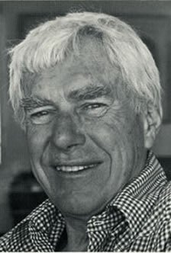
Low- vs high-context cultures
Edward Hall (1976)
His distinction of low-context and high-context cultures is probably the most useful concept for understanding cultural differences in (business) communication
differences in communication styles

Slide 9
Case 1:
Mr. Browning: Since we have a few minutes left in our meeting, I’d like to bring up the subject of Yamada distributors.
Mr. Otomo: Yamada? What about them?
Mr. Browning: Well, I don’t think any of us are that pleased with their services. I think we should find a new distributor. I’ve heard that Inoue Company is quite good.
Mr. Otomo: I wonder what others think. Have you discussed this with anyone else?
Mr. Browning: Not really. That’s why I’m bringing it up now, to get your opinions.
Mr. Otomo: Yes, we should get other people’s opinions before we decide.
Mr. Browning: Good. So what do you think, Otomo-san?
Mr. Otomo: I couldn’t really say.

Slide 10
Low- vs high-context cultures
importance of context – different cultures use different ‘amounts’ of context (information that surrounds an event; it is connected with the meaning of that event)
In high-context communication, the message cannot be understood without a great amount of background information. Low-context communication clarify more of the information explicitly in the message

Slide 11
High context cultures
high-context communication or message is one in which most of the information is either in the physical context or internalised in the person, while very little is in the coded, explicit, or transmitted part of the message (Hall 1976)
messages are both spoken and read between the lines. Messages are often implied but not plainly expressed.
communication is indirect, ambiguous, reserved, layered and understated
non-verbal aspects of communication are of a greater importance than the verbal aspects.

Slide 12
Law context cultures
meanings are explicitly stated through language; messages are expressed and understood at face value
people expect explanations
communication is direct, precise, simple, clear, dramatic, open
https://www.youtube.com/watch?v=1vgRBENL5es

Slide 13
Law- vs high-context cultures

Slide 14
HC vs LC cultures
Relationships - in HC cultures, they depend on trust, build up slowly, and are stable. How things get done, in business as well, depends on relationships with people and attention to group proces. In LC cultures relationships begin and end quickly, and things get done by following procedures and paying attention to the goal.
HC cultures are avoiding disagreement (personally threatening) x LC cultures (diagreement is depersonalized)
Politeness (asking questions)

Slide 15
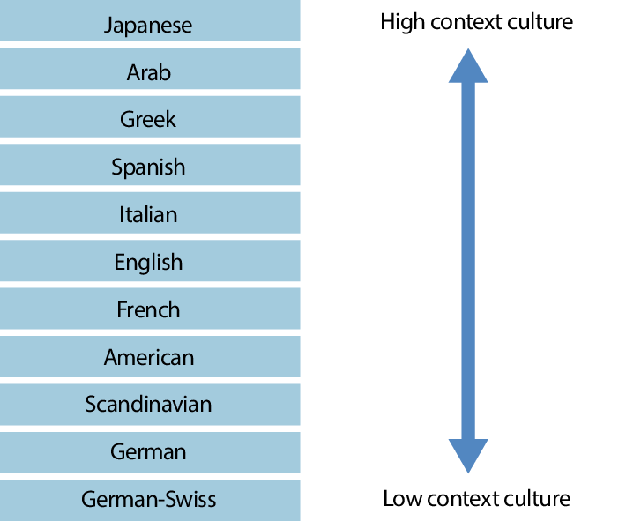
CULTURES ACCORDING TO HALL

Slide 16
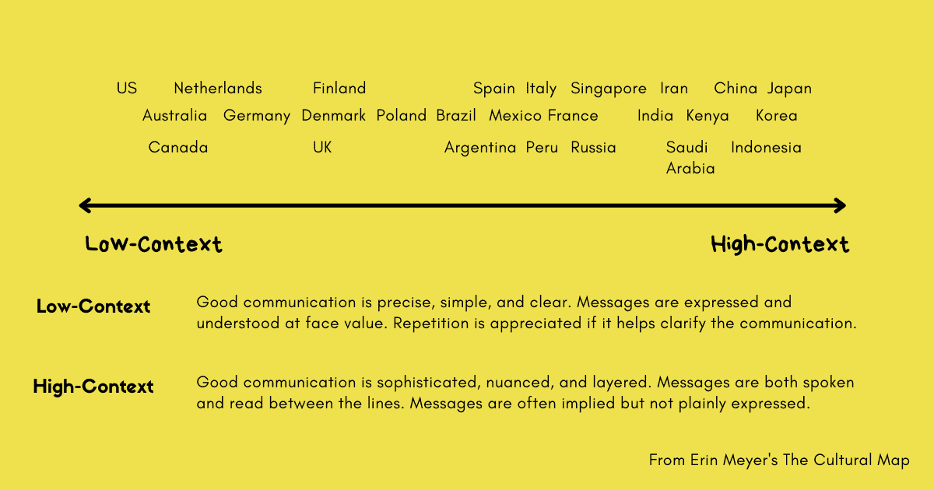
High vs law context cultures

Slide 17
High vs low context cultures
proliferation of signs and written instructions in LC cultures
different approaches to regulating behavior – Westerners live in a world of rules and instructions and are lost without them, but many other nations live in a social context

Slide 18
Implications for business communication
LC cultures – written instructions, emoloyee manuals
HC cultures - company norms are communicated personally, close personal supervision is essential
Western contracts are thorough, once a contract is signed, there is no flexibility in the terms unless both partiers agree to renegotiate
In HC countries a written contract may be more a memorandum of understanding than a real legal document; the terms are vague, room for adjustment as the situation develops. People are more likely to rely on a existing trust relationship than a legal system.
the idea of a contract itself is central only in certain cultures, especially those historically influenced by the Middle East
Confucian culture – doing business is primarily about developing personal relationships. These can be based on family or clan connections, or on relationships of mutual obligation popularly known as guānxì

Slide 19
Implications for business communication
HC cultures negotiations – indirect speech, a desire to save face or otherwise avoid giving offense (meaning of „yes“, „maybe“, „we will think about it“, „silence“, desire to „save face“)
business meetings serve different purposes in different parts of the world – in low-context cultures they provide an occasion for the company to consider pros and cons and even arrive at a decision. In high-context cultures, deliberation and decision-making tend to take place behind the scenes and at upper levels. A meeting might be an occasion to announce and explain the decision.
the concept of negotiation itself may be problematic in a relationship-based culture (confrontation that undermines harmony)

Slide 20
Case 1:
Mr. Browning: Since we have a few minutes left in our meeting, I’d like to bring up the subject of Yamada distributors.
Mr. Otomo: Yamada? What about them?
Mr. Browning: Well, I don’t think any of us are that pleased with their services. I think we should find a new distributor. I’ve heard that Inoue Company is quite good.
Mr. Otomo: I wonder what others think. Have you discussed this with anyone else?
Mr. Browning: Not really. That’s why I’m bringing it up now, to get your opinions.
Mr. Otomo: Yes, we should get other people’s opinions before we decide.
Mr. Browning: Good. So what do you think, Otomo-san?
Mr. Otomo: I couldn’t really say.

Slide 21
Implications for business communication
MR. DÍAZ: It looks like some of us are going to have to be here on Sunday to host the client visit.
MR. CHEN: I see.
MR. DÍAZ: Can you join us on Sunday?
MR. CHEN: Yes, I think so.
MR. DÍAZ: That would be a great help.
MR. CHEN: Yes, Sunday is an important day.
MR. DÍAZ: In what way?
MR. CHEN: It’s my daughter’s birthday.
MR. DÍAZ: How nice. I hope you all enjoy it.
MR. CHEN: Thank you. I appreciate your understanding.
Díaz laughs about the situation now. “I was quite certain he had said he was coming,” Díaz says. “And Mr. Chen was quite certain he had communicated that he absolutely could not come because he was going to be celebrating his daughter’s birthday with his family.”

Slide 22
Explicit vs. implicit

Slide 23
High vs. Low context – online communication
High context
Many different content types
Focus on entertaining content
Long accompanying text with photos
Longer videos with narrative content
Emotional interaction with the customer
High frequency of social media posts
Low context
Concentration on a few content types
Focus on information
Shorter photo texts
Shorter videos with a focus on information
More objective interaction
Lower post frequency

Slide 24
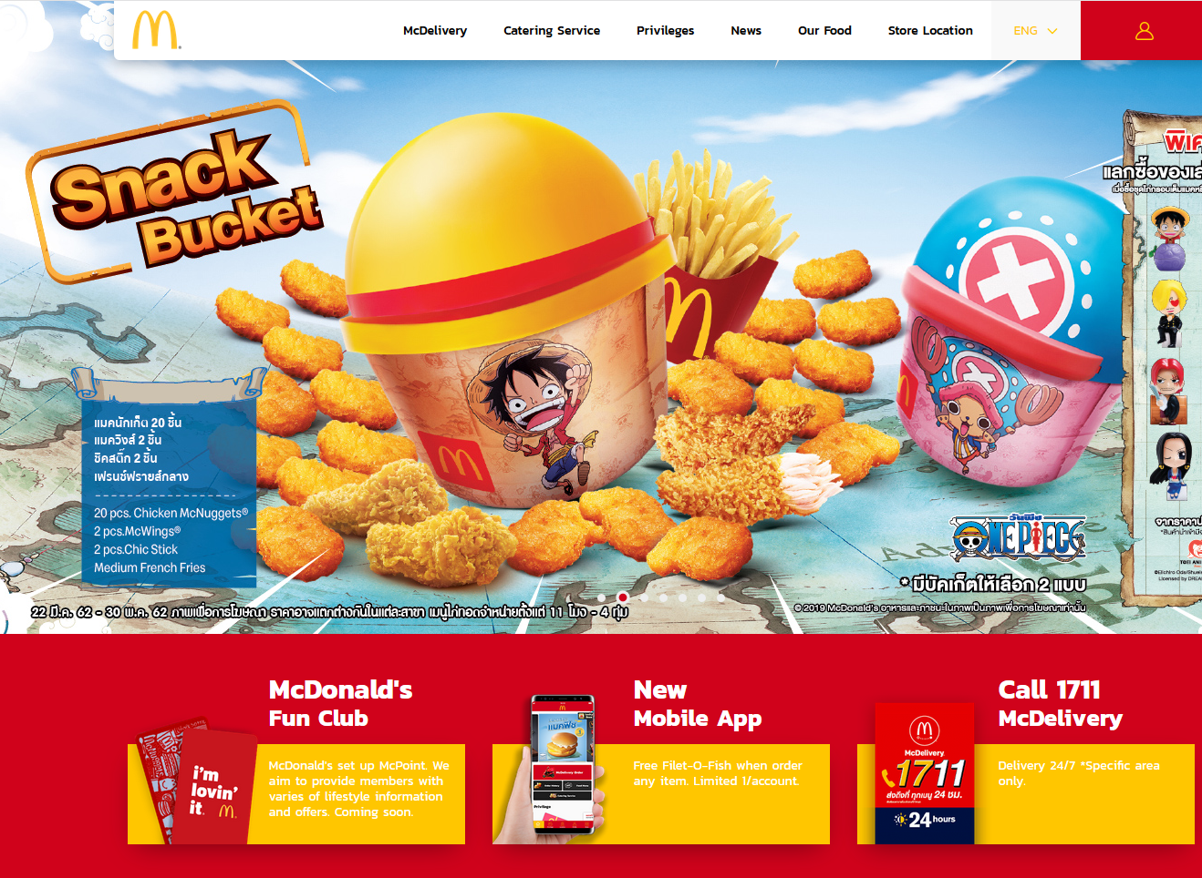
High vs. Low context – online communication

Slide 25
Verbal communication
je zapotřebí porozumění jak oběma zapojeným kulturám, tak oběma jazykům
Sapir-Whorf hypothesis
lingua Franca
cultures with a high / low communication context

Slide 26
Verbal communication

Slide 27
Verbal communication

Slide 28
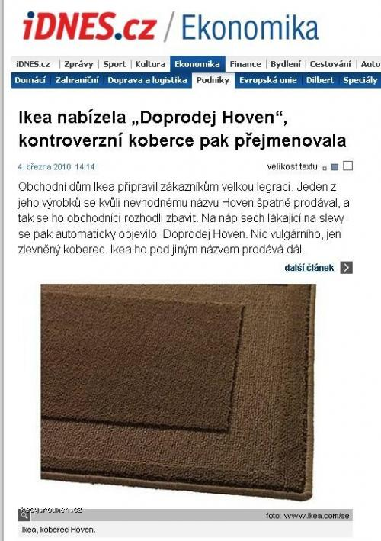
Verbal communication

Slide 29
Nonverbal communication
all communication expressed without words
facial expressions, postures, eye gaze, proxemics, gestures, tone of voice, haptics, chronemics…
influenced by cultural environment (kinesics, proxemics, artifacts, haptics, colors, silence)
some components are genetically determined

Slide 30
Intercultural communication
communication etiquette (greetings, introductions, conversational topics, humor, gifts)
within the framework of intercultural communication, the phenomenon of confusion can often be observed. It can also occur in monocultural communication (if the communication is incomprehensible and leaves the individual in a state of uncertainty / misunderstanding). In intercultural communication, this phenomenon occurs more often, and people tend to solve this situation by explanation based on the experience of their own culture. This often deepens the misunderstanding.
intercultural competence (langue + cultural specifics)

Slide 31
Intercultural aspects of nonverbal communication
communication differences between cultures are more a matter of degree rather than absolute difference
some facial expressions are universally readable across cultures, the difference between cultures lies in whether people are willing to express their emotions externally and to what extent (Ekman, 2007).
universally readable expressions include those that express emotions: happiness, anger, disgust, and sadness; fear and surprise?
universatility of a smile (silent smile, loud laughter)

Slide 32
Intercultural aspects of nonverbal communication
some gestures are universal across cultures – pointing, shrugging, head-nod, clap, backon, wave, halt sign, tap on the back, thumbs down, female body gesture.
come to me gesture is also considered universal; Some gestures are considered inborn (shrugging).

Slide 33
Intercultural aspects of nonverbal communication
several areas of nonverbal communication are directly culturally conditioned. - gestures, eye contact, interpersonal space, posturics, differences in color perception, chronemics.
the biggest difference within cultures is the degree of overall expressiveness

Slide 34
Intercultural aspects of nonverbal communication
Areas of non-verbal communication that are directly culturally conditioned: symbolic gestures (emblems)
1. A difference in the form of an emblem across cultures in relation to the same verbal message. Insults, for instance, occurred in all regions and likely serve the same function, conveying offensive or aggressive messages to another.
2. A difference in meaning to the same forms. The ‘‘ring,’’ for instance, in which a circle is made with the thumb and index finger and the other three fingers are open, can mean ‘‘A-OK,’’ ‘‘money,’’ or a variety of other messages.
3. Culturally unique emblems. The emblem for ‘‘apology,’’ for instance, occurred only in South Asia; the emblem for ‘‘hunger’’ occurred only in East Asia; and the emblem for ‘‘day after tomorrow’’ occurred only in the Middle East, despite the fact that these are clearly universal concerns.

Slide 37
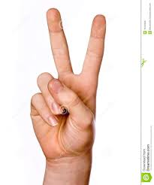

Slide 38
Intercultural aspects of nonverbal communication
Areas of non-verbal communication that are directly culturally conditioned: differences in eye contact - some cultures consider making direct eye contact aggressive, rude, or a show of disrespect - other cultures and some religious groups consider eye contact between men and women inappropriate and either as threatening or flirtatious - in many Asian cultures, avoiding eye contact with a member of the opposite sex or a superior is seen as a show of respect - however, in the United States and most of Europe, making eye contact is not only seen as appropriate but is necessary for establishing yourself as a powerful business professional

Slide 39
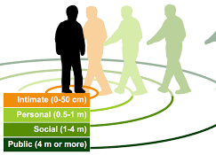
Intercultural aspects of nonverbal communication
Areas of non-verbal communication that are directly culturally conditioned: proxemics - personal space varies from culture to culture - in the Middle East, social distance is closer than it is in the United States, so as you back up, your conversational partner may attempt to close the gap once again. It’s easy to imagine an awkward dance down a sidewalk, with one party retreating and the other advancing as the conversation progresses.

Slide 42
Intercultural aspects of nonverbal communication
Areas of non-verbal communication that are directly culturally conditioned: differences in the rules of expressing emotions
- frequency and intensity - display rules (Ekman) - who can show their emotions to whom and when - interpretation of expressions - individualistic cultures encourage the expression of happiness, but limit the sharing of sorrow. In collectivist cultures, the opposite phenomenon occurs.

Slide 43
Intercultural aspects of nonverbal communication
Areas of non-verbal communication that are directly culturally conditioned: other differences - colors perception - perception of time

