Slide 1
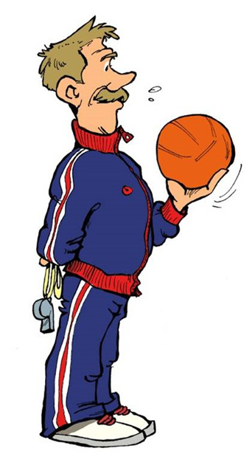
How athletes learn? Teaching Sport Skills
PhDr. Radka Peřinová, Ph.D.

Slide 2
What is learning?
Performance is observable behavior that demonstrates a skill (quality of performance), such as throwing, kicking, sliding, catching, and so on.
Learning is a relatively permanent improvement in performance capability arising from practice.
Learning is not directly observable, it must be inferred from changes in performance over time.
The improvement in performance is relatively permanent.

Slide 3
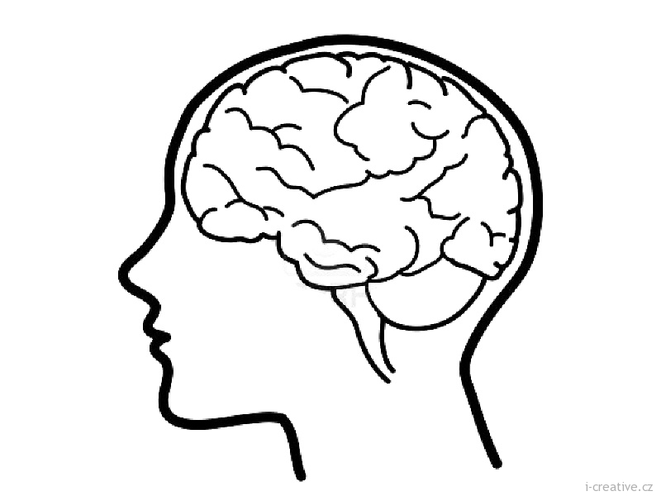
How athletes or pupils learn?
Key pieces of information from each performance to create rules about how to perform in the future.
Each time athletes perform complex skills their brains will seek to abstract four types of information about the movement.
• The condition of the environment and the position from performance is initiated.
• The demands of the movement being performed, such as speed, direction, and force.
• The consequences as perceived by the senses during and after the movement.
• A comparison of the actual outcome with the intended outcome based on available feedback

Slide 4
As learners continue to practice these abstracted pieces of information are synthesized to mold the general rules
is a complex set of rules that, when we called into action, permits athletes (pupils) to produce a movement.
Motor Program
Once the movement is initiated the basic pattern of action is carried out, even though the wrong movement is initiated may have been selected.
Minor adjustments can be made in basic movement pattern, but the pattern itself cannot changed.

Slide 5
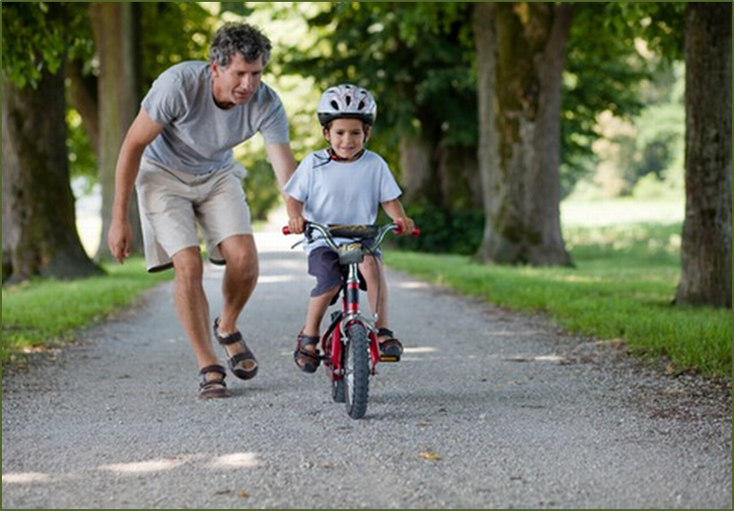
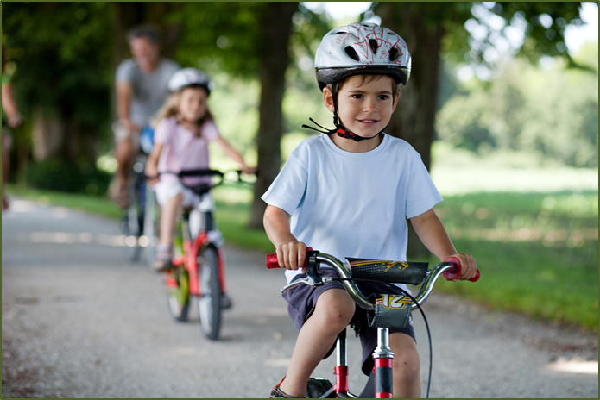
PHASES (STAGES) OF SENSORY-MOTOR LEARNING

Slide 6
The phases of learning mean the general, the qualitatively same signs of the:
state of learning
activities of learning persons
attained level of regulation and control
teachers´ activities
Closed skills are characterized by stable environment, little change in environmental conditions
Open skills in which the relationship between the environment and the individual or object changes
Three or four phases in the process of motor learning can be identified.
Three phases are typical for learning of closed skills and four ones for learning of open skills.
Notes:
We have basic tenets upon which we can build motor skill acquisition description. We have "road map" where certain markers or behavior can be used to chart progress in the learning of motor skills. What are open and closed skills?
Closed skills are characterized by stable environment, little change in environmental conditions and the individual´s control of spatial environment. Open skills in which the relationship between the environment and the individual or object changes; the individual must determine the spatial and temporal demands and match them with the environment.

Slide 7
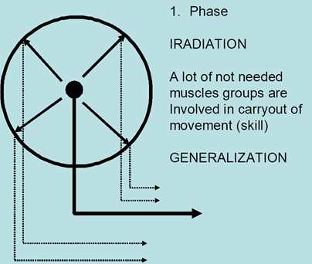
1st. PHASE OF MOTOR LEARNING
GENERALIZATION
Generalization means not only the activation of needed muscles but the antagonists’ muscles as well.
It’s resulted from irradiation of neural energy which spreads to the different parts of the cerebral cortex. The movement is much tensioned.
Introduction, creation of movement schema (image)
Introduction with learned skill starts throw the stimulation of visual, audio and kinesthetic receptors and this information are cognitively processed.
The first attempts to carry out the motor skill consequently continued.
Notes:
This level at which learns initially attempt to form the overall concept of specific motor skill by gaining information through the senses in the form of sensory feedback by observing, getting verbal feedback from other or through muscle spindles that detail each movement internally.
The learner senses that behavior does not produce the desired outcome but does not know what to do or how to do differently to enhance the quality of each performance. The learner discovers many dimensions of time, space, force and flow relative to the movement.

Slide 8
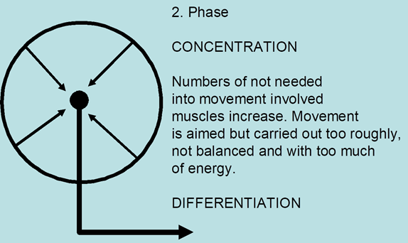
2. PHASE OF MOTOR LEARNING
DIFFERENTIATION
The learning movements are differentiating and reinforced toward the correct form on associated connections: desired movement reaction and feedback reinforcement (praise, encourage, success, etc.).
On the base of the external circle of regulation, the internal circle of regulation (by stimulation of proprioceptors) gradually arises.
Partial activities, operations and structure of skill are yet carried out correctly, but inserted effort is usually not adequate and economical. Inadequate inserted energy, spasmodic coordination and non-rhythmical signs could be in the learned skill observed.
Notes:
The learner seemingly comprehends how parts of the movement relate to one another; movements begin biomechanically efficient; errors are fewer and quality practice produce refinement of skill.

Slide 9
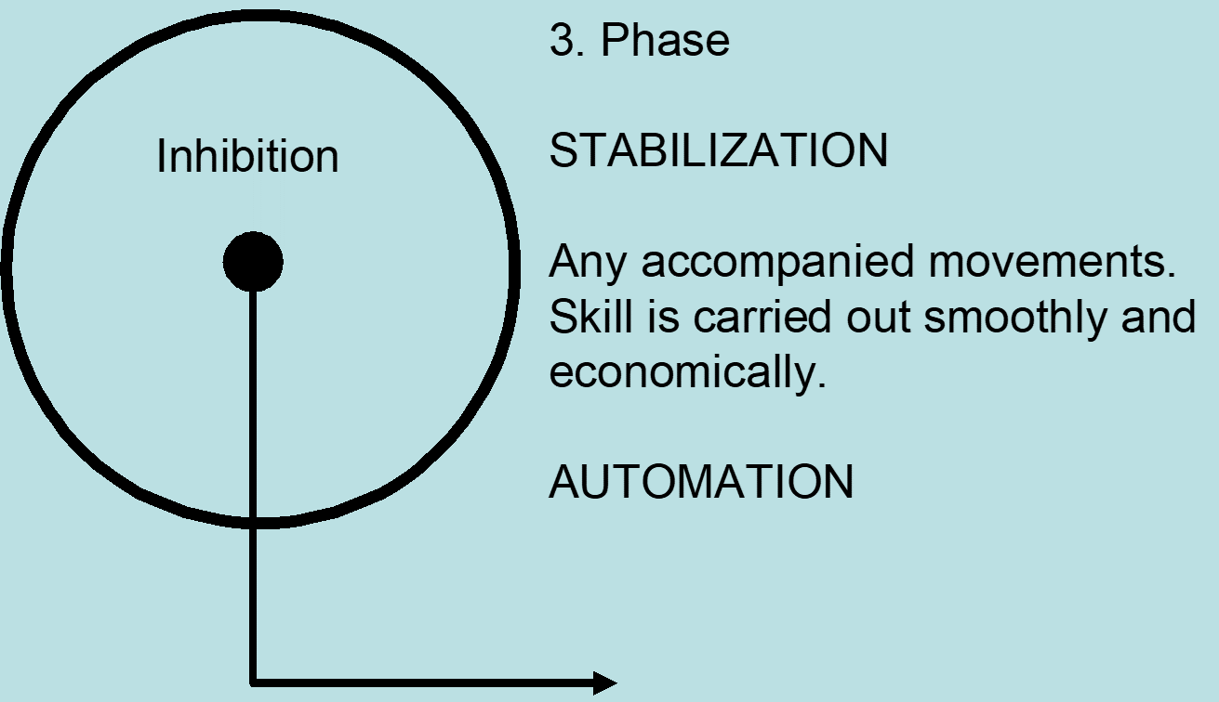
3. PHASE OF MOTOR LEARNING
AUTOMATISATION
The intentional changing of external and internal learning conditions leads to their better quality and growing up the physical performance.
The simultaneous development of motor skills and motor abilities is typical in this phase.
Learned skills are incorporated into formerly learned movement schemas and saved in the storage of motor memory. Internal circle of regulation plays a dominant role in the movement control.
Automatisation and coordination of movements attain the high level.
Notes:
Automation stage of learning: the level at which a learner's movements appear automatic, stable, and somewhat effortless.

Slide 10
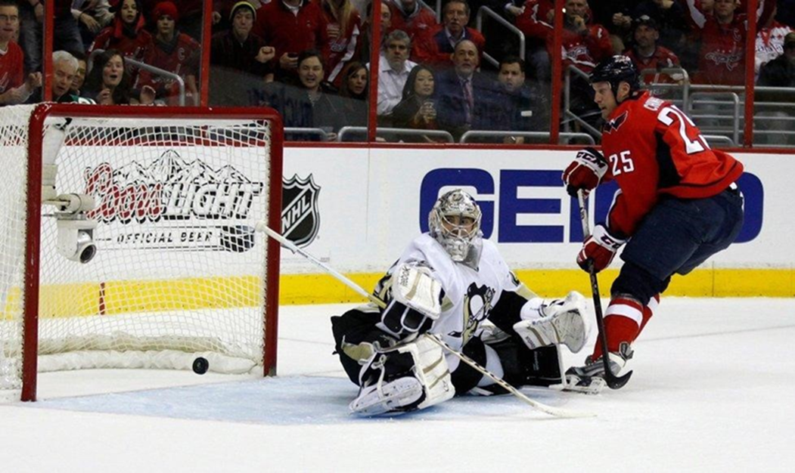
4th. PHASE OF MOTOR LEARNING
CREATIVE COORDINATION
The high variability in execution of movement and progress of motor performance are in this phase typical.
High level of involved creativity issued into personal movement style.
High level of anticipation in execution of movements is typical for this phase of motor learning as well.
- concerns to the open skills
Notes:
The expert (master) stage: Adapting movement pattern to environmental demands. (release and reorganize)

Slide 11
Phase |  | Signs |  | Level |  | External expression |  | Processes in CNS |  | Mental activity
1. |  | Introduction, instruction, motivation |  | Low |  | Generalization |  | Irradiation |  | High
2. |  | Reinforcementfeedbacks, verbal control |  | Middle |  | Differentiation |  | Concentration |  | Middle
3. |  | Improvement, retention, coordination |  | High |  | Automatisation |  | Stabilization |  | Low
4. |  | Transfer, integration, anticipation, performance |  | Master |  | Creative coordination |  | Creative association |  | High

Slide 12
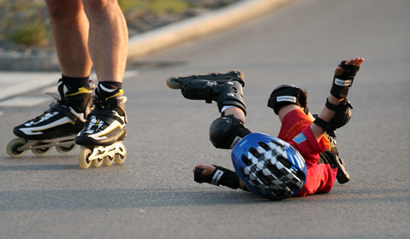
Teaching strategies:
1. Teach movement in such a way so it should be understandable to learners.
2. Give the opportunity to learners in order they could be active in learning of skills. These parts of learned skill which were directive defined by teacher are remembered worse than these ones which were selected by learner.
3. Repeat previously these movements, those parts of motor skill which should to be primary remembered.
4. In the frequent repeating of skill’s exercises the habituation effect could decreases the effective learning. Use the play forms in the learning of motor skills.
5. Give to learners the opportunity to select his/her learning and remembering strategy.

Slide 13
