Slide 1
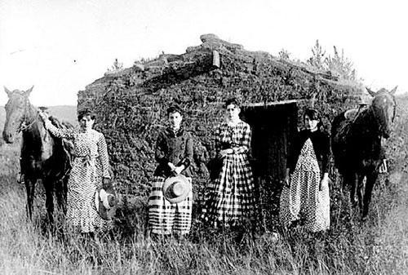
Mark Twain, the Tall Tale, and Local Color Local Color and the Tall Tale
“Local color” – U.S. term for what is called Regionalism in Europe and Canada.
However there are only a few local color writers whose works survived their times: Sarah Orne Jewett (1849-1909), author of novels and tales from Maine,
Joel Chandler Harris (1845-1908) African-American folklore from Georgia
(“Uncle Remus stories” – 9 books of tales 1880-1948). Interest in Regionalism
revived in feminist scholarship (focusing, e.g., on Kate Chopin).
In the U.S., regionalism is undermined by an excessive mobility of population, especially by westward migration – the Frontier. Accelerated by the Gold Rush (1849) and the end of the Civil War (1865).
Two important myths connected with this migration: 1. Manifest Destiny - the permanent progress of civilization across the continent caused by Divine Providence. 2. The Pioneer - a lone, intrepid, and noble individualist “paving the path for civilization and national prosperity” (a quote from W.F. Cody “Buffalo Bill”, who was called “a great national and international educator”).
The frontier was identified with a new, religious and technological, form of the American Dream. The deserts of the Great Basin (especially in NV and UT, between the Sierra Nevada and the Rocky Mountains) represented as future paradises that can be created by irrigation.
Myth and Reality Top: Emmanuel Gottlieb Leutze: Westward the Course of Empire Takes Its Way (1862); Bottom: the Chrisman sisters before their sod house in Nebraska (1886)

Slide 2
Sources of Tall Tale: Booster Talk and Tall Talk
Booster talk: “giving noble names to insignificant places and things” (Daniel Boorstin). Boosters - developers in the West, attracting new settlers to squalid places called by noble names (Alexandria, Athens, Rome, Venice, Rialto), with almost no amenities (a saloon called “an opera house”, a two-room school building called “academy”), and sometimes even non-existent (“paper towns”). The failure of booster activities led to the fast decline of the new settlements: “ghost towns”
Tall talk: based on the same principle of overstatement; a language of jokes, blurred, ambiguous meaning, humor, and irony. Used by ordinary colonists for entertainment and in order to avoid topics referring to the harshness and dangers of everyday life.
Important features:
- comical or grotesque metaphors and similes, often gradated into hyperboles
(“He walks through a fence like a falling tree through a cobweb.”)
- vague or ambiguous use of quantifiers (“pretty considerable better”).
Tall tale: a folk genre of the frontier anecdote characterized by hyperboles or violent understatement (which often takes the form of black humor). It blurs the distinction between the fictitious and the real: the ‘realistic’ features only enhance the absurd and grotesque effect.
Tall tale culture is still alive in the West (schools or contests for narrators)
Top: Remains of the ghost town of Bodie, once the second largest city in California
Bottom: Boosters‘ dreams come true -
gondolas in Las Vegas, Nevada

Slide 3
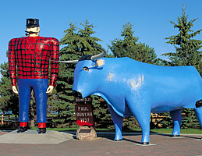
Features and Heroes of Tall Tale
“They settled in Morgan County, and he got nipped by the machinery in the carpet factory and went through in less than a quarter of a minute; his widder [widow] bought the piece of carpet that had his remains woven in, and people come a hundred miles to ’tend the funeral. There was fourteen yards in the piece. She wouldn’t let them roll him up, but planted him just so--full length.” (Mark Twain, Roughing It, 1872)
The narrative frees itself from established authorities and invents the events in a strange chain of associations, often based on black humour (deadpan humour – deadpan face)
“To lie and … to tell the truth at the same time” (Harry Wonham)
Exaggeration leads to the overstraining and collapse of metaphor (in the above extract where the carpet cannot serve as a metaphor of the dead husband but must be “planted […] full length’ to display ‘his remains woven in”).
A “rhetorical pattern of interpretive challenge and response” dramatizing “the interaction of voices” (Wonham)
Creating a new community of narrators and listeners, scattered in the immense “Big Empty” of Western deserts.
the relation of the community to strangers: pretending to educate “greenhorns” or “tenderfoots” in the complexities of life and the art of discrimination (“I saw a mountain lion so big that it almost blocked this road.”).
Heroes of tall tales: (a) legendary historical figures: Col. Davy Crockett – a hero from Alamo, TX (Davy Crockett‘s Almanacks), Daniel Boone (Kentucky), Mike Flint (Mississippi boatman) Kit (Christopher) Carson (Bear Flag Revolution in California); (b) invented, fantastic: Paul Bunyan, giant Canadian lumberjack accompanied by the grotesque Babe Blue Ox
Bottom: Paul Bunyan

Slide 4
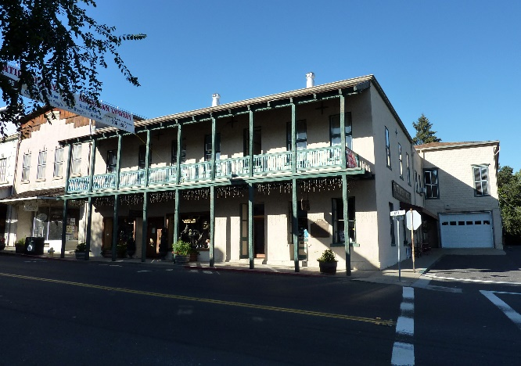
Mark Twain: Early Years
Mark Twain is a pseudonym of Samuel Langhorne Clemens (1835-1910) meaning “two fathom depth” of safe water, in reminiscence of the pre-Civil War times when he piloted Mississippi steamboats. His experience is the source of Old Times on the Mississippi (1875) and other works.
S.L. Clemens left in his native Missouri in 1861 (after an unsuccessful period of service in the Confederate militia) for the Nevada Territory, where his more successful brother Orion (1825-1897) became government Secretary. The adventurous journey to Carson City and travel to numerous mining camps (ending as far as on the Hawaii Islands) became the subject of Roughing It (1872), a travelogue composed of loosely connected stories, some of which can be called “tall.”
In 1862 Clemens established himself as a journalist in Virginia City in Nevada. He became the editor of a booster paper called Territorial Enterprise and he started to use the pseudonym Mark Twain.
His first publication, Jim Smiley and his Jumping Frog (1865; several titles of this tale are “The Celebrated Jumping Frog of Calaveras County” and “The Notorious Jumping Frog of the Calaveras County”) resembles a transcript or an imitation of a tall tale. But it may also be an ironical version of a booster tale (an adventurous enterprise is substituted by betting, riches by a surfeit of animals, and booster names are given--ironically--to animals: the puppy is called Andrew Jackson – a popular U.S. President - and the frog is named Daniel Webster – a contemporary politician).
In 1864 Mark Twain arrived in San Francisco and a year later he started to contribute to the literary magazine The Californian. Here his first tales appeared, and he also became acquainted with another story-teller and successful writer from the West Coast, Bret Harte (1836-1902), a journalist and a poet who also started to write short stories from mining camps and had great success with the collection entitled The Luck of Roaring Camp and Other Stories (1870).
Twain‘s next very popular work, Innocents Abroad (1869) has no longer features of tall tale, but the tall tale tradition became formative for all his later creation. It is a series of letters (originally written for newspapers) describing a steamboat travel of a party of Americans to Europe, Egypt and Palestine. It is ironical and looks at everything foreign with deep suspicion, but its irony turns also against the narrow-mindedness of Americans unable to understand cultural differences. Although the balance in this book is still in favour of Americans, Twain‘s later satires become exceedingly critical of U.S. mentality and religion.
Top: Virginia
City; Middle:
Angels Hotel
at Angels Camp, CA, where Twain heard the story of the Frog; Bottom: one
of the Frog statues

Slide 5
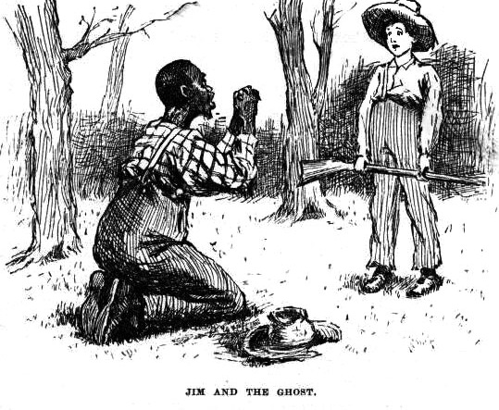
Mark Twain’s Later Years: Huckleberry Finn
The real gateway to Twain’s literary success was not his writing but his marriage to Olivia Langdon, the delicate daughter of a wealthy industrialist from New York State. In terms of his writing, the support of William Dean Howells, the editor of leading literary magazine Atlantic Monthly played an important role.
The letter to Twain‘s friend Will Bowen (1870) reveals a deep split between Twain‘s family life + the lifestyle of upper class society, and his memories from childhood and youth whose syntax resembles the tall tale.
This split shows itself in Twain‘s literary creation:
- works written for his “drawer,” posthumously published bitter satires: Letters from the Earth, Papers of the Adam Family, Damned Human Race, etc., and the novel The Mysterious Stranger. The speaker is usually Satan visiting the Earth and writing derogatory accounts on Americans and all human beings. Some satires (The Man Who Corrupted Hadleyburg, Puddenhead Wilson, United States of Lyncherdom) published in Twain‘s late years.
works written for publication, but reviving and recasting the memories of his boyhood and youth: The Adventures of Tom Sawyer (1876, the original title was A Boy’s Manuscript), Old Times on the Mississippi (later Life on the Mississippi, 1883), The Adventures of Huckleberry Finn (1884).
Features of Huckleberry Finn:
Original concept: local color novel documenting the dialects spoken in the Mississippi valley.
First person narrative: tension between child‘s and adult‘s perspective.
The first novel of uprootedness: the hero always “on the road”, bound for “the territory” (Nevada)
Moral dilemma and pragmatic (non-ideological) attitude to the question of slavery: Huck decides to lie in order to protect his black friend Jim from slave-hunters. Jim is not liberated but emancipated.
Satire: booster behaviour, confidence men (David Garrick, Edmund Kean – Duke of Bridgewater, the Dauphin of France), Southern Romanticism, mass violence (lynching).
Top: Olivia Langdon, aged 15
and S.L. Clemens, aged 31
Bottom: E.W. Kemble‘s illustration
to Huckleberry Finn (1884)

