Slide 1
Sociological theories of populism
Introduction

Slide 2
Course details
Courses credits: 8 ECTS
Type of completion: final essay and test
Evaluation: 70 % essay, 30 % test
Test – last week in December
Final essay
Choose a politician/political party. Argue (based on theories of populism) why he/she is populist.
Evaluation based on content as well as formal criteria
3.000 words long (without references)
APA style references
Abstract
tomas.dvorak@fsv.cuni.cz (by January 15, 2025)

Slide 3
Course details
Student Information System:
Syllabus
Suggested reading
Moodle - Sociological theories of populism
Reading for lectures (& test) - PDFs

Slide 4
Aims of the course
Introduce main sociological (and political) theories of populism.
Overview of the historical debate about populism.
Contemporary debate about populism in Europe and other countries.
Warnings:
Course is theoretical!
Reading is required!

Slide 5
Content of the course
Populism in Latin American countries
Classical theories of populism (Peronism in Argentina)
Contemporary populism in Venezuela, Ecuador
Varieties of populist mobilizations
Overview of typology of populist movements by Canovan (Russia, U.S., etc.)
Contemporary debate about populism
Populism in Western European countries
Populism in post-communist region (technocratic populism)

Slide 6
Why study populism?
The term „populism“ not much used in 20th century.
Margaret Canovan – „impossible to define“
Today populism often (over)used term. Debate about populism increased after:
Financial crisis in 2008 – led to emergence of new populist parties
Brexit vote in 2016
Donald Trump electoral success in 2016
However, populist parties on rise for decades.

Slide 7
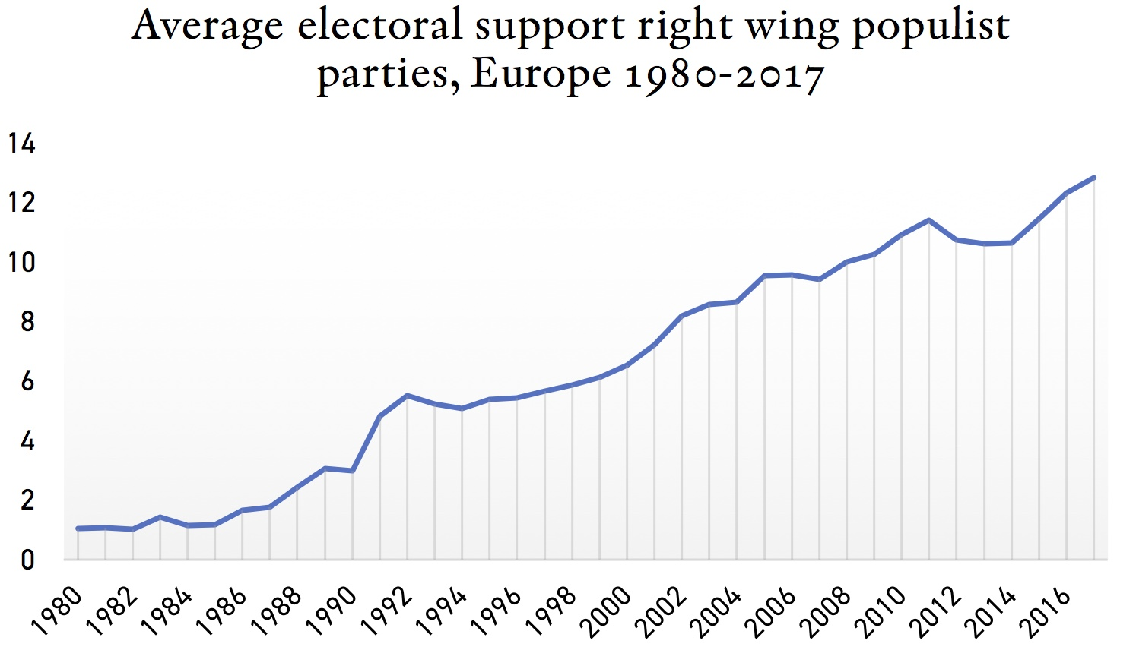
Support for populist parties

Slide 8
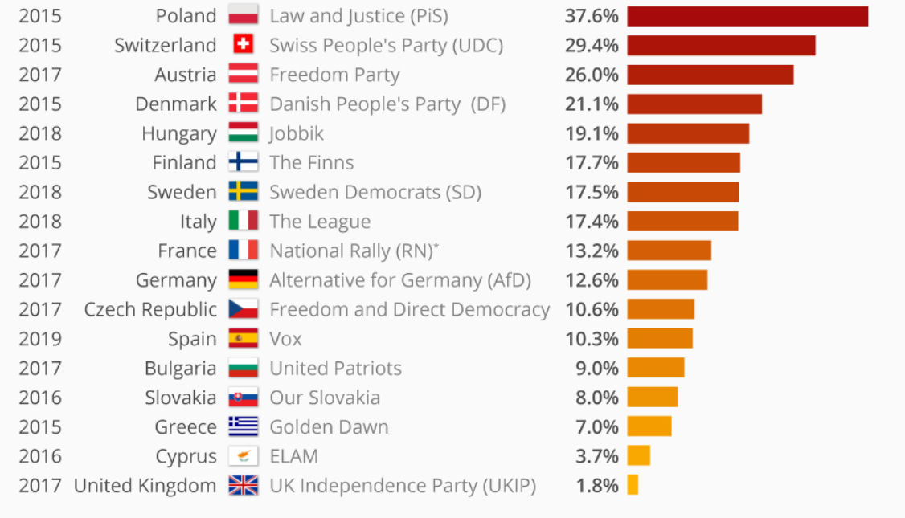
Right-wing populist parties in Europe: examples

Slide 9
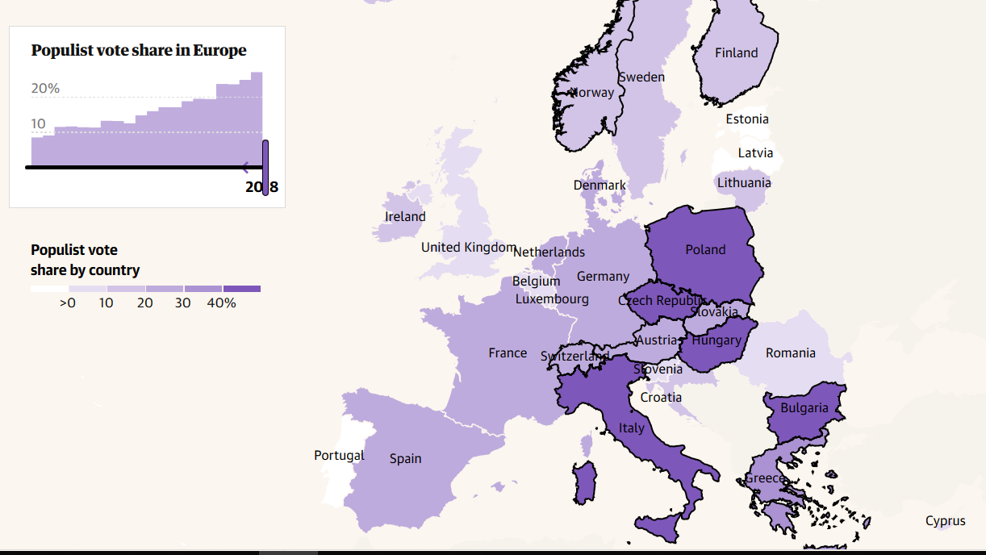
Support for populist parties

Slide 10
What is not populism
Populism means promising people what they want to hear.
That is opportunism. Characteristics of all politics.
Populism means giving money to the people, increase in spending.
Irresponsible fiscal policy – budget deficits. Policy that neglects the adverse consequences of fiscal expansion.

Slide 11
Preliminary definition
When a political party/politician argues that society is divided. And it is divided into two parts: corrupt elites and „the people“. And that this party/politician speaks in the name of this „people“.
Not (primarily) about representation of particular (left, right, liberal, conservative) interests.
Tradional parties: political competition is structured around substantive social issues and goals.
For populism it is about „who represents the people“ and less about traditional ideological conflicts.

Slide 12
Latin American societies and political regimes

Slide 13
Latin American societies and political regimes
LA countries Spanish and Portuguese colonies.
Wars of independence between 1800-1830s.
Difficult path to democratization. Unstable political regimes.
No well defined national identity
Not clearly established borders
Old (Spanish) institutions abolished (Spanish crown)
New (democratic) institutions weak, power in hands of caudillos
Caudillismo

Slide 14
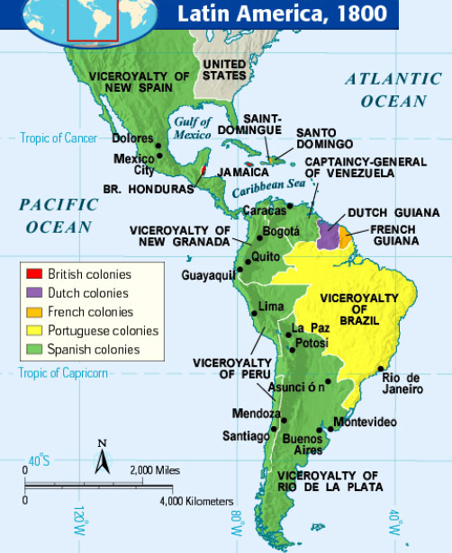
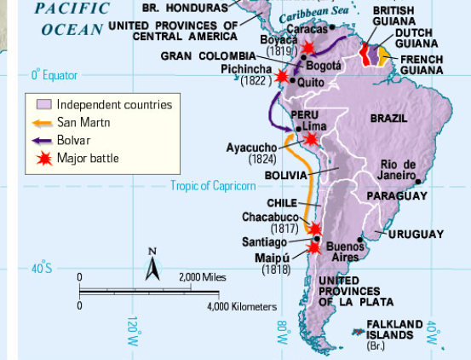
LA in 1800-1830
1830

Slide 15
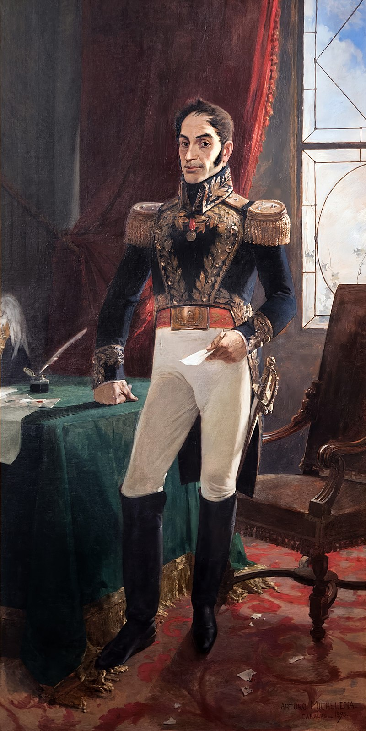
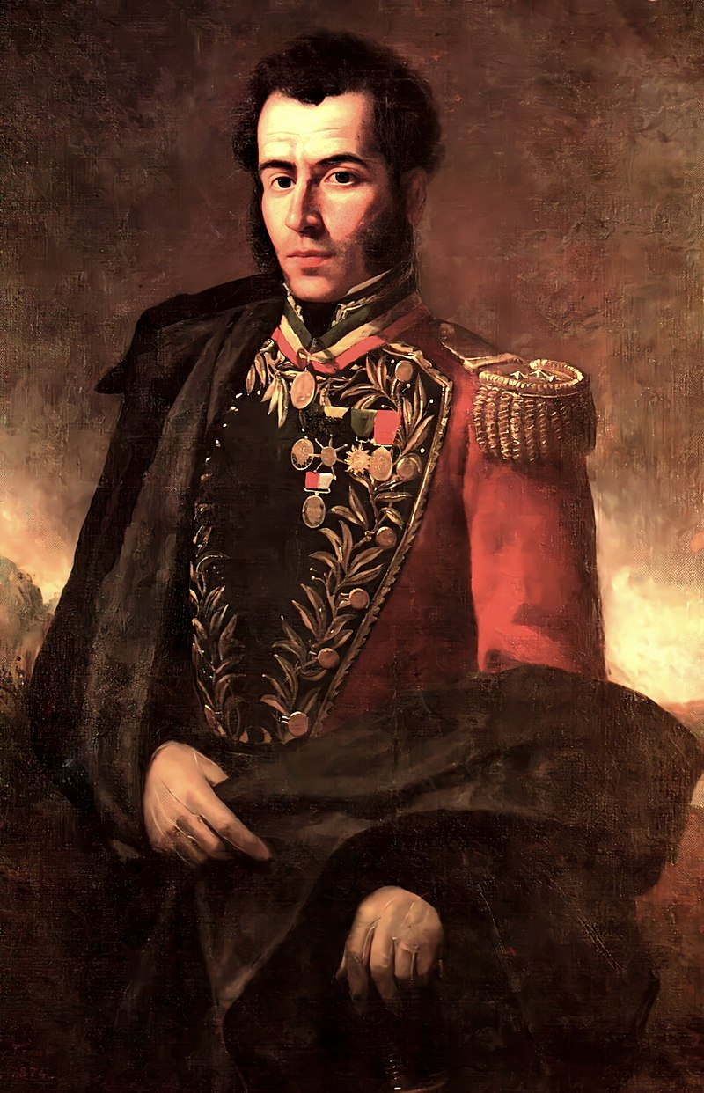
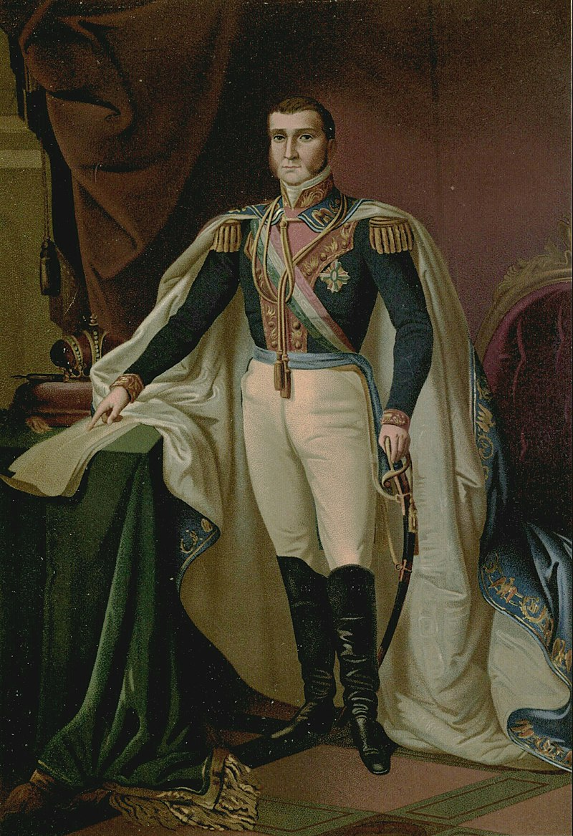
Simón Bolívar
Antonio José de Sucre
Agustín de Iturbide

Slide 16
Oligarchies in LA countries
Characteristics of oligarchies
Came after caudillo regimes. More stable, better financed, better defended.
Oligarchic regimes (oligarchic republics) around turn of the 19/20th century.
Oligarchs derived power from exports (coffee, sugar, cotton, primary products)
Mainly fought among themselves – not really challeged from outside.
But due to economic growth a new „world“ was created:
Strong states with growing urban areas with growing standard of living and rising education.
Result: expanding middle class and independent military which challenged the ruling class.
Still: NOT DEMOCRATIC SOCIETIES. Some democratic institutions in place (elections), but not democratic in practise.

Slide 17
Latin American societies and political regimes
Process of nation-building not finished
Democratic institutions weak – power in hands of oligarchies (autocratic regimes)
Nations appeared first, democratization much longer process.
4 phases of democratization/consolidation
Until turn of 19/20 century – caudillo regimes
1900-1940: Weak democratization (driven by oligarchies)
1940-1980: Middle and low classes begin to participate in politics
1980- almost all LA countries democratic

Slide 18
II. Latin American populism: Argentina

Slide 19
Argentina in 1920s & 1930s
The government “a conservative and pro-aristocratic coalition” protected the interests of oligarchies.
Some democratic institutions were in place, but the lower classes were excluded from politics.
Argentina was hit by economic crisis; also due to WW2.
Labor laws were often unenforced, the labor movement was divided and weak.

Slide 20
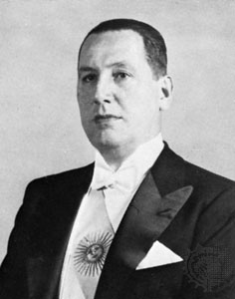
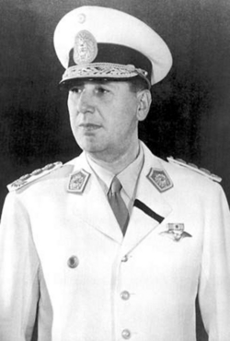
Juan Domingo Perón
1885-1974
Spanish ancestors from Sardinia
Middle class
Military education
Inspired by Mussolini

Slide 21
Social and economic reforms by Perón
Military coup (1943): one of key 4 figures
Ministry of Labour and Ministry of War
Progressive economic reforms:
Social welfare benefits
Minimum wage for workers
Maximum working hours
Vacation time for workers
Introduced social insurance

Slide 22
Perón: presidency
In 1946 elected as president
Strong support from military, working class, catholic church.
In 1951 elected as president for 2nd time
Not really „democratic“ elections
In 1955 military coup
Perón left Argentina, until 1972 in exile.
In 1973 democratic elections – won presidency.

Slide 23
Peronims – Why populist?
He used specific „populist“ way of doing politics
Used anti-establishment discourse. His enemies portrayed as „oligarchy“ with him „speaking“ in the name of the people. Created-constructed ordinary people as the symbol of a nation. Relied on broad coalition of interests (working class, military, church)
He polarized society into two antagonistic camps!
Charismatic leader – created a cult o personality. Presented himself as „God-like“ figure.

Slide 24
Peronist ideology: Peronism
Peronism (as a political regimes) was combination of authoritarian and demoratic politics. Its characteristics were:
Politically nationalistic (Peronism as a „third-way)
Social reforms
Nationalized large corporations and blurred divide between government and private sector (power of foreign investors decreased)
Created mass Peronist party
Repressed political opponents
Nationalized media

Slide 25
Peronism – evaluation
BAD
Perón maintained democratic institutions but undermined them
Nationalized media, cancelled opposition ones
Attacked opponents as traitors, imprisoned opposition politicians
Inefficient state-run economy
Inspired by Italian fascism
GOOD
Recognized industrial workers as citizens
Brought the urban masses into politics
Increased political participation
Introduced socially progressive reforms

Slide 26
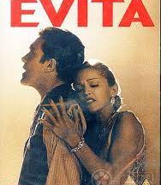
Movie Evita (1996)

Slide 27
Movie Roma (2018)

Slide 28
Latin American populism: Theories of Gino Germani and Torcuato di Tella

Slide 29
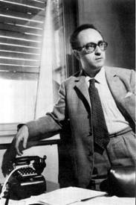
Gino Germani
Italian sociologist (1911-1979)
Active in anti-fascist movements (in prison for 1 year).
Left Italy in 1934 for Argentina.
Studied at University of Buenos Aires.
In 50s director of the Institute of Sociology, with focus on empirical research.
In 1966 moved to the U.S. In Argentina alienated both political left and right.
In 1970s returned back to Italy.

Slide 30
Founding father of sociology in Argentina
Director of the Institute of Sociology. Wanted to establish sociology as
Scientific discipline (sociology = philosophy)
Free from ideology (left or right)
Combining both theory and empirical research
However,
Ruling elites (church, military) viewed sociology as subversive discipline.
Intelectuals and students on „left“ viewed sociology as ideology of „American imperialism“
After military putsch (coup d'état) in 1966 he left Argentina for Harvard.

Slide 31
Germani: societal conditions
Argentina not equally integrated society. Didivided into central regions (urban, developed, modernized) and rural (argicultural, traditional, politically passive).
Latin american countries were only partially „democratic“ (not fully democratic). Oligarchy.
Only elites were politically active. Populism = process of political activization of the marginalized parts of the society.
Populism in Latin America – „shift from total political passivity to total political mobilization“.

Slide 32
Germani: Structural causes
Start: demographic and (structural) economic changes.
Latin American countries faced strong migration
Immigration flows from outside countries that were impossible to integrate
Movements of big parts of the population from agricultural areas to cities.
Influx of new masses of people – change in political landscape. No existing political parties that would provide these people means of political expression – would represent their interests.
These masses of people „depoliticized“. These people had political requests – but not represented by any political party. Start of populism.

Slide 33
Germani: „Populist mobilization“
Suddenly major parts of society, previously excluded from politics, demanded political rights and participation.
These „masses“ of people did not have political representation (political parties, leaders etc.). Situation used by certain groups such as military (and middle class) to rise to power. Constituted movements to represented these „masses“.
RESULT: populist movements that emancipated previously excluded population into politics BUT were not really democratic (semi-authoritarian).
Coalition of workers/immigrants/low class/middle class against ruling oligarchy. Unification based on idea of „the people“ – „el pueblo“ (=nation). Notions „people“/“nation“/“country“ same.

Slide 34
Germani: theory of populism
Theory of populism = modernization theory
Driven by economic, demographic, social changes and crises.
Expectation for LA: gradual transition from traditional to modern societies
Mismatch between mass mobilization and backward political structure
Differences in social change in parts of society
Growth of working and middle class – political system not ready
Populist revolution – new institutions emerge (new political system)
General idea: due to science/progress social change occurs – mismatch between parts of society – tensions/conflicts emerge – change of political systems.

Slide 35
Democratization process (Germani)
Full political participation after „populist“ revolutions
„Unifiying“ dictatorship regimes
Wars of independence
Colonial regimes
????
Anarchy, civils wars, caudiismo
Representative regimes with limited participation
Representative regimes with „extended“ civic participation
Fully participatory democratic regimes

Slide 36
Torcuato di Tella
Similar view of populism as Germani (phase of modernization)
Populism more typical for less developed Latin American countries.
In more developed countries „class politics“ more common.
Essential role of middle classes.
More developed LA countries: Middle class in leading role. Once „populist movemenent“ achieves its goals – middle classes leave the movement.
Less developed LA countries: coalition of working and middle classes long-term.

Slide 37
Characteristics of populism in LA
Integration of different social classes in one political movement.
Vague political discourse
Single charismatic political leader (Perón) – legacies of Caudillo regimes
-------
Growth of working and middle classes - increased demands of power and income – existing system unable/unwilling to fulfill these demands – political tensions (populist revolutions). -
Modernization theory; theory of social change.

Slide 38
Today relevance of theories of Germani and di Tella:
Relevant still today in developing countries because favourable conditions for populism are:
Divided societies (advanced vs. rural/backward areas) – recent debate in WE.
Developing world: Increase in education/urbanization leading to aspirations the society can not satisfy.

Slide 39
Critique of the theory
It does not uniquely define populism.
Definition of populism corresponds to „catch all party“ in WE.
Catch-all-party
Replaced parties build around well defined cleavages
Well-defined class identities, institutionalized political systems, stability of societies – stable political identities.
After WW2 rise of welfare state – decreased importance of these identities.
Political parties less ideological, less interest i grassroot members, appeal to more potential voters, more dependent on state, more focus on political leaders (personalization of politics).

Slide 40
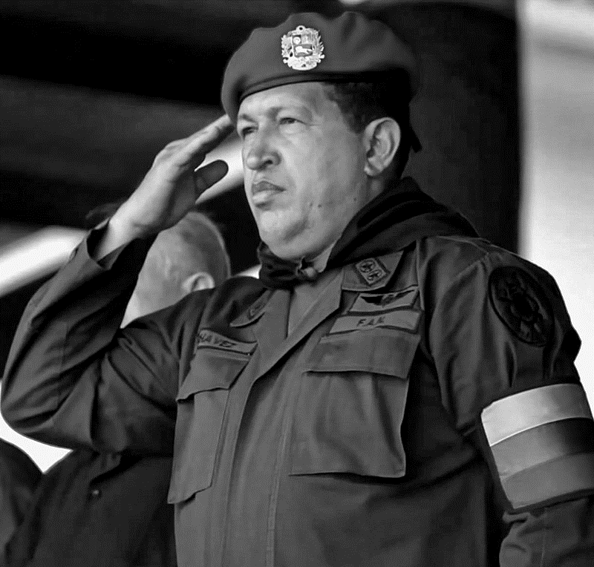
Venezuela: Hugo Chávez
1954-2013
Military officer
Imprisoned in 90s
Founded a political party Fifth Republic Movement
President since 1998

Slide 41
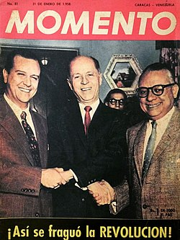
Party system in Venezuela
Revolt against political parties. Revolt against „Puntofijo pact“ (1958)
In Venezuela 2-party political system (50 % identified with either).
AD (left-wing)
COPEI (christian-democratic)
Strongly institucionalized political system
Political power in control of these two parties
After 2nd w.w. – strong political parties and stable party system viewed as modernization

Slide 42
Party system in Venezuela - characteristics
Party system
Limited competition between political parties. Depolitization.
Parties similar to each other. No strong class cleavages. Both parties centrist.
High electoral turnout (even over 90 %)
Politics based on consensus and control. Political conflict limited.
Economics
Dependence on oil revenues.
State controlled industry.
In 1990s economic recession

Slide 43
Hugo Chavéz
Won presidential elections in 1998.
Reformed Venezuelan political regime. Based on referendum: Pushed through a new constitution which
Increased powers of president
Increased centralization of the state
Limited political competition
Slowly moved to authoritarian regime in 2000s.

Slide 44
Perón and Chavéz
Both represent nationalistic populism. Combine democratic and authoritarian practices.
Concentrated powers
Confrontational discourse
Media control
Control of civil society
Polarized societies

Slide 45
Populist playbook (Carlos de la Torre)
First, populist politicians claim to address social problems (inequalities, unresponsive political elites, loss of national soverignty)
Their solutions, simplistic, and in most instances, instead of leading to better forms of democracy, their outcomes are authoritarian.
Concentrating power in the hands of the president, using the legal system instrumentally to punish critics, and attacking the media and civil society.
Populists lead to processes of democratic erosion and even transform malfunctioning democracies into hybrid regimes

Slide 46
Rafael Correa (Ecuador)
Ecuador unstable political situation.
Correa professor of economics at UNI.
First ministry of economy (in 2005)
Won elections in 2007
Changes leading to dismantling of liberal democracy:
Change of constitution,
Increase of presidential powers,
Gained control of the media
Repressed opposition

