Slide 1
Ludovico Ariosto
Zuřivý Roland
(Orlando furioso – Raging Orlando)
Introduction

Slide 2
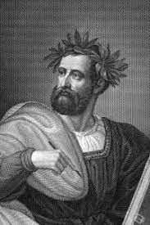
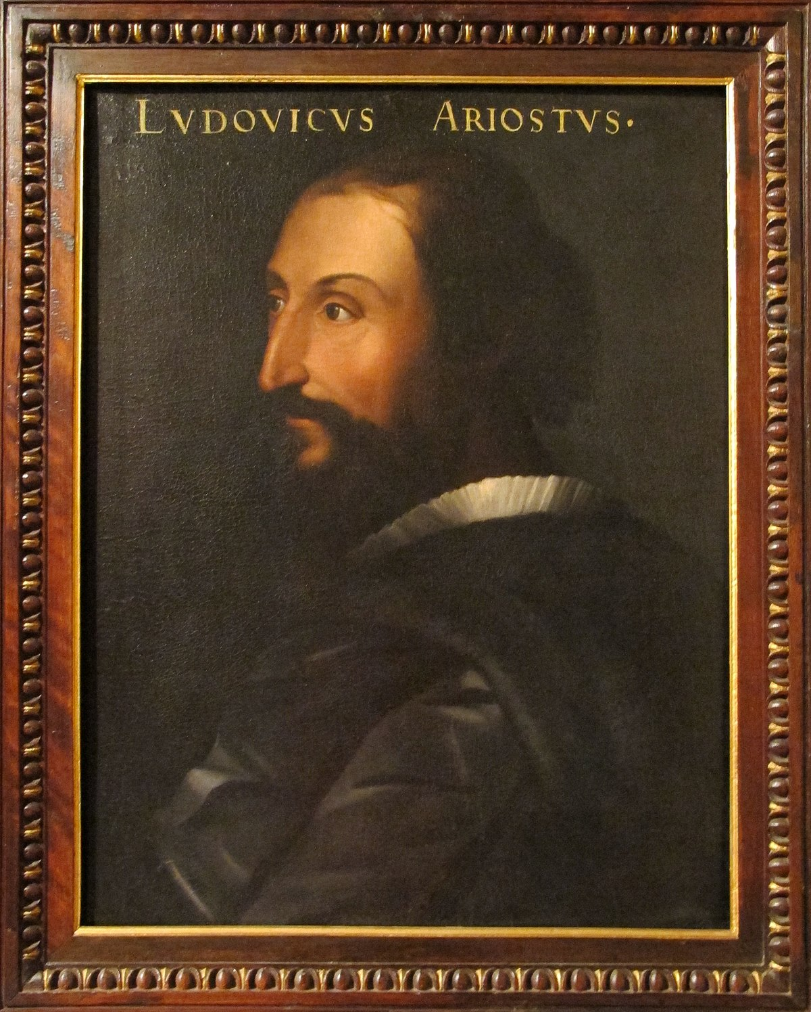
Ludovico Ariosto

Slide 3
Ludovico Ariosto
September 1474-July 1533 (Ferrara)
Poet, working at the service of Ippolito D’Este (Cardinal of Ferrara)
Diplomat and ambassador to Pope Julius II
Governor of Garfagnana (small province in the region of Tuscany)

Slide 4
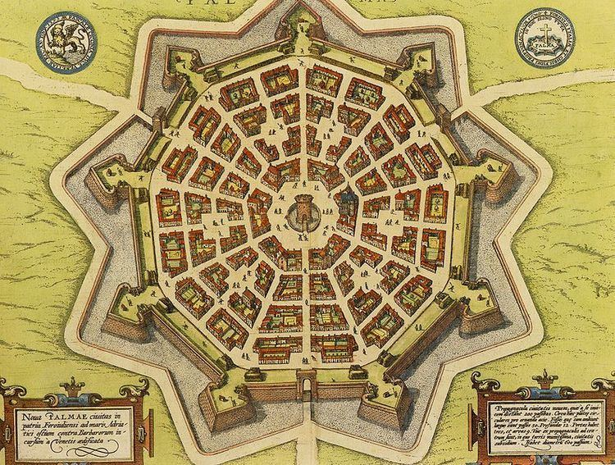
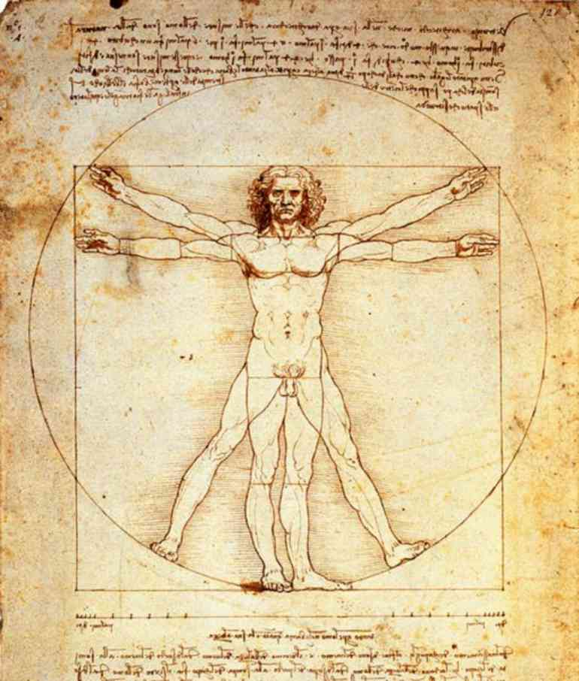
Stereotypical “Renaissance”

Slide 5
Ariosto = Renaissance’s Dark Side
Instable world
“Now here, now there, now everywhere” (I, 31)
“Now here, now there…” (II, 30)
“To east, to west… Where the wind drives” (XXII, 10)

Slide 6
Ariosto = Renaissance’s Dark Side
Instable world
Human beings seldom have control on their action (and the consequences of their action)
Angelica: “I only did it for the best, God knows / Although the results have sadly gone amiss” (XII, 64)

Slide 7
Ariosto = Renaissance’s Dark Side
Instable world
Human beings seldom have control on their action (and the consequences of their action)
Human beings are always on the verge of losing their own identity, thereby losing their own humanity

Slide 8
Orlando Furioso
Three editions: started in 1506 and published in 1516 → 1521 → 1532
46 cantos: each canto contains a variable number of eight-line stanzas in ottava rima (a rhyme scheme of abababcc)
Intertwinement structure → no linear plot → a web of stories: “horrible harmony” (XIV, 134)
Each canto presents a series of stories that intertwine, intersect and overlap → the poem mirrors the complexity of reality
Both the narrator and the reader have the impression of getting lost (it is impossible to master the complexity of the poem (= reality)

Slide 9
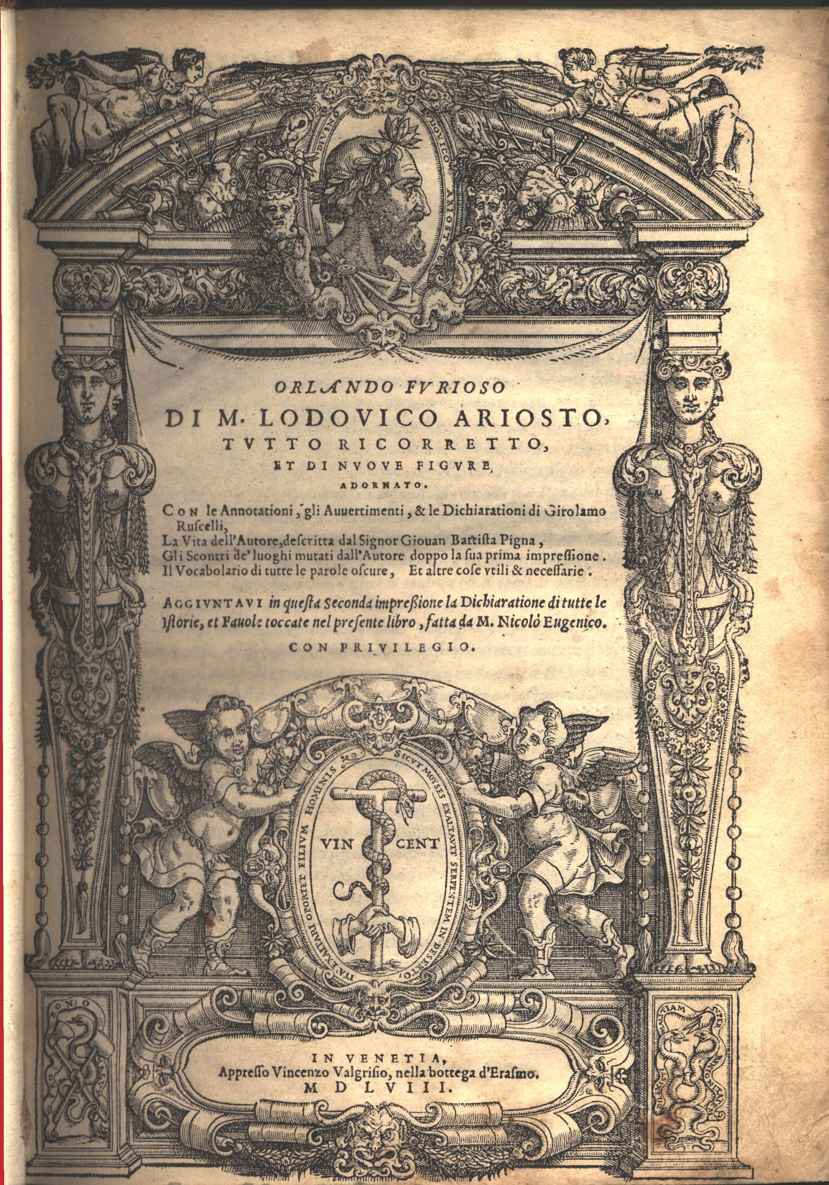
Orlando Furioso
1558 edition

Slide 10
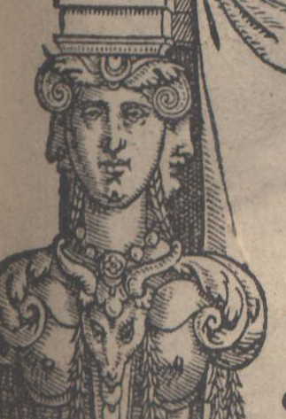
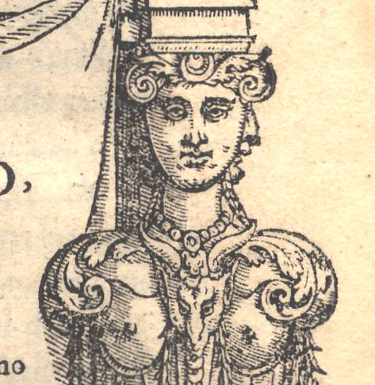

Slide 11
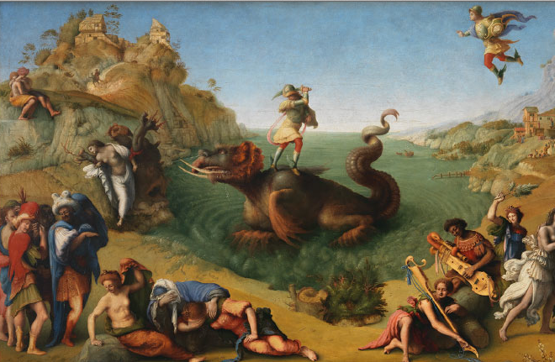
The World of the Orlando Furioso

Slide 12
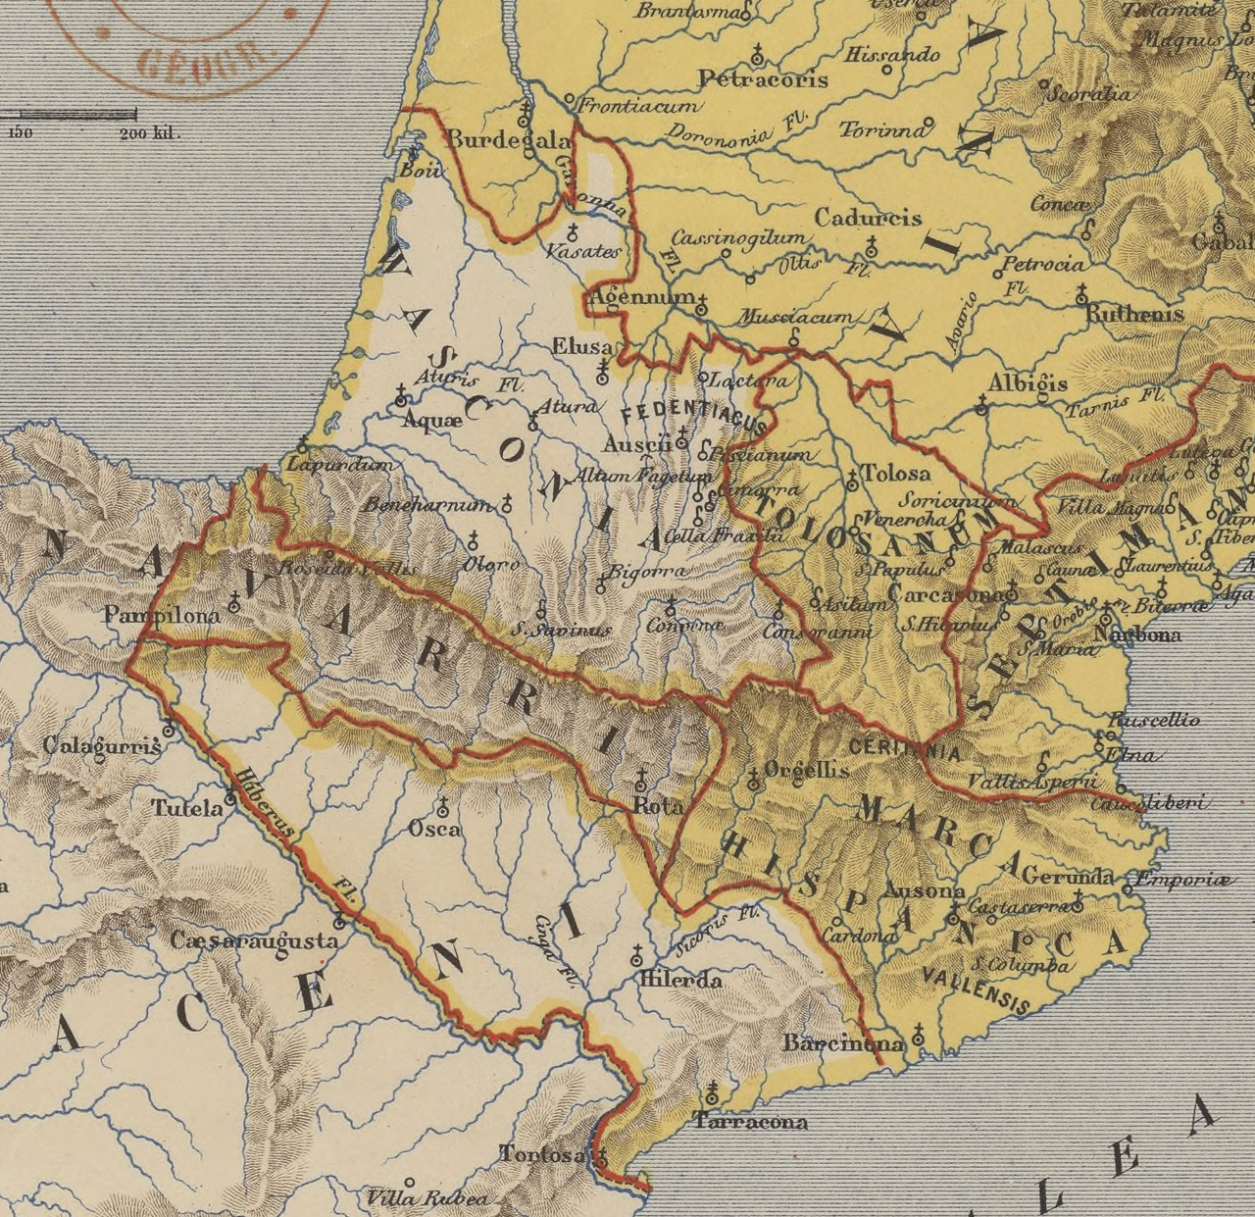
Time
Starting point (historical background):
- Battle of Roncevaux Pass (778 AD): a battle on the Pyrenees between Charlemagne and the Basques. Charlemagne’s army, in the attempt at expanding his empire in the Basque region, tore down the city of Pamplona
In the evening of August 15, 778, the rearguard was ambushed by the Basques as they crossed the mountains on the way back. The Franks try to escape the ambush and the army falls in confusion. Roland (Orlando) is killed.

Slide 13
Time
Ariosto’s fiction:
The battle is between Charlemagne and the African Moors who are trying to invade France to conquer Paris
Angelica (“the princess of Cathay”), whom Orlando loves, takes advantage of the confusion of the battle to flee from the French camp
Orlando, in love with Angelica, leaves the camp trying to catch her

Slide 14
Space
Paris: the center of the battle (where all characters try to go or from where they try to flee)
The rest of the known world (Europe, England, Bohemia, North Africa, Spain, Asia) – with the awareness that it is not the entire world
The moon

Slide 15
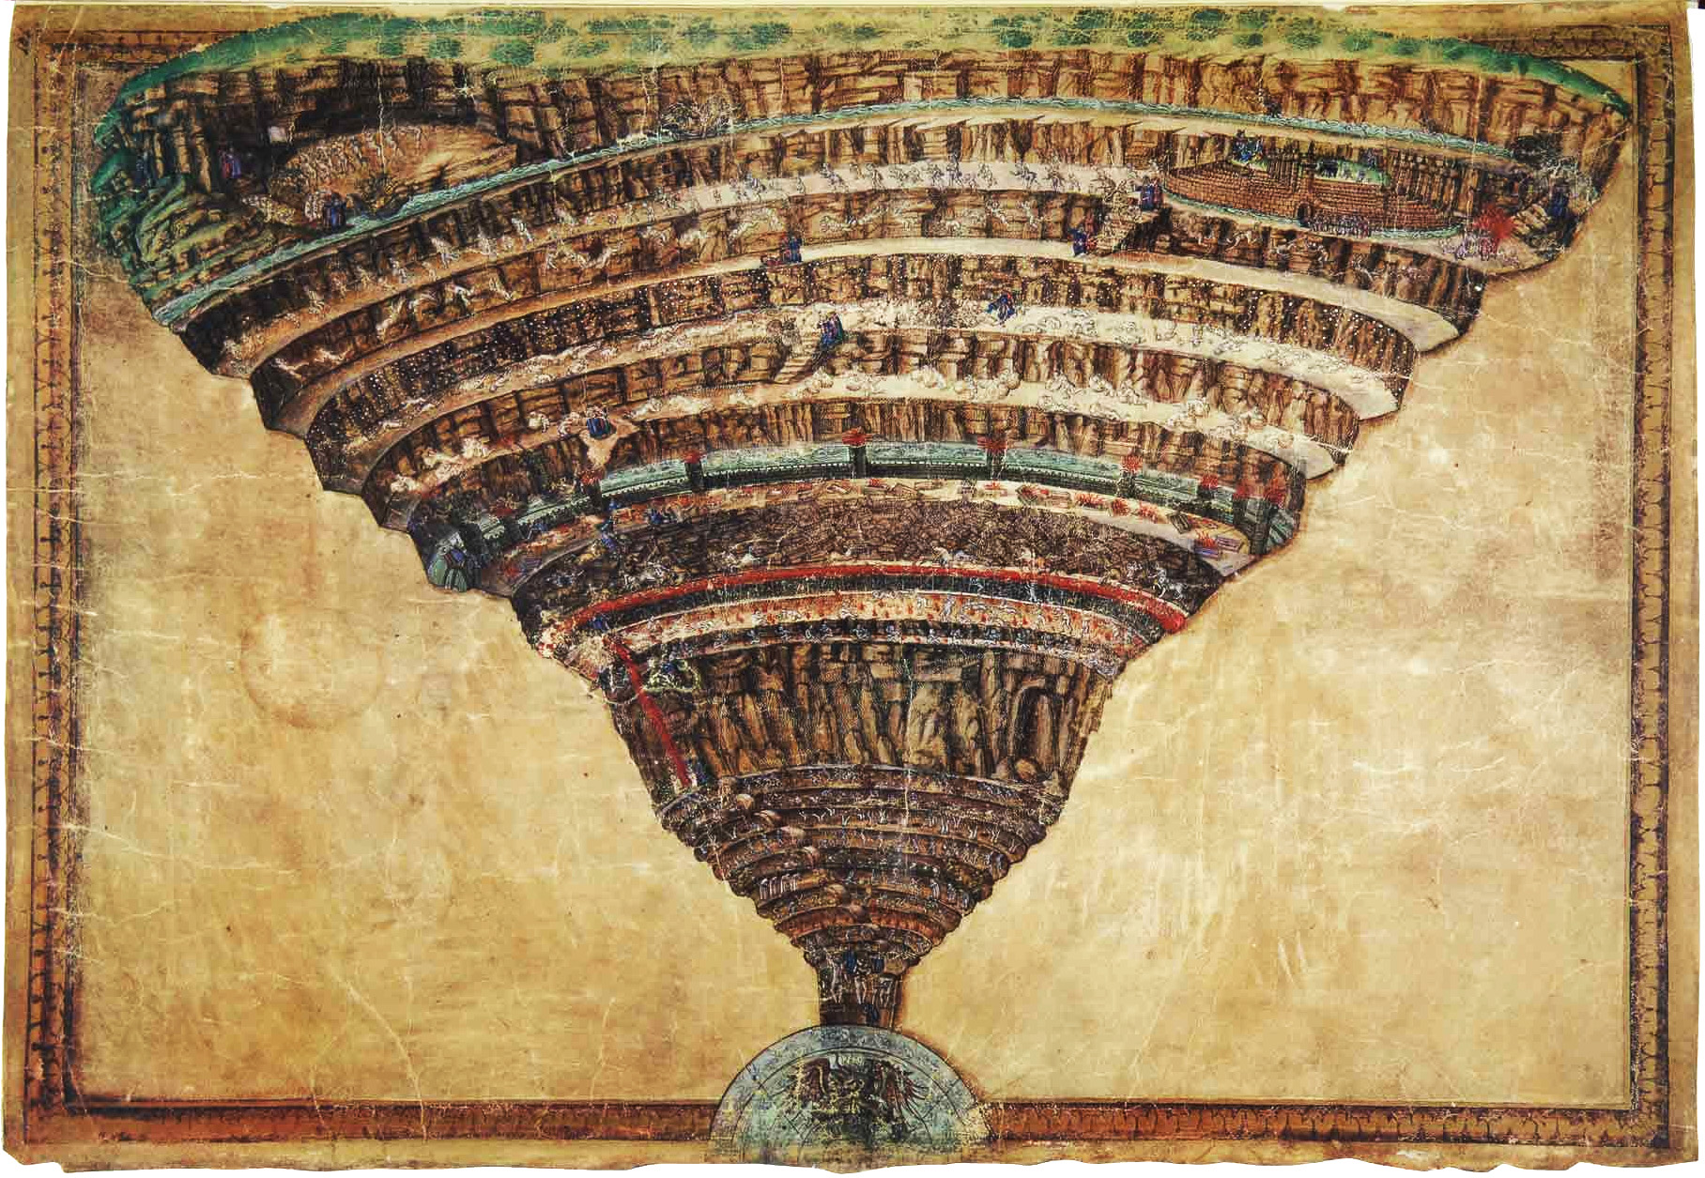
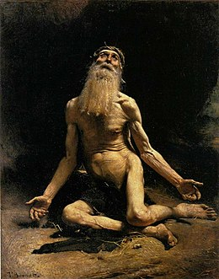
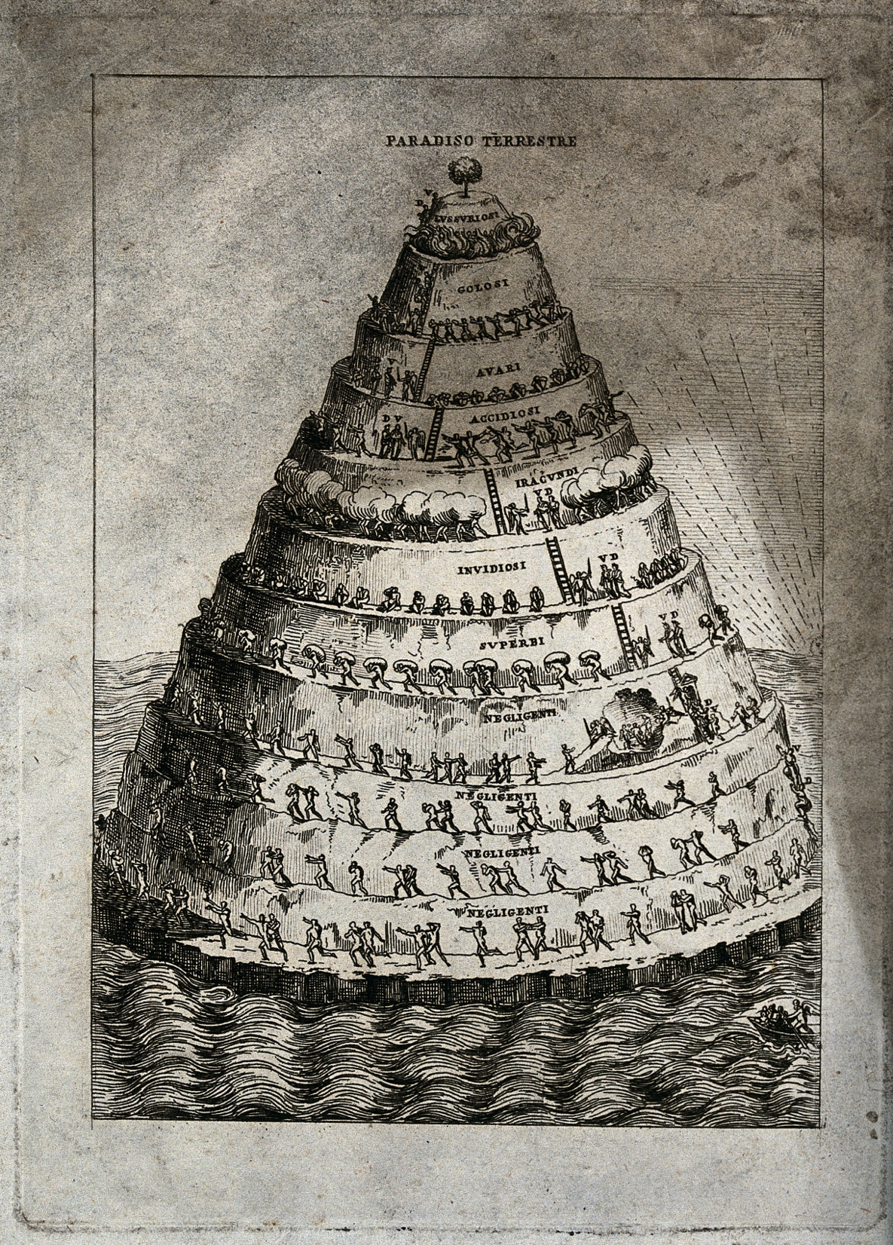
Dante’s Inferno and Purgatory
Job

Slide 16
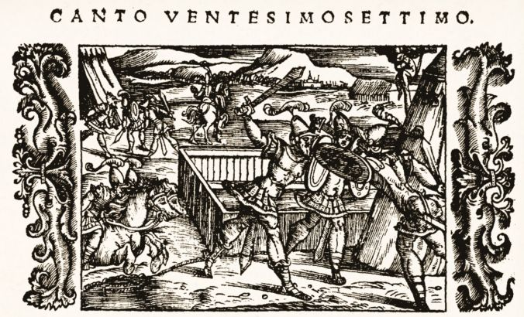
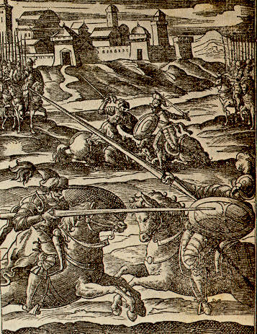
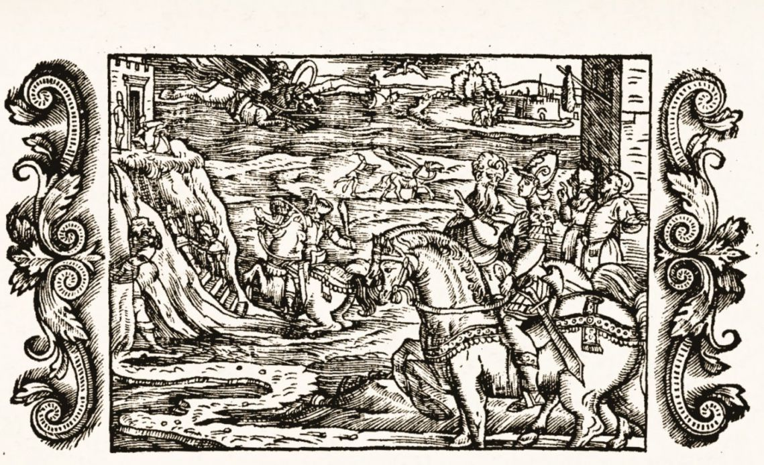

Slide 17
Main Stories and Characters
- Charlemagne / Agramante = Background story

Slide 18
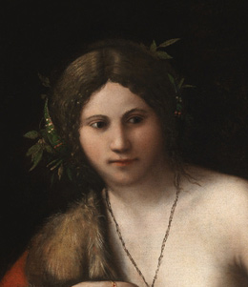
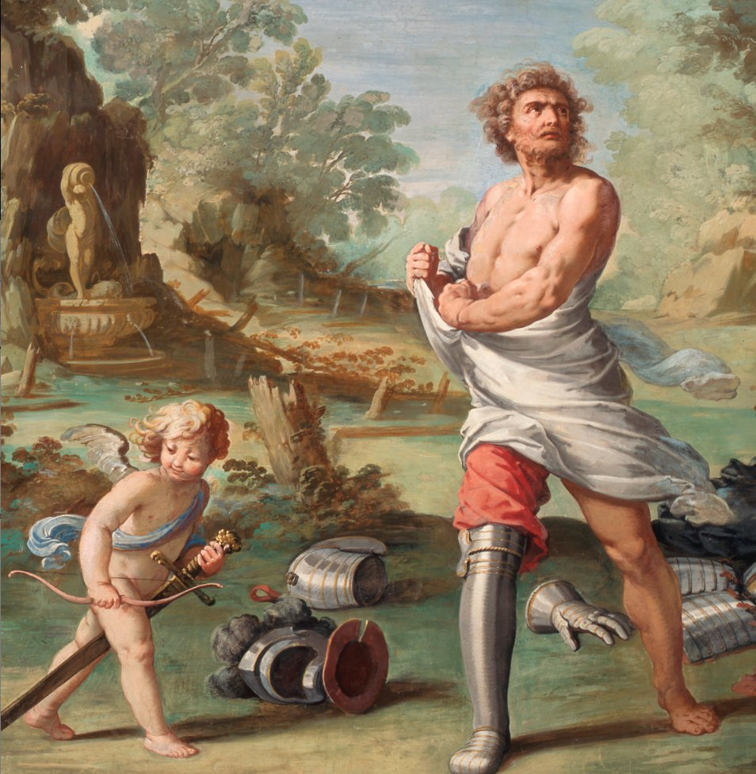
Main Stories and Characters
Charlemagne / Agramante = Background story
Roland (Orlando) / Angelica = Unifying story

Slide 19
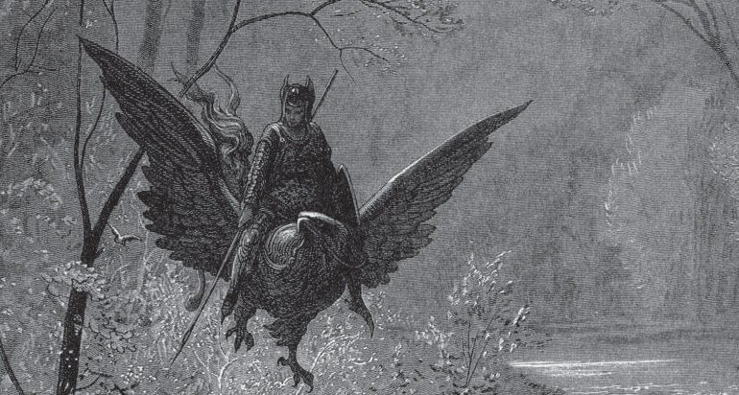
Main Stories and Characters
Charlemagne / Agramante = Background story
Roland (Orlando) / Angelica = Unifying story
Astolfo = son of the Kind of England (who will help Orlando get his reason back)

Slide 20
Main Stories and Characters
Charlemagne / Agramante = Background story
Roland (Orlando) / Angelica = Unifying story
Astolfo = son of the Kind of England (who will help Orlando get his reason back)
Rinaldo (cousin of Orlando ) / Rodomonte

Slide 21
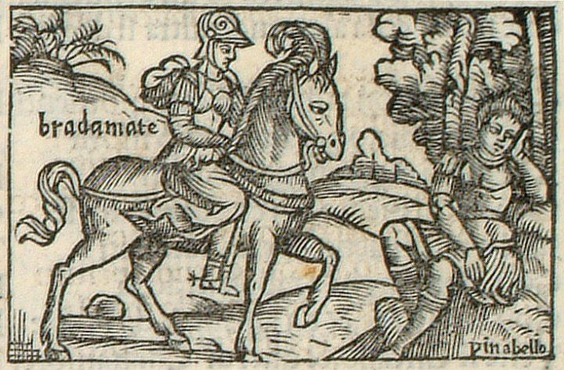
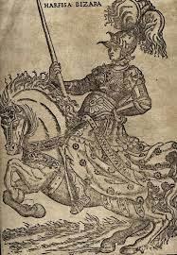
Main Stories and Characters
Charlemagne / Agramante = Background story
Roland (Orlando) / Angelica = Unifying story
Astolfo = son of the Kind of England (who will help Orlando get his reason back)
Rinaldo (cousin of Orlando ) / Rodomonte
Bradamante (sister of Rinaldo) / Marfisa (twin sister of Ruggiero)

Slide 22
Part 1
The Anthropology
of Desire and Illusion

Slide 23
Every character is characterized by a desire

Slide 24
Every character is characterized by a desire
Love as a paradigm
Love for a woman/man - desire of honor - more power - vengeance -magical artifacts - food/wine

Slide 25
Every character is characterized by a desire
Love as a paradigm
Love for a woman/man - desire of honor - more power - vengeance -magical artifacts - food/wine
Folly / madness / rage = the consequence of an impossible desire
Identity crisis

Slide 26
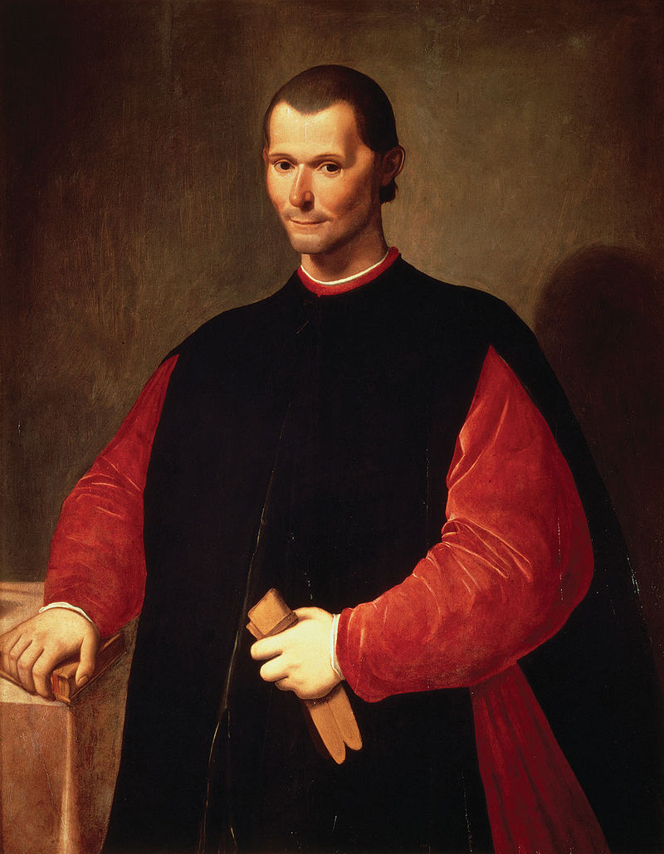
Niccolo’ Machiavelli (1469-1527)
The Prince (1513-1514)(Vladař)
Discourses on Livy (1513-1519)
(Rozpravy nad prvními deseti knihami Tita Livia)
G. Ferroni, Machiavelli aneb o nejistotě (Praha 2020)
J. Bíba, Estetické čtení Vladaře (Praha 2022)

Slide 27
“For whenever engaging in combat through necessity is taken from men they engage in combat through ambition, which is so powerful in human breasts that it never abandons them at whatever rank they rise to. The cause is that nature has created men so that they are able to desire everything and are unable to attain everything. So, since the desire is always greater than the power of acquiring, the result is discontent with what one possesses and a lack of satisfaction with it. From this comes the variability of their fortune; for since some men desire to have more, and some fear to lose what has been acquired, they come to enmities and to war”
(Discourses on Livy, I, 37-15)
“human appetites are insatiable, for since from nature they have the ability and the wish to desire all things and from fortune the ability to achieve few of them, there continually results from this a discontent in human minds and a disgust with the things they possess makes them blame the present times, praise the past, and desire the future” (Discourses on Livy, II, Preface, 20-21)

Slide 28
Every character is characterized by a desire
Love as a paradigm
Love for a woman/man - desire of honor - more power - vengeance -magical artifacts - food/wine
Folly / madness / rage = the consequence of an impossible desire
Identity crisis
Anthropology of illusion: the object desired as a projection of the desire

Slide 29
Isabella
“… the cruel tyrant, Love
Who treacherously every promise breaks,
Who bides his time and watches every move,
And every chance to thwart true lovers takes,
Now with malicious cunning robs me of
My joy, and of good fortune sorrow makes”
(XIII, 20)

Slide 30
Bradamante
“But, in the end, of what do I complain
Except of my irrational desire,
Which lifts me far above the azure plain,
Until at last its pinions have caught fire?
My weight no longer able to sustain,
It drops me to earth; then even higher
It raises me; its wings are singed anew;
To such repeated falls no end I view”
(XXXII, 22)

Slide 31
The Starting Point
- Angelica takes advantage of the confusion in the French army to leave the camp
- Roland decides to leave the battlefield to pursue his desire rather than stay and fight the enemy

Slide 32
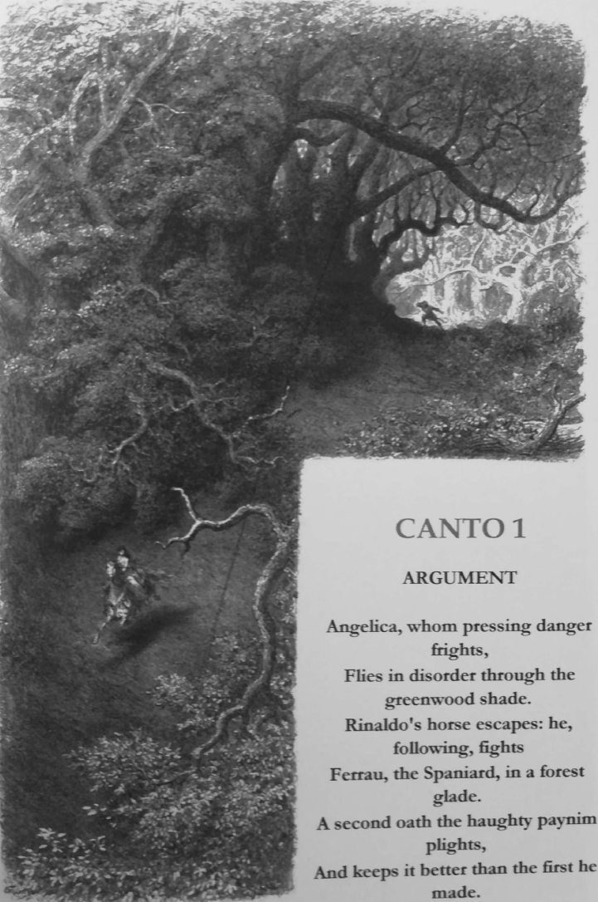
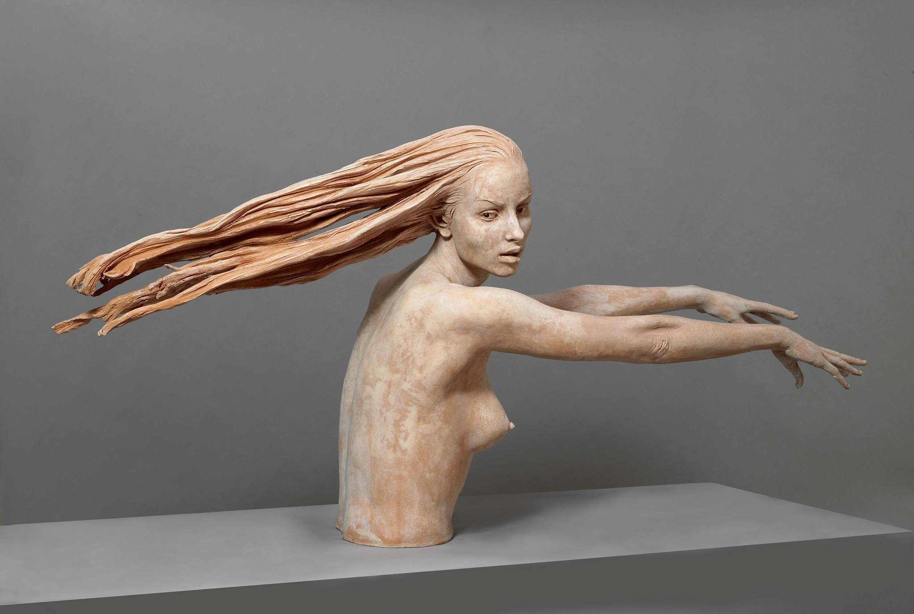
Gustave Doré, Illustrations for the Orlando Furioso (1879)
Giuseppe Bergomi, Angelica Runs Away (2014)

Slide 33
Orlando’s illusory desire
“…Defended her, and how she was, in fact,
As when she left her mother’s womb, intact.
It may be true, but no man in his senses
Would ever credit it; yet possible
It seems to him, for, lacking in defences,
To what is plain, but made invisible,
The king is blind (or with his sight dispenses),
Since what is not, lover’s power makes credible.
Thus he believes her for, as all men do,
He gives assent what he hopes is true”
(I, 55-56)

Slide 34
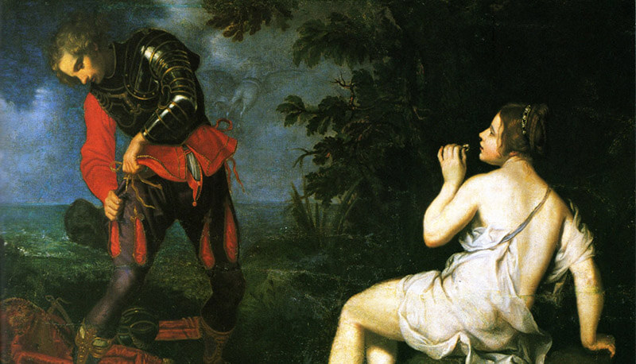
Giovanni Bilivert (Firenze 1585 – 1644)

Slide 35
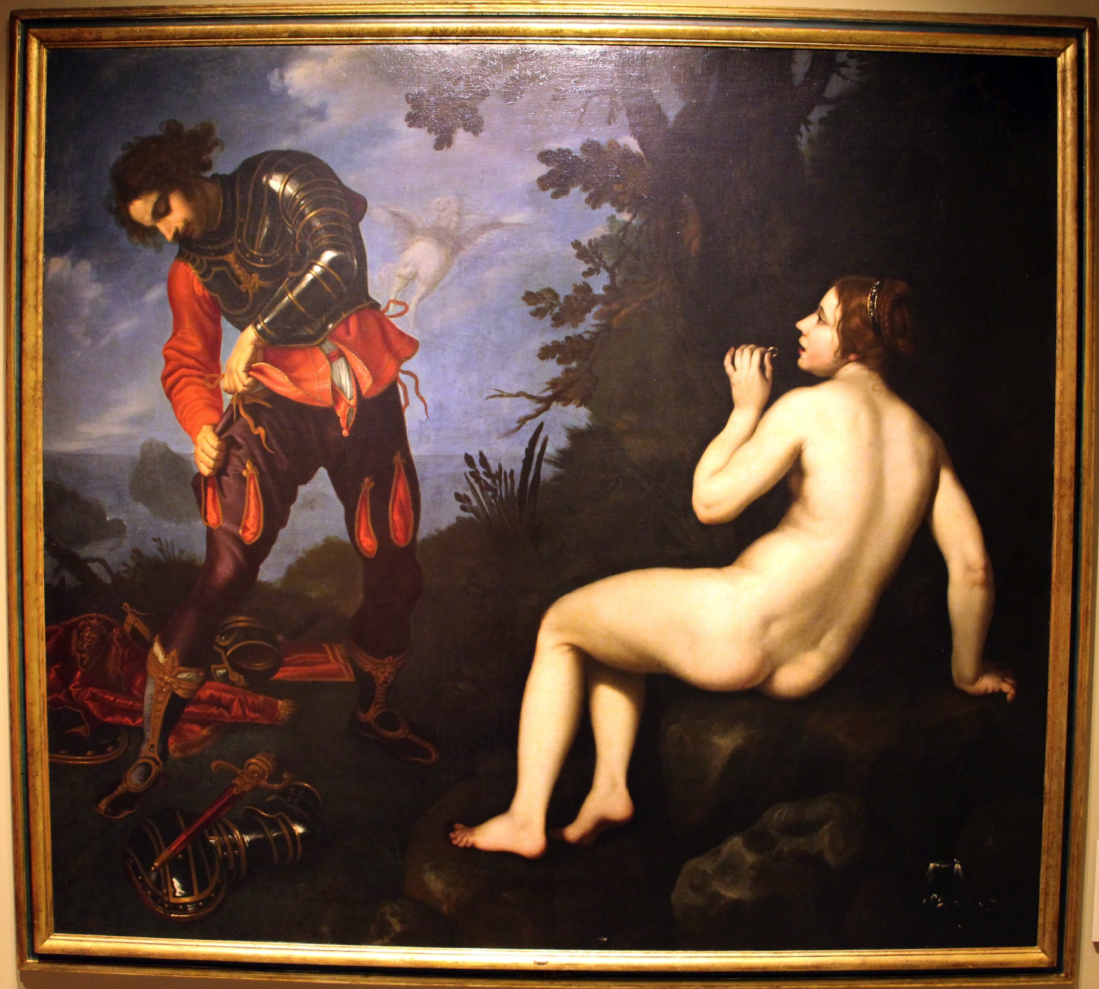
Giovanni Bilivert (Firenze 1585 – 1644)

Slide 36
“Ruggiero looked about him everywhere,
Turning and twisting like a man deranged (un matto)
Until, the ring recalling, to a stare
Of stupefaction his expression changed.
He cursed his inattention then and there,
Railing against her who has thus exchanged
In recompense for all his help and tact.
This rude, ungrateful disappearing act
… Now, by the fountain, now in many places,
He groped as he played at blind-man’s-buff.
How often did his arms in an embrace
Close on the empty air!” (XI, 7, 9)

Slide 37
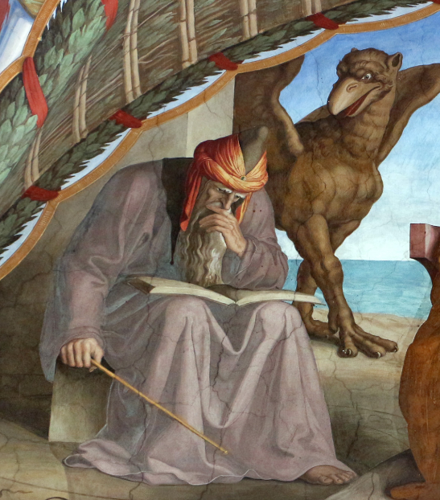
Atlante’s Palace
Julius Schnorr von Caroesfeld, Atlante

Slide 38
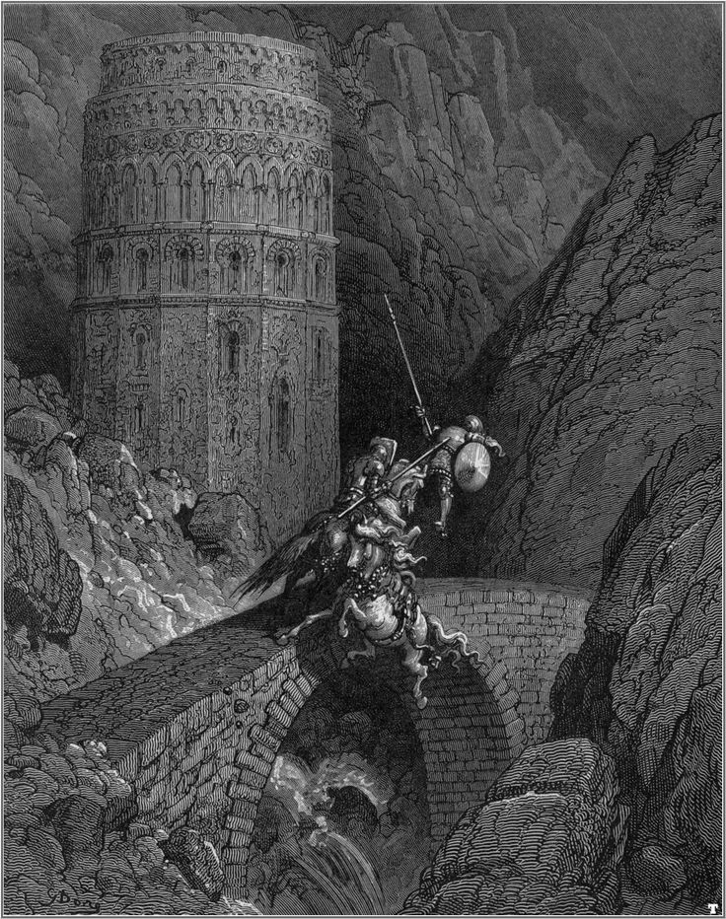
“He has a castle in the Pyrenees,
[…] built by magic art
Of shining steel; so beautiful it is,
In the whole world there is no counterpart.
Of all the cavaliers who visit this
Enchanted palace, none, they say, depart.
It’s my belief, good sir, I greatly fear,
They’re put to death or held as captives there”
(IV, 6-7)
Gustave Doré, Illustrations for the Orlando Furioso (1879)

Slide 39
“He’s looked for her in France; now he prepares
To search Italian shores and Germany;
Next, new and old Castile; from Spain, where there is
A ship, to Libya he will cross the sea.
Then, as he ponders on this plans, he hears
A plaintive voice lamenting piteously,
And, pressing forward, he beholds a knight
Advancing on a charger of great height
Upon his saddle-bow, clasped in one arm,
This knight a damsel holds against her will
[…]
I do not say myself that it was she,
But that he seems to be the one he loved”
(XII, 5-6)

Slide 40
“A coverlet of silk or golden adorns
Each bed, and not an inch of wall is bare.
Now this way and now that his steps he turns.
Soft draperies and carpets everywhere
Regale his gaze, but not the sight he burns
To see, the longed-for presence of the fair
Angelica; nor can he find the thief
Within whose grasp he saw her, to his grief.
And while in every room he looks in vain,
Cast down with care, nor knowing what to do,
In similar bewilderment and pain,
Gradasso, Brandimarte, Ferraù,
And Sacripante the Circassian,
With other cavaliers, go wandering through
The palace as they bitterly reproach
Its owner for evading their approach”

Slide 41
“They wander looking for him, and each one
A private battle with him seeks to wage:
This knight laments because his horse is gone;
Loss of his lady makes another rage;
Some injury or wrong they all bemoan,
Fixed in their vain regrets as in a cage;
And many who persists in their delusion
For weeks and months remain thus in confusion”
“The self-same voice, the same phenomenon,
Which for Orlando was Angelica,
Is now Ruggiero’s lad of Dordogne
And keeps him of himself a prisoner.
If to Gradasso or to anyone
It calls of those who in the palace are,
He takes it for the thing he most desires,
And longingly, in vain, for it aspires”
(XII)

Slide 42
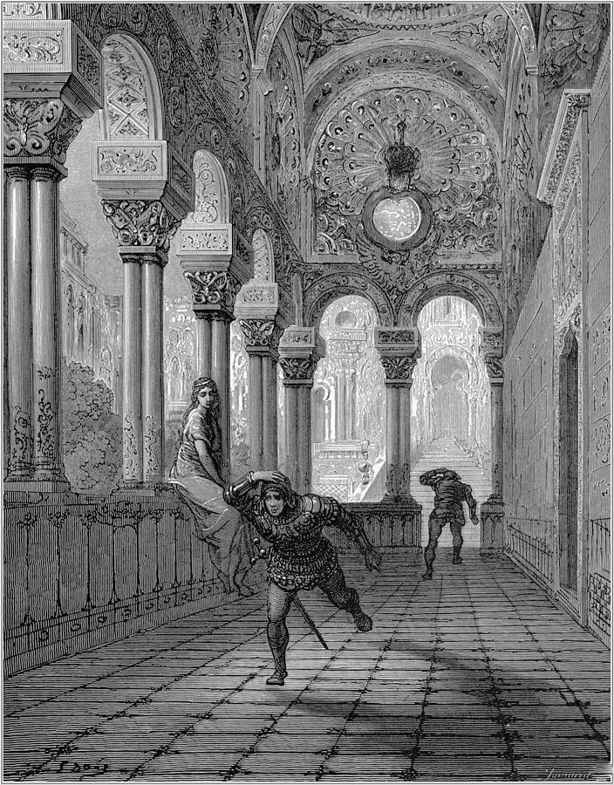
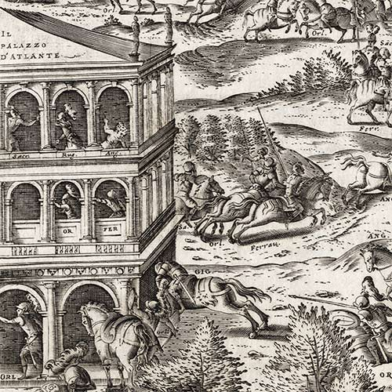
Orlando furioso (1556)
Gustave Doré, Illustrations for the Orlando Furioso (1879)

Slide 43
A Recent Interpretation…
https://operavision.eu/en/library/performances/flashback/le-palais-enchante-opera-de-dijon
https://www.youtube.com/watch?v=3NpD_Rr5Txc

