Slide 1
Theory Construction
2. Creative theorising.
The context of discovery.
Dina Abdelhafez
Notes:
Have you ever think about
Ask yourself
Why am I here in this faculty, what surprise you in the society and you want to study about or read, analyze and read more.

Slide 2
Overview of Lecture
Context of discovery and contexts of justification
Social observation
Heuristics

Slide 3
This week
R. Swedberg, The art of social theory, pp16-28.
Phase 1. The prestudy or early theorising (“context of discovery”)
Observe and focus on something interesting or surprising
Generate ideas that help you understand and/or explain the phenomenon
Think creatively and wildly (almost anything goes)
Phase 2. The main study (“context of justification”)
Turning early theories into research questions and designs
Execute the research, draw conclusions from your data and theorise again
Construct a fully-fledged theory of your phenomenon
Refute alternative explanations

Slide 4
Two phases in scientific research
J. Gerring (2012) Social Science Methodology. A Unified Framework, Cambridge: Cambridge University Press, pp27-36
“Broadly stated, the goal of science is to discover new things about the world and to appriase the truth-value of extant propositions about the world.”
Two phases
Discovery: “uncover new things”
Appraisal: “test theories”
Notes:
Find new interesting topic 1- discovery: the idea of science and the producing new knowledge, how to come up with new knowledge, to get inside research that we do not yet know about.
2- appraisal: Test the new finding or theories through the hypothesis

Slide 5
Discovery
Context of discovery: to contribute something novel
Often exploratory, initial phases of research
Inherently anti-nomothetic (anarchic): “there is no systemetic procedure for discovering new things”
This phase is crucial to develop theoretical (scientific) insights…
Karl Popper: “Discovery contains an irrational element, or a creative intuition.”
Play with ideas, theorise wildly, use your imagination,…
Notes:
No book that learn you how to get new knowldegde

Slide 6
Discovery
Gerring puts a strong emphasis on innovation: contributing something novel
e.g. Democratization: “how and why do some states democratize, while others do not?”
Descriptive innovation: how can we conceptualise and measure democratisation?
Are there critical moments of transition?
A point of consolidation beyond which reversals are unlikely?
Are there distinctive sequences
Which subtypes exist? (illliberal democracy, electoral democracy, competitive authoritarianism,…)

Slide 7
Discovery
Gerring puts a strong emphasis on innovation: contributing something novel
e.g. Democratisation: “how and why do some states democratise, while others do not?”
Causal innovations:
Are certain authoritarian regime types more likely to democratise than others?
Does the existance of mineral wealth make democracy less likely?
Role of colonial experiences?
Economic development?

Slide 8
Appraisal
Rigorously testing theories
“The criterion of the scientific status of a theory is its falsifiability, or refutability, or testability” (Karl Popper) Falsification: it must be possible to test whether a theory is wrong or not…
Following rules and procedures
The domain of methodologists
e.g. Marxism and Freudianism as unscientific because these theories are difficult if not impossible to falsify…

Slide 9
Discovery and Appraisal
Popper saw them as perfectly complementary Yet there are irresolvable tensions between them…
“If one’s primary motivation is the discovery of new theories, then researchers must have latitude to propose broad and abstract theories without clearly testable hypotheses.” The theories they produce should be “open-ended”, surprising, original. They may not be “very convincing – though it may be provocative, and may lead, down the line, to more convincing demonstrations of truth.”
“Insofar as one’s primary motivation is to test the truth-value of an existing theory”, then the “theory should be framed in as precise a manner as possible”

Slide 10
Discovery and Appraisal
At some point theories ought to falsifiable. Yet many scientists differ on precisely when this should be…
Gerring: “good science must embrace both the goal of discovery and the goal of appraisal. One without the other is not serviceable. Indeed, science advances through a dialectic of these two broad research goals.”
Yet both require a different attitude, skills, ways of thinking and approaching your phenomenon…

Slide 11
Discovery and appraisal
Context of discovery
= ’the form in which thinking processes are subjectively performed ’ (Reichenbach)
Characteristic of initial phases of research
Finding an interesting preliminary research question
Finding a ‘puzzle’ + theory or idea about how to solve the puzzle
theoretical
explorative
Not systematic but rather making conjectures
In Kuhn’s terms: ‘revolutionary science’
Context of justification
= ‘ the form in which thinking processes are communicated to other persons’ (Reichenbach)
- Characteristic of later phases of research
- Empirically testing possible answers to a research question or puzzle
Systematic: general methods and procedures
Falsififiability as an ideal
Relying on as few theoretical assumptions as possible
In Kuhn’s terms: ‘normal science’
Notes:
Algemeen: The context of discovery = phase 1 (Prestudy); context of justification = phase 2 (main study)
But during the concrete research process, both phases are regularly alternated and can overlap
Thomas Kuhn: philosophy of science. Normal science: you go about and test things, you build up knowledge. You usually think within a paradigm. Paradigm = one particular way of looking at reality. We’ll see more about that later but good to have some idea.
Revolutionary science / context of discovery: when these paradigms are disputed.
E.g. people long thought that the earth was the centre of the universe. When this shifts ~ is a paradigm that is created…
Eg. Thinking of magnetic fields rather than gravity…

Slide 12
Doing research
How does this phenomenon work?
We often think that all research starts with a research question, which you than try to solve…
Early theorising
Broadening up
Literature Design Data analysis writing
RQ Data collection Back to lit.
Formal theorising
Narrowing down
But in reality, the fully developed research question often becomes clear only after a long process, sometimes even at the end of the research…
Explaining how this phenomenon works

Slide 13
A quick reminder
Everything starts with the sociological imagination
How does this work? What is social about it?
What are its causes and its consequences?
How does it change over time, and why?
Why is it socially significant?
“social phenomena”, or finding a link between :
the personal and the public
biography and history
troubles and issues…
See C.W. Mills, The sociological imagination, pp5-11

Slide 14
Social observation
R. Swedberg, The art of social theory, pp29-51.
“Theory construction”
1960s and 1970s in the social sciences to help make the social sciences more “scientific”
An attempt to make “theory” more systematic
Strongly focused on generating hypotheses and integrating hypotheses into a broader theory
… and its problems
Proceeds rather logically and mechanistically
Little built-in reflection for dealing with (unconscious) prejudices
Little room for detailed and nuanced observation
Little attention for the creative role of theory
Notes:
More systematic: following procedures, perceive theory construction as a method. As a “cookbook” version: you need to do this, then that, follow every step and the end product will be precisely what you expected it to be.
Also: very positivistic. Very quantitative. Aimed at constructing models or algebraic formula.
That’s not so much a problem. The problem was that it was quite separated from qualitative methods and from theory. And especially, that it was…

Slide 15
Social observation
Theory construction and its weaknesses
(formal) theory construction works best at the later stages of theorising, after the early phase of creative theorising (the context of discovery)
That is: when you already have a good idea of what you want to study, which explanation you want to test and how you will proceed

Slide 16
Social observation
So instead of engaging with formal theory construction at once, you need a first phase, where you open up your mind to explanations and cases you would not necessarily expect to be important…
In this early phase, Swedberg suggests, to collect data from a broad range of sources (e.g. interviews, archives, newspapers, auto-biographies, data sets, dreams, films, music, personal experiences,…
Almost “anything goes”:
Dot not analyse or think too much, but observe: “Don’t think, but look!” (Wittgenstein)
Open your ears, your eyes, your mind,…
It has to be social data (something for which you need your sociological imagination)

Slide 17
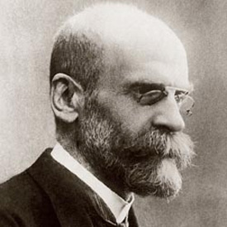
Social observation
Émile Durkheim’s basic rules of sociologisch research
“all preconceptions must be eradicated” (Durkheim)
You need to assume that ‘it is always different from what you think’ (Swedberg)
Look at the phenomenon you’re interested in with fresh eyes, as if you knew nothing about it

Slide 18
Choosing a topic to observe…
Something “interesting!”
Something that undermines what you and many other people take for granted
Finding out the facts of something that is widely discussed… (e.g. the causes of second generation immigrants’ employment rates…)
Your topic has to appeal to your curiosity…
Notes:
Can be difficult…
Important: for papers, for leeronderzoek, for seminars, for master theses…

Slide 19
Choosing a topic to observe…
Something “interesting!”
A problem…
Social scientists do not necessarily seek to find ready-made solutions for social problems, but they often try to contribute to understanding the causes and effects of those problems
Finding out what the problem actually is...

Slide 20
Choosing a topic to observe…
E.g. debates on headscarves…
Why is it perceived as a problem?
Because it is a religious symbol in public places?
Because it signifies a loss of identity?
Because it represses women?
What are the actual effects of disallowing headscarves on women’s lives?
And on social integration?
What is more interesting to study? The controversy? The social effect of wearing a headscarf? Or the social effect of a ban on headscarves?

Slide 21
Choosing a topic to observe…
Something “interesting!”
A problem
Surprise!
Contradicts your presuppositions, or what the scientific literature would suggest
Durkheim: “all preconceptions must be eradicated”
Notes:
If you feel surprised the first time you think of that explanation, and if you continue to be surprised by what it means over time, then you’re probably on the right track…

Slide 22
Observing
In the first phase you observe broadly and you describe what you see, hear, sense, smell and taste…
Until you stumble upon something interesting, problematic or surprising: that’s what you need to study in your research…
Unfortunately, this also means that you won’t be able to do something with a lot of the creative theorising and observing you have done in the early phase… So narrowing down afterwards is a big part of the work!

Slide 23
Observing
In statistics
Explore which types of data are (not) available, and which would be most interesting
Explore possible connections without delving deeply into theory and method…
In (qualitative) fieldwork
Everett C. Hughes: you need to see (and hear) for yourself
E.g. if you want to study elites, go to places where the elite gather (luxury hotels, golf resorts, charity parties,…) and talk to them
You do not need formal interviews per se, as lang as you listen and see for yourself…
Notes:
Centre for social policy here at the university: almost exclusively quantitative scientists, a lot of economists as well. Most of them are researching poverty or social policy in general. at least once a year, they used to visit local social organisations and take a guided walk in the neighbourhood. It’s something, it’s important, it’s healthy. Make sure you do not only see your phenomenon through the eyes of a pure scientist.
Or e.g. refugees: visit asylum centres, go to events that are organised. Not necessarily as data that will later be central in your work, but just to get some feeling, some sensitivity of the social milieux you are studying.

Slide 24
Observing
In this phase: you (temporarily) ignore the existing literature
You see, hear and feel for yourself
After that you think about possible explanations by yourself
Then you go back to the literature of course

Slide 25
3. Heuristics
After observing, comes the initial, early theorising…
Heuristics: tricks to help you think/theorise…
Gerring: social scientists need to “contribute something novel”, and hence need to come up with innovative, different explanations…
abbott: “rules for coming up with new ideas”
Notes:
Heuristics as short-cuts etc…

Slide 26
3. Heuristics
A. abbott (2004) Methods of Discovery. Heuristics for the Social Sciences, New York: Norton, pp. 113-146.
J. Gerring (2012) Social Science Methodology. A Unified Framework, Cambridge: Cambridge University Press, pp. 38-57
Firebaugh, G. (2008) Seven Rules for Social Research, Princeton: Princeton University Press, pp. 8-13.
Ragin, C. and Amoroso, L (2010) Constructing Social Research. The Unity and Diversity of Method (2nd edition), Pine Forge Press, pp. 63-68.
Notes:
Gerring is more positivistic. Which means that his idea of doing research is more linear. You start by reading the literature, than trying to come up with new ideas.
That is indeed one, very legitimate way of working. Yet it is not the only one, and in this course we do emphasise to learn to think by yourself, even before doing a systematic literature review. That is, in the first, creative phase, you do need to read (academic) literature. But you do not necessarily conduct a systematic literature review.

Slide 27
3.1 In and out of your comfortzone… (Gerring)
Begin where you are
Many research projects emerge from personal experiences or the experiences of friends and family members (e.g. discrimination, violence, addiction, health, alienation, individualism, friendship,…)
Or from particular ideas (e.g. a sense that something is wrong with the world…)
This helps to make you think of something that may be interesting to others (lay persons)
And it may help you to get a more intimate sense of what is happening
Notes:
e.g. my own research: emerged from being interested in the simple fact that we are continuously confronted with bad news on the rest of the world. On famines, violent repression, terrorism, war, refugees, poverty, exploitation…
And yet most of the time we simply swipe it away on our smartphones. How did this happen? How is it, that we have become so used and indifferent to the continuous flow of bad news on the rest of the world… Is not so much a matter of this is all bad and I will change it. Honestly, more of a personal fascination: how is this possible?
Hence I began to research: indifference towards the Syrian refugee crisis. That was in 2012, 3 years before the big asylum crisis in Europe. Began to research how journalists dealt with those situations, how social workers did, etcetera…

Slide 28
3.1 In and out of your comfortzone… (Gerring)
Get out of your comfort zone!
Pay attention to excluded groups or groups that are rarely researched (e.g. elites)
A good ethnography renders the exotic familiar or the familiar exotic
Try to think like a total stranger when approaching a seemingly obvious topic (e.g. food)
e.g. try to innovate by crossing disciplines, theories and methods,…
Try to assemble knowledge of different social participants, also those with less status or power
Notes:
Academic researchers have a specific social background. If they would restrict themselves to topics drawn from personal experience, little attention would be be paid to social worlds which remain invisible and inaccessible to them.
Many of the works that we regard today as path-breaking have been the product of exotic encounters across fields and subfields. So, try reading inside and outside your area of training.

Slide 29
3.2 Use a metaphor/analogy (Gerring/abbott)
Using analogies means truly changing the terms of analysis
Think about everyday social interaction as if it is a theatrical performance (Goffman)
e.g. frontstage vs backstage…
E.g. acting as a social actor, playing your (scripted) role
Think about society as if it is an organism
e.g. society needs to be “integrated”
The economic analogy
e.g. Gary Becker, economics of marriage, intimate relations
Think about the city or organizations as an ‘ecological system’ (Park & Burgess)
E.g. different places with each having a different function, different system of communication, of mobility,…
Notes:
Becker: economic model to family planning: to look atk the decision of having children in the same way as the decision to buy hamburgers…
e.g. close similarity between schools, prisons and mental hospitals…
e.g. Mary Douglas Purity and danger: bodily fluids like mucus and blood cross boundaries in the same way as spiders do… (symbolic pollution, in between categories…)

Slide 30
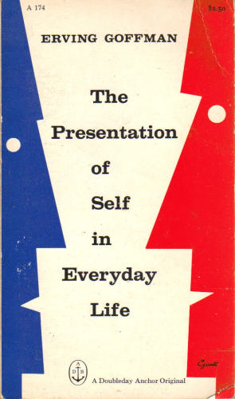
3.2 Analogies and metaphors…
Using analogies means truly changing the terms of analysis
E.g. Think about everyday social interaction as if it is a theatrical performance (Goffman)
Frontstage vs backstage…
Acting as a social actor, playing your (scripted) role
Managing the self (o.a. Facebook)
Think about society as if it is an organism
e.g. society needs to be “integrated”

Slide 31
3.2 Analogies and metaphors…
Using analogies means truly changing the terms of analysis
The economic analogy
e.g. Gary Becker, economics of marriage, intimate relations
Think about the city or organizations as an ‘ecological system’ (Park & Burgess)
E.g. different places with each having a different function, different system of communication, of mobility,…
Mary Douglas, Purity and Danger
Notes:
He gave example for university education as a market product that attract students. economics of marriage: people is educated in uni to get married to uni grads

Slide 32
3.2 Analogies and metaphors…
However: something may be lost in analogies though…
e.g. Talcott Parsons analyzed power as money
It worked to analyse some thing (scarcity of resources, supply and demand, assets, markets,…)
Yet it left out questions of who gets what, why, when and how. And it are precisely these questions that are central to power.

Slide 33
Example for Talcott Parsons
Parsons’s discission of power is largely directed towards meeting what he sees as major flaws in the' traditional' view of power as embodied in 'coercion theory' (or' zero-sum' theory).But his treatment of power is at least as partisan as the view which he wishes to replace. Parsons deals with the main points at issue between integration and coercion theorys implyby setting most of them as ideas of little importance, or by ignoring them altogether. While his new conceptualization of power makes his treatment of the subject more consistent with his general social theory, it draws his position even further away from coercion theory. Thus, he focuses on the nature and sources of power in society which is money in his opinion.

Slide 34
Example for Talcott Parsons…Cont’d
Power Parsons proposed, can be seen as being 'generated' by a social system, in much the same way as wealth is generated in the productive organization of an economy.
Mills's thesis, Parsons argued, gains weight from a 'misleading and one-sided’ view of the nature of power, which Parsons labeled the' zero-sum' concept of power. That is, power is conceived to be possessed b y one person or group to the degree that it is not possessed by a second person or group over whom the power is wielded. Power is thus defined in terms of mutually exclusive objectives, so that a party is conceived to hold power insofar a s it can realise its own wishes at the expense of those of others. In terms of game theory, from which the phrase 'zero-sum' is taken, to the degree that one party wins, the other necessarily loses. According to Parsons, this tends to produce a perspective from which all exercise of power appears as serving sectional interests. Parsons then went on to suggest that power is more adequately conceived by analogy with a non zero-sum game: in other words, as a relation from which both sides may gain

Slide 35
Example for Talcott Parsons…Cont’d
Power is conceived by Parsons as a 'circulating medium' in the same sense, 'generated' primarily within the political subsystem as money is generated in the economy, but also forming an 'output’ into the three other functional subsystems of society. Power is defined, therefore, as 'generalized capacity to serve the performance of binding obligations by units in a system of collective organization when the obligations are legitimized with reference to their bearing on collective goals’. By 'binding obligations’ Parsons means the conditions which those in power, and those over whom power is exercised, are subject to through the legitimation which allows them that power; all power involves a certain 'mandate', which maybe more or less extensive, which gives power-holders certain rights and imposes on them certain obligations toward those who are subject to their power.

Slide 36
3.2 Analogies and metaphors…
Partly depends on your personality: you need to make rash connections…
But you can cultivate the ability to make analogies as well…
Read broadly, beyond social science: many innovators in sociology were also trained in different disciplines (e.g. biology, economics, law, history, literature,…)
Notes:
Weber: law; Simmel, philosophy; Marx of course politically active;
Lewis Coser: studied literature first…
Perhaps most compelling example is Richard Sennett. Writes really well, interesting stuff. Corosion of character, the loss of craftsmanship, loss of public life… used to play cello. Injury with his hand forced him to stop.

Slide 37
3.2 Analogies and metaphors…
It is possible that you use your analogies to think and even to analyse your data, while you do not necessarily use the analogy in your final writing…
e.g. blowing bubbles…
Notes:
Blowing bubbles. Metaphor that is often used: to designate we all live in our small bubbles, not coming out of it.
Used it to analyse moral relations between different Belgian journalists, social workers, activists, students and Syrian refugees. Helped me to analyse that you find a more personal, more intese relation going beyond institutions.
Yet I could not really use the metaphor in academic articles, because it would take me too much words to explain the metaphor properly…

Slide 38
3.3 Problematising the obvious (abbott)
Well accepted and carefully tested ideas are sometimes profoundly wrong
e.g. university may not be just for education…
E.g. Fogel & Engerman succesfully attacked the standard idea that Southern slave agriculture in the US was economically inefficient
e.g. Fischer, To Dwell Among Friends: people in cities are not more isolated than people in rural settings…
e.g. Latour and Woolgar: doing an ethnography of life in scientific laboratory
Notes:
Suppose the function of education is to save marriages by getting cranky adolscents out of the house; lowering youth unemployment by keeping millions of young people out of the labour market; providing a supportive environment in which young people can experiment with erotic and emotional relatinships…
Fischer: kinds of people they know are different: more likely to be friends and peers, rather than family…

Slide 39
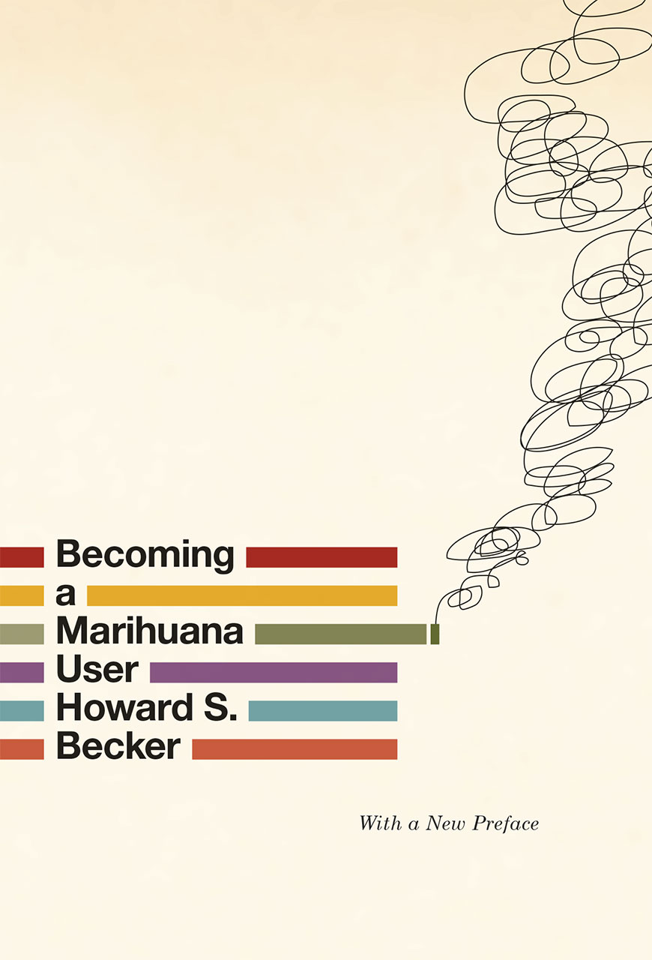
3.4 Reversing theories or concepts
e.g. e.g. college may prevent education, rather than produce it…
e.g. Granovetter: “the strength of weak ties”
E.g. Herbert Gans, The positive functions of poverty
e.g. Becker’s ‘Becoming a Marihuana user’ reverses conventional vision on ‘deviant behaviour’ “Instead of deviant motives leading to deviant behaviour, it is the other way around; the deviant behaviour in time produces the deviant motivation”
Notes:
Gans begint met de economische functies van de armoede. Een markteconomisch systeem dat op vrije mededinging is gebaseerd, steunt voor een groot deel op de aanwezigheid van armen. Zij leveren de laagbetaalde arbeidskrachten die, omdat ze weinig keuze hebben, tegen doorgaans lagere lonen het vuile en gevaarlijke werk opknappen. Zonder handlangers, onderhoudspersoneel of vuilnisophalers zou onze economie niet kunnen draaien.
Een andere economische functie is dat mensen in armoede tweedehandsgoederen kopen of woningen van mindere kwaliteit huren die anders ongebruikt blijven en dat ze een beroep doen op dienstverleners die anders zonder werk dreigen te vallen, zoals incompetente artsen en slinkse advocaten.
Daarnaast zijn er beroepen en diensten die bestaan bij de gratie van armoede: sociale werkers, bijstandsadministraties, voedselbanken, maar ook pandjesbazen. Sommige beroepen en instellingen worden dan weer ingezet om hen van de rest van de samenleving af te schermen, ja tegen hen te ‘beschermen’: politie en gevangenissen.
De armoede heeft ook sociale functies, hoewel die op het eerste gezicht minder duidelijk zijn. Ze fungeert als opgestoken vinger: hard werken en spaarzaamheid worden het best in ere gehouden en luiheid loont niet. Het hoeft niet dat wie arm is, ook spilziek of lui is opdat deze functie inderdaad wordt vervuld; het volstaat dat ze zo worden gezien door de rest van de bevolking. Een treffende illustratie van het theorema dat zegt: wanneer mensen een situatie definiëren als werkelijk, dan wordt die situatie ook werkelijk ook in zijn gevolgen.
Tenslotte verschaft de armoede aan de niet-armen een moreel referentiepunt. Liefdadigheid laat de hogere klassen toe om zich ook de betere klasse te voelen en neer te kijken op wie in armoede leef
People who do such emotion work try to produce the proper emotions in others (flight attendants, bill collectors, and others)
Becker: ambiguous physiological experience. People did it first, before they got to learn to think of the loss of control they experienced as a pleasant experience, rather than a confusing or a frightening one… Hence behaviour came first, and motivation after.

Slide 40
The positive functions of poverty Herbert Gans
First, the existence of poverty ensures that society's "dirty work" will be done. Every society has such work: physically dirty or dangerous, temporary, dead-end and underpaid, undignified and menial jobs. Society can fill these jobs by paying higher wages than for "clean" work, or it can force people who have no other choice to do the dirty work - and at low wages.
Second, because the poor are required to work at low wages, they subsidize a variety of economic activities that benefit the affluent. For example, domestics subsidize the upper middle and upper classes, making life easier for their employers and freeing affluent women for a variety of professional, cultural, civic and partying activities.
Third, poverty creates jobs for a number of occupations and professions that serve or "service" the poor, or protect the rest of society from them.
Fourth, the poor buy goods others do not want and thus prolong the economic usefulness of such goods - day-old bread, fruit and vegetables that otherwise would have to be thrown out, secondhand clothes, and deteriorating automobiles and buildings. They also provide incomes for doctors, lawyers, teachers, and others who are too old, poorly trained or incompetent to attract more affluent clients.

Slide 41
The positive functions of poverty Herbert Gans
Fifth, the poor can be identified and punished as alleged or real deviants in order to uphold the legitimacy of conventional norms.
Sixth, and conversely, the poor offer vicarious participation to the rest of the population in the uninhibited sexual, alcoholic, and narcotic behavior in which they are alleged to participate and which, being freed from the constraints of affluence, they are often thought to enjoy more than the middle classes.
Seventh, the poor also serve a direct cultural function when culture created by or for them is adopted by the more affluent. The rich often collect artifacts from extinct folk cultures of poor people; and almost all Americans listen to the blues, Negro spirituals, and country music, which originated among the Southern poor.

Slide 42
The positive functions of poverty Herbert Gans
Eighth, poverty helps to guarantee the status of those who are not poor. In every hierarchical society, someone has to be at the bottom; but in American society, in which social mobility is an important goal for many and people need to know where they stand, the poor function as a reliable and relatively permanent measuring rod for status comparisons.
Ninth, the poor also aid the upward mobility of groups just above them in the class hierarchy. Thus a goodly number of Americans have entered the middle class through the profits earned from the provision of goods and services in the slums, including illegal or nonrespectable ones that upper-class and upper-middle-class businessmen shun because of their low prestige. As a result, members of almost every immigrant group have financed their upward mobility by providing slum housing, entertainment, gambling, narcotics, etc.

Slide 43
Tenth, the poor help to keep the aristocracy busy, thus justifying its continued existence. "Society" uses the poor as clients of settlement houses and beneficiaries of charity affairs; indeed, the aristocracy must have the poor to demonstrate its superiority over other elites who devote themselves to earning money.
Eleventh, the poor, being powerless, can be made to absorb the costs of change and growth in American society.
Twelfth, the poor facilitate and stabilize the American political process. Because they vote and participate in politics less than other groups, the political system is often free to ignore them.
Thirteenth, the role of the poor in upholding conventional norms (see the fifth point, above) also has a significant political function.

Slide 44
3.5 Describe your phenomenon differently… (abbott)
Changing context
Switching foreground and background
E.g. Arlie Hochschild has influenced study of emotions by treating emotional life no longer as a context for something else (work place) (e.g. differences between formal and informal organisation) but as a part of work itself (‘emotion work’)
Changing levels (macro and micro)
E.g. Saskia Sassen’s work on ‘The global city’ holds that the structure of certain primate cities (New York, London, Tokyo) is determined by their position in global economic networks
Notes:
Are there parts of your phenomenon that you are treating as background that could become foreground, or vice versa?
Sassen: these global cities serve as centers for product in the global economy (law, accounting, banking, insurance). That is what gives them their structure, rather than locality
Or reversely: that each city is unique, and that you need to focus on precisely what is distinctive and local about (smaller) cities to understand them.

Slide 45
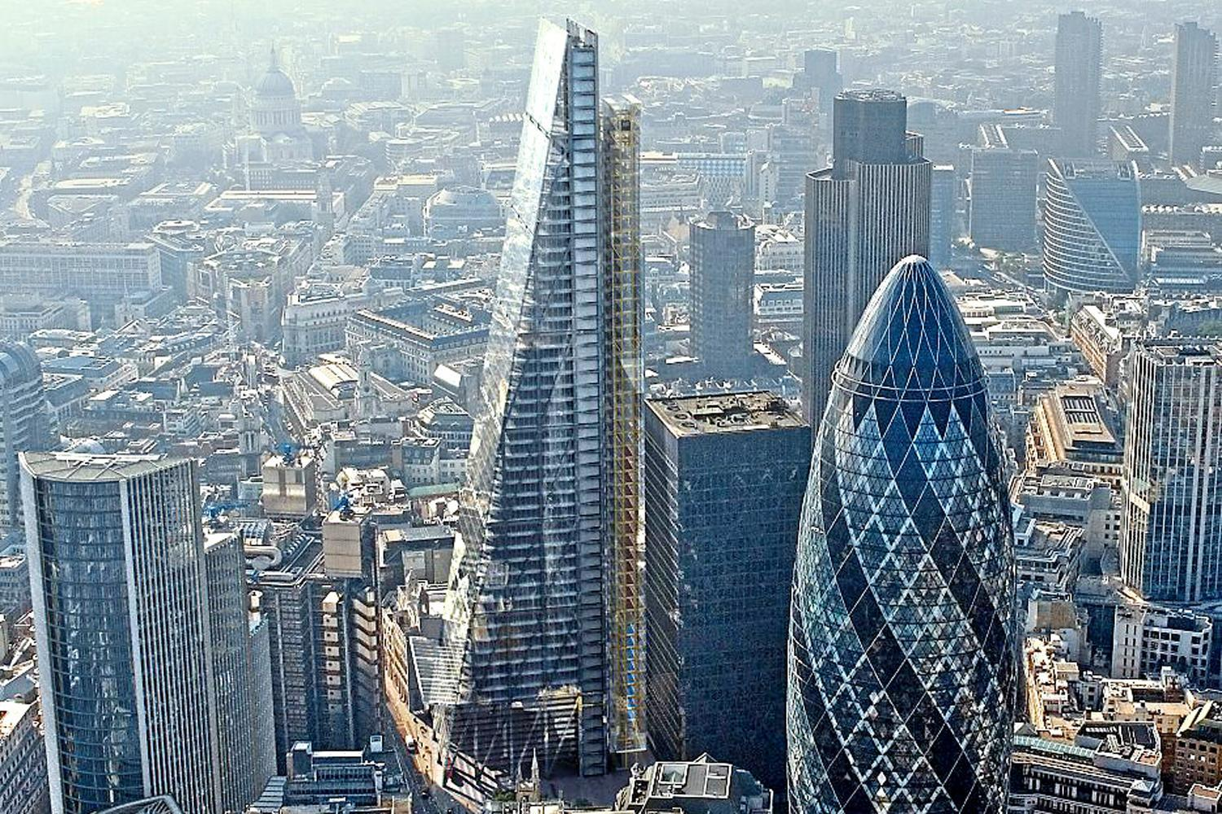
3.5 Describe your phenomenon differently… (abbott)
Lumping and splitting
E.g. Sassen: drawing the differences between global cities vs other cities to an extreme
E.g. Norbert Elias: took all kinds of subjects as an indication of a “civilizing process” (table manners, nose blowing, spitting, bedroom behaviour,…) which he connected to the formation of nation states…
Notes:
Both are exaggerations. But both help us to see connections and differences between things. To see us that there are things that do distinguish global cities from other cities, although the differences may not be that extreme.
And similarly, it may point to a similar tendency across a wide range of behaviours, even though there may actually be a lot of differences between them.

Slide 46
3.6 Static and dynamic (abbott)
Putting things in motion
Static to dynamic
E.g. change in communities
Beyond cross-sectional analyses…
Or reversely: stopping the clock
Expand your analysis of the present
Notes:
Stopping the clock: expand upon the present context, embed it, analyse more fully…

Slide 47
3.7 Study the literature (Gerring, Firebaugh)
There is an extensive and long (sociological) literature about most topics. Every subject has an intellectual history!
What do we know already about the subject? Which issues are under-explored or badly understood? What questions have other authors left unanswered? What questions do you find yourself asking when finished reading?
A necessary, but insuffficient condition for finding a research question
Most recent work cannot be found in published articles or even books, but in conference (papers) and seminars
So your first recourse may be Google rather than JSTOR
Notes:
Gerring and Firebaugh are more positivistic. Which means that his idea of doing research is more linear. You start by reading the literature, than trying to come up with new ideas.
That is indeed one, very legitimate way of working. Yet it is not the only one, and in this course we do emphasise to learn to think by yourself, even before doing a systematic literature review. That is, in the first, creative phase, you do need to read (academic) literature. But you do not necessarily conduct a systematic literature review.

Slide 48
3.7 Study the literature (Gerring, Firebaugh)
When you go through the literature, be conscious of what excites you and what bothers you
Where do you think authoriative voices may be wrong?
What is missing, what is badly understood?
What questions do you find yourself asking after reading?
You can go back to the classics for inspiration
Be cautious for two common responses:
Worship the tradition
Summarily dismiss the whole tradition (do not reinvent the proverbial wheel)
Notes:
Classics: you can learn directly from them
You can use them as a source of suggestions for your own projects …
Warns you to not reinvent what has already been done…

Slide 49
3.7 Study the literature (Gerring, Firebaugh)
Challenging prior research (Firebaugh)
Clarifying concepts in prior research
Hence reduce the “fuzzyness” of earlier explanations…
E.g. link between crime and drugs can be better researcher if you link particular types of crime to particular types of drugs…
Extending prior research
Focus on a key subpopulation (e.g. is this finding the same for men as for women?)
Use a new population (e.g. study of youth employment in a particular city)
Use a different time period (e.g. positive association between marriage and happiness)
Notes:
Challenging prior research: actually refuting earlier researcher empirically. But is often not easily done. You have to show why earlier research is dubious + show why your explanation is better and works better empirically.

Slide 50
3.7 Study the literature (Gerring, Firebaugh)
Extending prior research
Focus on a key subpopulation or subtype
Use a new population
Use a different time period
Use a new population or subpopulation to test a specific hypothesis
Challenge the findings

Slide 51
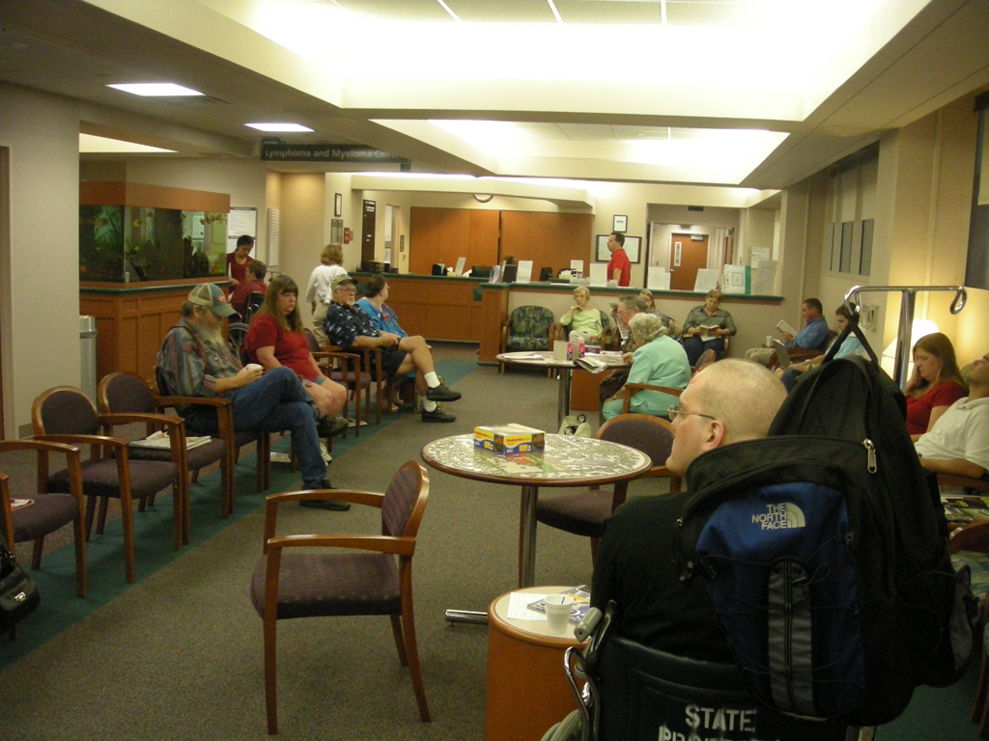
3.8 Reframe your phenomenon (Ragin & Amoroso) Non-interaction as a social accomplishment (Erving Goffman)
Notes:
Armed with the proper analytic frame – one emphasizing nonverbal communication – it is possible for researchers to see that the noninteraction is accomplished. Without this frame, it might appear simply that nothing is happening.
What is this a case of? What do you see? (waiting room/nothing happening). They do a lot of effort to avoid interaction. They turn their faces away from each other. Their noninteraction is intentional, and therefore a social accomplishment.
You can often see the same in coffee houses, or perhaps even beter, when you’re standing in a lift/elevator with someone.

Slide 52
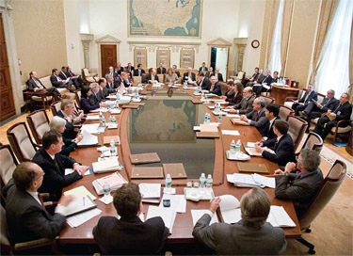
Using analytic frames in everyday life
Notes:
Analytic frames in everyday life: people claissfy and characterize the things around them.
They know how to distinguish between people standing around ina room and a party because they understand and can use the term party. They generally know wha tmakes a party fun.
They have an implicit analytic frame for parties. An analytic frame defines a category of phenomena and provides conceptual tools for differentiating phenomena within the category (more and less successfull; more and less formal).
The person who doesnot know wha ta party is, might not be able to tell the difference between a conference and a party. Both involve rooms full of people who are talking, at the same time, often without listening to each other, often with laughter, and so on.

Slide 53
3.7 Reframe your phenomenon (Ragin & Amoroso)
Analytic or theoretical frames
The process of using analytic frames to classify and characterize phenomena is carried out explicitly and formally in social research
Sometimes a researcher will study something because it is unclear what it is or how it should be characterized
E.g. civil support for refugees: a social movement? Social support organisations? A political movement?
E.g. what is the meaning of a wave of anorexia among young women ?
Notes:
Analytic frames is thus a way of seeing. You use it in everyday life, to understand what happens around you.
But it can also be important for social researchers – it can be a large part of what they do.
e.g. emerged hundreds of civil initiatives supporting refugees and newcomers. What is their nature? Are they social movements, like labour unions and pillars (zuilen)? Do they provide social support? Are they volunteer organisations? Are they part of the existing midfield? Are they a political movement

Slide 54
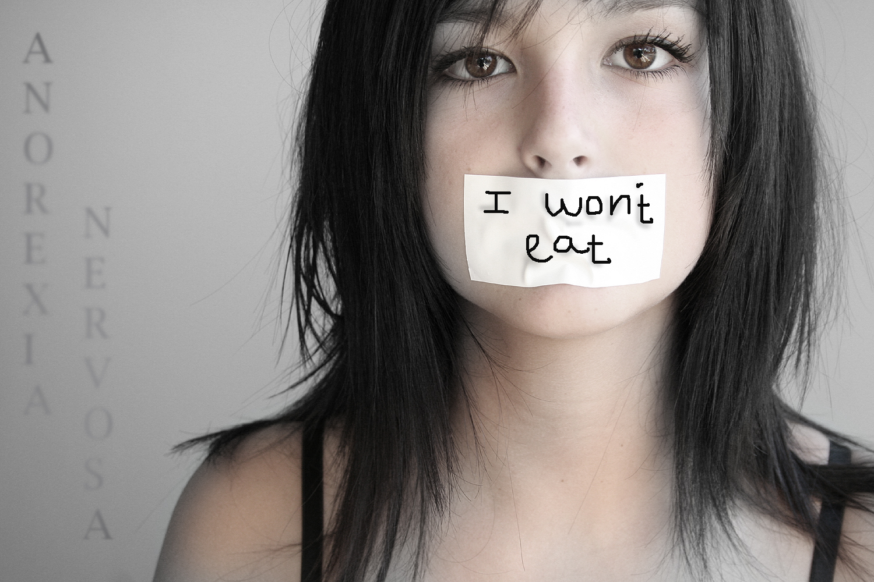
Anorexia Nervosa as a social phenomenon: which analytic frames work best?
A network response to ‘fashion’ and the increasing availability of diet instruments: teen girls are learning from each other to consume low-caloric, low-fat foods and diet pills?
An attempt to conform to contemporary bodily ideals promoted by media and advertising?
An emergent form of social protest against gendered body images? Opposing how the media put men and women in a position where they have to mould their appearances in accordance with a pre-established standard that is created with no consent of theirs
Notes:
Different analytic frames will lead to different views of anorexia as a cultural phenomena, a different way of breaking it into key components

Slide 55
Different frames lead to different ways of seeing, different ways of looking for evidence (cf. paradigms)
Network response : investigate whether anorexia is ‘epidemic’, is being diffused through social networks
Attempt to conform: investigate whether those with anorexia have much higher contact with cultural sources that promote weight-loss
Emergent form of social protest: investigate whether those with anorexia have negative or ambivalent attitudes towards the media
Two other examples (Ragin & Amoroso):
Act of voting as a calculation of individual gains and losses or as being influenced by the social networks one is a member of
Decision by same-sex couples to hold a commitment ceremony can be considered as a ‘political act’

Slide 56
3.8 Reframe your phenomenon (Ragin & Amoroso)
“By debating, using, and formalizing analytic frames, researchers are able to relate their work to that of other researchers and to general knowledge about social life from their separate, individual efforts” (Ragin, 65)
Most analytic frames are derived from social theory (or: by choosing a specific analytic frame you locate your research within a specific paradigm)
An analytic frame defines a category of phenomena (for example gatherings, parties) and provides conceptual tools for differentiating phenomena with the category
Without concepts or theoretical frames it can even become difficult observe anything at all

Slide 57
Two main components of frames: classify and characterise phenomenaanalytic
Frame by case
When researchers use concepts to classify the phenomena they study
f.i. by describing interaction in a doctor’s waiting room as ‘accomplished non-interaction’ the researcher answers the question ‘What is this a case of?’.
Researchers thus claim that the people or events they are studying are an instance, or ‘case’ of something wider and more important (bvb. Genocide in Darfur, Sudan as a case of ‘ineffective international intervention’)

Slide 58
Frame by case (what is this a case of?)
“A central aspect of the process of the music industry is how songs get adopted by radio stations. This is a special case of the general issue of how ideas and practices spread through social fields, which suggests the broader theoretical concerns of the book”
“This book’s substantive concern of how songs become hits on the radio is part of a more general class of problems in social science known as the diffusion of innovation. This literature covers a wide variety of substantive areas where actors within a population each decide if and when to adopt an innovation. The seminal studies in this field were about such eclectic phenomena as:
farmers in Iowa planting a new kind of corn
firms in heavy industry adopting various new production technologies
small-town doctors prescribing the antibiotic tetracycline
postwar households purchasing such appliances as televisions and washing machines”

Slide 59
Framing by Aspect
Once the ‘broader category’ that is relevant to an investigation is defined, one can specify the key features or aspects that differentiate the cases in this broad category.
In this way one indicates how cases vary within a category
f.i. how do people accomplish non-interaction in similar social settings (train, buses, swimming pools, etc.)? Which verbal en non-verbal cues are being used to communicate ‘non-involvement’? What features of settings influence which cues are being used and how they are used?
It helps you see what is present and absent in a given case
Notes:
Idea is that you can compare. E.g. includes coffee houses, airports, buses, elevators, waiting rooms, barsr,…
Sometimes people are spread out and can move about (airport), sometimes they are tightly packed (plane).
Some spaces are closed (buses), some are open (parks).
In each, you will probably have slightly different strategies to avoid contact with other people…

Slide 60
Next week (I)
Working seminar on “depression”
Interactive seminar on a phenomenon of your choice
Work on a draft of your first assignment by next week. We will use it in class to discuss your phenomenon in small groups

