Slide 1
Public Management for 21st Century
Vladimír Kváča, Ph.D. October 2022 – January 2023
#7 December 21, 2023

Slide 2
Outline for today:
Conclusion of Topic 6: New Synthesis, Metagovernance
Reading reflection
Recap of the key ideas
Q&A
Short break
Recap of the whole course
Q&A

Slide 3
Public Management for 21st Century
Topic 6: New Synthesis, Metagovernance and conclusions

Slide 4
Post-NPM debate
Post-NPM debate
Human Learning Systems
Other concepts…
New Public Governance
New Synthesis of Public Administration
Metagovernance
Similar solutions to similar problems,
overlapping, not mutually exclusive…

Slide 5
New Synthesis of Public Administration
Key author – Jocelyne Bourgon (Canada)
What are your key take-aways from the reading?

Slide 6
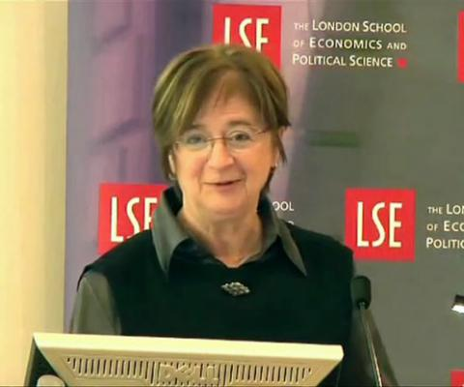
The Honourable Jocelyne Bourgon is President of PGI (Public Governance International) and President Emeritus of the Canada School of Public Service. She is also a Distinguished Research Professor at the University of Waterloo.
Madame Bourgon has had a distinguished career in the Canadian Public Service. She served as Deputy Minister of several major departments. She also served as Secretary to the Cabinet for federal provincial relations and later as Clerk of the Privy Council (head of the Canadian civil service) and Secretary to the Cabinet for five years.
She served for eight years as member and President of the UN Committee of Experts in Public Administration. She was President of the Commonwealth Association for Public Administration and Management (CAPAM) for four years and is credited with creating a Network of Training and Development Institutes across the Commonwealth. She was Canada’s Ambassador to the Organisation for Economic Co-operation and Development (OECD) from 2003-2007.
Madame Bourgon has published extensively on the subject of public administration. In 2008, she received the Sam Richardson Award for her article entitled “The Future of the Public Service: A Search for a New Balance.” as the most influential article published in a volume of the Australian Journal of Public Administration. Additionally, her article entitled “Responsive, Responsible and Respected Government: Towards a ‘New’ Public Administration Theory” was the most frequently cited article in the International Review of Administrative Sciences in 2007 and, as of February 2011, was the eleventh most cited article in the history of the journal.
She has been awarded the Public Service Outstanding Achievement Award (1999), the Order of Canada (2001) and the Ordre de la Pléiade (2001).
New Synthesis World, a network starting with 6 countries,
including 2 EU ones (Netherlands and UK) and Brazil,
Singapore, Australia and Canada.

Slide 7
My take aways from readings Shifts in governance ideas as a basis
closed vs open systems
silo thinking unable to create cross-cutting responses to issues that do not fit in these silos
resistance to change versus innovation
consensus based approaches that are suitable for processing and delivering on already known, agreed and well-defined issues within the comfort zone…
…create rigidity in the face of ever-faster change and not easily definable policy issues that require exploration
government “to you” versus “with you”
helpless, incapable service users versus co-producing political citizens
accountability lies only with government versus shared with others:
from direct public service delivery to indirect tools (grants, loans, insurance, transfers to other levels of government, tax credits)
J. Bourgon, A new synthesis for public administration

Slide 8
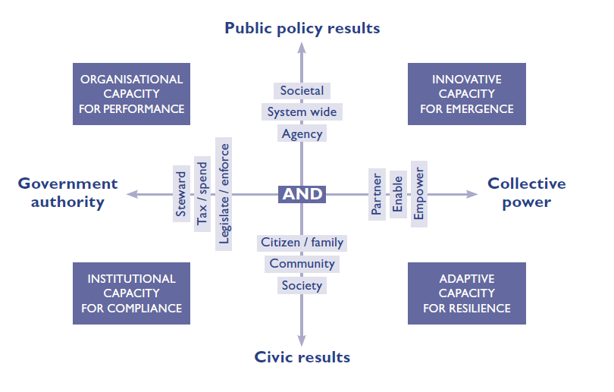
New Synthesis approach
Public management is about the “AND”:
in terms of performance:
“traditional” results (outputs, outcomes)
civic results
in terms of the use of power:
government
collective
J. Bourgon, A new synthesis for public administration

Slide 9
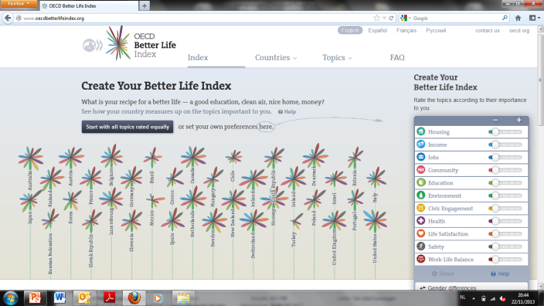
Need to work on BOTH!
OECD Better Life Index: requires ALL societal actors
traditional basis for accountability in the sense of achieving and improving efficiency
public purpose, that extends beyond the walls of the organisation and the programmes and services they administer and requires to work with other public organisations (eg within the health system, the education system, etc.)
active citizenry, resilient communities and a civic spirit conducive to collective action builds the social capital that contributes (next to other forms of capital) to overall performance of a society. Achieve by improving access, allow stronger voices and give greater choice.

Slide 10
New Synthesis approach
Public management is about the “AND”:
in terms of performance:
“traditional” results (outputs, outcomes)
civic results
in terms of the use of power:
government
collective
J. Bourgon, A new synthesis for public administration

Slide 11
Government as primary agent in serving the public good and defining the collective interest, operates without much interaction, within the limits of their mandate and with instruments and resoures granted to them.
Equitable risk/reward sharing in delivery
Allow people to exercise power and mobilise into action
Support innovation of others, co-create and co-produce
Government as steward is monitoring, anticipating and introducing corrective and
preventative measures when the collective interest demands it

Slide 12
Synthesizing is about creating the power of a narrative of change for a better future.
A narrative of change helps to reconcile aspirations for a better future and concrete actions through re-framing challenges to focus on societal as well as agency outcomes, through re-thinking issues to utilize the assets of other actors, and through re-creating policy responses by engaging society to enact sustainable change.
In synthesizing these approaches, practitioners can effectively re-design the narrative surrounding their policy challenge to illustrate the change they seek to effect

Slide 13
Lean and purposeful
Adaptive
Honest and fair
Robust and resilient
AND= New Synthesis

Slide 14
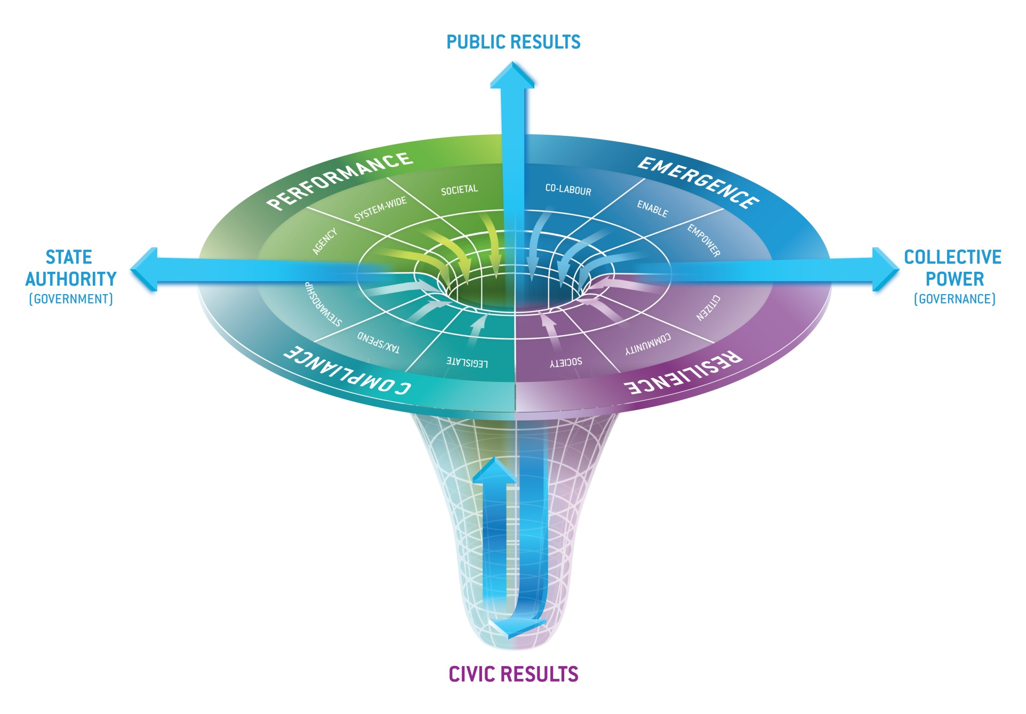
14
The NS Initiative – The Next Steps
“A reservoir of civic capacity and civic will to deploy it for collective problem-solving”
A well of Civic Capacity
Replenishing?
Spoiling?
Depleting?

Slide 15
Institutional capacity for compliance
Reflects the consitutions, conventions, rules and norms that govern how we live in society
includes public institutions that make and oversee the implementation of political decisions on behalf of society and the expectation that public office holders exhibit integrity and that there is due process
Audit, in terms of ensuring process controls, is a key component of this system.
set limits within which public office holders can exercise discretion
set the parameters of acceptable behaviour
must be objective, rule-based, enforceable and verifiable

Slide 16
Organisational capacity for performance
Converts purpose into action by combining authority, policy instruments, organisational capacities and public resources as well as public platforms of cooperation to achieve agency, system-wide and societal results
focused on making government more productive and efficient and pay attention to user satisfaction.
however, some reforms have led to an explosion of controls that are stifling innovative capacity crucial for dealing with complexity
input controls (constraining the nature of resources that can be used to fulfill a mission)
ex ante controls (obliging to get permission to use resources that were already allocated)
output controls where performance indicators were converted into performance targets in effect ceasing to be a source of information to actually improve results and leading to phenomena such as “hitting the target but missing the point”

Slide 17
Innovative capacity for emergence
anticipate and detect emerging issues and be pro-active in the face of imperfect knowledge in uncertain circumstances:
stimulate thinking about alternative futures and how to get there as well as detecting weak signals (scenarios, sensemaking,…)
no right (or wrong) way to divide powers and responsibilities in the face of complex, multifaceted, emerging issues and a diversity of dispersed networks
each new structure creates a new boundary to be crossed
rather ensure resources shared among government and external partners (memoranda of understanding, shared reporting on OECD Better life index regarding joint actions, mobility between units, HR focused on collaboration, attention to networking, collaboration budgets…)
support social experimentation (with incubators, hubs, easy to access funds, social media…)

Slide 18
Adaptive capacity for resilience
Resilience: “adaptive capacity of the system to resist/absorb external factors and persist”
in society this is built up via self-reliant individuals who have the ability to take charge of their lives and shape their futures
with a critical mass of such people, resilience is also developed as they work together and learn they can count on each other
this provides a basis for even greater capacity of communities to define issues, find solutions and act
these strong networks lift everyone up when times are good and reduce risks when times are rough
cannot be created by government…
but it has to avoid taking action that erodes natural resilience by creating dependencies or increasing vulnerabilities and it can nurture it by
building on strengths rather reinforce disempowering deficit thinking
using collaborative networks and citizen engagement in the design of public policies and programmes and ensuring that helping others is built into the service delivery system, deliberately creating active roles for citizens and communities (co-production).

Slide 19
New Synthesis approach
Find the mix that works in the given context
Market
Network
Hierarchy
J. Bourgon, A new synthesis for public administration

Slide 20
Metagovernance – Outline
Introduction/Recapitulation
(1) Why is metagovernance introduced?
(2) How is metagovernance performed?
(3) Who is metagovernor?

Slide 21
Metagovernance – Introduction
Governance = “the sum of relations and interactions in which public actors (such government and other public bodies) and private actors (such as private sector and civil society) participate, aiming at solving societal problems or creating societal opportunities, taking into account the institutions within which these governance activities take place.”
(Kooiman, 2003; Meuleman, 2008)

Slide 22
Metagovernance – Governance Modes/Styles
Governance style = “the processes of decision-making and implementation, including the manner in which the organizations involved relate to each other”
(Van Karsbergen and Van Waarden, 2004)
Governance style = “defines the roles and lines of responsibility of public sector and societal players in different ways: hierarchical, market and network governance”
(Meuleman, 2008)

Slide 23
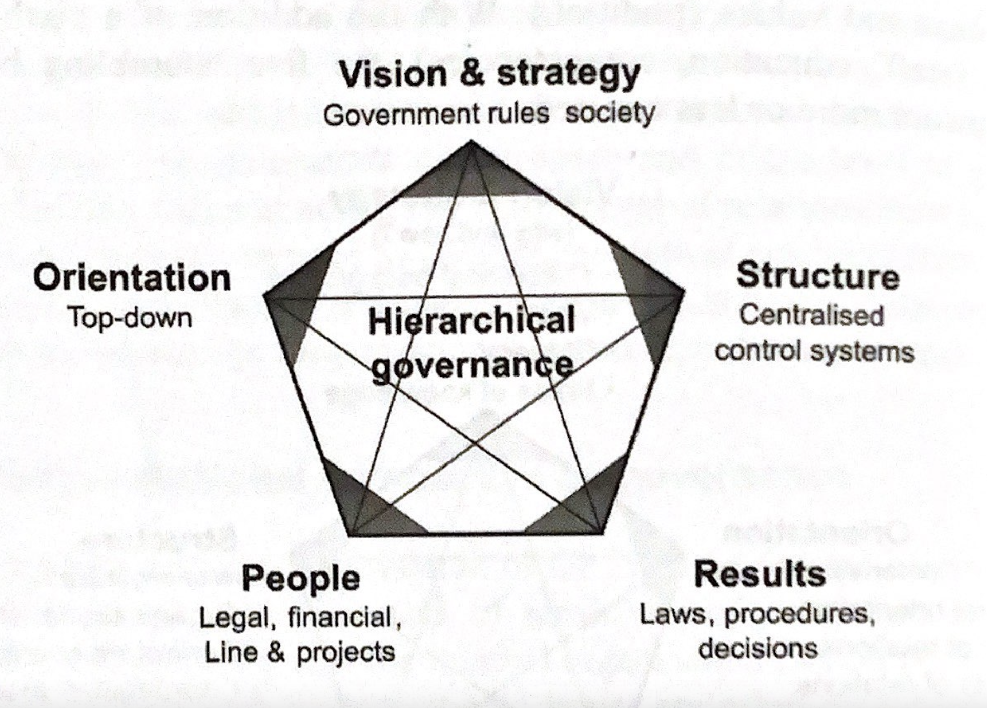
Metagovernance – Hierarchical Governance
Ideal type of bureaucracy
Max Weber, 1950s and 1960s
Ideas of efficiency ~ from mechanisation of the industrial revolution
Clear hierarchy relations and uniform rules
Defined division of tasks
Impersonal authority
Way for standardizing government tasks
Reducing complexity by splitting complex problems into smaller ones
For crisis management
Failures
(Meuleman, 2008)

Slide 24
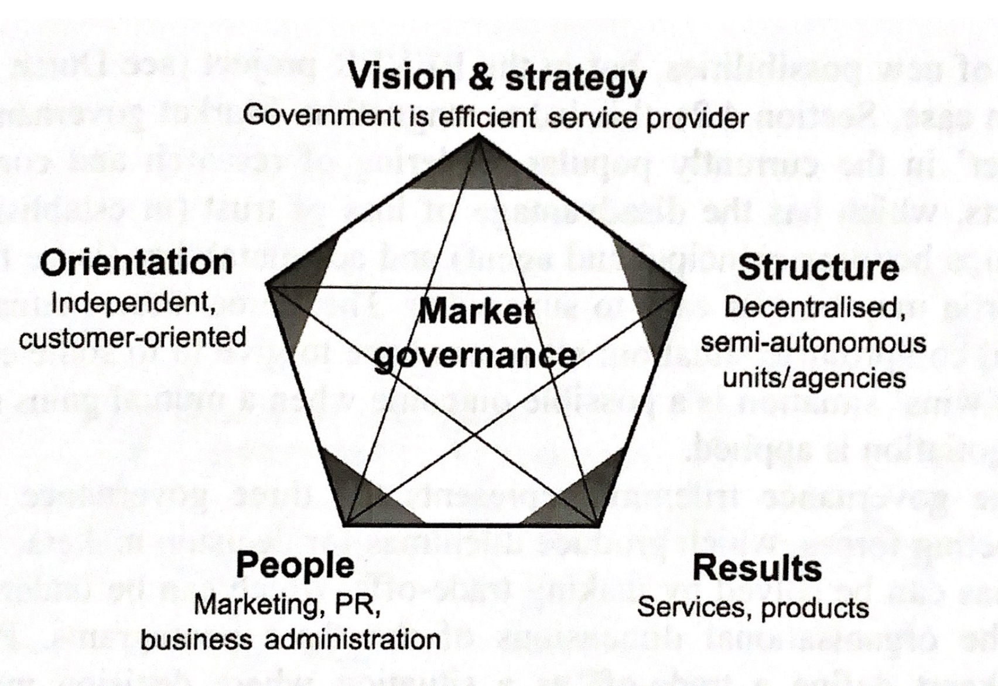
Metagovernance – Market Governance
Connected to market-oriented reform – New Public Management
1980s (time of recession)
Incorporation of efficiency principles, procedures and measures from the private sector
Customer orientation
Explicit standards and measures of performance
Greater emphasis on output control
Greater discipline in public-sector resource use
For routine issues
Failures
(Meuleman, 2008)

Slide 25
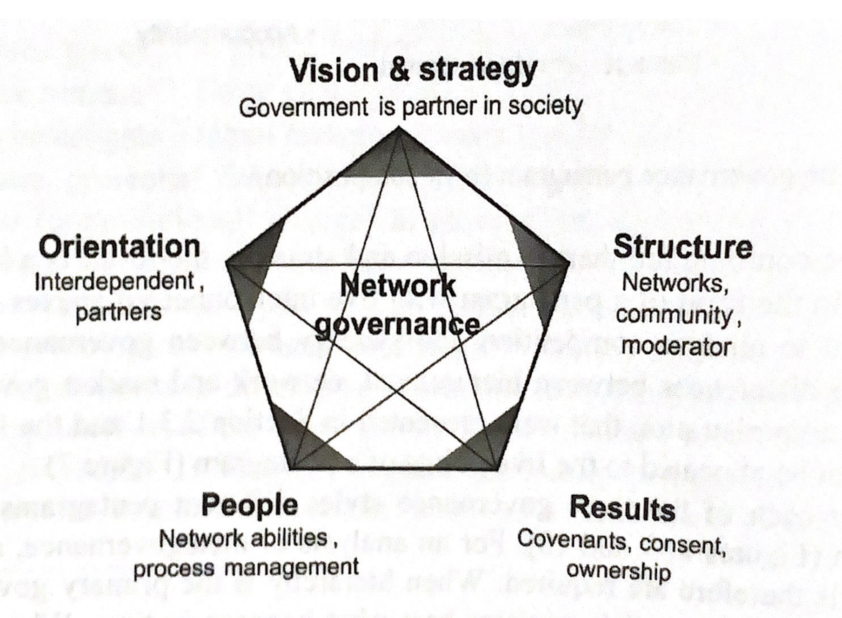
Metagovernance – Network Governance
Mainly in 1990s
Alternative to “top-down planning” and “anarchy of the market”
“management of complex networks, consisting of many different actors”
Mutual dependence of actors → sustainable relations between them
Complex policy process, not predictable (many involved actors)
Policy = result of complex interactions between actors
For “wicked” problems
Failures
(Meuleman, 2008)

Slide 26
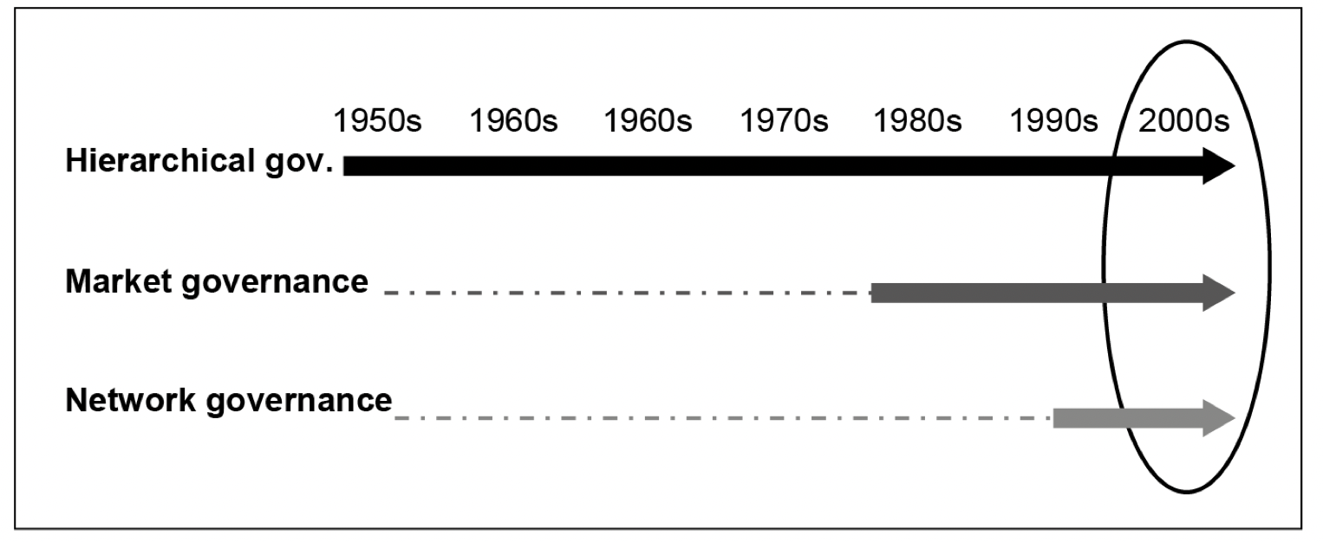
Metagovernance – Differences and Combinations
Each of the style is internally consistent (clear internal logic)
Mixture of them can produce variety of conflicts
Dependency vs. Independency vs. Interdependency
External governance-mixture conflict (administration and societal actors)
H vs. N
H vs. M
M vs. N
Complementarity
H vs. N
H vs. M
M vs. N
(Meuleman, 2008)

Slide 27
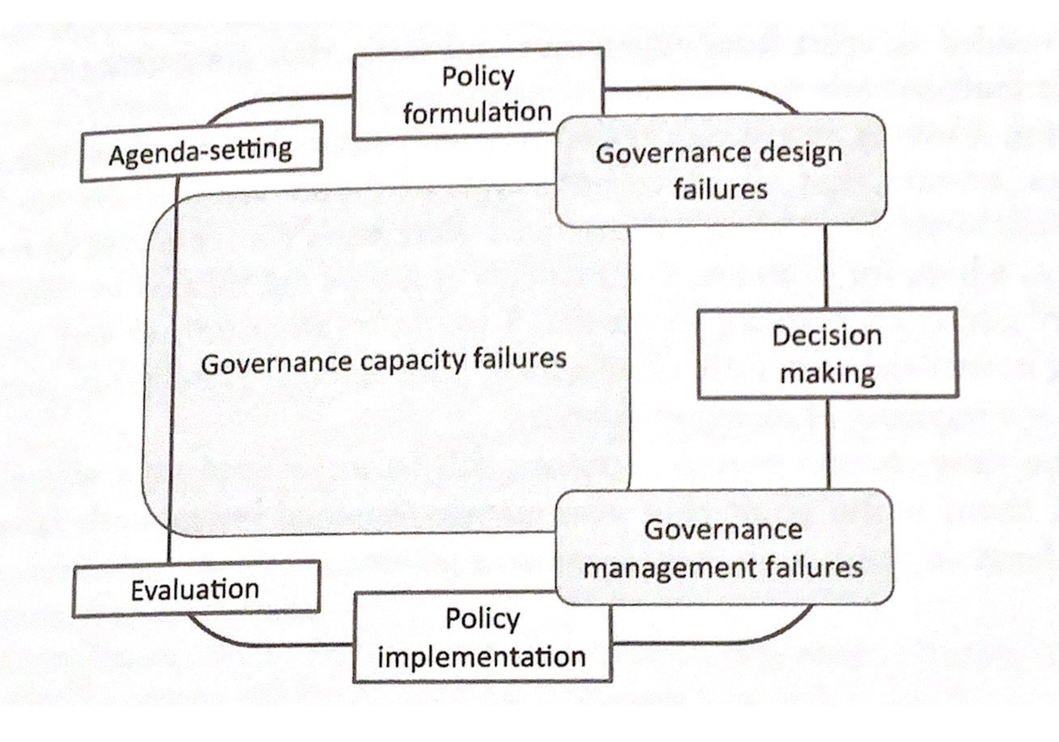
Metagovernance – Governance Failures
Governance failure occurrence in the policy cycle
Governance design failure
Mismatch of problem context and governance style
Governance management failure
Ineffective management of governance framework (e.g. lack of information, ability to make a good judgement)
Governance capacity failure
Mismatch of governance style and governance capacity
(Meuleman, 2018)

Slide 28
(1) Why Metagovernance?
Metagovernance = “means by which some degree of coordinated governance is produced, by designing and managing sound combinations of hierarchical, market and network governance, to achieve the best possible outcomes from the viewpoint of those responsible for the performance of public-sector organizations: public managers as metagovernors” (Meuleman, 2018)
Metagovernance = “a practice by (mainly) public authorities that entails the coordination of one or more governance modes by using different instruments, methods, and strategies to overcome governance failures” (Gjaltema et al., 2020)

Slide 29
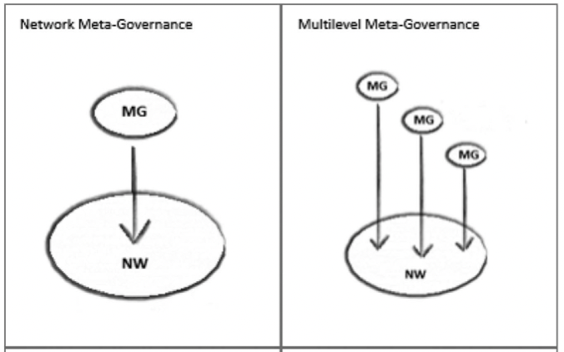
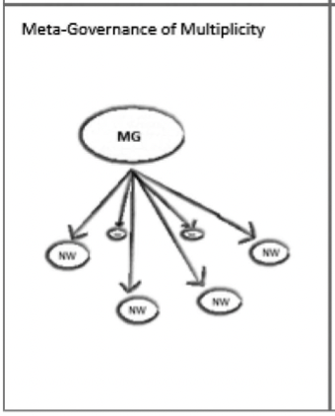
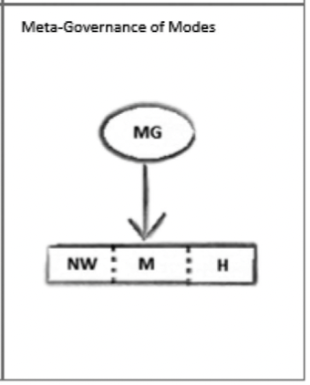
(2) How to Metagovern? Different Views
Dominant Network Governance
= “first-order metagovernance”
No Dominant Style of Governance
= “second-order metagovernace”
(Gjaltema et al., 2020)

Slide 30
Metagovernance – Network Types
Reaction to “hollowing out of the state” debate
State is still able to steer the networks
Metagovernance “brings government back in at the more central stage”
Most frequently identified type of metagovernance
Steering of governance networks
One metagovernor steers one network
Multiple metagovernors steer one network
One metagovernor steers multiple networks
Metagovernance provides means how to influence network governance
Combines “control and facilitation”
(Gjaltema et al., 2020)

Slide 31
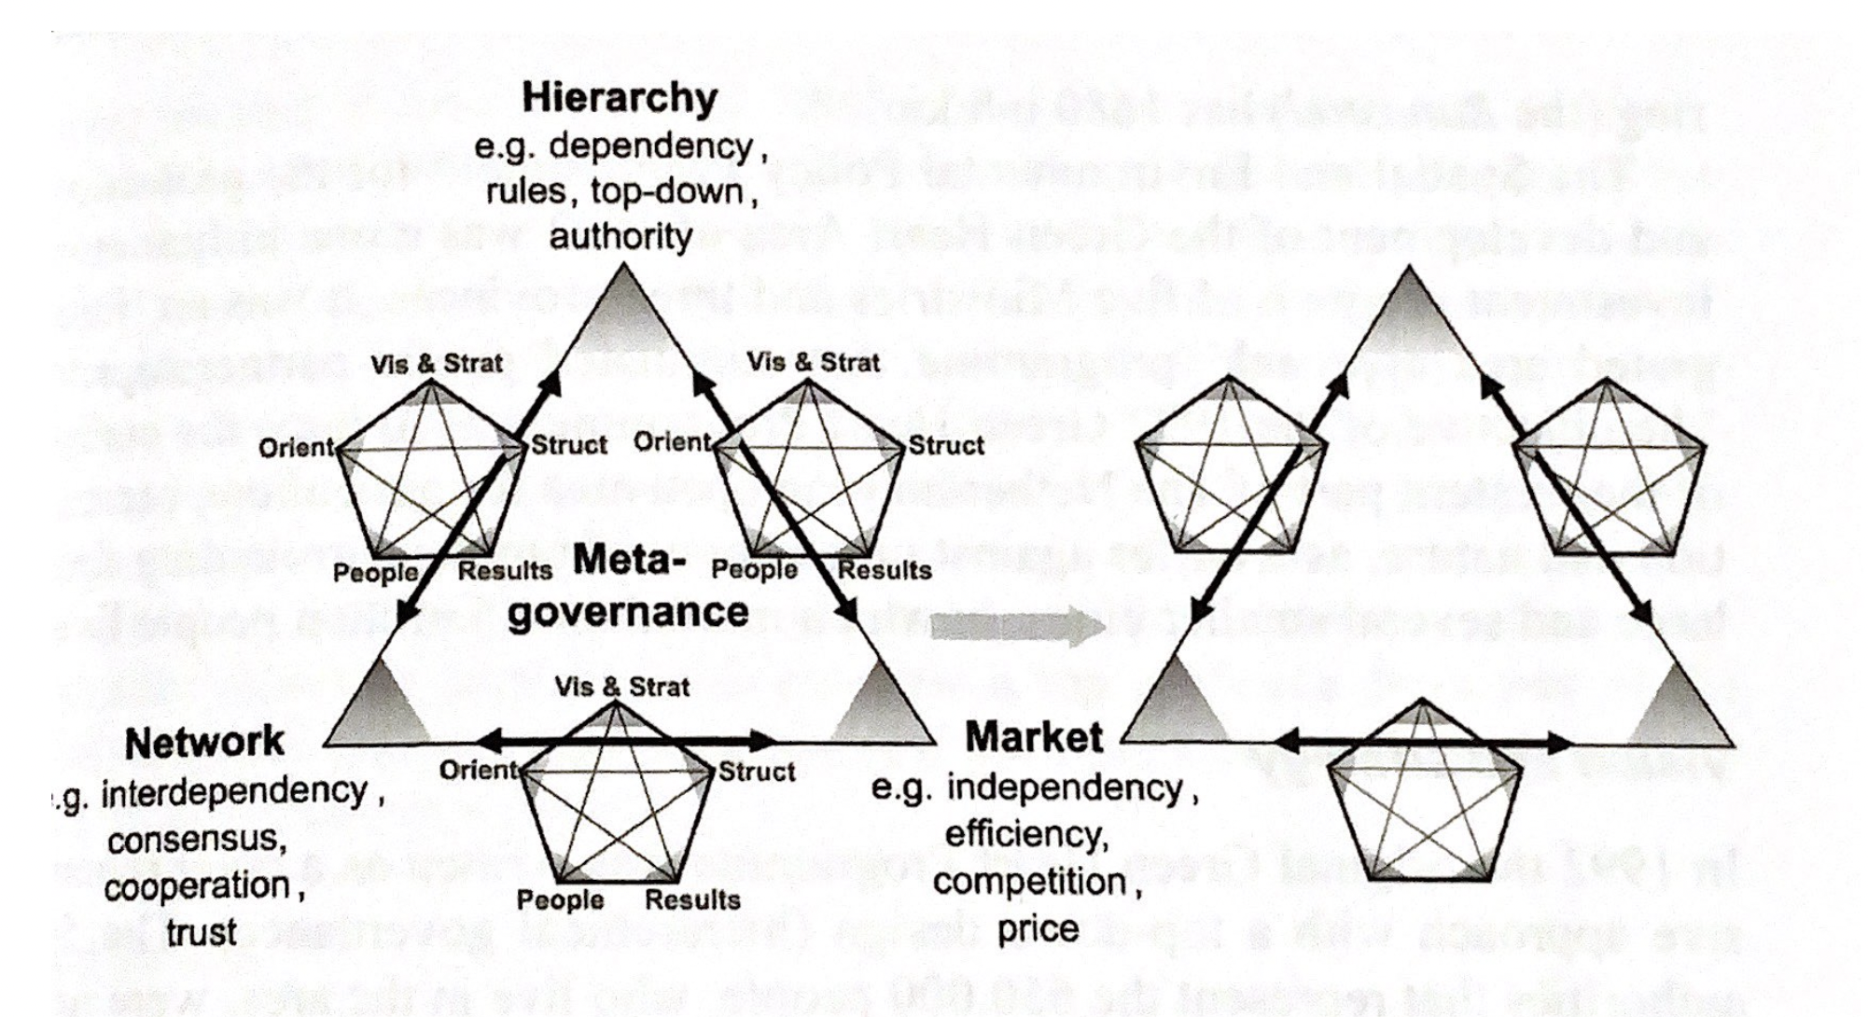
Metagovernance of Modes
Metagovernor seeks to balance H, M and N governance
How to use the benefits of each governance mode + minimalize negative consequences of each mode? How to design and manage the combination?
Concept positioned above the three main governance styles, “helicopter view” approach
Situational and flexible approach – mixing and combining, need to fit into the context and time (no best practice, no “blue prints”)
(Meuleman, 2008)

Slide 32
(3) Who is Metagovernor?
Important role – key component
Public vs. private actors
Different levels:
International,
National (the most common),
Regional,
and Local.
Multiple metagovernors
Different types:
Institutional (~ state),
Organizational (~ ministry),
and Individual (~ civil servant or polititian).
Usually: Public Managers as Metagovernors

Slide 33
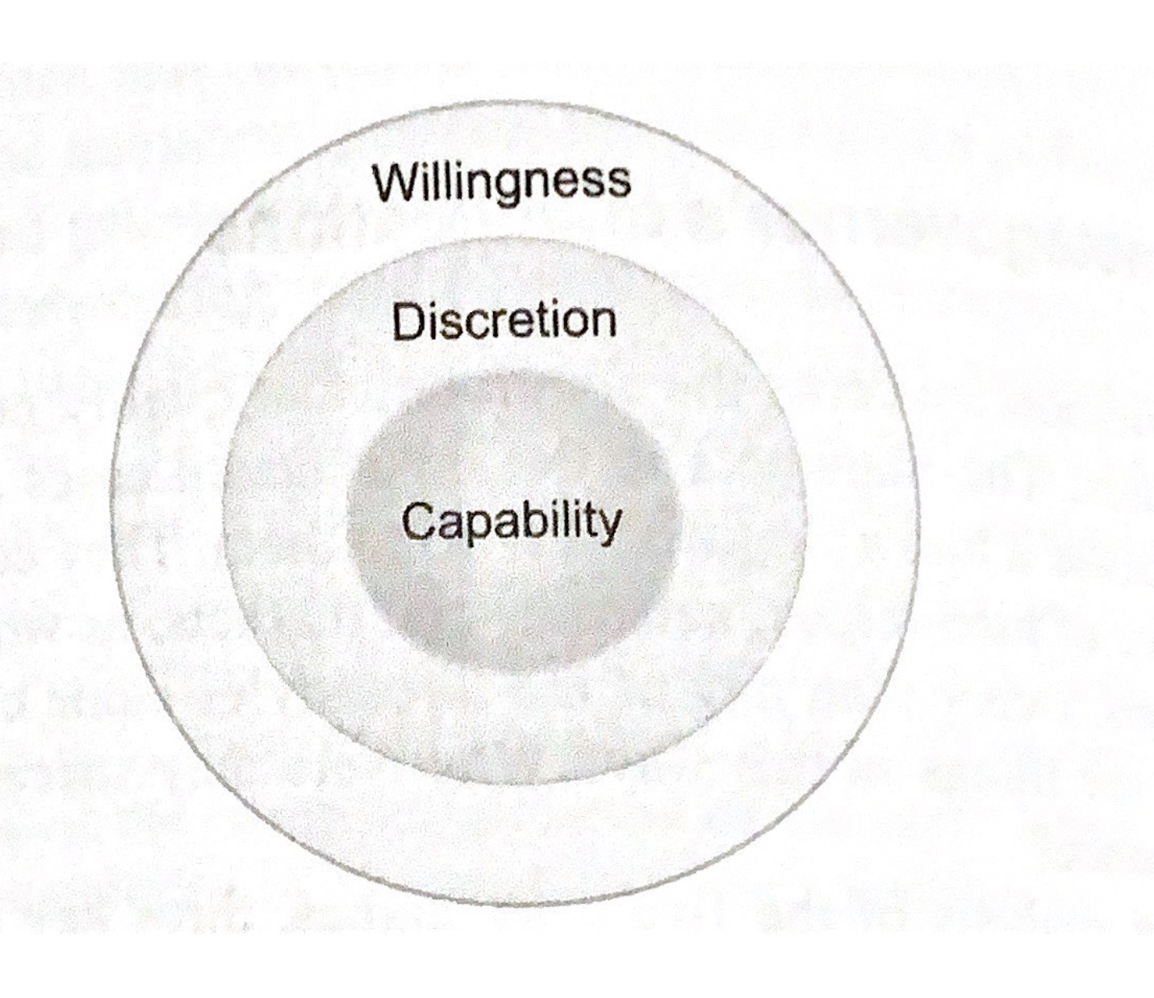
Metagovernor’s Qualifications
Three key qualifications = general conditions for innovative action
Play a different role in different phases of policy
Willingness
Highly motivated
Believe in what they do
Learning, innovative and exploring attitude
Courage to make mistakes
Discretion (= the freedom to decide what should be done in a particular situation)
To prevent and solve most conflicts
React immediately
Level depends on governance style
Capability
Highly educated and well-trained + experience in management
Ability to take multiple perspectives, to “stand above”
Reflexive and flexible orientation + recognition of complexity
(Meuleman, 2008)

Slide 34
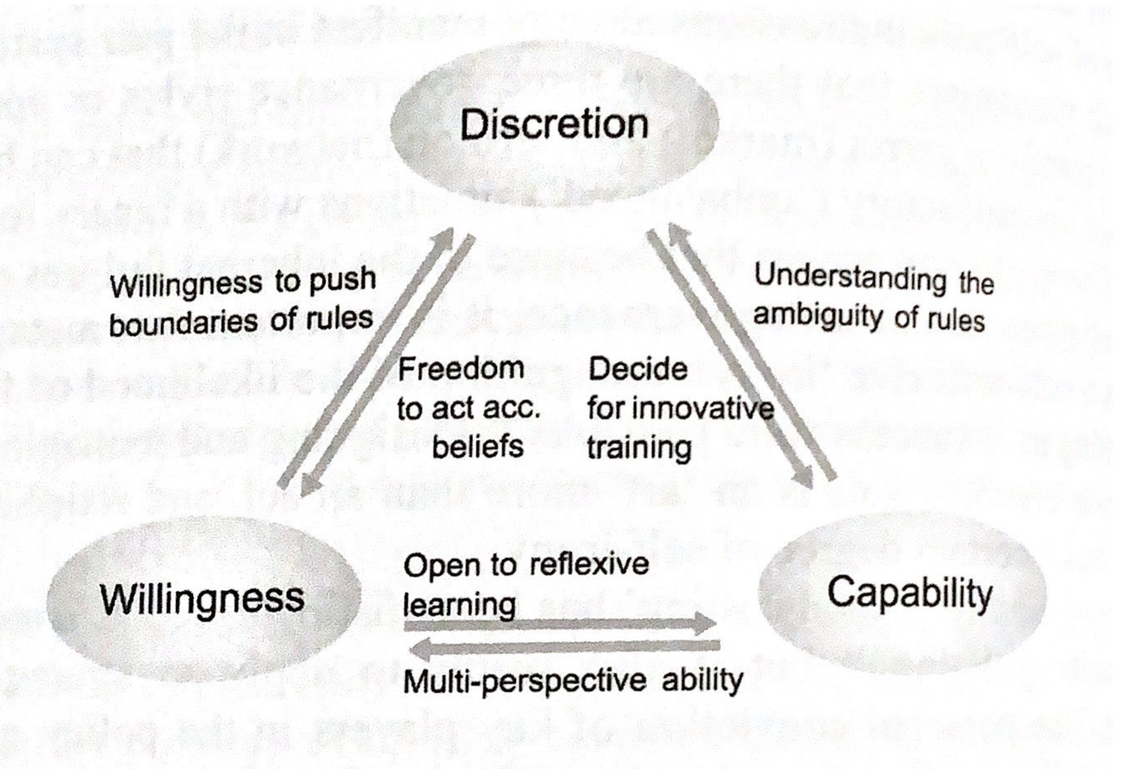
Relations between Qualifications
Qualifications are interrelated
Willingness to metagovern requires discretion and capability
Capability requires will to do so and discretionary power to act
Discretion without capability and/or willingness is pointless
If one of the three qualifications is absent, metagovernance is not possible
(Meuleman, 2008)

Slide 35
Metagovernor’s Strategies
Designing a framework by combining elements of different governance styles into compatible arrangement, maintaining of a chosen governance framework or arrangement
Switching from one to another (main) governance style,

Slide 36
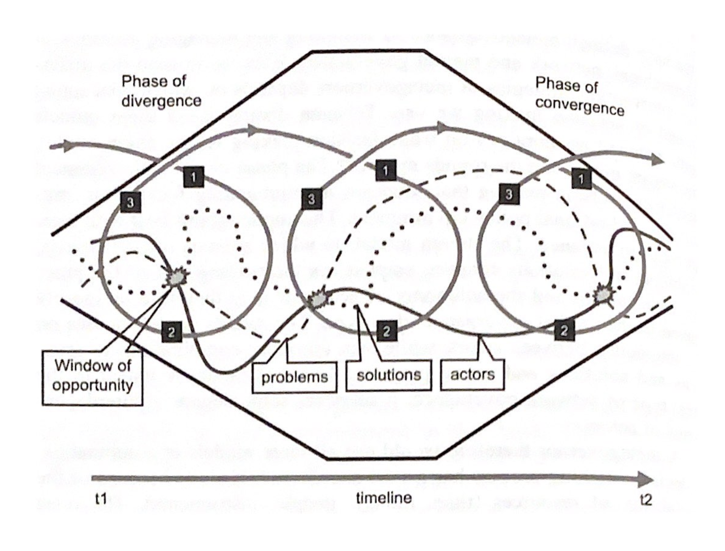
Decision Making of Metagovernors
Different conceptual framework of decision making = different intervention strategies
Phase Model (~ hierarchical g.)
Predictable, rational environment
Stream Model (~ market g.)
Contingency of process, autonomy of actors
Rounds Model (~ network g.)
Interaction between actors, combination of problems + solutions, create progress
(Meuleman, 2008)

Slide 37
Metagovernance – Management Development
Human dimension = key to the quality of public-sector organizations (no more than 10%)
Management development program, including training in:
Hierarchical management: Line and project management
Market management: Public business management
Network management: Network abilities and process management
Analyzing the governance environment (factors analysis, actor analysis, risk analysis, network analysis, organizing meetings, etc.)
Personal development (courage, adaptability, vision of future, flexibility, multi-perspective ability, dealing with complexity, “out of the box thinking”, etc.)

Slide 38
Metagovernance - Conditions
Internal and external context, conditions that enhance/undermine the feasibility of metagovernance
Politico-administrative culture
Personal conviction
Societal expectations (of civil society, enterprises, etc.)
Organisational characteristics (dominant style of leadership, educational background of policy officers, etc.)
Type of problem (crisis vs. routine vs. complex problems)

Slide 39
Metagovernance – Limitations
Inter/national level:
Culture influence (e.g. preffered governance style) can underlay the feasibility of metagovernance
Sectoral level:
Policy sector with particular tradition and preffered governance approach
Process level:
Impossibility/difficulties about the course that will be followed
Inability of managing agreement
Individual level:
Insufficient level of three important qualifications of metagovernors
Learning-by-doing and Learning-from-experience

Slide 40
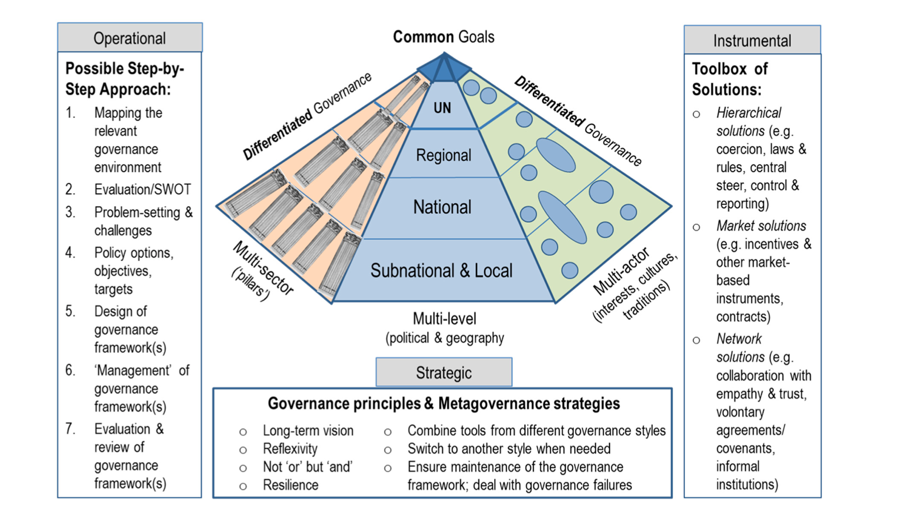
Metagovernance – Example
How to use metagovernance?
(Meuleman, 2018)

Slide 41
Metagovernance – Answers
(1) Why metagovernance?
(2) How/what to metagovern?
(3) Who is metagovernor?

Slide 42
Break - be back at 15:30

Slide 43
Course overview - Structure
Paradigm shifts 1: The Environment, The People we Serve, The Way of Management
Paradigm shifts 2: The Nature of Public Organisations, Motivation of Staff, Accountability
Human Learning Systems 1: Introduction and Human element
Human Learning Systems 2: Learning element
Human Learning Systems 3: Systems element
New Synthesis, Metagovernance and conclusions
Questions
(Tentative) answers

Slide 44
What do you remember as the most important things?
From the „Paradigm shifts“ part
From the Human Learning Systems part
From the New Synthesis and Metagovernance

Slide 45
Reminder - Homework #6
Feedback on the Public Management course using Human Learning Systems as a Framework. Different tasks for different students, 400-800 words:
A) If you are an incoming student (just for a term or two – Erasmus…) or based at different faculty:
Use Human Learning Systems as a Framework for your feedback to this course:
Did you feel psychological safety and good relations? (Human)
Were individual topics well interlinked? (Systems)
What was helpful / useless in your learning, in what circumstances you could learn even more? (Learning)
Anything else you want to share – what to keep, what to change, what to improve...
B) If you study a program where Dept. of Public and Social Policy (KVSP) plays a role (PASP, VERASP):
Same as A) but for Systems element think about the wider system – your study programme:
Where do you see overlaps/repetitions with other courses?
Where do you see complementarity/synergies with other courses?
Where do you see contradictions/discrepancies to other courses?
This time Czech version is welcomed.
Deadline: Thursday, January 6, 23:59 CEST
10/10 automatically for all serious submissions (challenger safety ☺ )

Slide 46
Final discussion dates
January 11 (Wed) 10:30 full
January 11 (Wed) 14:00 full
January 11 (Wed) 14:45 available
January 25 (Wed) 10:30 available
January 25 (Wed) 16:15 available
Does it fit your needs? Please don‘t forget to register.
Groups of 2-3 people, discussing solution of the task similar to Assignment 5.

Slide 47
Thank you and
see you at the final discussion.

