Slide 1
The Constitutional Sociology of Europe:
Politics, Law and Society
Paul blokker, PhD
Institute of Sociological studies, Charles University
13 March, 2018

Slide 2
Constitutional Sociology
Summary last class
Foundational (revolutionary) and societal (evolutionary) constitutions;
Sociology of constitutions;
Classical sociology and constitutions (Durkheim, Weber);
The example of Iceland.

Slide 3
Constitutional Sociology
Objectives today - Explore relations between national identity, constitutional identity, and symbolism of constitutional orders;
Explore different constitutional traditions;
Explore the European constitutional order;

Slide 4
Constitutional Sociology
Final Exam
-The student will be evaluated at the end of the course by means of a written essay, to be handed in at the end of the semester (exact date will be stipulated);
The written essay will be of a minimum of 2.000 words, and needs to contain a bibliography with at least 5 academic resources (MA: 3.000 words/10 resources).

Slide 5
Constitutional Sociology
Final Exam
-Possible topics:
Social movements and constitutions;
Constitutional illiberalism in Central and Eastern Europe/National identity and constitutions;
Constitutionalism and populism;
The relation between national constitutions and the EU;

Slide 6
Constitutional Sociology
Paper titles (of papers submitted last year)
-"Gender, Constitutionalism and populist nationalism: the example of French National Front”
“Women’s socio-economic development, democratic rights, and constitutionalism”
“The Public Sphere and Democracy: Constitutional de-legitimation through improper conduct”
“Social movements and the constitutionalization of the commons”
“The Constitutional Reform in Italy”

Slide 7
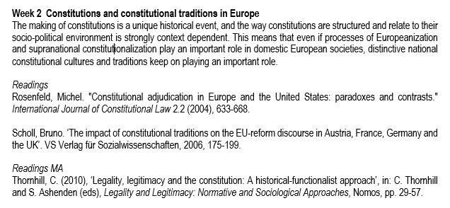
Readings
Constitutional Sociology

Slide 8
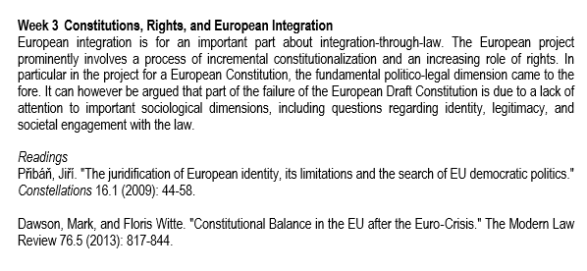
Readings
Constitutional Sociology

Slide 9
Overview 1. Constitutional Traditions and Identities in Europe 2. Integration-through-law of the European Union
Constitutional Sociology

Slide 10
Introduction
Constitutional Sociology
How do constitutions relate to (national) identity?

Slide 11
Introduction
Constitutional Sociology
What is a constitutional identity?

Slide 12
Constitutional Sociology - Constitutions are hermaphrodites: they are both politics and law (Vorländer 2017); - Key questions are: • how do politics and society relate to each other, • how does power influence both the process of legislation and the implementation of law, and • which empirical factors ensure the real validity of a constitution? • what is the status of constitutions in different societies?
Constitutional Sociology

Slide 13
Constitutional Sociology - The debate on constitutions has for a long time been dominated by: • legal positivism: stressing the normativity of law itself; law as a separate sphere • political science: stressing the constitution as an expression of the political balance of power; the constitution as the outcome of political negotiations/pacts, etc. - Both approaches have difficulty analysing and explaining empirical validity of constitutions over time;
Constitutional Sociology

Slide 14
Constitutional Sociology - A more societally-attuned sociological approach explores the normativity and actual legitimacy of the constitution as an empirical problem or an ‘on-going validity problem’ (Vorländer 2017); - This requires a more institutionalist sensibility, which stresses processes, interactions, and dynamics of constitutional orders over time;
Constitutional Sociology

Slide 15
Constitutional Sociology - Constitutional sociology avoids a purely functionalist and structuralist explanations of constitutions (as spontaneously emerging from societal evolution and modernization) (Vorländer 2017); - Constitutions can be understood as social and political order arrangements, in which the guiding principles are symbolically represented;
Constitutional Sociology

Slide 16
Constitutional Sociology - Institutions can be understood as meaningful interfaces between guiding principles and structures of action and communication (Vorländer 2017); - Institutions have an implicit meaning and value structure, and need to make this explicit to make the institution permanent, in forms of medial, emblematic, ritual, mythical, narrative expression;
Constitutional Sociology

Slide 17
Constitutional Sociology

Slide 18
Constitutional Sociology

Slide 19
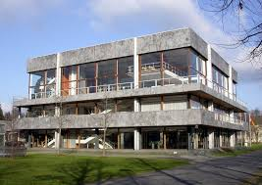
Constitutional Sociology

Slide 20
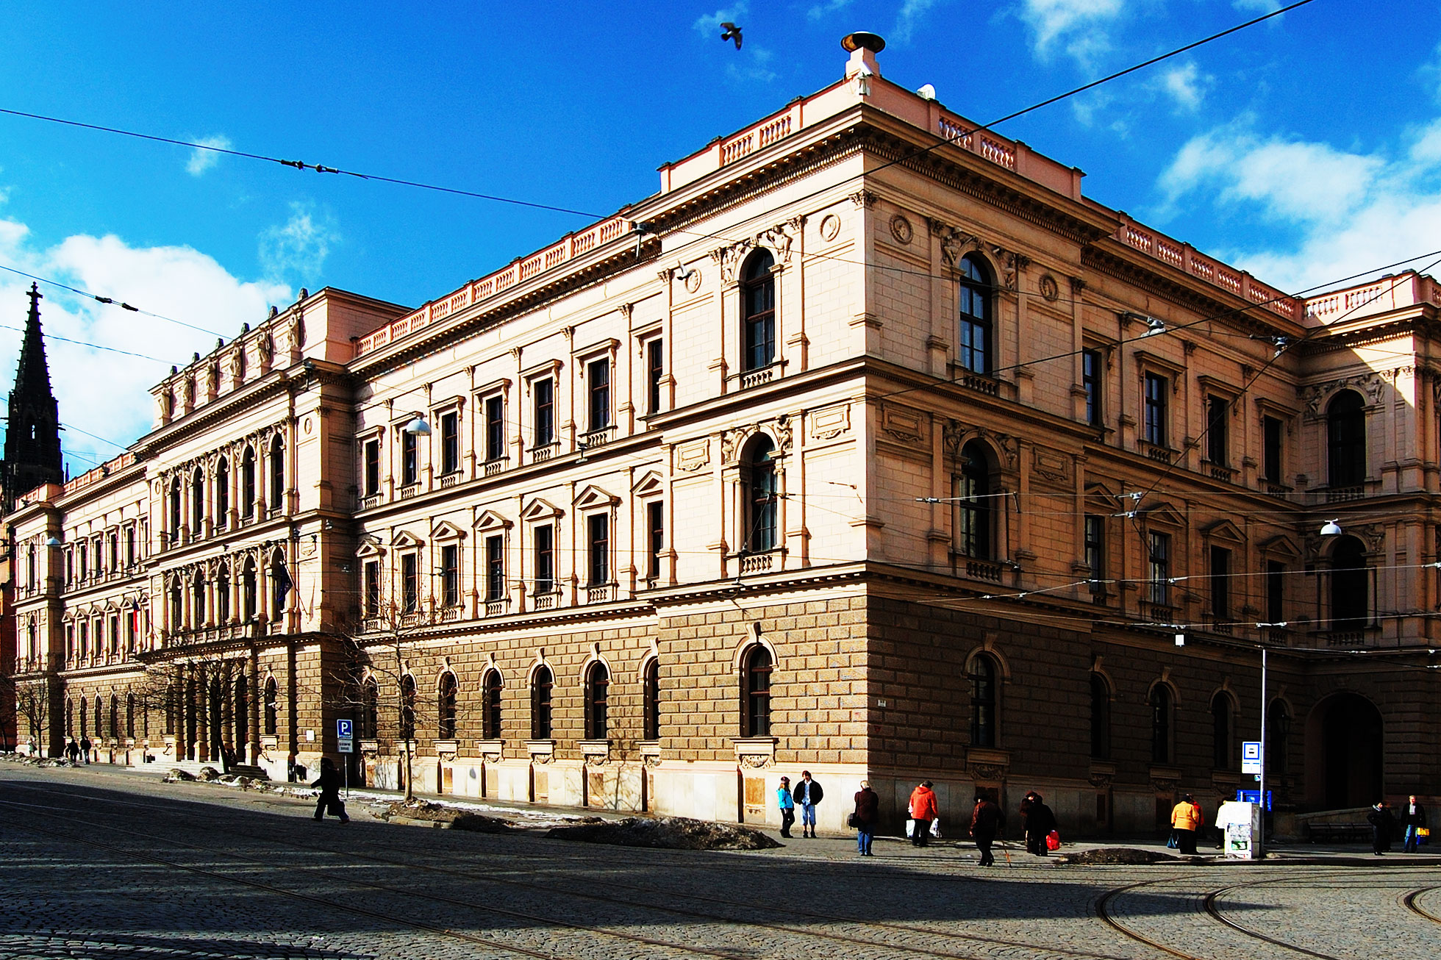
Constitutional Sociology

Slide 21
Constitutional Sociology - Institutional stability therefore stems from the interplay of interpretations, practices and symbolic representations; - Also constitutional arrangements are grounded in interpretation, practice, and symbols, and have a historicity;
Constitutional Sociology

Slide 22
Constitutional Sociology - In this regard, there is an affinity with institutionalism in sociology, in particular ‘ideational or constructivist institutionalism’ (Colin Hay); - What needs attention is informal, intersubjective, and communicative processes that ‘uphold’ constitutional structures;
Constitutional Sociology

Slide 23
Constitutional Sociology - A ‘hermeneutics of constitutions’ entails: 1. the dimension of meaning, the guiding principles and normative ideas which connect a political community with its constitution; 2. the praxeology of conduct guided by rules, including rule-following and the interpretation thereof (Vorländer 2017);
Constitutional Sociology

Slide 24
Constitutional Sociology - Constitutions make claims of order and claims to validity, but they do not produce these themselves; - It is not the inherent normativity of constitutions that provides legitimacy and integration, but rather a ‘complex process of recognition and acceptance in a space of potentially competing- legal, political an social - interpretations and political-social practices’ (Vorländer 2017);
Constitutional Sociology

Slide 25
Constitutional Traditions and Identities - There is increasing discussion of ‘constitutional identity’, ‘constitutional culture’, and ‘living constitutions’; - Culture in general might be likened to a jellyfish on the beach – to be observed with interest, but not to be touched (see Oomen 2016)
Constitutional Sociology

Slide 26
Constitutional Traditions and Identities - We can distinguish between: 1. Constitutional identity (the identity a constitution reflects, articulates, in terms of political system, rights, who is a member of the community, collective identity ) (Rosenfeld); 2. Constitutional culture (the network of values and attitudes relating to the constitution, which determines when and why people invoke constitutions) (Habermas); 3. Interplay of constitutional and national identity (how are collective dreams and aspirations expressed in constitutions) (Anderson, Imagined Communities) (Oomen 2016)
Constitutional Sociology

Slide 27
Constitutional Traditions and Identities - While constitutionalism is understood as a singular form of legally integrating a society, different constitutional models exist: the German, French, American, British,and Spanish models (Rosenfeld 2010); - Every constitution is unique, and so is the structuring of every constitution and its relationship to its socio-political environment (Rosenfeld 2010: 149);
Constitutional Sociology

Slide 28
Constitutional Traditions and Identities - Constitutional identities consists of specific views of the Self and the Other; - Some emphasize an ethno-centric model, others a civic model; - A key difference is between constitutions based on ethnos or on demos;
Constitutional Sociology

Slide 29
The German Constitutional Model - The central defining feature of the German Constitution or Basic Law is the ethnos which stands in sharp contrast to the demos (Rosenfeld 2010: 152); - The German model imagines the existence of indissoluble pre-political bonds cemented in common language, culture, ethnicity, religion, and which have an absolute primacy;
Constitutional Sociology

Slide 30
The German Constitutional Model - The state is in the German model at the disposal of an already well-defined nation, rather than being an instrument for state-building; - The German constitutional tradition, not least exemplified by Carl Schmitt’s thinking, understands constitutionalism and democracy in ethnicist terms;
Constitutional Sociology

Slide 31
The German Constitutional Model - The constitution is therefore a framework for expression politically the nation’s unique culture and character, as opposed to those of other ethnic groups and as different from liberal-universalist aspirations;
Constitutional Sociology

Slide 32
The German Constitutional Model - In many ways, German constitutional democracy is understood as the authentic expression of a unified pre-political identity of the ethnically identified people; - This does not mean that the German model promotes authoritarianism or discrimination; in the post-WWII years a strong constitutional tradition has been built up, which strongly emphasizes fundamental rights and the essential nature of democracy and the rule of law;
Constitutional Sociology

Slide 33
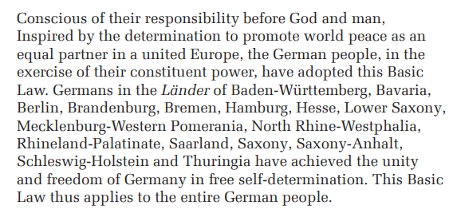
The German Constitutional Model
Constitutional Sociology

Slide 34
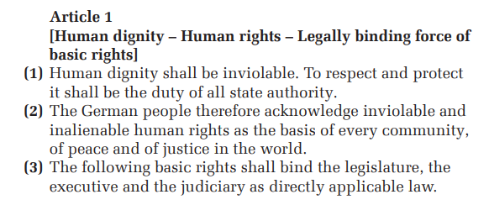
The German Constitutional Model
Constitutional Sociology

Slide 35
The French Constitutional Model - The French constitutional model is based on the idea of the citizen – ‘citoyen’ – and the demos; - The French model is grounded on democratic self-government for a polity of equal citizens; - Each citizen regardless of his or her ethnic origin, enjoys rights conceived as universal (Rosenfeld 2010: 155);
Constitutional Sociology

Slide 36
The French Constitutional Model - The famous 1789 declaration of the Rights of Man and of the Citizen mentioned the rights of ‘man, and ‘citizen’, and not of the ‘Frenchmen’; Article I – Men are born and remain free and equal in rights. Social distinctions can be founded only on the common good. - Article XVI – Any society in which the guarantee of rights is not assured, nor the separation of powers determined, has no Constitution.
Constitutional Sociology

Slide 37
The French Constitutional Model - The French model can be related to Rousseaun ideas of the polity’s general will; - In this, the French model is highly individualistic, and leaves no room for the recognition of specific group or national identities; - The idea is that the foreigner/newcomer sheds his/her identity and embraces the ideal of reason and equality;
Constitutional Sociology

Slide 38
The French Constitutional Model - The twin pillars of the French model are equal citizenship and democratic self-rule; - Historically, the abstract French model was obviously realized in the context of the French nation-state (highly centralized and unified); - The constitution in French terms is a political one and realizes democratic self-rule;
Constitutional Sociology

Slide 39
The American Constitutional Model - The 1787 American Constitution is based on the idea of ‘We, The People’, which was an American people in formation (stemming from migrant waves); - The American political credo is ‘E Pluribus Unum’, indicating a ‘melting pot’ of diverse ethnic populations that together form an American people;
Constitutional Sociology

Slide 40
The American Constitutional Model - The American people at the basis of the Constitution was a construct projected into the future: 1. no people existed yet in the late 18th century (rather, different states); 2. the multi-ethnic composition of the people is to be held together by constitutional allegiance and the idea of liberty;
Constitutional Sociology

Slide 41
The American Constitutional Model - The Constitution and American constitutional identity have thus been very importing in weaving together different groups into a constitutional unity (Rosenfeld 2010: 159); - The Constitution transformed different groups of newcomers into ‘insiders’ and a group of people forming the distinct American nation;
Constitutional Sociology

Slide 42
The British Constitutional Model - Britain has its own peculiar constitutional history, dating all the way back to the Magna Charta (1215); - Britain (as the US) is based on a so-called common law system, in which rather than written rules, constitutional conventions play a strong role; - In Britain, parliamentary sovereignty has been a key component of its constitutional system;
Constitutional Sociology

Slide 43
The British Constitutional Model - An important role in this system is then parliamentary self-restraint (‘informal’ or non-written adherence to the rule of law, fundamental rights, and governmental customs); - Britain is sociologically most interesting in its emphasis on constitutional conventions being part of the political culture;
Constitutional Sociology

Slide 44
The British Constitutional Model - Rather than a ‘made’ constitution, the British constitution is a ‘grown’ one (Rosenfeld 2010: 163); - The British constitution in this sense is closer to a ‘living constitution’; other systems see a more marked distinction between the ‘living constitution’ and the written one;
Constitutional Sociology

Slide 45
The Spanish Constitutional Model - The Spanish model is distinct: 1. It provides a framework for a multi-ethnic polity; 2. It directly relates to and imports transnational norms;
Constitutional Sociology

Slide 46
The Spanish Constitutional Model - In 1978, Spain faced the difficult task of finding a balance between national unity and meaningful autonomy for ethnic communities (in particular the Basques and the Catalans); - The solution was an open-ended and ambiguous formulation of Spanish unity; - The Constitution refers to ‘communidades autonomas’, providing significant, but not fully detailed regional self-government powers;
Constitutional Sociology

Slide 47
The Spanish Constitutional Model - In contrast to a federal system such as the US, the Spanish model explicitly accommodates regional autonomy and regional identities; - A key manner in which the different groups were bound together was by reference to the EU and to EU law;
Constitutional Sociology

Slide 48
The Romanian Constitutional Model - The Romanian Constitution was adopted in 1991, and could be understood as the product of ‘constitutional nationalism’; (1) Romania is a sovereign, independent, unitary and indivisible National State.
Constitutional Sociology

Slide 49
The Romanian Constitutional Model - The 1991 Constitution as adopted by the Social Democratic Party, whose members stemmed from the communist nomenklatura; - The PSD followed a nationalist-democratic policy until the end of 1996;
Constitutional Sociology

Slide 50
The Romanian Constitutional Model - In particular from the early 200s onwards, the Romanian approach became increasingly pro-EU; - The constitutional amendment of 2003 was importantly about EU membership;
Constitutional Sociology

Slide 51
The Romanian Constitutional Model - It can be argued that the Romanian constitutionalization process was for an important part influenced by: - EU membership and EU conditionality; - membership of the CoE and the ECHR; - the EU Charter of Fundamental Rights;
Constitutional Sociology

Slide 52
The EU’s Constitutional Model - Whereas a formal European Constitution was rejected in two referendums in 2005, the EU can be said to have a de facto constitution based on EU law; - The EU process is often referred to as ‘integration-through-law’;
Constitutional Sociology

Slide 53
The EU’s Constitutional Model - EU law has acquired a constitutional nature due to important cases ruled by the CJEU, which have led to EU law having primacy and direct effect in the European system; - In this regard, the EU constitution is an incremental or a ‘grown’ constitution.
Constitutional Sociology

Slide 54
The EU’s Constitutional Model - One major attempt to ‘make’ a constitution was the attempt in the early 2000s, in the form of the Convention on the Future of Europe (Scholl 2006); - The draft produced by the Convention was however rejected by two referenda in France and the Netherlands in 2005;
Constitutional Sociology

Slide 55
The EU’s Constitutional Model - The European attempt to create a constitution is fraught with complexity, not least due to the impossibility of a European ethnos, but, as some have argued, equally due to the difficulty of creating a European demos (the no-demos thesis, Grimm 1995);
Constitutional Sociology

Slide 56
The EU’s Constitutional Model - But it could be equally argued that the European project of a constitution ought to be one of projecting a united ‘people’ into the future; - This is for instance the argument of Juergen Habermas, in his notion of ‘post-nationalism’ and ‘constitutional patriotism’ (Habermas 1998);
Constitutional Sociology

