Slide 1
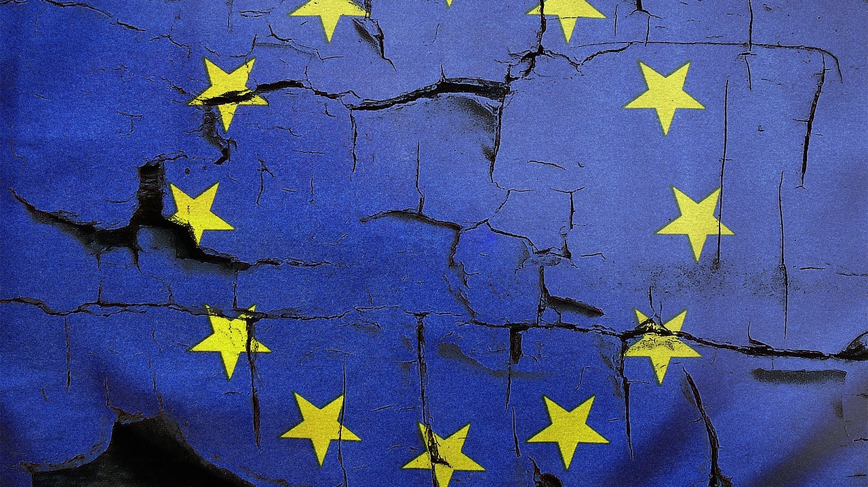
Blame it on Brussels
Maxima Heilmann, Finn Güntzel, Zeno Burger

Slide 2
What Does Blame it on Brussels Refer to?
Basic Idea:
Blame the EU for actions they are not responsible for or the MS themselves supported
Only possible because of integration
Two Logics:
Policy implementation lies within member states blame-shifting logic
EU-level actors carry the implemting task delegation logic
2

Slide 3
Two Logics of Blame it on Brussels
1. Blame-shifting logic:
Member states are responsible for policy implementation
National implementing authority is visible in public target for blame
Opposition blame the government for contested policies
National governments deflect blame towards external actor being the EU
2. Delegation logic:
EU is responsible for policy implementation
National implementing authority is not responsible no target for blame
Opposition directly blame EU policy makers
National governments duck and cover behind complexity of EU policymaking
3

Slide 4
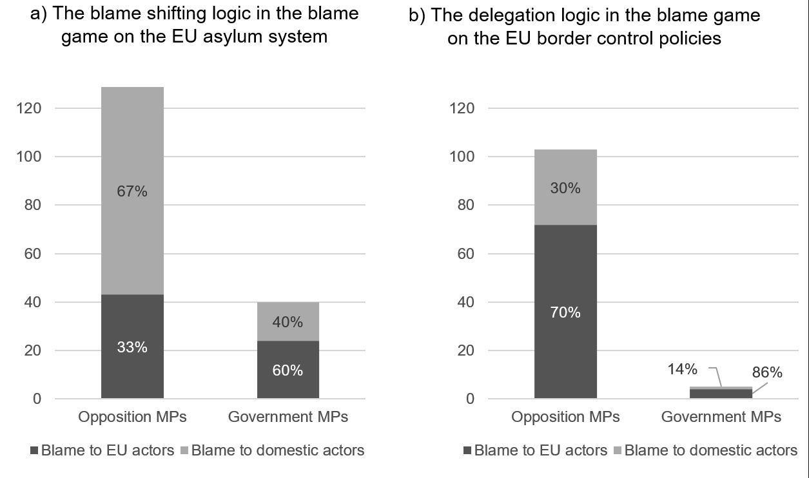
Who Blames Whom?
Mostly government is blamed
Government mostly blames the EU
Mostly the EU is blamed
Government ducks
Heinkelmann-Wild, T & Kriegmair, L & Rittberger, B. (n.d.–a)
4

Slide 5
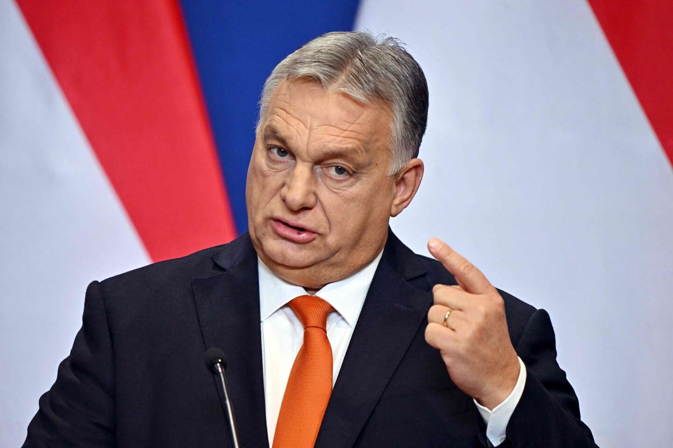
The Blame Game
Three Criteria to play the Blame Game
1. Outside intervention
„Foreigners impose policies!“
2. Sanctioning the whole country
„Foreigners impose policies on us!“
3. Lack of legitimacy
„Foreigns impose policies on us and
dont have the right to do so!“
https://www.lemonde.fr/en/international/article/2022/12/24/hungary-viktor-orban-continues-his-anti-european-rhetoric_6008919_4.html
5

Slide 6
Why do MS Blame on Brussels?
What is their Benefit?
Government: Creation of a crisis – Outside intervention by externals
Support for local élites increases
Support for governments framing
Higher support for governmental policies – although they are authoritarian
Blaming EU‘s institutions make national alternatives seem more favorable
Irresponsibility for disappointments – Externalizing the blame – Diffuse responsibility
Opposition
Disagreement with EU as disagreement with government which is pushed around by EU
Positive voting results
6

Slide 7
What do the MS Blame Brussels for?
Slow vaccination
Asylum system
„Goods dumping“
Green Deal
Brexit
Agricultural policies
Targets of Blame
EU interventions against democratic backsliding
Health care policies
EU‘s border control policy - FRONETX
Contested national policies
7

Slide 8
Case Study: Brussels, Hungary & Migration
Brussels has substantial control over migration
Often has to take the blame for issues on migration
Migration Crisis of 2015
Peaked at 1 million refugees and migrants
Countries of Origin: Syrian, Iraq, Libya, Afghanistan, Eritrea
Target Countries: Germany, Sweden
Transit Countries: Greece, Italy, Bulgaria, Croatia, Slovenia, Hungary
8

Slide 9
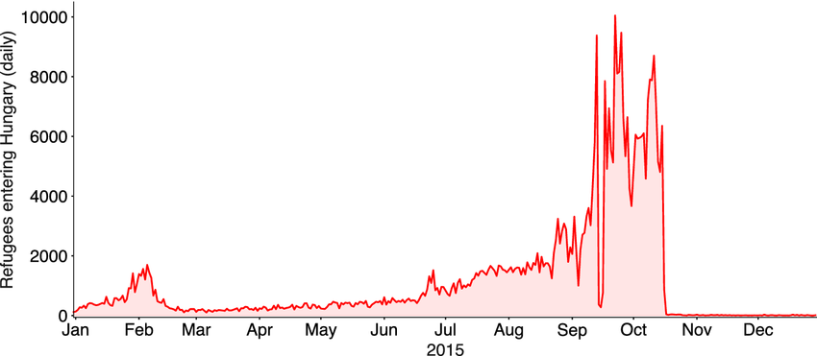
Gessler et al. (2022)
9

Slide 10
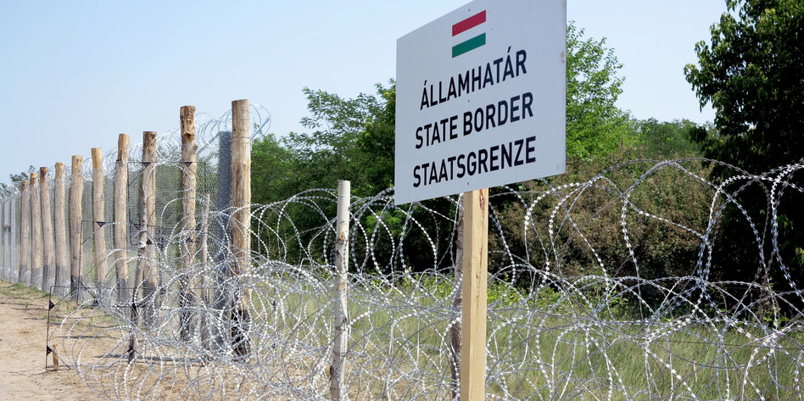
Hungary‘s Migration Policies
Hungary pursued a harsh right-wing policy:
Apprehending migrants
Building border fences
Demanded half of the total costs from the EU
https://taz.de/Ungarischer-Grenzzaun/!5222696/
Hungary protected all Europeans from illegal migration
The EU should cover the costs out of solidarity
10

Slide 11
Blame it on Brussels
The EU is responsible for the migration crisis:
It let the migrants enter without permission to do so
It failed to control who entered
It failed to properly respond to the crisis
Motives
Creating a United State of Europe
Swallow up member states
Existential threat for Hungary
The EU must be restrained
11

Slide 12
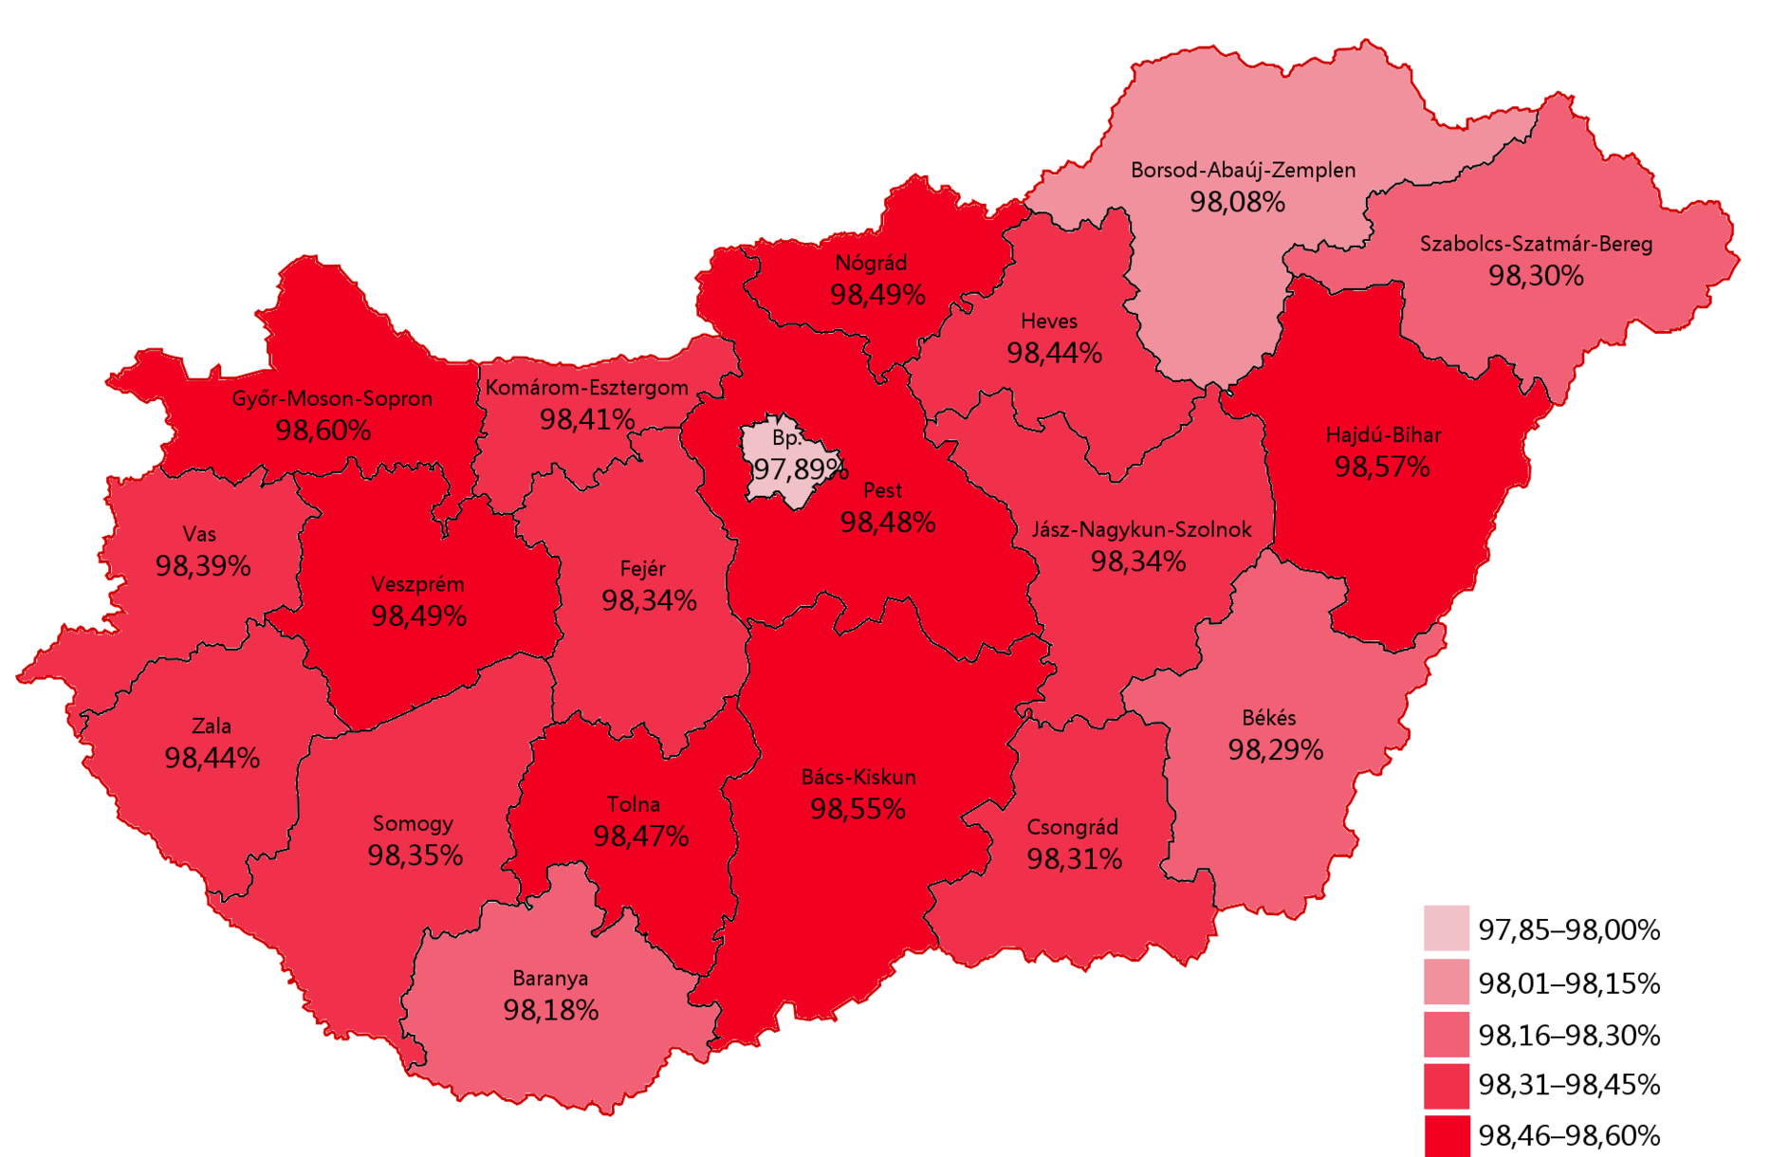
The Anti-Migration Referendum
Emergency Relocation Programme
Reduce burden of Greece and Italy
Hungary should take 1,294 people
Should the EU be allowed to demand this?
NO
12
https://upload.wikimedia.org/wikipedia/commons/thumb/2/27/Referendum_in_Hungary_2016.png/1920px-Referendum_in_Hungary_2016.png

Slide 13
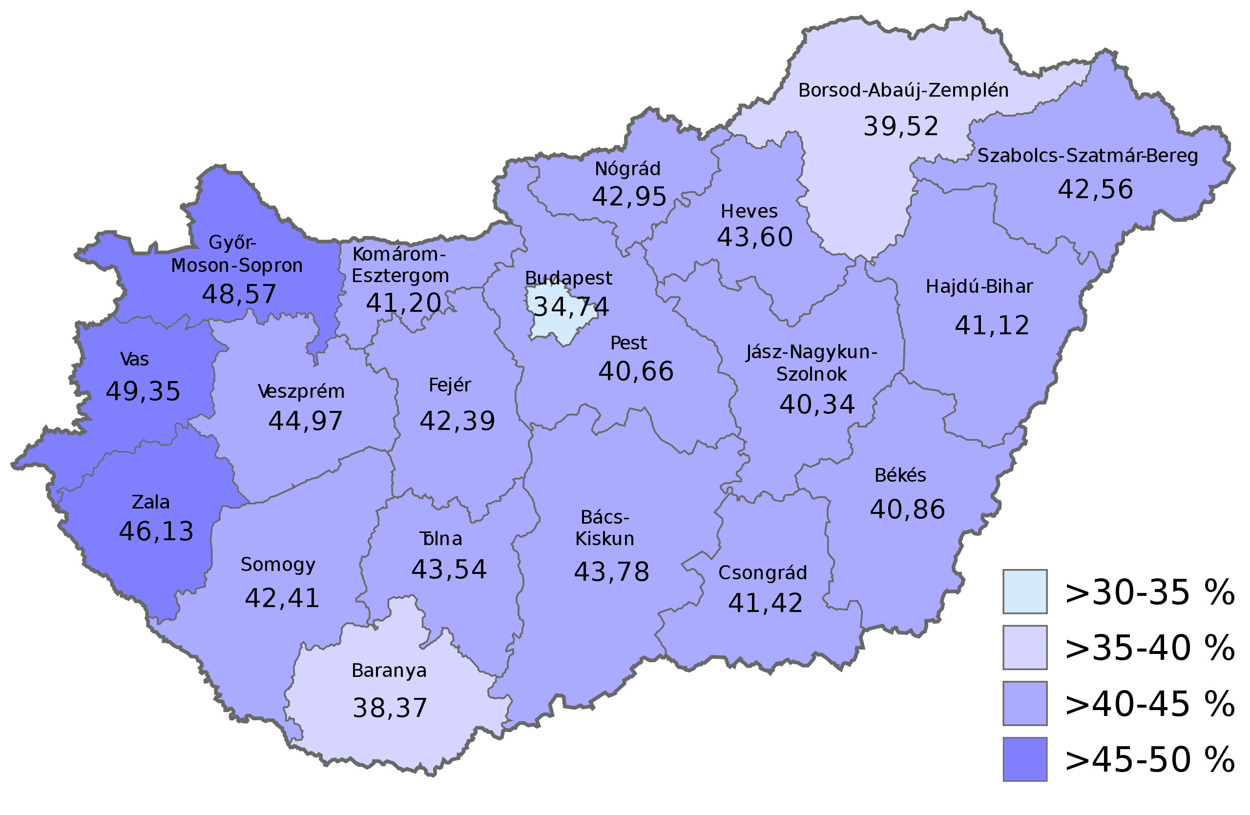
The Anti-Migration Referendum
Emergency Relocation Programme
Reduce burden of Greece and Italy
Hungary should take 1,294 people
Should the EU be allowed to demand this?
WE DO NOT CARE?
https://upload.wikimedia.org/wikipedia/commons/thumb/e/ef/Referendum_in_Ungarn_2016_Wahlbeteiligung.svg/2560px-Referendum_in_Ungarn_2016_Wahlbeteiligung.svg.png
13

Slide 14
The Anti-Relocation Trial
Hungary called upon the European Court of Justice
Defeated in 2017
No effect on anti-migrant policies
Is the EU an alliance of free nations or a European empire?
14

Slide 15
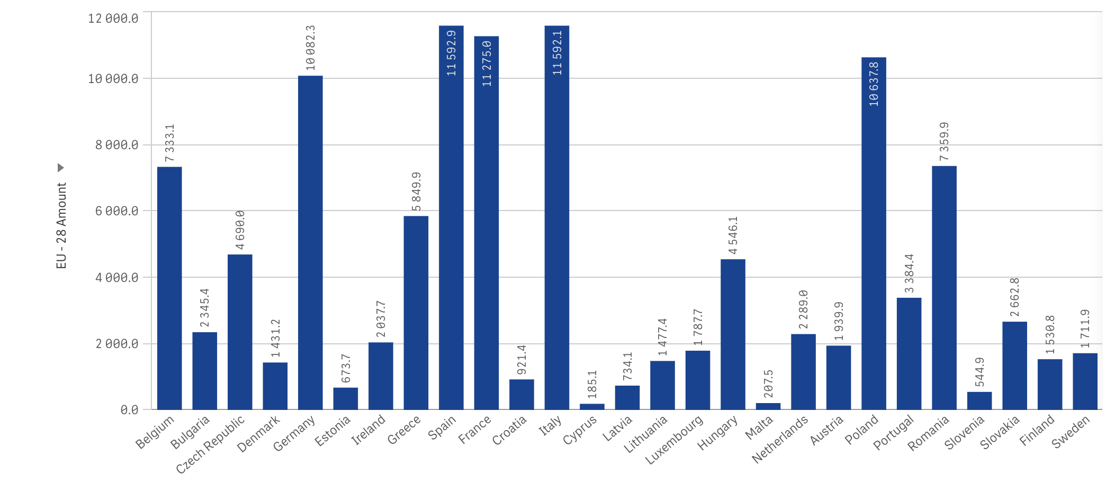
15
https://commission.europa.eu/strategy-and-policy/eu-budget/long-term-eu-budget/2014-2020/spending-and-revenue_en

Slide 16
Domestic Developments
Nowadays: Right wing
2015/2016: Conservative
Right-wing development of the Prime Minister
«We would like Europe to remain the continent of Europeans»
«We want to preserve Hungary as a Hungarian country»
https://upload.wikimedia.org/wikipedia/commons/thumb/c/cc/Fidesz_2015.svg/1920px-Fidesz_2015.svg.png
16

Slide 17
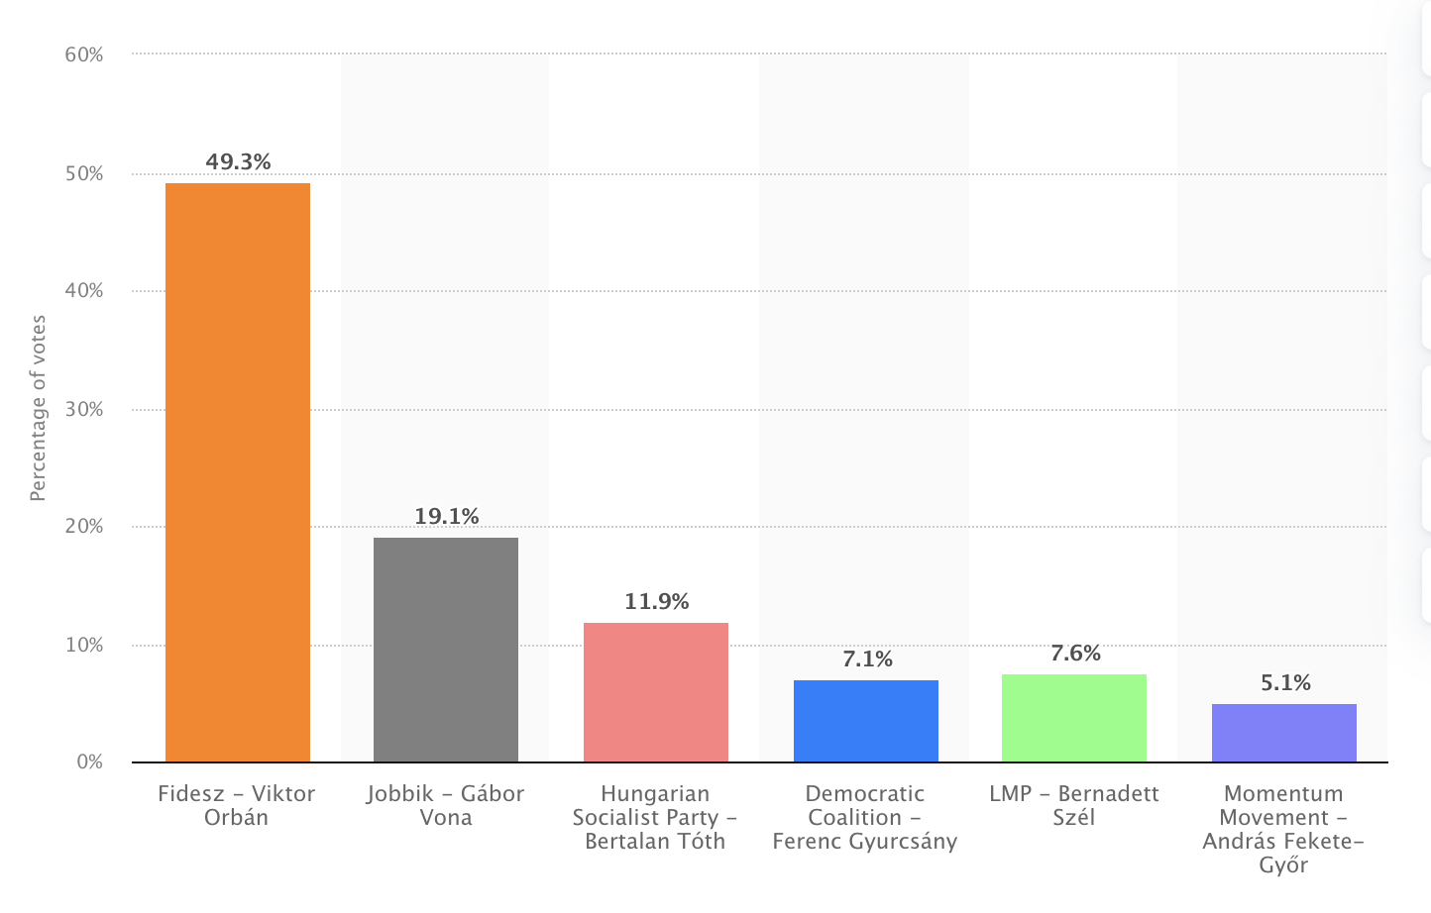
17
https://www.statista.com/statistics/895670/hungary-election-share/

Slide 18
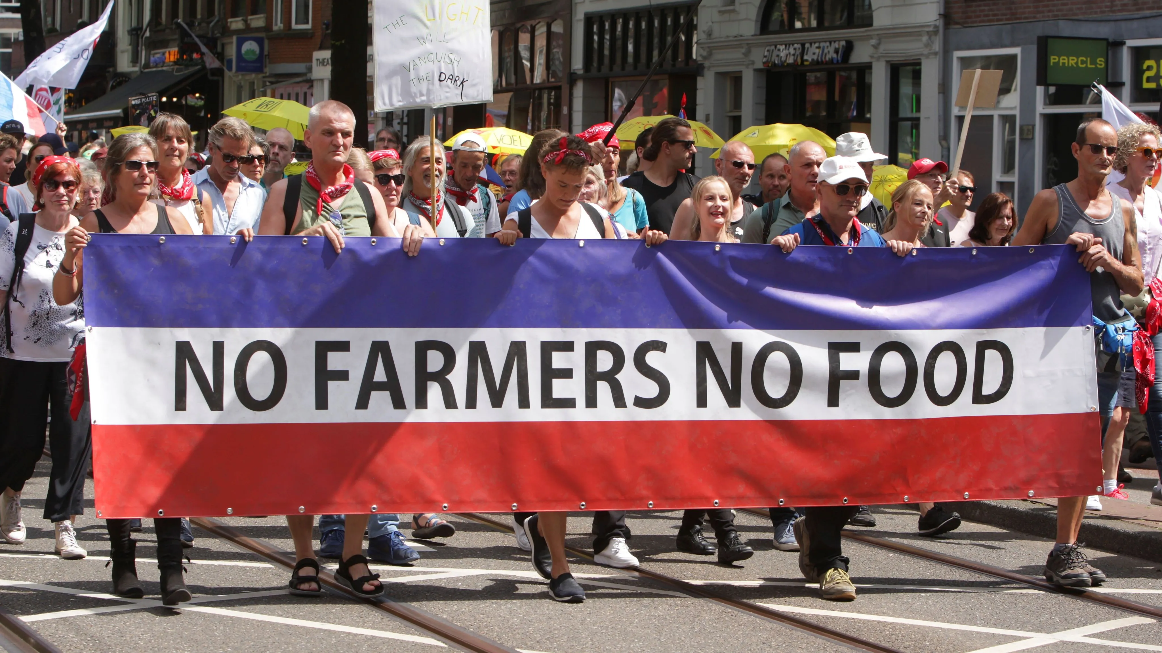
Case Study: Brussels, France & Farmers
Farmers face substantial challenges
France announced to facilitate conditions for farmers
Blamed the responsibility on Brussels
EU-Mercusor Trade Deal
Gap between citizens and the EU
https://www.worldpoliticsreview.com/wp-content/uploads/2023/04/netherlands-farmers-protest-agriculture-climate-change-politics-04202023-1.jpg
18

Slide 19
Who is to Blame?
France approved an EU-New Zealand Deal
Marked as hypocritical
France is part of the European Institutions
Blaming Brussels means blaming yourself
19
https://cdn2.vectorstock.com/i/1000x1000/28/51/france-and-european-union-waving-flags-vector-15202851.jpg

Slide 20
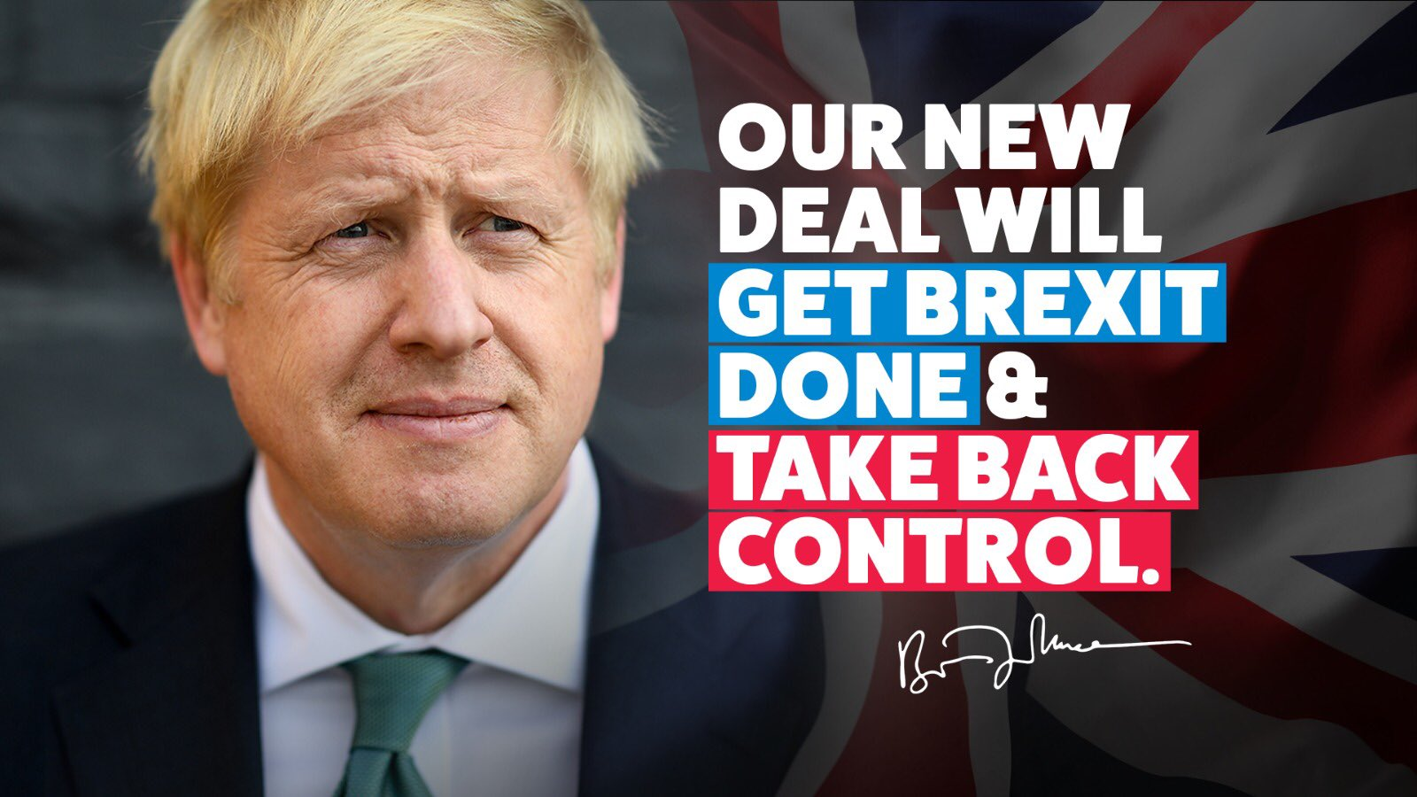
Case Study: Brexit Campaign
Blames
EU regulations constrain ability to address domestic challanges
Conservatives: Defense of national sovereignity; need to “take back control“
Labor Party: Protection of working class
Connection between immigration and identity politics such that the EU becomes the “other” in allowing every Freedom of Movement and promoting economic inequalities
20

Slide 21
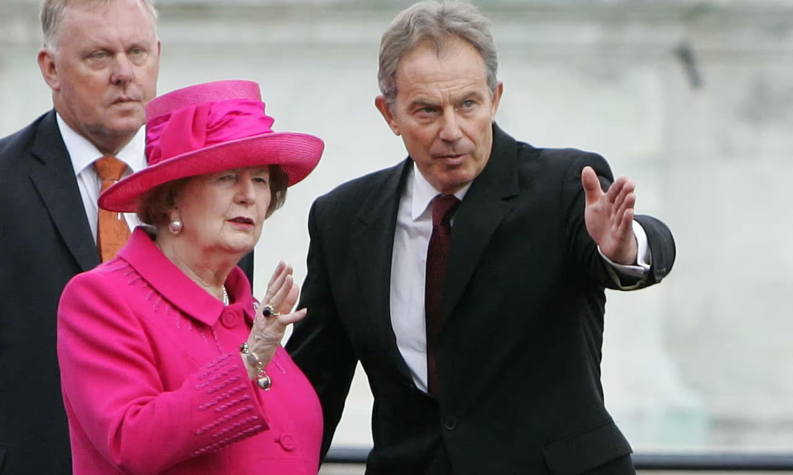
Case Study: Brexit Campaign
Neoliberal policies that caused uneven economic development were already implemented in Thatcher era
Domestic liberal economy welcomed imports of commodities that could be produced cheaper elsewhere
Tony Blair´s “Third Way“ reduced overall poverty levels but failed to adress widening inequalities
https://www.theguardian.com/politics/2023/jul/19/margaret-thatcher-praised-tony-blair-for-supporting-us-after-911-files-reveal
21

Slide 22
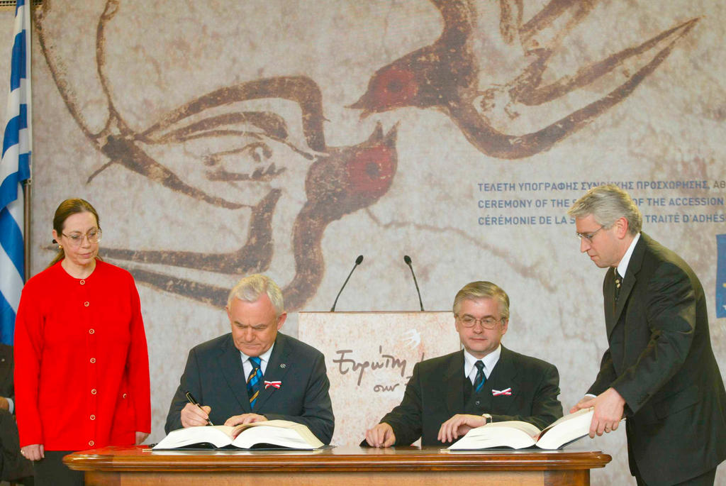
Case Study: Brexit Campaign
E.g. decision to allow immediate entry to the 8 CEE accession states made by Tony Blair himself
Decision was made with incorrect estimates of migrants by the Home Office
Could have taken advantage of the 7-year transitional period outlined in the 2003 Accession Treaty
Flow of migrants concentrated on countries that had chosen to open borders immediately
2003 Accession Treaty
https://www.cvce.eu/en/obj/signing_of_the_treaty_of_accession_of_poland_to_the_european_union_athens_16_april_2003-en-c27dad64-78b2-4f96-86a4-baf18369ea4f.html
22

Slide 23
Case Study: Country-by-Country Reporting
International companies register profits in EU countries with low tax rates (Ireland)
Draft of public Country-by-Country Reporting to make tax avoidance visible
Blocked in the European Council, most interestingly by Portugal (and Sweden)
Social Democratic government that promised to fight tax avoidance:
«Fight for greater tax justice on a European scale, combating the erosion of tax bases between different states, tax evasion and unfair competition»
«The increasing sophistication and globalisation of tax evasion and avoidance mechanisms make greater European and international cooperation indispensable»
23

Slide 24
Case Study: Slow Approval of Covid Vaccination
Blame
Former Czech Prime Minister Babiš accused EU for slow starting of vaccination programme
Norms and Regulations in Opposition:
Regulatory Processes: vaccines undergo approval by EMA, ensures safety standards that are crucial for maintaining public trust
Collaborative Approach: joint procurement empowers member states to negotiate lower-priced vaccines, ensuring fair distribution
Solidarity: EU coordination fosters equal vaccine access for all citizens, contrasting nationalistic approaches that risk exacerbating vaccine inequality
24

Slide 25
Sources
Bayer, L. (2017). Hungary says refugee ruling ‘raped’ EU law. POLITICO. https://www.politico.eu/article/hungary-says-ecj-ruling-on-refugee-quotas-has-raped-eu-law-asylum-seekers-italy-greece-relocation-scheme/. Retrieved April 26, 2024.
Bíró-Nagy, A., Szászi, Á., & Varga, A. (2022). How much EU do Hungarians want? Pro-EU and Eurosceptic attitudes in Hungary. Friedrich Ebert Stiftung.
Bernd Schlipphak & Oliver Treib (2016): Playing the blame game on Brussels: the domestic political effects of EU interventions against democratic backsliding, Journal of European Public Policy, DOI: 10.1080/13501763.2016.1229359
Boris Popivanov (2024) Putting the blame back on Brussels: strategic communication of the populist radical right in the 2019 European Parliament elections, European Politics and Society, 25:1, 54-68, DOI: 10.1080/23745118.2022.2082708
Directorate-General for Communication. (n.d.). EU spending and revenue 2014-2020. Retrieved April 27, 2024, from https://commission.europa.eu/strategy-and-policy/eu-budget/long-term-eu-budget/2014-2020/spending-and-revenue_en. Retrieved April 26, 2024.
Directorate-General for Migration and Home Affairs. (n.d.–a). Common European Asylum System. Retrieved April 27, 2024, from https://home-affairs.ec.europa.eu/policies/migration-and-asylum/common-european-asylum-system_en?prefLang=de. Retrieved April 26, 2024.

Slide 26
Directorate-General for Migration and Home Affairs. (n.d.–b). Relocation: EU solidarity in practice. Retrieved April 27, 2024, from https://home-affairs.ec.europa.eu/policies/migration-and-asylum/migration-management/relocation-eu-solidarity-practice_en. Retrieved April 26, 2024.
Gall, L. (2016). What Does Hungary's Migrant Quotas Referendum Mean for Europe? Human Rights Watch. https://www.hrw.org/news/2016/10/06/what-does-hungarys-migrant-quotas-referendum-mean-europe. Retrieved April 26, 2024.
Gessler, T., Tóth, G., & Wachs, J. (2022). No Country for Asylum Seekers? How Short-Term Exposure to Refugees Influences Attitudes and Voting Behavior in Hungary. Political Behavior, 44(4), 1813–1841. https://doi.org/10.1007/s11109-021-09682-1.
Gotev, G. (2015). Orbán slams EU migration policies ahead of Juncker’s mini-summit. Euractiv. https://www.euractiv.com/section/justice-home-affairs/news/orban-slams-eu-migration-policies-ahead-of-juncker-s-mini-summit/. Retrieved April 26, 2024.
Heinkelmann-Wild, T & Kriegmair, L & Rittberger, B. (n.d.–a). How European integration affects blame games in national politics . Retrived May 6, 2024, from https://blogs.lse.ac.uk/europpblog/2020/06/18/how-european-integration-affects-blame-games-in-national-politics/.
International Organization for Migration. (n.d.). The European Migration Crisis and Hungary. Retrieved April 27, 2024, from https://hungary.iom.int/european-migration-crisis-and-hungary#:~:text=In%202015%2C%20Hungary%20was%20the,borders%20with%20411%2C515%20recorded%20crossings. Retrieved April 26, 2024.

Slide 27
Mudde, C. (2015). Is Hungary run by the radical right? Washington Post. https://www.washingtonpost.com/news/monkey-cage/wp/2015/08/10/is-hungary-run-by-the-radical-right/. Retrieved April 26, 2024.
Peters, L., Engelen, P.‑J., & Cassimon, D. (2023). Explaining refugee flows. Understanding the 2015 European refugee crisis through a real options lens. PLOS ONE, 18(4), 1-20. https://doi.org/10.1371/journal.pone.0284390.
Saeed, S. (2017). Hungary: We built a wall and the EU should pay for it. POLITICO. https://www.politico.eu/article/hungary-we-built-a-wall-and-the-eu-should-pay-for-it/. Retrieved April 26, 2024.
Stiens, T. (2016). Viktor Orbán blames Brussels for migration crisis. POLITICO. https://www.politico.eu/article/viktor-orban-blames-brussels-for-migration-crisis/. Retrieved April 26, 2024.
Than, K. (2017). Hungarian PM Orban says will fight after EU ruling on migrant quota. Reuters. https://www.reuters.com/article/idUSKCN1BJ0NE/. Retrieved April 26, 2024.
Traynor, I. (2015). Refugee crisis: east and west split as leaders resent Germany for waiving rules. The Guardian. https://www.theguardian.com/world/2015/sep/05/migration-crisis-europe-leaders-blame-brussels-hungary-germany. Retrieved April 26, 2024.

Slide 28
https://www.opendemocracy.net/en/can-europe-make-it/behind-closed-doors-secret-deals-council-eu/?fbclid=IwAR1RJGieRrFpNRaqWH3mT746HS0-ad4a4kjv3MUZ50iYJHnKih0u5A2U4D8)
https://www.opendemocracy.net/en/can-europe-make-it/scapegoating-europe-how-discontent-with-d/)
https://english.radio.cz/babis-eu-too-slow-approving-coronavirus-vaccines-8704619
https://papers.ssrn.com/sol3/papers.cfm?abstract_id=3854841

