Slide 1
Marie-Louise von Franz Interpretation of Fairy Tales Chapter 6
Agathe Pailler
Filip Mauer
Martina Čechmánková
Weronika Krzepicka-Kaszuba
Linda Materna
Notes:
- symbolism of the motif of jumping through the hoop (Agate)
- other versions of the story and their importance to the interpretation (Filip)
- symbolism of water (motif of immersion) and (Martina)
-fire (motif of burning skin) (Weronika)
- Anima and its role in the story (Linda)

Slide 2
Symbolism of the motif of jumping through the hoop
Agathe Pailler

Slide 3
Meaning of a ring
Two basic meanings:
positive : chosen union with a higher power
negative meaning : being caught, trapped.
Earlier in The Three Feathers a ring symbolises a union.
Notes:
Early in the tales : ring → the symbol of the union, two meanings, positive : chose the union and negative meaning : being caught

Slide 4
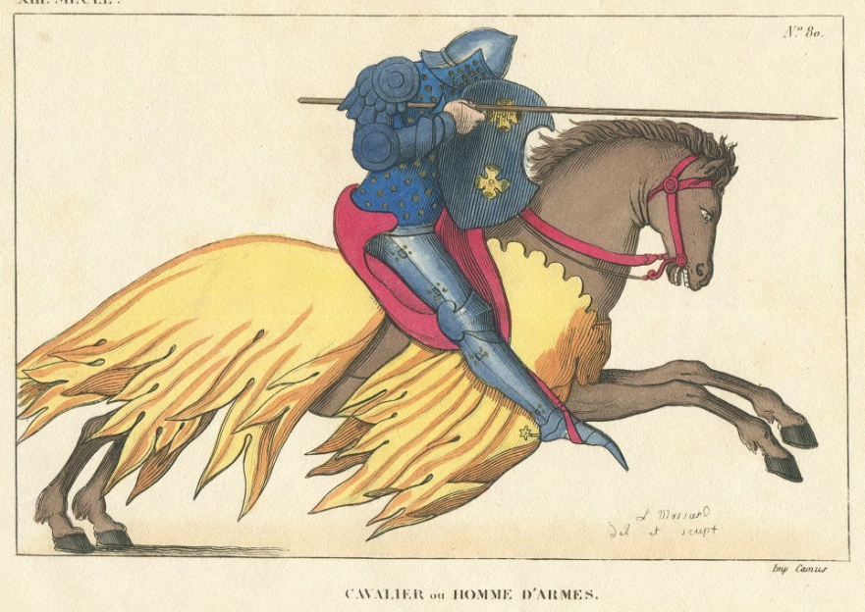
Historical and folkloric roots
Festivals in Old German countries (spring fertility rites):
an acrobatic test for the men and their horses, who had to aim for the center of the ring with a spear.
Notes:
Action of jumping through the hoop is in the old german countries festivals (spring fertility rites) but with a horse → acrobatic test for the men with their horse, they had to aim for the center of the ring

Slide 5
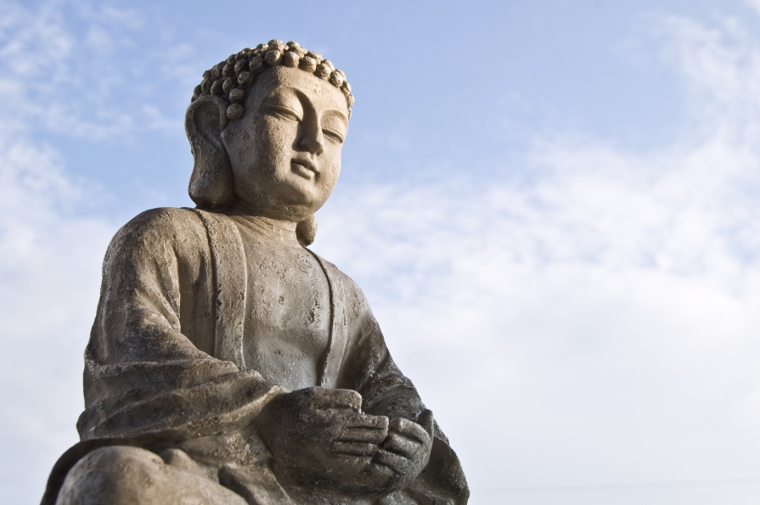
Connotations with Buddhism
Idea of being at the middle of the circle can be related to Buddhism:
founding the inner centre of the personality through physical skills and strong conscious concentration
Buddhist art of archery.
Notes:
Idea of being at the middle of the circle can be related to the buddhism → found the inner center of the personality with physical skills and strong conscious concentration

Slide 6
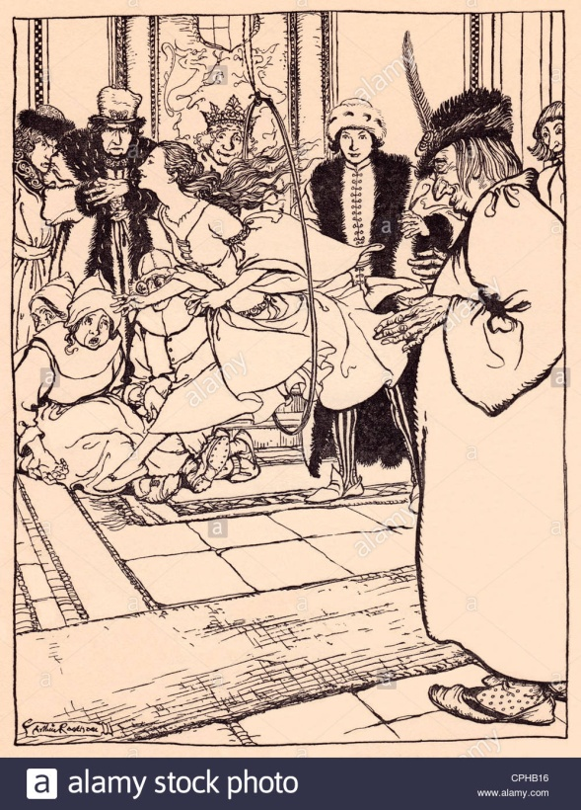
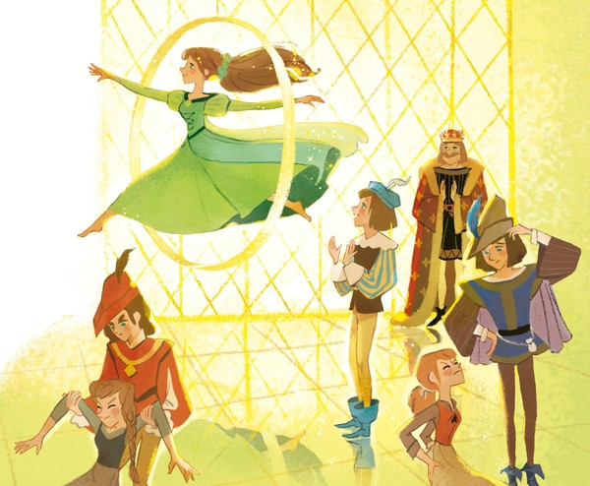
Jumping through the hoop
Frog princess (anima) jumps through the hoop without any problems.
Two peasant women are too heavy, they fall and break their legs.
Notes:
The person who jump had to leave the earth and be able to land in the middle of the circle so in the tale the anima - princess is able but the two peasants are too much heavy → they brake their arms and legs
Because of this symbolic of jumping into the circle only the anima can do it, a simple woman are not able to leave just a little the earth except the anima

Slide 7
Symbolism
Frog Princess = anima
She is able to jump because the anima combines the outer world (physical reality) with the inner world (imagination). Harmony of anima.
The peasant women cannot jump because they are too closely connected to a concrete reality.
Notes:
The person who jump had to leave the earth and be able to land in the middle of the circle so in the tale the anima - princess is able but the two peasants are too much heavy → they brake their arms and legs
Because of this symbolic of jumping into the circle only the anima can do it, a simple woman are not able to leave just a little the earth except the anima

Slide 8
Other versions of the story and their importance to the interpretation
Filip Mauer

Slide 9
First alternate form: The German addendum

Slide 10
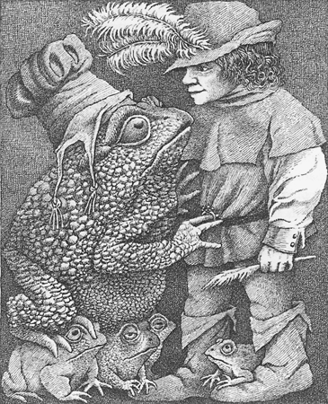
Changes and added motifs
Frog form: Instead of appearing as a beautiful woman in court, the beautiful woman in the underworld appears as a frog.
Additional test: The frog says umschling mich (embrace me) and versenk dich (immerse yourself). Dummling embraces the frog, and dives into the water, the frog turns into a woman, they swim up as a couple.
Notes:
Instead of appearing as a beautiful woman in court, the beautiful woman in the underworld appears as a frog (reverse from the original.)
Additional test: The frog says umschling mich (embrace me) and versenk dich (immerse yourself, deep meditation/mystic connotation.)
Dummling embraces the frog, and dives into the water, the frog turns into a woman, they swim up as a couple.

Slide 11
Second alternative form: The Frog Daughter and the Czar

Slide 12
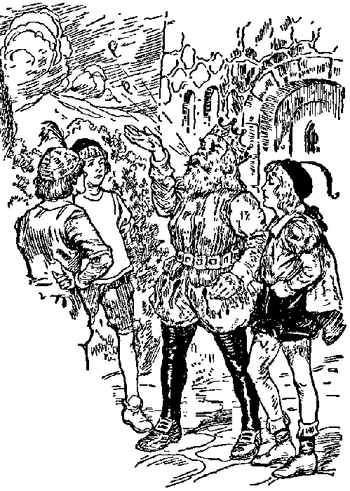
Set up of the story
A czar and his wife have 3 sons, who are told to look for wives by shooting arrows and going to whoever’s house they land near to.
The third son’s arrow lands in a bog and is caught by a frog, who won’t return it unless the son marries it. He is forced by the czar to do so.
Notes:
A czar and his wife have 3 sons, who are told to look for wives by shooting arrows and going to whoever’s house they land near to.
The third son’s arrow lands in a bog and is caught by a frog, who won’t return it unless the son marries it.
The czar says that he has to go through with it because he promised, so he does, and cries about it a lot. (The son cries every time he’s reminded of his frog wife or when he has to do anything with her).

Slide 13
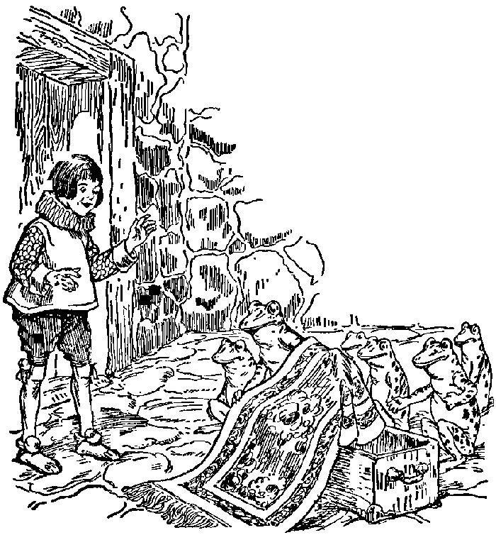
Tasks for the future wives
Tasks involve making towels, a cake, and coming to the ball.
The frog wife does at night by taking off her frog skin, she succeeds every time.
The wives of the other two princes try the same and fail.
At the ball, she arrives in her human form, dances, and uses food she put in her sleeve to create fantastical gardens and lakes.
Notes:
The czar gives tasks, which the frog wife does at night by taking off her frog skin (common trope of animal wives with a skin of their former, animal form, where the wife is kept around by withholding the skin, but eventually escapes with it/marries normally, but gets into a row and storms off with it)
Tasks involve making towels, a cake, and coming to the ball
At the ball, she arrives in her human form, dances, and uses food she put in her sleeve to create fantastical gardens and lakes (cat that tells stories and folktales as part of 1, image of paradise as 2) (An allegory for creativity, forming spiritual food from mundane food)
The wives of the other two princes try the same and fail (repeating the act literally, not understanding)

Slide 14
The curse and the search
After the party, the son returns and finds his wife’s frog skin, and decides to burn it, which forces the frog wife to flee as a bird.
The son travels across many lands, spares animals that aid him, and is given a thread that lead him to an island across the sea (underworld) where finds and reunites with his wife.
They fly back in bird form, and upon getting back, he learns that , his wife was cursed by her father, but managed to regain her freedom.
Notes:
After the party, the son returns and finds his wife’s frog skin, and decides to burn it, which forces the frog wife to flee as a bird (an example of a different story, the hedgehog prince, where burning the skin was a positive thing, is given; burning the skin isn’t necessarily a negative act, it depends on the context.)
The son travels across many lands, spares animals that aid him, and is given a thread that lead him to an island across the sea (underworld) where he goes through some doors in a glass palace, and finds and reunites with his wife.
They fly back in bird form, and upon getting back, the wife says “It was my father who cursed me and had given me to a dragon to serve for three years, but now I have paid the penalty.” (Referring to the start of the story, when she was in the bog? Connections to opposing fathers of the conscious (Czar) and the unconscious (The dragon), their conflict depicted as clashes between newer and older forms of god? And the daughter is hurt as a passing of the conflict downwards.)

Slide 15
Symbolism of water (motif of immersion)
Martina Čechmánková

Slide 16
In the German Version
Notes:
In russian version this is not appearing.

Slide 17
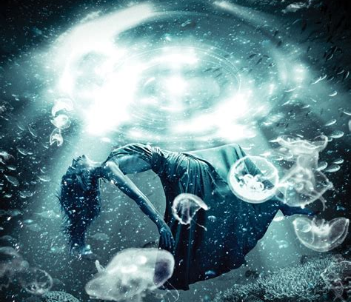
Symbolism of immersion
It implies the action of lowering something into the water or into the earth.
It also means to go into deep meditation, to go in his own inner depths.
Notes:
Frog Princess
The frog princess watnts to immerse with her in a pond (pool) – this is the final test. It implies the action of lowering something into the water or into the earth. It also means to go into deep meditation, to go in his own inner depths.

Slide 18
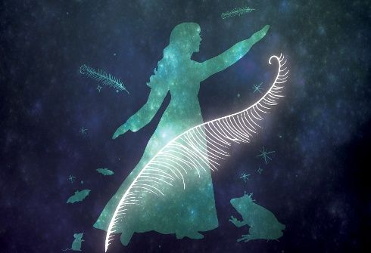
Symbolism of following the princess
When Dummling jumps with her into the pool she transforms herself into a beautiful woman
Jumping after the princess = following her into her kingdom, accepting her way of life.
Notes:
He jumps with her into the pool, and in that moment she transforms herself into a beautiful woman. We can say that Dummling has to follow her into her kingdom, accepting her way of life.

Slide 19
Symbolism according to Jung’s theory
Acceptance of the frog and the frog's life implies a jump into the inner world, sinking down into inner reality:
acceptance of the symbolic life
getting rid of rational objections
a gesture of generous acceptance - "In the name of God, whatever happens, I will jump into it and realize it."
Notes:
Acceptance of the frog and the frog's life implies a jump into the inner world, sinking down into inner reality. The anima's intention is to convert rational consciousness to acceptance of the symbolic life, sinking into it without any buts, criticisms or rational objections , but with a gesture of generous acceptance, saying, "In the name of God, whatever happens, I will jump into it and realize it."

Slide 20
Symbolism fire (motif of burning skin)
Weronika Krzepicka-Kaszuba

Slide 21
In the Russian Version

Slide 22
Symbolism of fire
in mythology: purifying, transforming rituals
in alchemy: used to uncover what’s indestructible, a piece of immortality
in Gnosticism: fire as a judge of what’s worthy of survival, clarification
in psychology: emotions and affects, allows to reach higher levels of consciousness
positive – transformation, purification
negative – loss of control, hate, destruction
Notes:
Fire symbolism:
in mythology: purifying, transforming rituals
in alchemy: used to uncover what’s indestructible, a piece of immortality
in Gnosticism: fire as a judge of what’s worthy of survival, clarification
in psychology: emotions and affects, allows to reach higher levels of consciousness
Fire has both positive and negative connotations: it can transform a thing into something better, speed up a progress, judge a value, but more often than not it can also cause destruction, which symbolises the loss of control over one’s affects. When one’s emotions are on loose it’s very easy to spread hate and destruction by causing others to lose control over themselves.

Slide 23
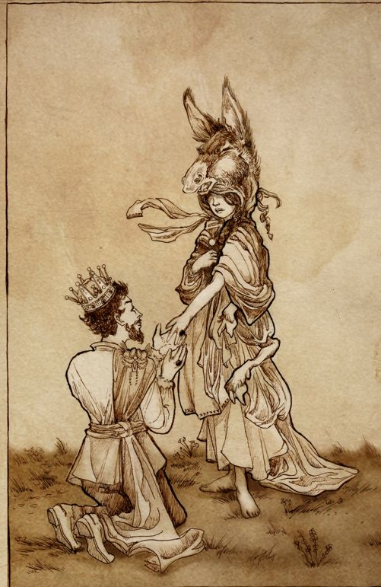
Motif of the animal skin
The animal/magical creature skin = the first form of anima.
In many tales burning the skin is the solution to the problem. It breaks the curse, prevents the wife from running away and the husband from a long quest of searching for her or death.
Notes:
the animal/magical creature skin = the first form of anima (in may tales)
Usually, in fairytales of this sort burning the skin is the solution to the problem of the wife running away in the old skin and saves the husband from a long quest of searching for her or death.

Slide 24
Burning the frog skin
Transformation of the motif – burning the skin causes a problem.
Burning the frog skin = destructiveness of fire, taking away the “moist” (the water aspect) of anima.
Fire as a symbol of rationality stands in opposition to the moisture of the symbolic life (anima).
By burning the frog skin the husband uses reason and denies his anima, he is punished for that and needs to set off on a quest to find her. His sacrifice is great enough, so that he is able to reunite with his wife and with his unconscious.
Notes:
But here, the burning effects in exactly that (causes a problem). There is no explanation for that in the story.
burning the frog skin = destructiveness of fire, taking away the “moist” (the water aspect) of anima

Slide 25
Jungian creative unconscious
Pulling the creative, fantasies and dreams (water, moist) to close to consciousness in a desperate and passionate attempt to interpret them using reason and logic (fire) unables one to create real art.
Creativity needs to be left alone in the darkness, art needs to be a product of unconsciousness.
That’s why the princess (anima) is able to create a tale-telling tomcat, whose songs and folktales should not be takes too seriously or with too much affect, as they should remain a part of the symbolic life.
Notes:
pulling the creative, fantasies and dreams (water, moist) to close to consciousness in a desperate and passionate attempt to interpret them using reason and logic (fire)
creativity needs sometimes to be left in the darkness, art needs to be a product of unconsciousness (surrealism and its inspiration in Jung’s theory)
Folktales and songs provided by the tomcat should not be taken too seriously or with too much affect; they should remain a part of the symbolic life.

Slide 26
Anima and its role in the story
Linda Materna

Slide 27
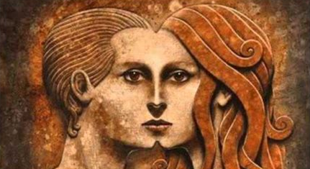
Anima in Jung’s theory
Anima is the inner side of man’s psyche, represents the archetype of life and is the main tool to communicate with deeper aspects of his unconsciousness.
It is projecting itself on the persons of opposite sex.
Yielding to the anima = to lose ability of human contact and to go completelly wild. Supressing the anima = could mean to lose the spirit and the energy.
Notes:
anima is the inner side of man’s psyche, represents the archetype of life and is the main tool to communicate with deeper aspects of his unconsciousness.
It is projecting itself on the persons of opposite sex, which brings many problems and dissappointments.
Anima takes various forms.
To yield to the anima means to lose ability of human contact and to go completelly wild. But when it gets surpressed, it could mean to lose the spirit and the energy.
Jung said we are all caught in rationalism today and don’t accept symbolism – we can get back to collective unconsciousness through letting our dreams interact with our day.

Slide 28
Anima in The Three Feathers
Anima = guide or even essence of the realization of symbolic life – the one, who don’t comprehend and don’t welcome his anima isn’t able to reach his unconsciousness .
The frog tells Dummling to embrace her and sink with her into the lake – which means to meditate; to accept her and go into his unconsciousness
Accepting his anima in frog form lifted it to higher level (princess).
The reason why anima was in a frog form comes from the fact, that the king and his sons consciousnes had no relationship to the feminine principle.
Notes:
anima = guide or even essence of the realization of symbolic life – the one, who don’t comprehend and don’t welcome his anima isn’t able to reach his unconsciousness – his conscious ego is against it
the frog tells Dummling to embrace her and sink with her into the lake –> which means to meditate; to accept her and go into his unconsciousness
from the water emerges Dummling with princess <– accepting his anima in frog form lifted it to higher level (princess)
maybe the reason anima was in frog form comes from the fact, that the royal family members mentioned were the king and his sons – consciousnes had no relationship to the feminine principle
but accepting is hard for men – going against conscious logical tendencies
if the tension between conscious and unconscious is too big, step to one side can improve the other

Slide 29
Anima in the Russian Version
Anima’s creative side is more visible = instead of jumping through a hoop it’s dancing and tossing scraps of food, which leads to creating paradise.
The reason of frog form – the czar family had czarina (a woman) – a feminine principle.
Princess was cursed by her father - she was dragged down to her unconsciousness. Fight between the czar and his daughter = fight between archetypal complexes within unconsciousness
The czars (father of the princes and father of the frog princess) are probably in some conflict – instead of fighting, one takes his child away.
Notes:
RUSSIAN VERSION
anima’s creative side is more visible = instead of jumping through a hoop it’s dancing and tossing scraps of food, which leads to creating paradise (the singing cat represents nature spirit able to create folk songs and fairy tales)
reason of frog form – the czar family had czarina (a woman) – a feminine principle
princess was cursed by her father (for what we don’t know) - she was dragged down to her unconsciousness – fight between the czar and his daughter = fight between archetypal complexes within unconsciousness
the czars (father of the princes and father of the frog princess) are probably in some conflict – instead of fight, one takes his child away

Slide 30
The motif of a god
The German Version:
taking anima away from the womb of mother nature.
The Russian Version:
on top of being taken away from earth, anima must be freed from dark father‘s /God‘s power.
Notes:
image of God (both fairy tales)
german tale – taking anima away from the womb of mother nature
russian – must be freed from dark father God on top of being taken from Earth’s

Slide 31
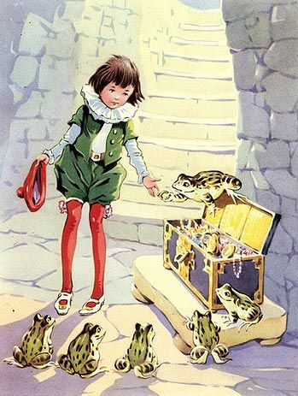
Thank you!

