Slide 1
Autonomic nervous system
Lecture in physiology - Mo 27.11.2023 (8:45 - 10:25h)
Helena Pivonkova

Slide 2
ANS – basic characteristics
Part of the peripheral nervous system
Mostly motor functions
Autonomous regulation, vegetative
It works independently of our voluntary control
Regulates basic organ functions
visceral functions – blood pressure, intestinal motility,...

Slide 3
Subjects to discuss today
Basic neuroanatomy and neurophysiology of ANS
Neurotransmiters
Receptors
ANS functions in specific organs
Control of ANS functions

Slide 4
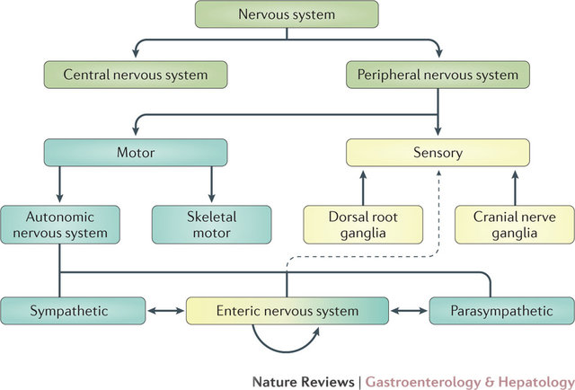
Divisions of the nervous sytem
+ specific sensory
functions

Slide 5
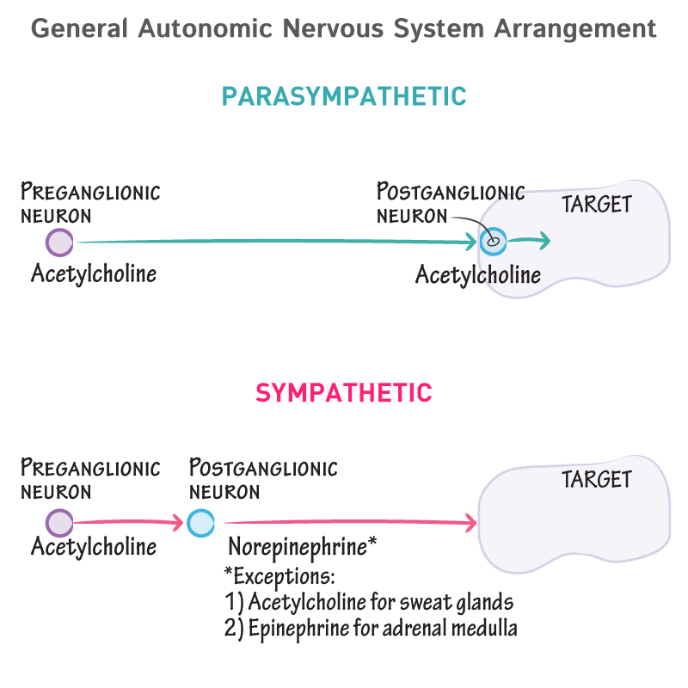
Basic organization of ANS
2 efferent neurons connected in series
Motor pathway
Preganglionic neuron/axon
Postganglionic neuron/axon
Preganglionic fibres - myelinated
Postganglionic fibres - nonmyelinated
Notes:
Somatomotoric system – 1 neuron – a motoneuron – Ach – NM receptors

Slide 6
Sympaticus
preganglionic neurons – cell bodies in the lateral horns in the spinal cord (intermediolateral horns)
Th1-L2 = thoracolumbal system
2 paravertebral chains of ganglia – truncus sympaticus
prevertebral ganglia for abdominal and pelvic organs (ggl. celiac, ggl. mesenteric, hypogastric)

Slide 7
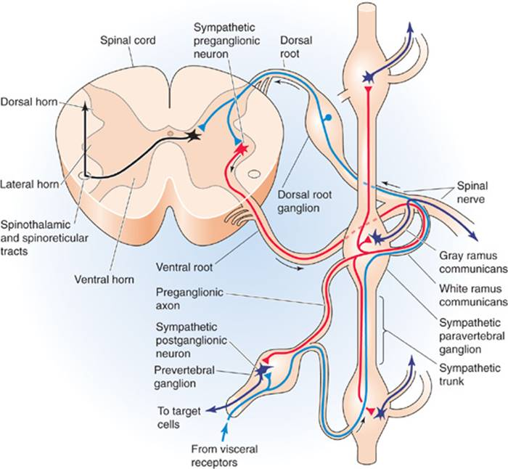
Branching of the spinal nerve - S
Preganglionic fibres
Postganglionic fibres
Ramus com. albus
Ramus com. griseus
1
3
Interpolation in another segment
Prevertebr. ggl. – visceral fibres
R. com. griseus – periphery (C fibres)
2
1

Slide 8
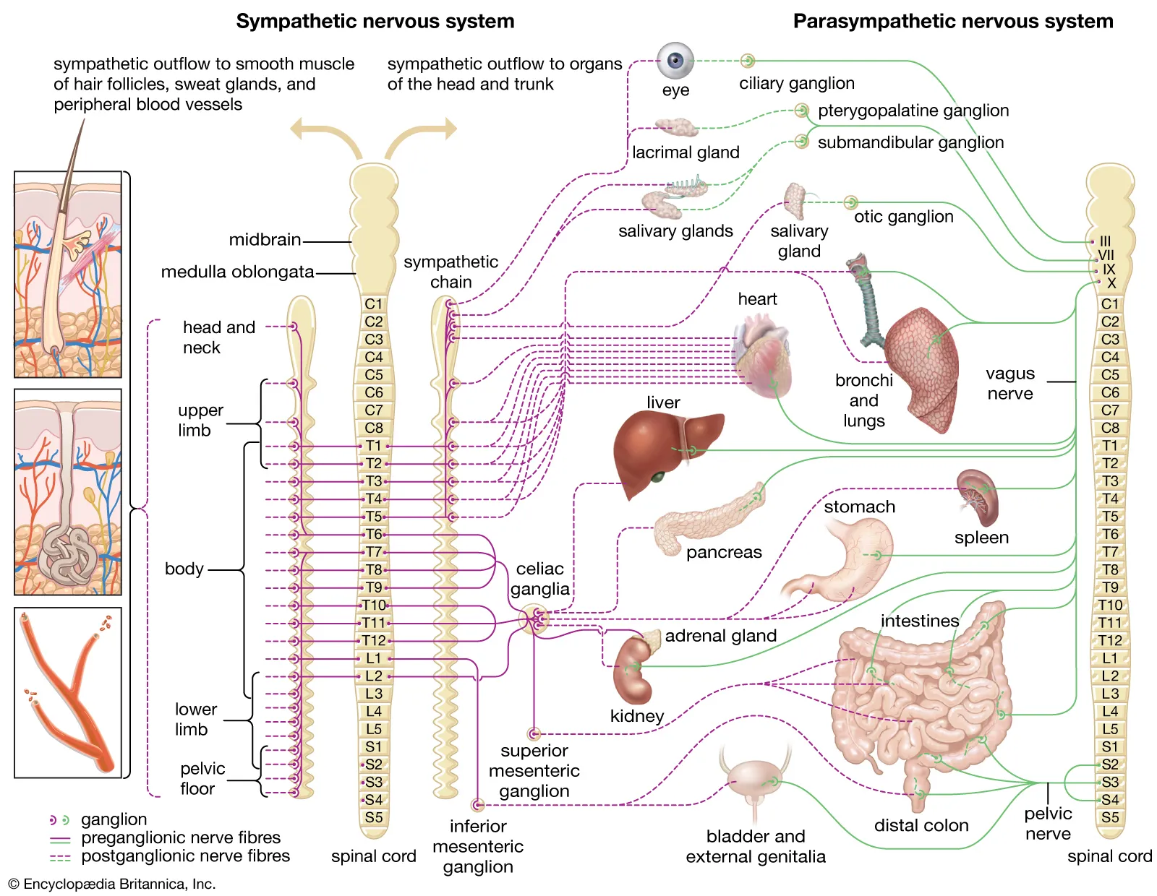
Sympatikus
Thoracolumbal system
Pilomotor
Sudomotor
Vasomotor function

Slide 9
Parasympaticus
Cell bodies of preganglionic neurons – brain stem + S2-S4
Preganglionic fibres – n.III, VII, IX, X + sacral segmental nerves
Craniosacral system
Ganglia in the wall of effector organs, often diffusely located (intramural)
Short postganglionic fibres

Slide 10
Parasympatikus
Craniosacral system

Slide 11
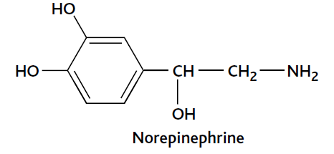
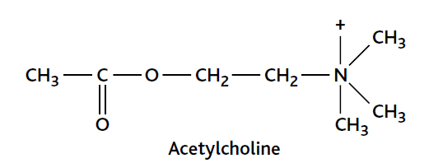
Neurotransmitters
S – noradrenalin = norepinephrin – postganglionic fibres
Acetylcholin – preganglionic fibres in S and PS + postganglionic fibres in PS
Ach in postganglionic S – sweat glands – exception!
Adrenergic and cholinergic fibres
S – response based on the type of receptor and affinity of neurotransmitters (ligands)

Slide 12
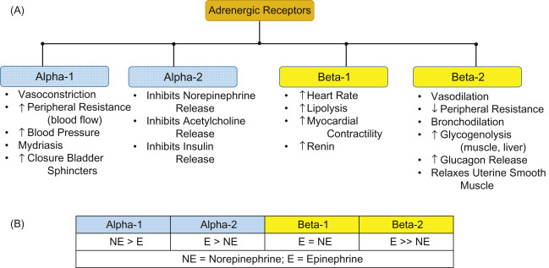
Adrenergic receptors
Gq
Gi
Gs
AFINITY

Slide 13
Adrenergic receptors
Norepinephrin – alpha-1 – vasoconstriction – prevalent in GIT blood vessels
Epinephrin from adrenal medulla – peripheral vasodilatation – prevalent beta-2 receptors in skeletal muscles
AFINITY

Slide 14
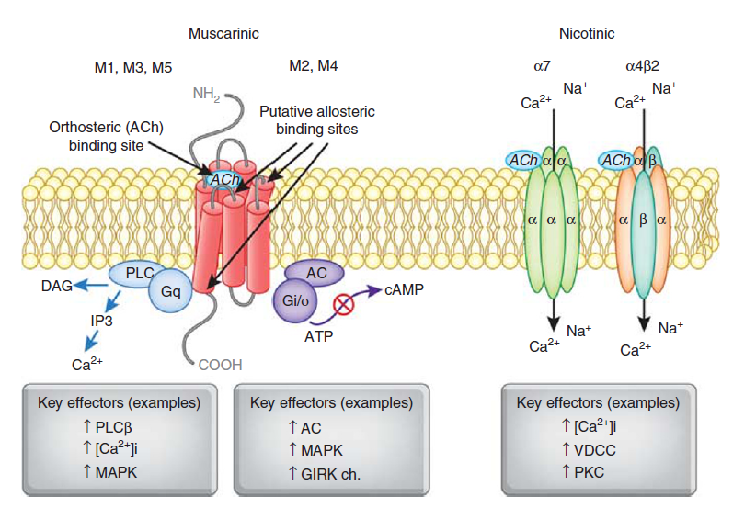
ACh - Nicotinic receptors
ion channels
ionotropic receptors
cation channels permeable for Na⁺ and K⁺
Muscular type – N_{M}
Neuronal type – N_{N}

Slide 15
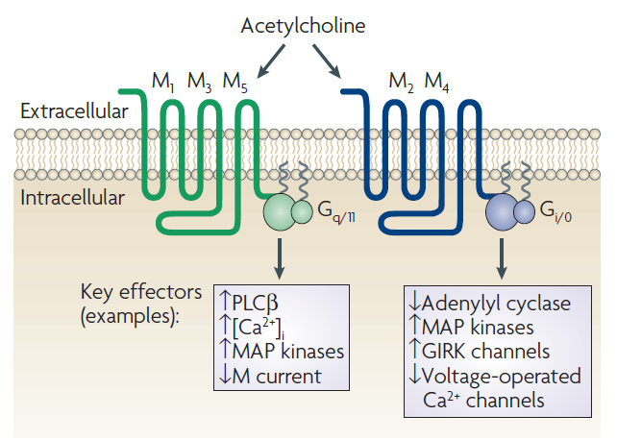
ACh - Muscarinic receptors
5 types
GPCRs = G-protein coupled receptors
Metabotropic receptors
Gq
Gi
depolarization
hyperpolarization

Slide 16
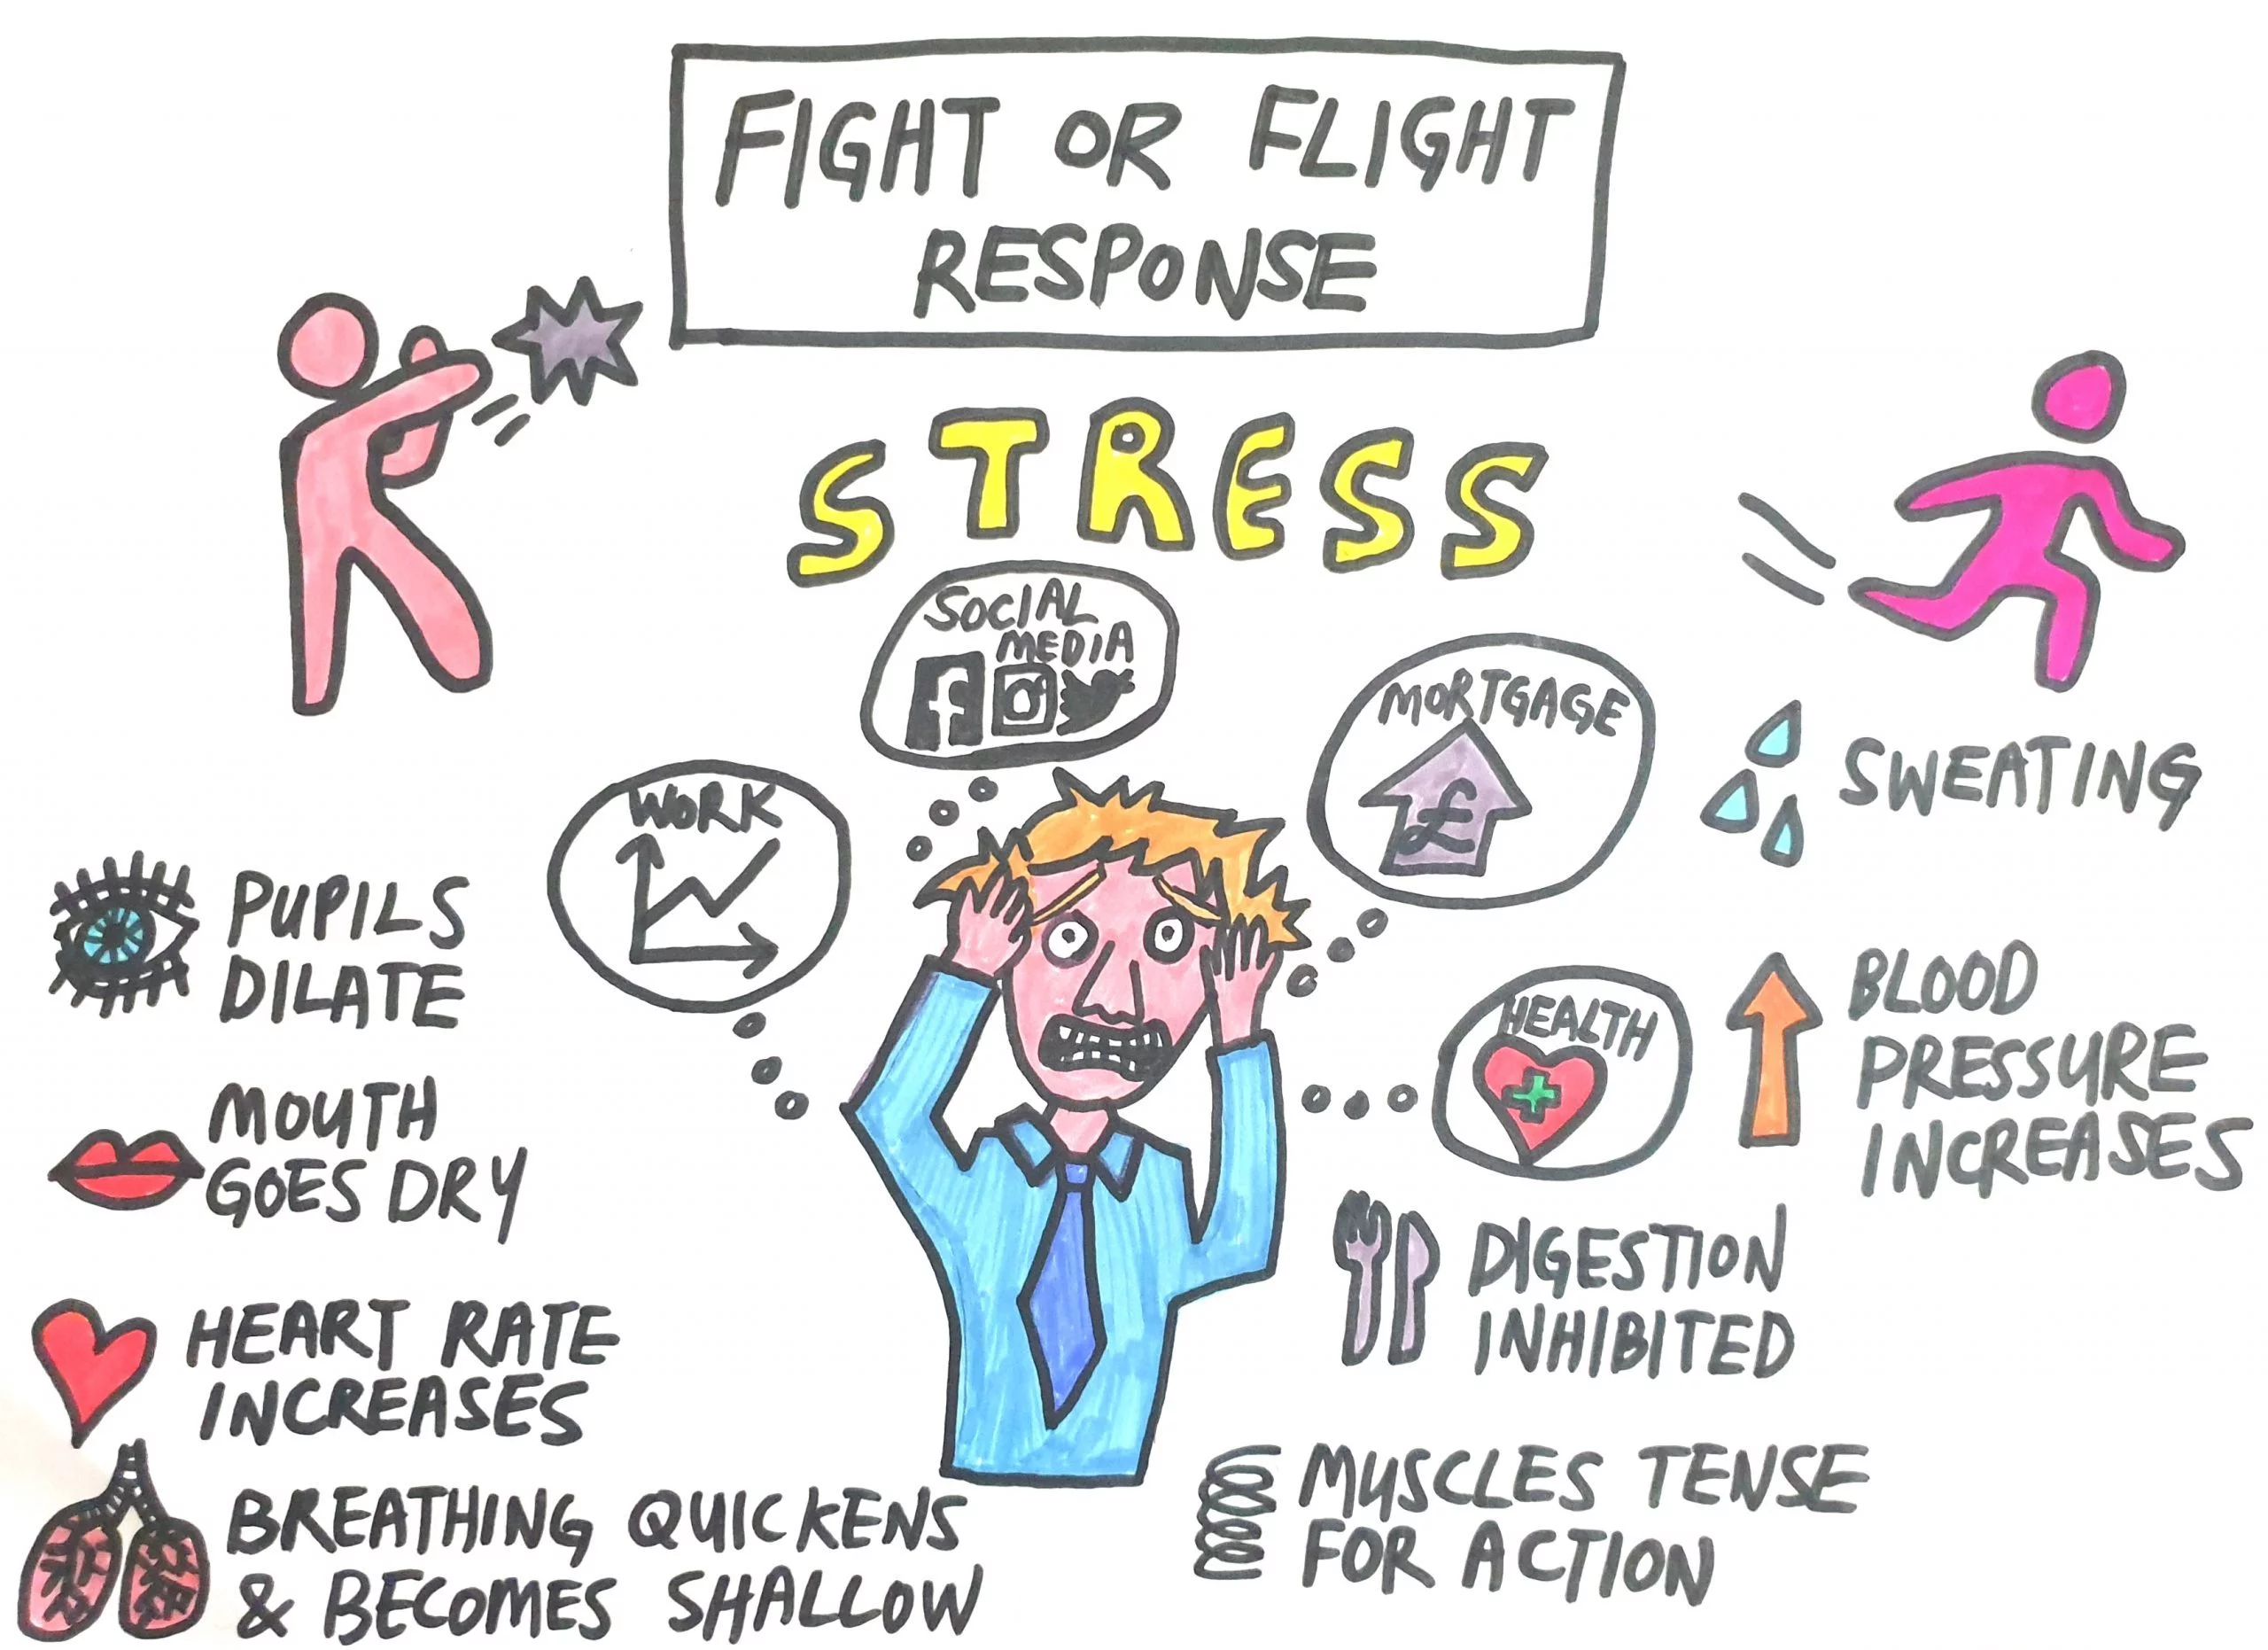
S – specific parts and their function
Metabolism
Glucose release
Glycolysis
Mental activity
The goal is to use energy
Activation of the
coagulation cascade

Slide 17
Carotid plexus
Cervical ggl.
Superior
Medial
Inferior
α₁
Gq
β₁
Gs
β₂
Gs

Slide 18
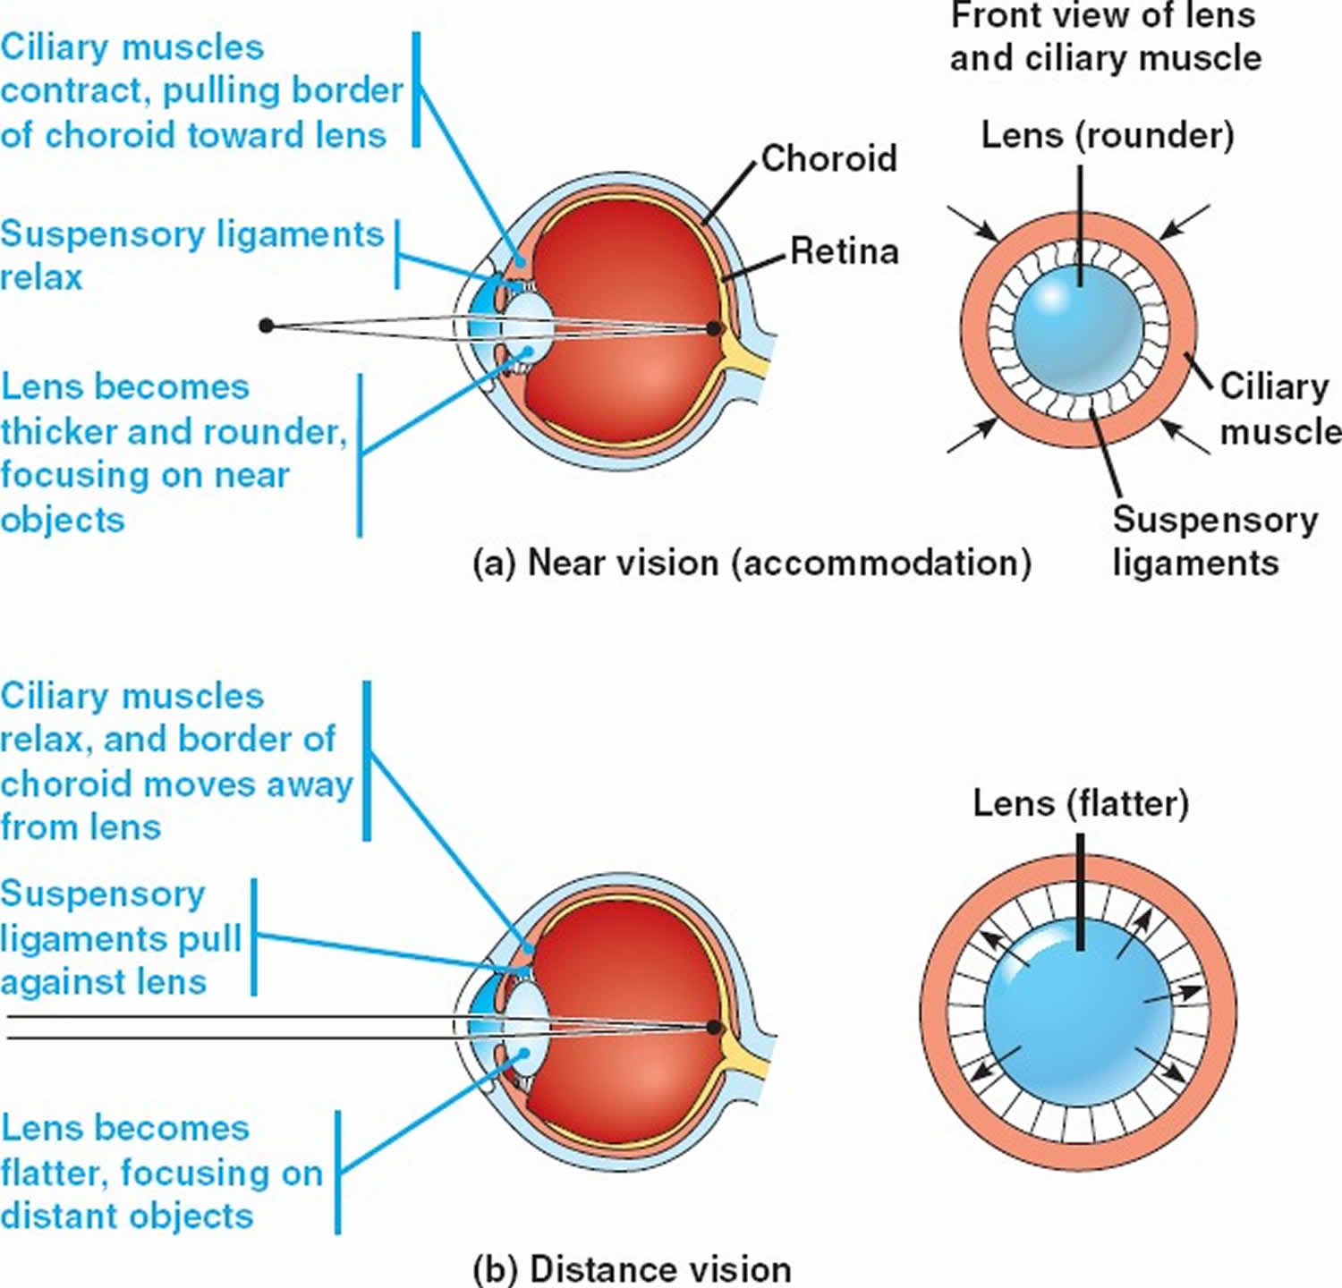
S – cranial part
α₁
Mydriasis – pupils dilatation – to increase the vision angle
Ciliaris muscle – relaxation – flat lens
-> far vision
glands – low importance
Thicker and less saliva secretion
β₂

Slide 20
S – heart
S increases the heart pumping
+ inotropic effect (increase in the heart force)
Increase in the heart rate
+ chronotropic, dromotropic, bathmotropic
Blood pressure – S increases the resistance in peripheral blood vessels (above all vasoconstriction in the gut) – causing acute increase in the blood pressure
β₁

Slide 21
S – T part - others
Metabolism
Glycogenolysis in the liver
Gluconeogenesis
Pancreas
increased glucagon secretion
decreased insulin secretion
Bronchi – smooth muscles relax to increase the diameter
Decreased secretion
β₂

Slide 23
S – visceral parts - GIT
Lower T and L segments
Coeliac ggl.
Duodenum, jejunum, ileum
Colon – up to 2/3 transversal
Vasoconstriction
Inhibition of digestion – decrease in peristalsis, adsorption, secretion
Increase in the sphincter tonus
Kidney – decrease in blood flow – lower urine production
α₁
β₂
α₁

Slide 24
S – visceral parts - GIT
Lumbar segments
mesenteric ggl. superior, ingerior
Colon – descending up to distal 1/3 transversal
Rectum – internal anal sphincter contraction
Ureter
Decrease detrusor contraction
Increase sphincter uretrae contraction
Uterus – end of gestation to prevent contraction
Ejaculation
β₂
α₁
α₁

Slide 25
S – adrenal gland
Adrenal medulla – chromaffin cells - modified postganglionic neurons
Preganglionic fibers come without reconnection in ganglia
Ach – cholinergic transmission
Release of epinephrine and norepinephrine into the blood stream
Platelets – aggregation
80%
20%

Slide 27
S – peripheral fibers
Coming through ramus communicans griseus
Reconnection at the same segment level
Periphery – blood vessels, sweat glands, mm. piloerectores
!!! Cholinergic fibers
Increase in the volume of secreted sweat
Skin – vasoconstriction
Skeletal muscles - vasodilation
α₁
β₂

Slide 28
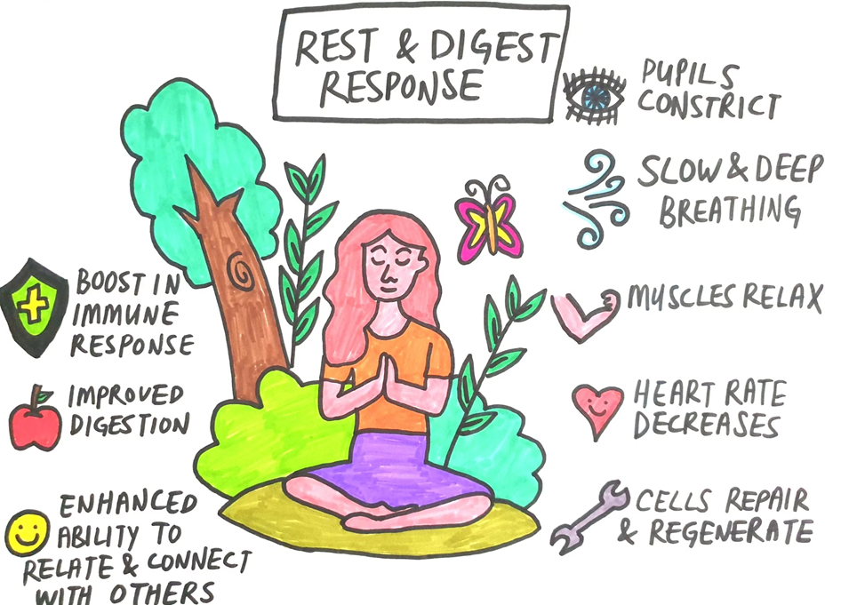
PS – specific parts and their function
The goal is to store energy

Slide 29
M1
Gq
M2
Gi
M3
Gq

Slide 30
PS – cranial part
nuclei PS:
ncl. Edinger-Westphal – n.III – ggl. Ciliare -> m. ciliaris, pupil
ncl. salivatorius superior – n. VII – ggl. pterygopalatinum + ggl. submandibulare -> lacrimal and salivatory glands
ncl. salivatorius inferior – n. IX – ggl. oticum –> parotid salivatory gland
ncl. dorsalis n. vagi – n.X
neuron – axon – transmission – neuron – axon – effector = 2 neurons

Slide 31
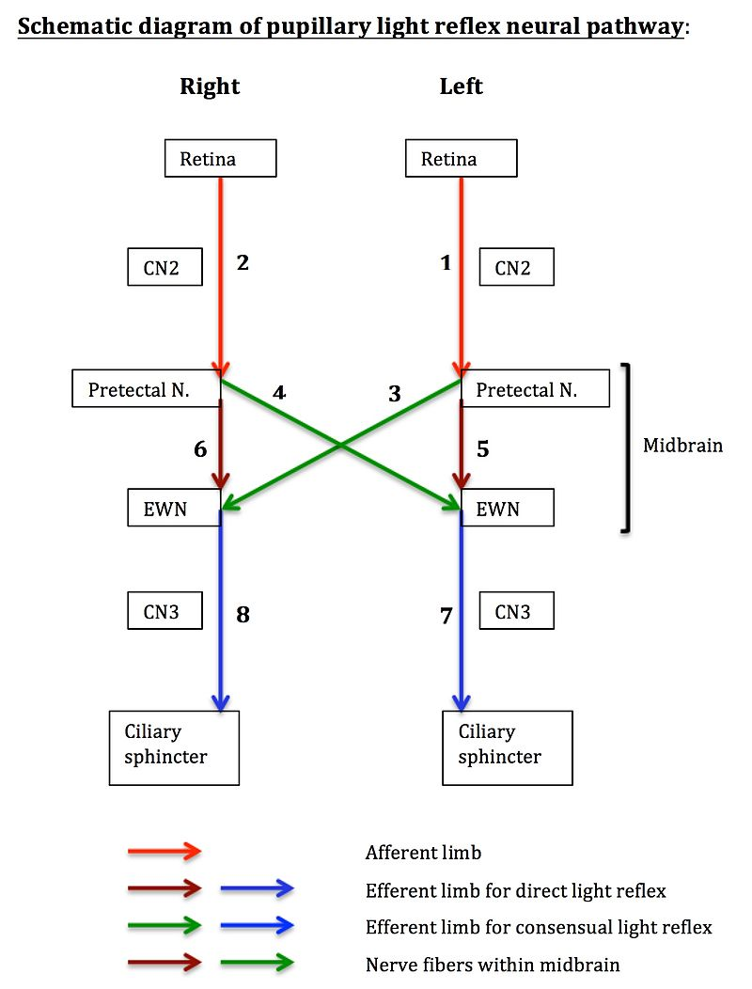
PS – cranial part
M. sphincter pupillae (ring) – miosis
M. cilliaris - contraction – accommodation
-> near vision – lens becomes globular
VII – lacrimation, salivation (submandibular gl.)
IX – salivation stimulation (parotid gland)
Increased secretion of saliva (enzymes,
watery secretion)
M3
Pupillary reflex – too much light entering
the eye triggers miosis in both eyes
Atropine – triggers mydriasis – anticholinergic effect through relaxation of m. sphincter pupillae

Slide 33
PS – n. vagus
75% of the PS
Bronchi – pulmonary plexus – bronchoconstriction, mucous secretion
Heart – cardiac plexus – SA node + AV node -> decrease frequency of Aps -> decrease heart rate = negative chronotropic, bathmotropic and dromotropic action => BP decrease
Oesophagus – peristalsis increase
Stomach – increase motility and secretion, sphincters relaxation
Celiac plexus – (right X) – kidneys, proximal 2/3of transversal colon, duodenum, jejunum, ileum, pancreas – increasing motility, secretion, absorption
β cells – insulin release
Left X – liver, biliary tract– hepatic plexus – glycogenesis, gallbladder contractions, relax hepatopancreatic sphincter
Ncl. Dorsalis n. X.
Ncl. Ambiguus
M2
M3
M1
Gastric glands
HCl, pepsin

Slide 35
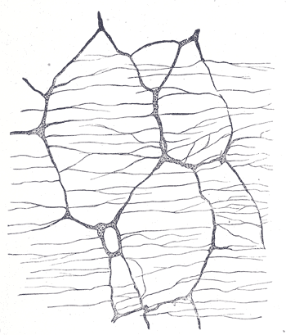
PS – sacral part – S2-S4
Pelvic splanchnic nerves – gonads, ureter, rectum, descending colon
Colon motility increase -> defecation – internal anal sphincter relaxation
Bladder emptying
detrusor muscle contraction
internal ureteral sphincter relaxation
Erection
M3
Plexus myentericus Auerbachi – muscle layer
Plexus submusosus Meissneri – glands - secretion

Slide 36
Visceral reflexes
Basic functional unit of ANS
Receptor – afferent fibers – center – efferent fibers – effector
The sensory signal is unconscious, from organs and receptors
Efferent fibers – sympaticus and parasympaticus
Sucking reflex, swallowing, salivation, gastric secretion, vomiting, defecation (PS-mediated spinal cord reflex)…
Baroreceptor reflex

Slide 37
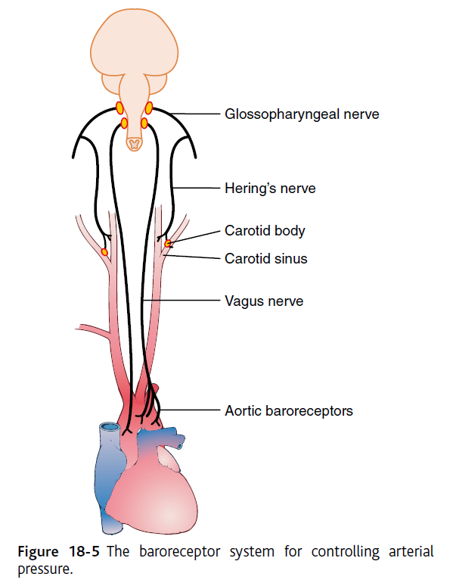
PS - interoreceptors
Chemoreceptors
Baroreceptors
Mechanoreceptors
N.X to ncl. Tractus solitarii
Baroreceptors
Negative feedback – inhibitory mechanism
Increase in blood pressure triggers inhibition of the vasoconstriction center in medulla oblongata followed by vasodilatation and a decrease in heart rate
Happens after standing from supine position – increase in S activity - orthostatic test

Slide 38
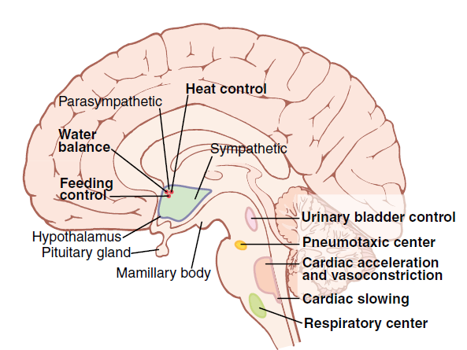
Central structures involved in ANS control
Spinal cord
Brain stem
Hypothalamus
Limbic system –
emotional responses and
their visceral manifestations
Vasoconstriction center
Cardiac regulation centers
Respiratory centers

Slide 39
Antagonistic function of S and PS
PS – anabolism
S – catabolism – glycogenolysis
Most of the organs receive both types of inputs
S only – most of the blood vessels, sweat glands
PS only – lacrimal glands
TONUS – S and PS active all the time
with maintaining signal frequency
The balance between S and PS
activity changes

Slide 40
Characteristics of the regulation
speed (heart rate can increase twice in a few seconds, blood pressure as well)
hormones – act in a slower way but for longer time

Slide 41
Other effects on ANS functions
Stress, fear, emotions, focus, attention
Circadian rhythms
Voluntary control of sphincters
Breathing exercises, meditation
Acute and chronic stress
Gut-brain axis

Slide 42
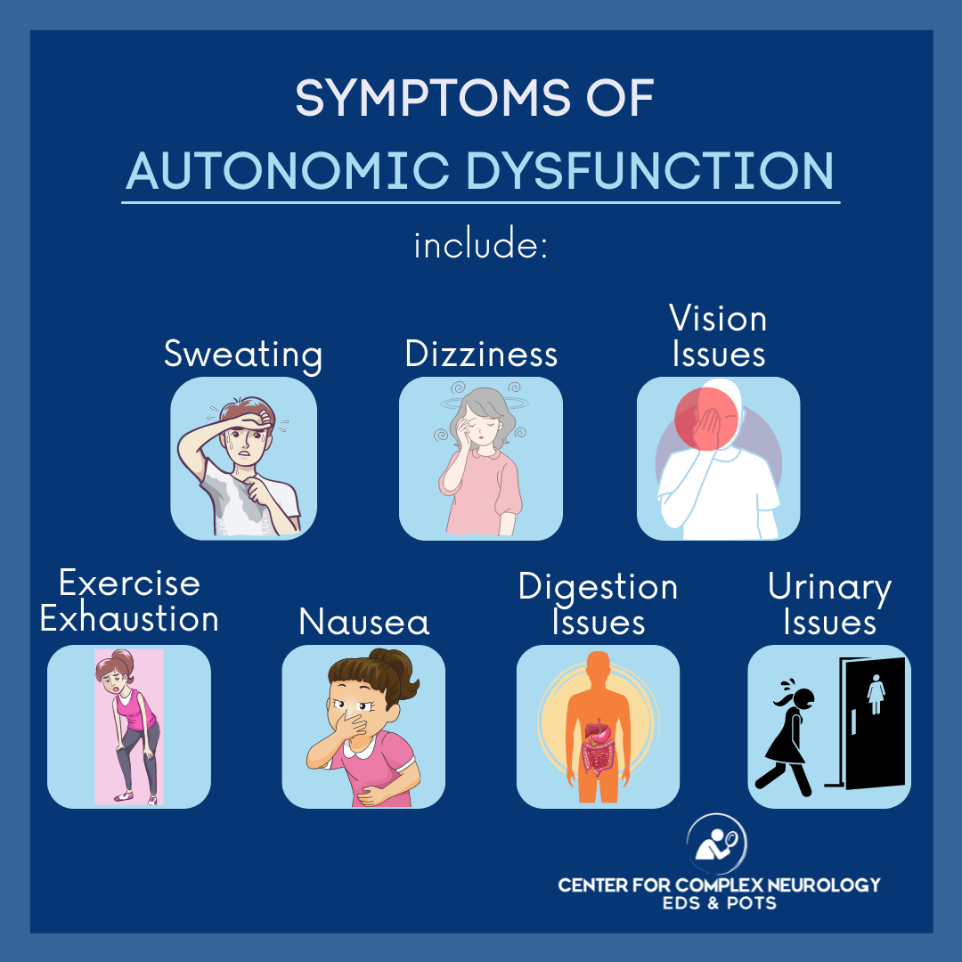
Take care of your ANS!

