Slide 1
Shakespeare’s Comedies

Slide 2
Conventions of comedy
Low genre
Ordinary people
Literary origins in Roman comedy (Plautus)
5 acts
Verse (English verse, rhyme and prose)
Old x young generation
Roman: city x English: magic, disguise, the supernatural
Plots from literary sources
From threat of disorder to harmony

Slide 3
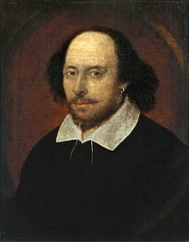
Life
23rd April (?) 1564
Baptised 26rd April
Died 23rd April 1616
Anne Hathaway
By 1592 in London*
1594 joined The Lord Chamberlain’s Men
1610 retired and returned to Stratford

Slide 4
Robert Greene A Groatsworth of Wit
“There is an upstart crow, beautified with our feathers, that with his tiger’s heart wrapped in a player’s hide supposes he is as well able to bombast out a blank verse as the best of you, and being an absolute Johannesfactotum is in his own conceit the only Shake-scene in a country.”

Slide 5
Francis Meres Palladis Thamia: Wit’s Treasury (1598)
As Plautus and Seneca are accounted the best for Comedy and Tragedy among the Latins, so Shakespeare among the English is the most excellent in both kinds for the stage.

Slide 6
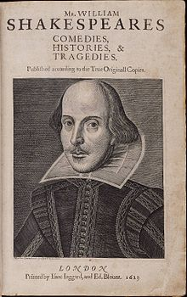
Ben Jonson in the First Folio (1623) ed. by John Heminges and Henry Condell
Triumph, my Britain, thou hast one to show
To whom all scenes of Europe homage owe.
He was not of an age, but for all time!

Slide 7
Works Early years
1588-95 Henry VI (1,2,3) 1594,1595,1623
A Comedy of Errors 1623
Richard III 1597
King John 1623
Titus Andronicus 1594
The Taming of the Shrew 1623
The Two Gentlemen of Verona 1623
Love’s Labour’s Lost 1598

Slide 8
Middle years (1595-1600) Romantic / Festive comedies
1595-6 Romeo and Juliet 1597
Midsummer Night’s Dream 1600
Richard II 1597
1596-8 The Merchant of Venice 1600 Henry IV (1,2) 1598,1600 The Merry Wives of Windsor 1602 Much Ado About Nothing 1600
1598-1600 Henry V 1600
As You Like It 1623
Twelfth Night 1623
Julius Caesar 1623

Slide 9
The Peak (1600-1608) Problem plays
1600-02 Hamlet 1603
Troilus and Cressida 1609
1602-05 All’s Well That Ends Well 1623
Measure for Measure 1623
Othello 1622
1605-06 Macbeth 1623
King Lear 1608
1606-08 Antonius and Cleopatra 1623
Coriolanus 1623
Timon of Athens 1623

Slide 10
The Late Plays (1608-1613) Romances / Tragicomedies
1608-10 Pericles 1609
Cymbeline 1623
1610-11 The Winter’s Tale 1623
The Tempest 1623
1613 Henry VIII 1623
Two Noble Kinsmen 1634

Slide 11
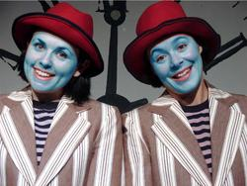
A Comedy of Errors
Plautus, Menaechmi
Antipholus of Ephesus
Antipholus of Syracuse
Dromio of Ephesus
Dromio of Syracuse
Aristotelian unity of time (24 hours) and place

Slide 12
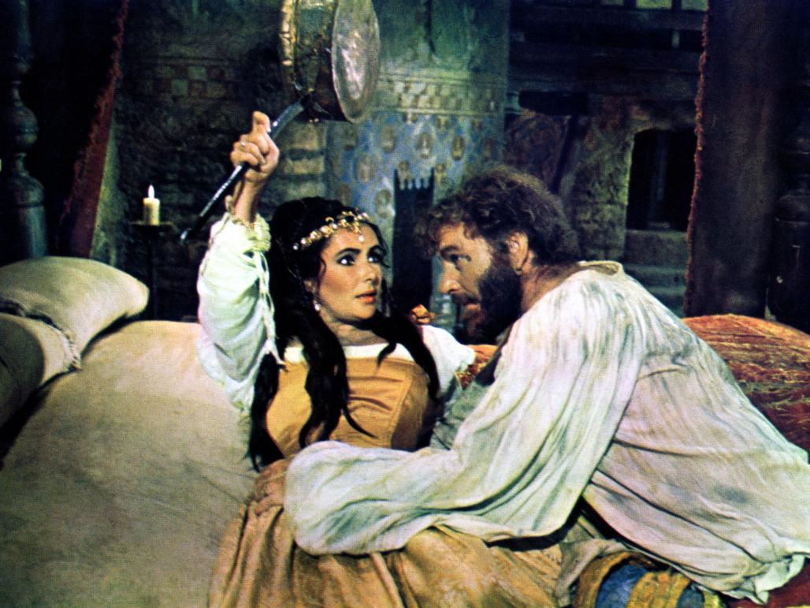
The Taming of the Shrew
Christopher Sly
Framing device
Play within the play
Kate and Petruchio
Bianca and Lucentio

Slide 13
Love’s Labour’s Lost
Ferdinand, King of Navarre
Lord Berowne (Biron)
Princess of France
Don Armado, a fantastical
Spaniard
Sir Nathaniel, a curate
Holofernes, schoolmaster

Slide 14
"When Daisies Pied and Violets Blue"
When daisies pied and violets blue
And lady-smocks all silver-white
And cuckoo-buds of yellow hue
Do paint the meadows with delight,
The cuckoo then, on every tree,
Mocks married men; for thus sings he,
"Cuckoo,
Cuckoo, cuckoo!" - O word of fear,
Unpleasing to a married ear!
When shepherds pipe on oaten straws,
And merry larks are ploughmen's clocks,
When turtles tread, and rooks, and daws,
And maidens bleach their summer smocks,
The cuckoo then, on every tree,
Mocks married men; for thus sings he,
"Cuckoo,
Cuckoo, cuckoo!" - O word of fear,
Unpleasing to a married ear!
"When Icicles Hang by the Wall"
When icicles hang by the wall,
And Dick the shepherd blows his nail,
And Tom bears logs into the hall,
And milk comes frozen home in pail,
When blood is nipped and waysbe foul, roads
Then nightly sings the staring owl:
"Tu-whit, to-who!"
A merry note,
While greasy Joan doth keel the pot. cool (as by skimming or
stirring)
When all aloud the wind doth blow,
And coughing drowns the parson's saw old saw, platitude
And birds sit brooding in the snow,
And Marian's nose looks red and raw,
When roasted crabs hiss in the bowl, crabapples
Then nightly sings the staring owl:
"Tu-whit, to-who!"
A merry note,
While greasy Joan doth keel the pot.

Slide 15
A Midsummer Night’s Dream
Fairies (Oberon, Titania, Puck etc.)
Athens (Theseus, Hippolyta, Egeus, Hermia, Lysander, Helena, Demetrius)
The “rude mechanicals” (Peter Quince, Nick Bottom, Flute, Snout, Snug, Starveling)
Unity of time
Rhymed verse, blank verse, prose

Slide 16
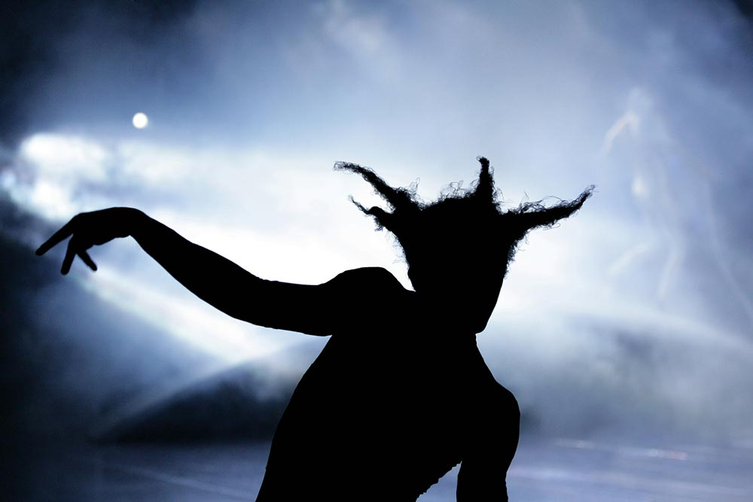
Dramatic illusion
… you have but slumbered here
While these visions did appear.
And this weak and idle theme,
No more yielding but a dream. (V.i.415-8)

Slide 17
Sir John Falstaff
Henry IV Part One and Part Two
Miles gloriosus
Gluttony
Vice
Il Capitano (commedia dell’ arte)

Slide 18
The Merchant of Venice
Christopher Marlowe, The Jew of Malta (Barabas)
Shylock – Don Juan, Jacques, Malvolio
Portia – Beatrice, Rosalind, Viola

Slide 19
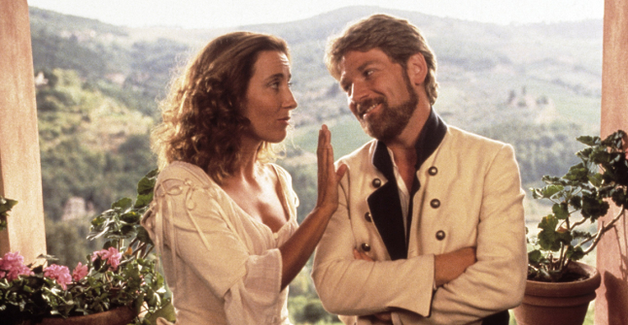
Much Ado About Nothing
Benedick and Beatrice
Don Juan, the bastard brother of Don Pedro, King of Aragon
Hero and Claudio
Dogberry, the constable in charge of the night watch in Messina
malapropisms
Actor Will Kempe

Slide 20
As You Like It
Thomas Lodge, Rosalind
Rosalind, Celia, Touchstone, Orlando
Jacques
Robert Arnim
Hymen
Blow, blow, thou winter wind,
Thou art not so unkind
As man’s ingratitude
Ay, now I am in Arden; the more fool I. When I was at home, I was in a better place; but travellers must be content.

Slide 21
Twelfth Night
Epiphany
Illyria
Olivia, Viola, Sebastiano, Orsino
Sir Toby Belch, Sir Andrew Aguecheek
Feste
Malvolio (“I'll be revenged on the whole pack of you.”)

Slide 22
Problem Plays Measure for Measure
Vincentio, Duke of Vienna
Angelo, his Deputy
Mistress Overdone
Barnardine, a dissolute prisoner
Mariana

Slide 23
The Last Plays Romances / Tragicomedies
Francis Beaumont and John Fletcher (WS’s Henry VIII and The Two Noble Kinsmen written in collaboration with JF)
The Blackfriars
Tragic opening, comic ending
Surprise, reversals
Miracles, magic, the supernatural
Plot, not character

Slide 24
Pericles
John Gower- Chorus
Pericles, Prince of Tyre
King of Antioch
King of Pentapolis
Marina

Slide 25
The Winter’s Tale
Robert Greene, Pandosto
Leontes, King of Sicily
Hermione, Perdita, Paulina
Florizel and Polyxenes, King of Bohemia
I was not much afeard; for once or twice I was about to speak and tell him plainly, The selfsame sun that shines upon his court Hides not his visage from our cottage but Looks on alike.
Autolycus
Princess Elizabeth and Frederick, Elector of Palatine (The Winter King)

Slide 26
The Tempest
Unities
Prospero, rightful Duke of Milan
Sycorax, Caliban, Ariel
Miranda, Ferdinand
O, wonder! How many goodly creatures are there here! How beauteous mankind is! O brave new world, That has such people in't!

Slide 27
Our revels now are ended. These our actors
As I foretold you, were all spirits and
Are melted into air, into thin air …
We are such stuff
As dreams are made on, and our little life
Is rounded with a sleep. (from act IV, scene 1)
https://www.youtube.com/watch?v=KFNTAsC8qQ0

