Slide 1
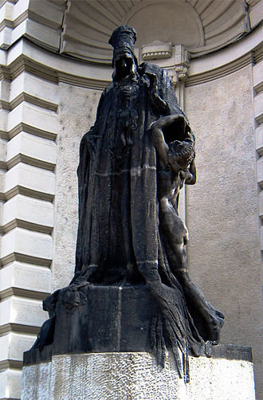
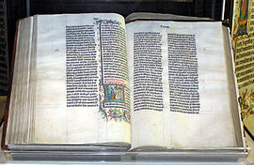
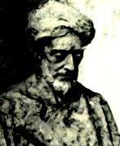
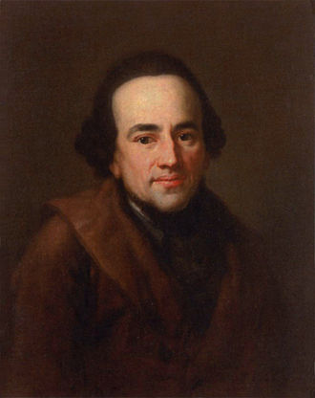
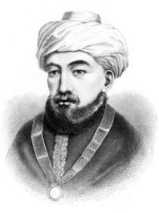
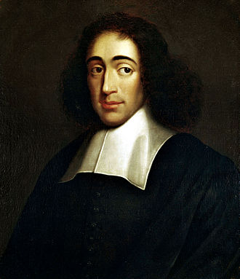
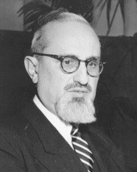
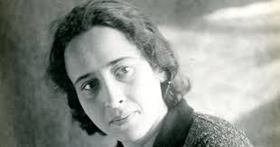
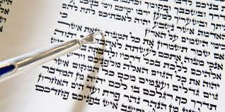
Introduction to Jewish Philosophical Thought
Thursday 9:10 – 10:45
Room 217
Dita Válová, Jana Tomešová

Slide 2
1. Texts and contexts
A: What is Jewish philosophy?
B: Scepticism towards foreign sciences. Talmudic criticism of philosophy and medieval controversy over philosophical teaching.
C: Texts: Sh. Carmy, D. Schatz: “The Bible as a Source for Philosophical Reflection” + Anonymous letter against philosophy
2. Jewish rationalism
A: Maimonides. Guide of the Perplexed and the Aristotelian background. Theory of prophecy.
B: Haskalah and Moses Mendelssohn. Jewish Enlightenment and the Exodus from the ghetto. Rational theology, Reform Judaism.
C: Texts: Maimonides, Letter on the Management of health and M. Mendelssohn: Jerusalem or On Religious Power and Judaism.
3. Jewish existentialism
A: J. D. Soloveitchik. The lonely man of faith in the modern world.
B: A. J. Heschel. The meaning of Jewish existence.
C: Texts: J. D. Soloveitchik, The Lonely Man of Faith; A. J. Heschel, God in Search of Man: A Philosophy of Judaism.
4. Jewish political and social philosophy
A: Spinoza: Comments on the traditional Judaism. The book forged in hell: Spinoza´s Theological-Political Treatise.
B: Hannah Arendt and political philosophy. Totalitarianism, citizenship and action. Nature of evil.
C: Texts: Spinoza, Theological-Political Treatise (book 1); H. Arendt, Eichmann in Jerusalem. A Report on the Banality of Evil.

Slide 3
Course on Moodle
http://ufar.ff.cuni.cz/
Rozvrh-tabulka
Tomešová, Válová: Introduction to Jewish Philosophical Thought
https://dl1.cuni.cz/course/view.php?id=7076
What´s there? → primary texts
→ PP Presentations
Sourcebooks
D. H. Frank, O. Leaman, History of Jewish Philosophy, Routledge, 1997¹
The Jewish Philosophy Reader, ed. by D. H. Frank, O. Leaman a Ch. H. Manekin, Routledge, New York, 2000.

Slide 4
Requirements
Students who wish to gain credits for the course must meet two requirements:
Attendance at the seminar each week. More than four absences will make one ineligible for the grade.
(2) Final paper in English (1000 - 1200 words) on a theme related to texts discussed
in seminars.
Deadline for final papers: 31st May 2020
Papers should be sent to: dita.valova@ff.cuni.cz

Slide 5
Theme 1: Texts and Contexts
What is the Jewish Philosophy? Who is the Jewish philosopher?

Slide 6
→ No „Jewish“ philosophers in the history of thinking. Only philosophers who were born as Jewish and imaged themselves as providing the interpretation of biblical and rabbinic tradition according to universal, philosophical categories. They interpret the Jewish tradition in philosophical terms.
→ Jewish philosophy is not a branch of philosophy, it is not a sub-discipline.
It is an interpretation of the Jewish tradition in the philosophical way.
Philo of Alexandria
c. 20 BC – c. 50
Allegorical commentaries on the Torah.
Hellenistic syncretism:
Plato and Moses
Moses Maimonides
1138 – 1204
Aristotle and Moses
Moses Mendelssohn
1729 – 1786
Reason and Moses

Slide 7
Wissenschaft des Judentums – Jewish Studies or Science of Judaism
19th century movement based on the critical investigation and research of Jewish
literature and culture, including rabbinic literature,
scientific methods to analyse the origins and pillars of Jewish traditions,
leading figure: Leopold Zunz.
Conclusion
Jewish philosophy is an academic discipline invented in the 19th century by Jewish scholars analyzing the texts of Jewish authors of Antiquity, Middle Ages and Modern Times which present a very different set of philosophical interpretations of Jewish traditional texts: Torah and Talmud.

Slide 8
a page pointer
Torah
first five books of 24 books of Hebrew Bible
= five books of Moses or Pentateuch
TaNaKH
Torah
+ books of prophets (Neviim)
+ writings (Khetuvim)
= Old Testament
Torah scroll

Slide 9
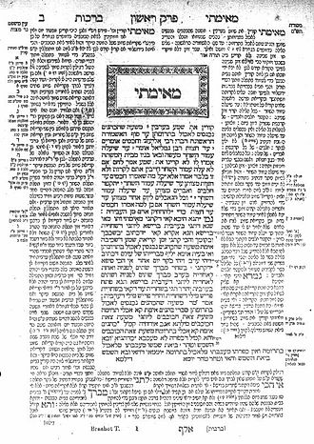
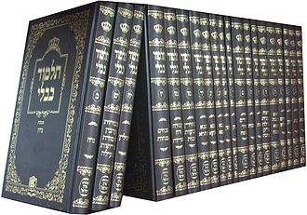
Talmud
commentaries on the Torah
central text of rabbinic Judaism
guide for daily life of religious Jews
63 tractates
Jerusalem Talmud and Babylonian Talmud
The first page of the
Babylonian Talmud,
Tractate Berachot, folio 2a
A full set of the Babylonian Talmud
in modern edition

Slide 10
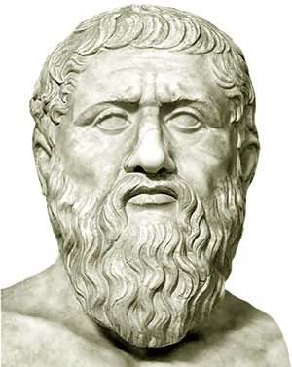
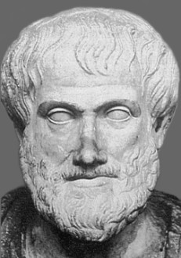
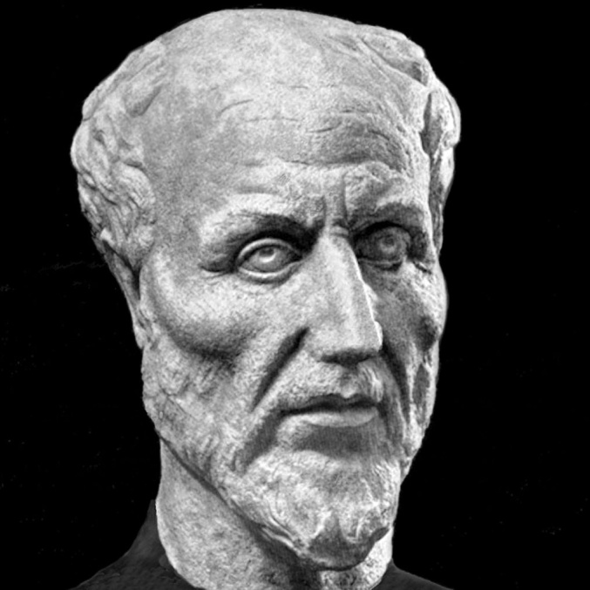
9th century – The age of translations
Plato: Timaeus, Sophist, Laws, Republic
Aristotle:
Organon (Categories, On interpretation, Prior Analytics, Posterior Analytics, Topics, On Sophistical Refutations) + Rhetoric, Poetics
Physics, On the Heavens, On generation and corruption, Meteorology, On the soul, Nicomachean Ethics, History of Animals, Parts of Animals.
Metaphysics.
Α α Β Γ Δ Ε Ζ Η Θ Ι Κ Λ Μ Ν
α Α Β Γ Δ Ε Ζ Η Θ I K Λ _ _
Neo-platonism:
So-called Aristotle’s theology
Paraphrase of the 4th, 5th and 6th book of Plotinus’ Enneads.

Slide 11
Reading for 5th March 2020
Shalom Carmy and David Shatz:
„The Bible as a source for philosophical reflection“
in: Daniel Frank and Oliver Leaman, History of Jewish Philosophy, Routledge, 1997.
! on Moodle !

