Slide 1
Local Government in Poland
Lecture for the students of the Institute of Political Studies,
Faculty of Social Sciences, Charles University in Prague
Daniel Klimovský (Comenius University in Bratislava)
6 March 2025, Prague
E-mail: daniel.klimovsky@uniba.sk
Instagram: daniel.klimovsky

Slide 2
A brief historical overview
Before 1918, Poland was a nation divided among three neighbouring countries (Russia, Prussia and Austria)
each of them used its own administrative system that varied form the others
The Polish state was re-instated after more than 120 years, and the country started building uniform local government structures
The constitutional foundations for local and regional self-government were established in the Constitution of 1921
municipalities have been the major territorial units since then

Slide 3
Self-government and the Communist regime
After World War II, the Communist Party‘s regime did not recognize self-government system as a system independent from authoritarian government
In 1950, all local governments were abolished and their assets were nationalized
The new system consisted of so-called people’s councils (rady narodowe), which later became territorial branches of the central government
The local councils suffered from a lack of electoral democracy, independent powers and independent budgets – there was a rule of strict and direct subordination in the public administration of Poland in the mentioned period

Slide 4
Development after the collapse of the Communist Party‘s regime – initial phase
The renewal of democratic local government system became one of the most essential pillars of the political transformation in Poland after the collapse of the Communist Party‘s regime
The very first steps were approved in December 1989, when amendments of the Constitution replaced the unified system of people’s councils with self-government institutions
In March 1990, local self-government at a municipal level (gmina) was legally restored
In May 1990, representatives of almost 2,500 local councils were elected in democratic elections

Slide 5
Development after the collapse of the Communist Party‘s regime – the second phase
The quick restoration of local self-government was feasible, because there were strategic concepts of self-government elaborated in the 1980s
In 1997, the new Constitution strengthened local government:
the Constitution mentions both decentralization and delegation
the preamble of the Constitution introduced the principle of subsidiarity
The crucial legislative package passed in June 1998 and enacted in 1999:
restoration of the 314 counties (powiat) as a second, supramunicipal tier of local government
establishing 16 regions (voivodeship) that replaced 49 former small voivodeships managed by the central administration

Slide 6
Local government structures
Since 1 January 1999, Poland has had a three-tier local government structure:
municipalities (gmina)
counties/districts (powiat)
voivodships

Slide 7
Municipal level
In Poland, as of 1 January 2020, there are 2477 communes:
1537 rural communes
638 urban-rural communes
302 urban communes, including 66 communes which are at the same time cities with district rights

Slide 8
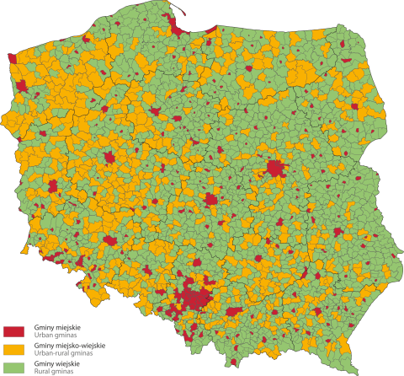

Slide 9
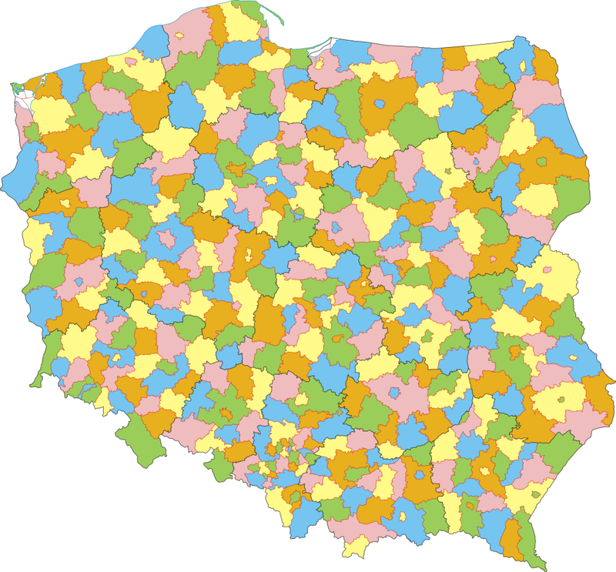
County/district level
314 counties in Poland

Slide 10
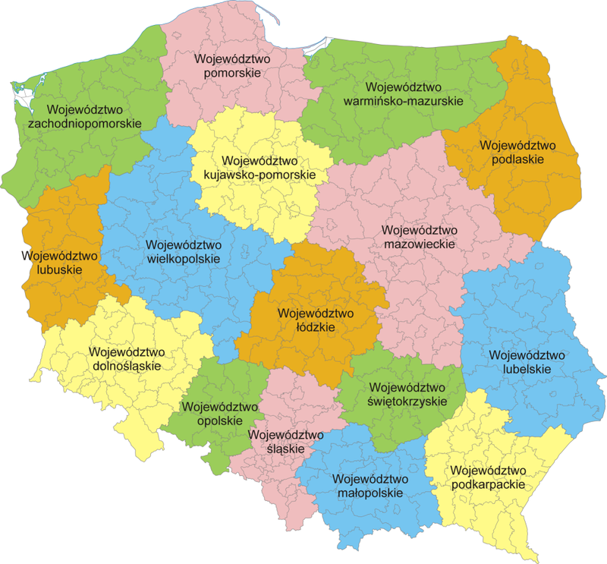
Regional level
16 voivodships in Poland

Slide 11
Main bodies at municipal level

Slide 12
Main bodies at county/district level

Slide 13
Main bodies at regional level

Slide 14
Tasks of municipalities
Management of municipal roads, streets, bridges and traffic organization
Water supply, sewage, waste disposal Heat and electricity supply
Local public transport Health and social welfare
Housing Education
Culture (municipal and public libraries, sports infrastructure)
Municipal greenery Cemeteries
Maintenance of markets and halls Fire protection

Slide 15
Electoral changes
In 2002, Poland introduced a direct election of mayors with a two-round system
In 2018, Poland adopted single-mandate election districts in municipalities up to 20,000 inhabitants and extends the term of local government bodies from 4 to 5 years

Slide 16
Participatory budgeting and civic engagement
Recently, Poland adopted legal provisions to enhance civic engagement
For instance, obligatory participatory budgeting has been introduced

Slide 17
Swianiewicz (2014)
Champions of decentralization (HUN, POL, SVK)
Relatively decentralized countries (CZE, EST, LAT)
Balkan countries (ALB, BUL, CRO, MAC, MOL, ROM, SLO, UKR)
Territorially consolidated countries (GEO, LIT, SER)
Funktionally centralized and territorially fragmented countries (ARM, AZE)

Slide 18
Heinelt, Hlepas, Kuhlmann, Swianiewicz (2018)

Slide 19
Ladner, Keuffer, Baldersheim, Hlepas, Swianiewicz, Steyvers, Navarro (2019)

Slide 20
Ladner, Keuffer, Baldersheim, Hlepas, Swianiewicz, Steyvers, Navarro (2019)

Slide 21
Thank you for your attention
daniel.klimovsky@uniba.sk

