Slide 1
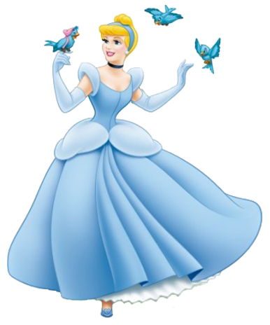
The Cinderella Syndrome Regarding the struggles of step children

Slide 2
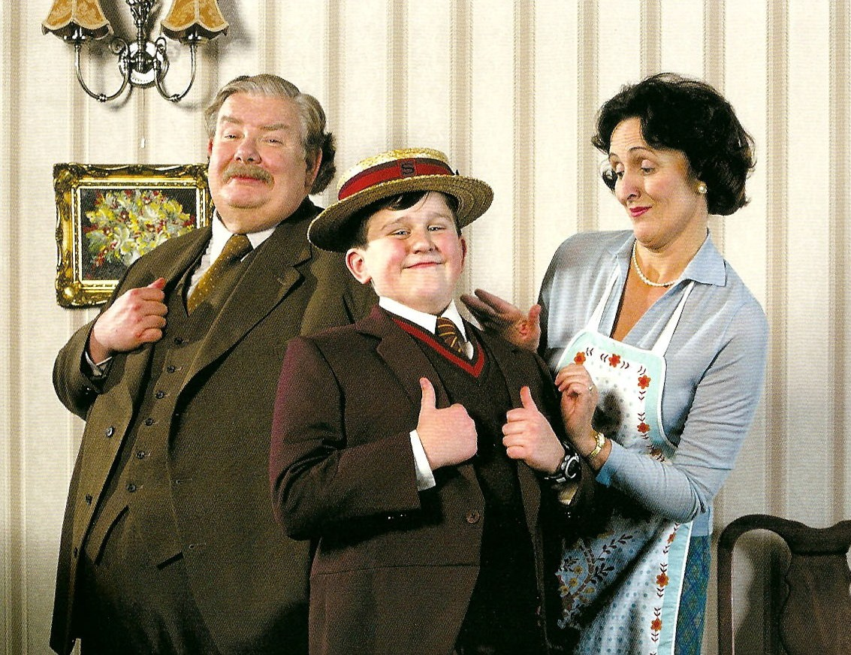
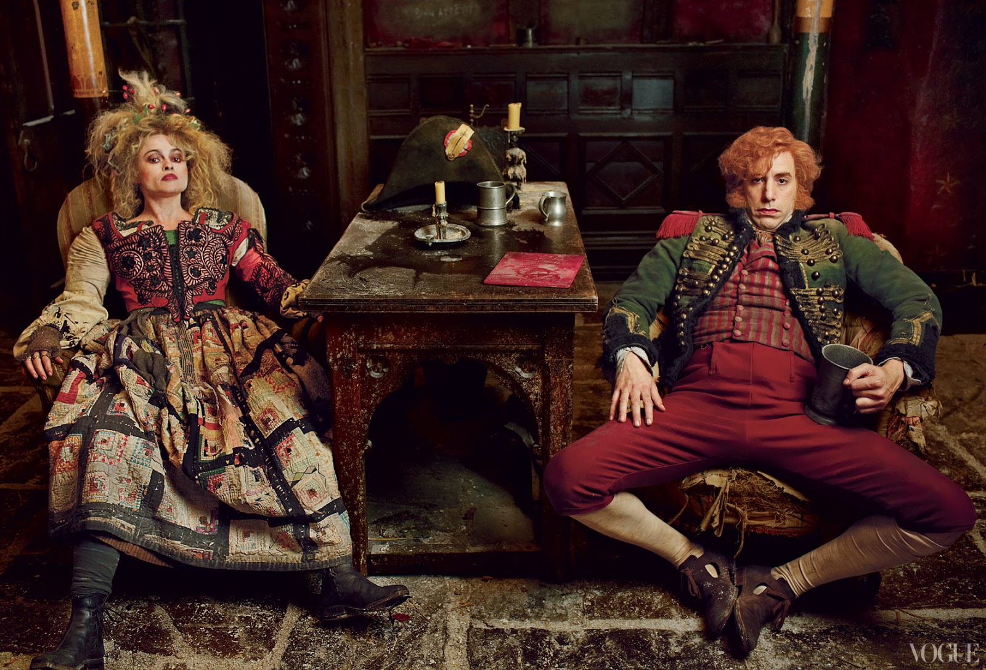
What in the Darwins’ Name is Going On?
There is an age-old motif of the “evil stepparent” manifesting itself as “Shades of Cinderella”
Cinderella is a transformative stock character, existing in numerous forms, in a multitude of cultures, but the same tale of woe is always easily identified: The concept of a deserving step-child being mistreated by the step-parent.
This phenomenon is Evolutionary Grounded in Darwinist underpinnings
Evolution frowns upon caring for another’s child as there is no “pay off”
To impart genes into the future is something that– despite social standing, culture, or social system--everyone wants to participate in

Slide 3
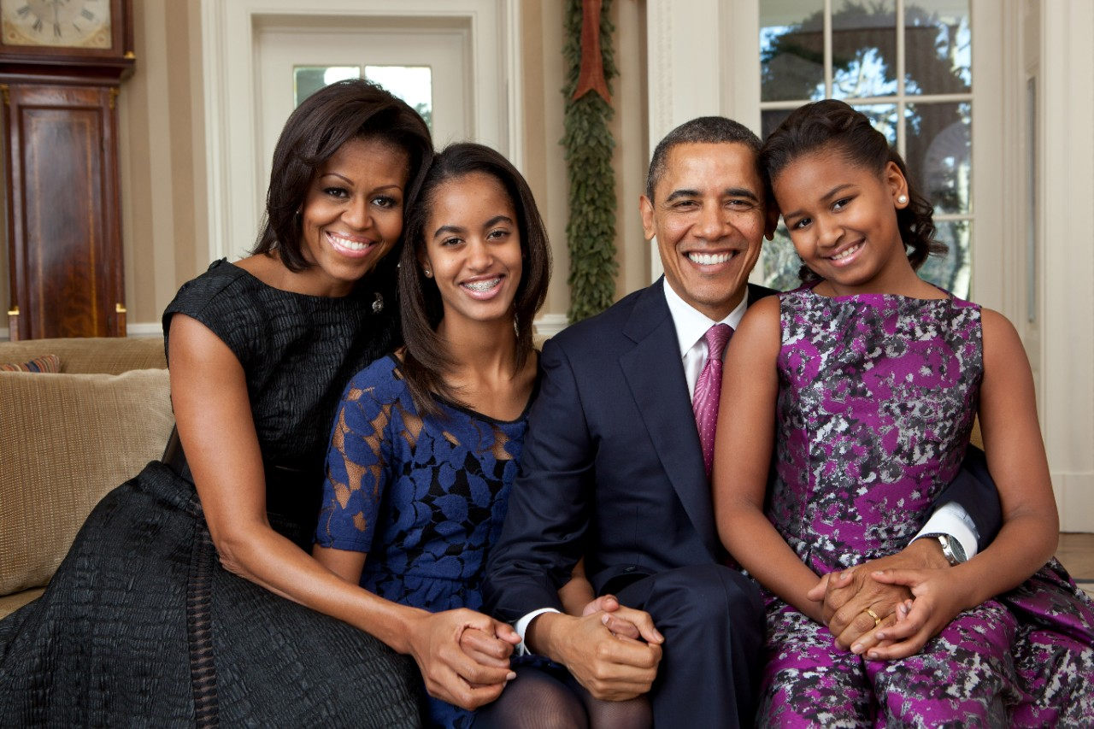
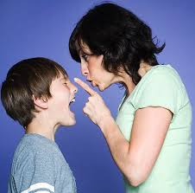
Biological Parents vs. Stepparents
Parenting is considered to by an “extreme form of kin selection” (174)
To be a parent is to participate in a one-directional flow of benefits which is necessitated by the fact that they are older, larger, wiser, and more powerful than their children
Parents are biologically expected to conform to these expectations and to accept an asymmetrical relationship with their children
Stepparents struggle to imitate biological parents in their behavior and in their feelings
Child rearing can be an extremely stressful undertaking, even for the most balanced and devoted genetic parents. Without a genetic connection to the child, there is a considerably lower tolerance for crying, interruptions, the constant necessities of food, clothing, education
Children who reside with a stepparent are far more predisposed to neglect, abuse, or even infanticide; their risk factor is about 40-60 times greater than children who live with biological parents

Slide 4
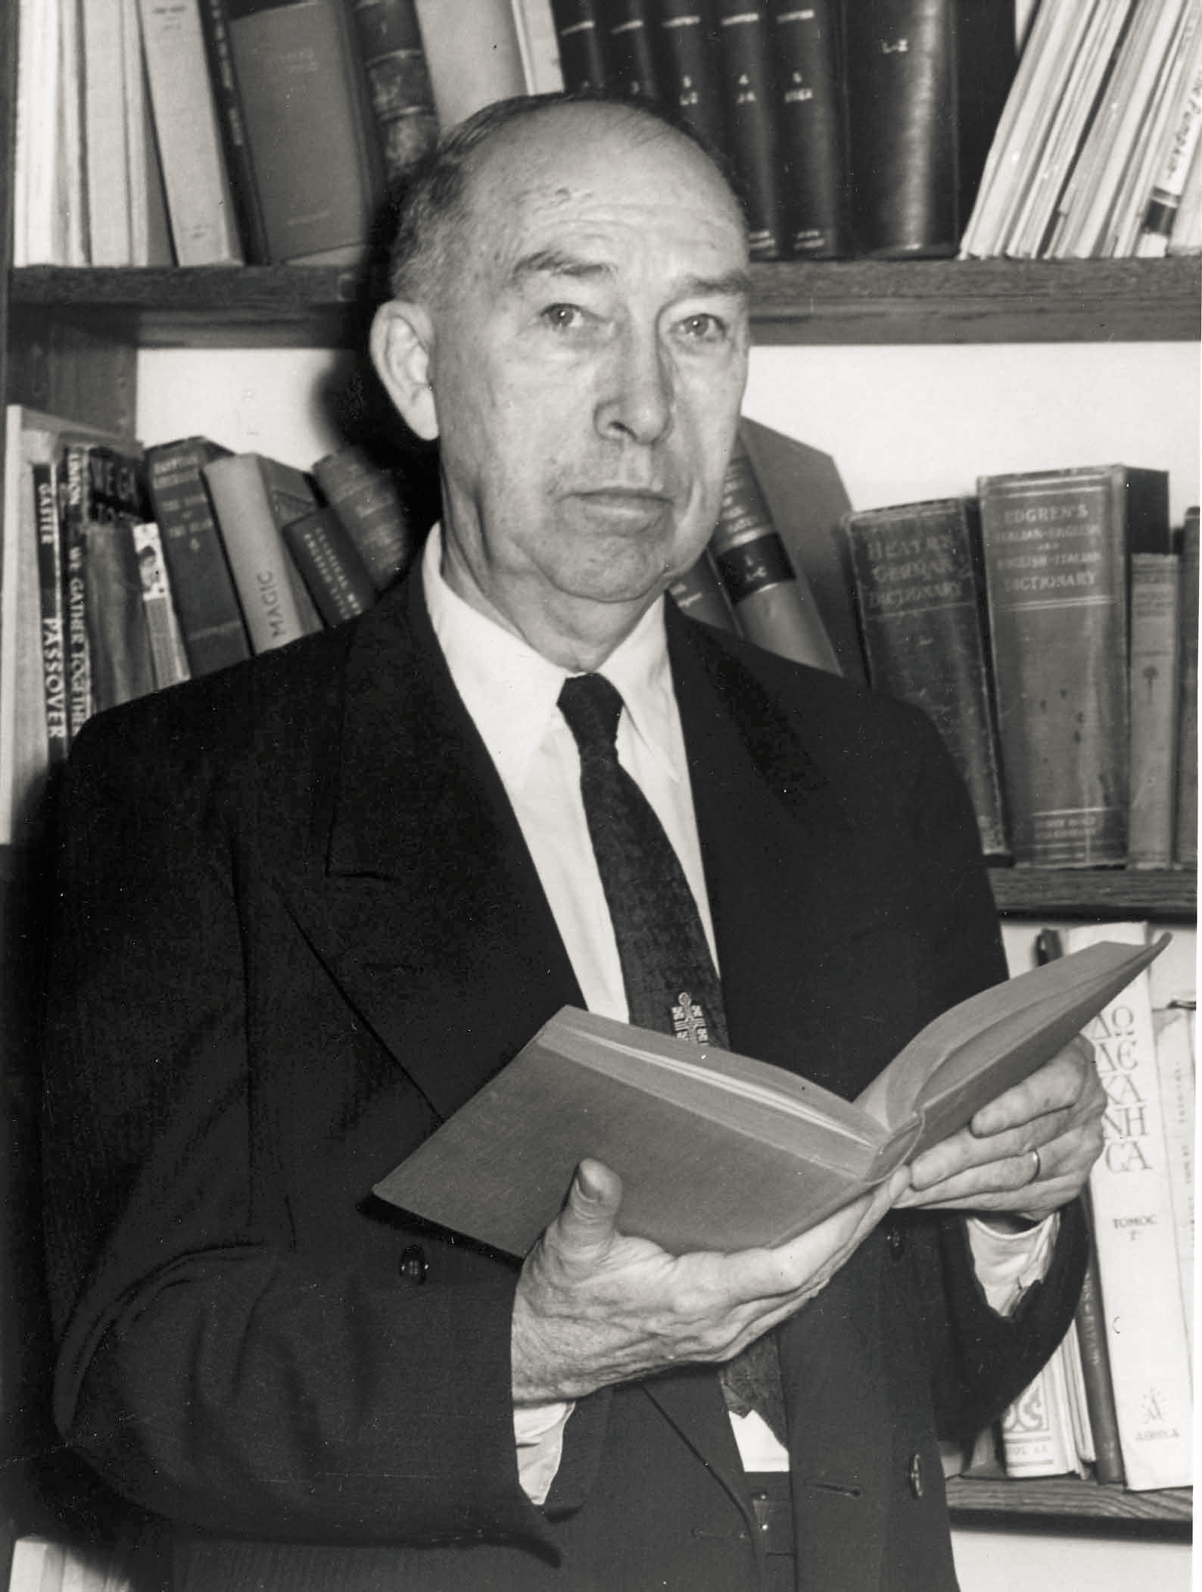
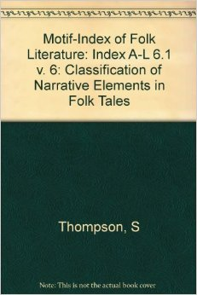
Motif-Index of Folk Literature
The Motif-Index of Folk literature is a comprehensive 6 volume compilation by Stith Thompson which classifies and proves how universal the phenomenon of an “evil stepparent” truly is
This is the Thompson from the infamous “Aarne-Thompson” classification system!
Fairy tales often feature evil stepmothers
They are rarely, if ever, purported to be well-intended or benevolent
Stepfathers are classified in two categories: Cruel and Lustful

Slide 5
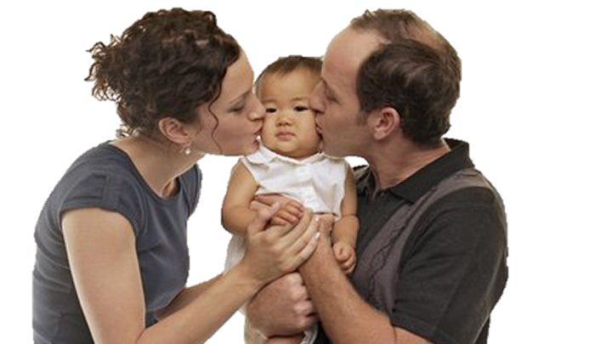
Biological Deception: Adoption
Ostensibly contradictory to Darwinisim as the concept of adoption is founded upon expending time and resources on a child that is biologically unrelated to the adopter; however, it deliberately illustrates how easy it is to fool mother nature
Humans have in innate mechanism which allows us to identify our offspring
Adoption is often times not most people’s first choice; many prefer to make their own
Only if this is not an option are most people inclined to satisfy their desire to be a parent by adopting and consequently parenting children that are not their own
Adoption typically takes place at infancy as it enhances the prospects of “fooling” their unconscious selves into responding as if the adopted child is genetically their own
Vastly less conflictual than step parenting as step children are often not a choice and are regularly older
Adopted children are typically loved and cared for, and about as successful as biological children

Slide 6
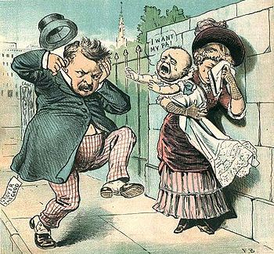
Male Strategy & Bastard Children
The stepchild is often a bastard child which is equated, in some respects, to “nastiness”
The male prerogative in evolutionary sense is to reproduce as many children as possibly, but to only nurture and invest in those that are legitimate
The consequential denial of the “bastard child” is ostensibly counter-intuitive to the principles set forth in Darwinism as parents ostensibly should want the best for their biological children, regardless if they are legitimate or illegitimate.
Why the idiosyncrasy?
Either the child or the parent is cynical of uncertain paternity
For example: Telemachus and Ulysses
A parent’s attentiveness towards his/her illegitimate child is often complicated by the involvement of a current spouse, particularly if other children have been produced legitimately

Slide 7
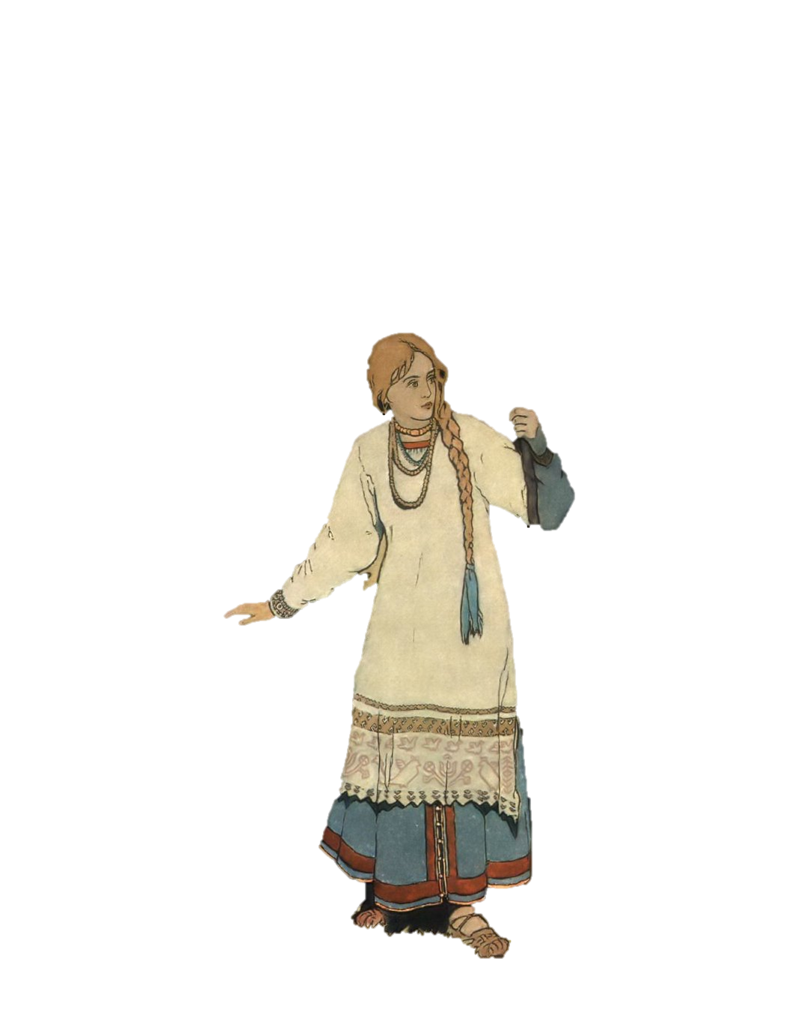
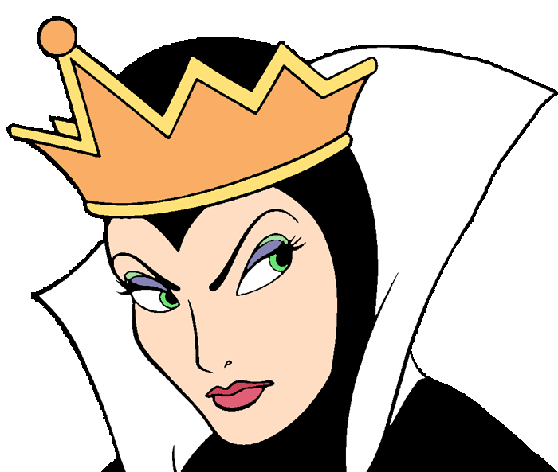
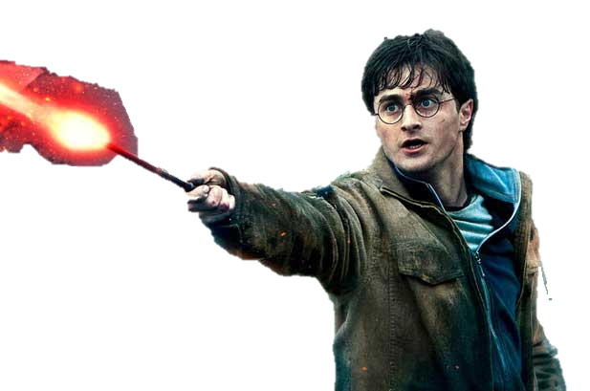
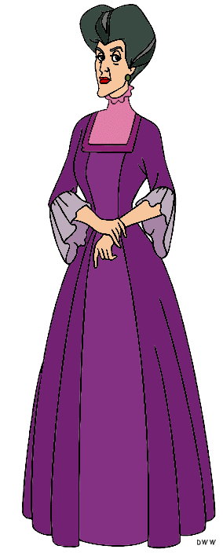
Examples of Darwinism found in Literature
Juniper Tree | The stepmother kills her step son and blames it on her own daughter in the attempt to rid her family of the illegitimacy.
Benizara (Cinderella) | In ancient folk lore, there was a kind and gentle lady, Benezara who was subjected to the deceitfulness and bitterness of her step mother. On her wedding day to a noble, the step mother attempted to substitute her own daughter.
Harry Potter | As a result of Harry’s parents’ untimely death, he was forced to live with his aunt and uncle, the Dudleys. He was never adequately fed or clothed, and was forced into a type of servitude. “Harry was used to spiders, because the cupboard was full of them, that is where he slept.”
Baba Yaga | A husband lost his wife and married again; consequently, the stepmother forced her step daughter to go to her wicked and cannibalistic aunt.

