Slide 1
Contemporary Theories of Consciousness
8
Panpsychism

Slide 2
Plan for today
The limits of physics
The poverty of emergence
Panpsychism
The problems with panpsychism

Slide 3
2. The Limits of Physics

Slide 4
Matter is an honorific designation
“The notions of body, material, physical are hardly more than honorific designations for what is more or less understood at some particular moment in time, with flexible boundaries and no guarantee that there will not be radical revision ahead, even at its core.”
Chomsky, ‘‘The Mysteries of Nature: How Deeply Hidden’, p. 180

Slide 5
Russellian monism
‘Another important variety of panpsychism is Russellian panpsychism. This view takes its name from Russell’s insight, in The Analysis of Matter and other works, that physics reveals the relational structure of matter but not its intrinsic nature. According to this view, classical physics tells us a lot about what mass does—it resists acceleration, attracts other masses, and so on—but it tells us nothing about what mass intrinsically is. We might say that physics tells us what the mass role is, but it does not tell us what property plays this role.’
David Chalmers, ‘Panpsychism and Panprotopsychism’, 2013

Slide 6
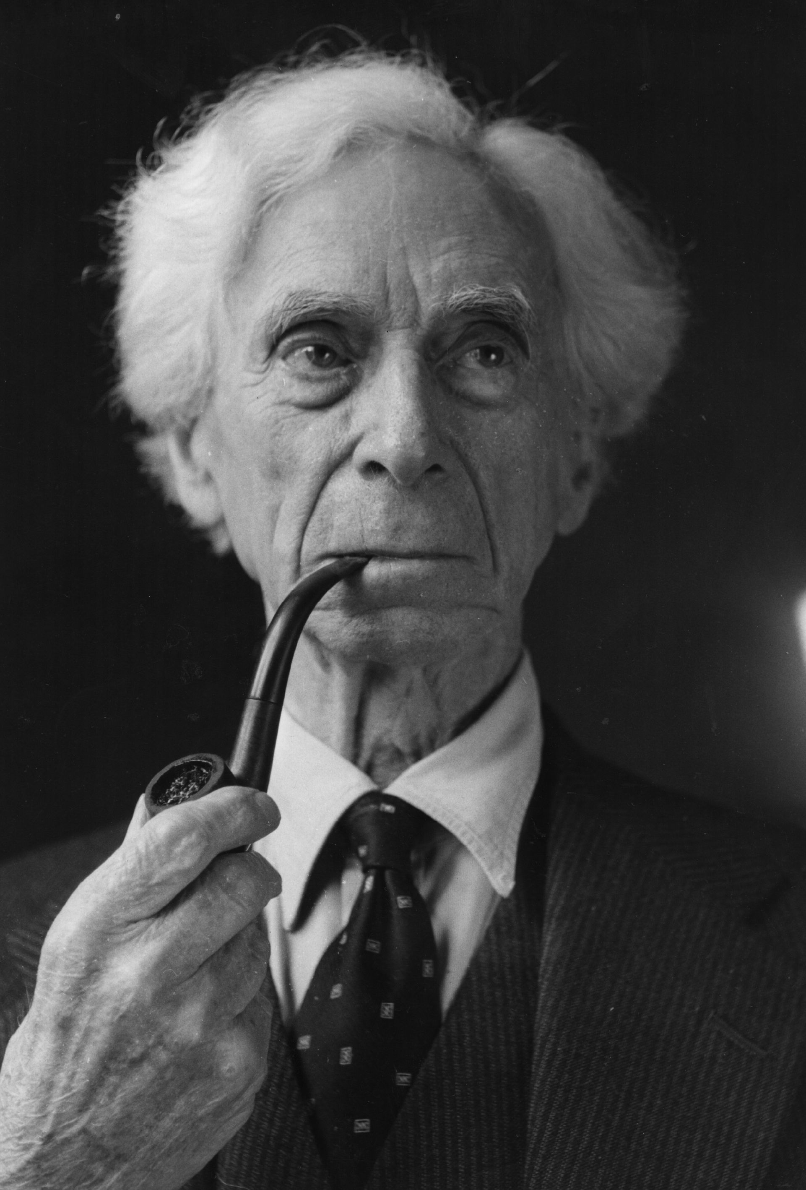
Bertrand Russell on physics
‘Modern physics … reduces matter to a set of events which proceed outward from a centre. If there is something further in the centre itself, we cannot know about it, and it is irrelevant to physics. The events that take the place of matter in the old sense are inferred from their effect on eyes, photographic plates, and other instruments. What we know about them is not their intrinsic character, but their structure and their mathematical laws … Physics is mathematical, not because we know so much about the physical world, but because we know so little: it is only its mathematical properties that we can discover.’
Russell, An Outline of Philosophy, 1927, p. 125

Slide 7
Physicalism and Physicsalism
Real physicalism can have nothing to do with physicsalism, the view—the faith—that the nature or essence of all concrete reality can in principle be fully captured in the terms of physics. Real physicalism cannot have anything to do with physicsalism unless it is supposed—obviously falsely—that the terms of physics can fully capture the nature or essence of experience.
Galen Strawson, ‘Realistic Monism’, p. 54

Slide 8
Strawson’s ‘Real physicalism’
‘As a real physicalist, then, I hold that the mental/experiential is physical, and I am happy to say, along with many other physicalists, that experience is ‘really just neurons firing’, at least in the case of biological organisms like ourselves. […] I certainly don’t mean that all characteristics of what is going on, in the case of experience, can be described by physics and neurophysiology or any non-revolutionary extensions of them. That idea is crazy. It amounts to radical ‘eliminativism’ with respect to experience, and it is not a form of real physicalism at all. My claim is different. It is that experiential phenomena ‘just are’ physical, so that there is a lot more to neurons than physics and neurophysiology record (or can record). No one who disagrees with this is a real physicalist, in my terms.’
Strawson, ‘Real Physicalism’

Slide 9
2. The poverty of emergence

Slide 10
Anti-emergentism
Emergence: ‘For Y truly to emerge from X is for Y to arise from or out of X or be given in or with Y given how X is.’
Analogies with the liquidity of water are in fact disanalogies
The analogy would be from the non-extended to the extended since all the ‘ultimates’ of physics, by their necessary implication in fields, are extended.
The ‘brute emergentism’ of the experiential emerging from the non-experiential would be a continuous ‘miracle’.
‘brute emergence is by definition a miracle every time it occurs, for it is true by hypothesis that in brute emergence there is absolutely nothing about X, the emerged-from, in virtue of which Y, the emerger, emerges from it.’ Strawson, ‘Real Materialism’, p. 65.

Slide 11
Continuity vs Emergence
‘Natura non facit saltum’

Slide 12
3. Panpsychism

Slide 13
Micropsychism Panpsychism

Slide 14
Two arguments for panpsychism over micropsychism
Monism is more acceptable. Micropsychism would be a form of irreducible dualism. (Strawson)
The fungibility of matter. Any particles could in principle make up our brains. (Nagel)

Slide 15
Fungibility of matter
‘Each of us is composed of matter that had a largely inanimate history before finding its way onto our plates or those of our parents. It was once probably part of the sun, but matter from another galaxy would do as well. If it were brought to earth, and grass were grown in it, and milk from a cow that ate the grass were drunk by a pregnant woman, then her child’s brain would be partly composed of that matter. Anything whatever, if broken down far enough and rearranged, could be incorporated into a living organism. No constituents besides matter are needed.’
Thomas Nagel, ‘Panpsychism’, Mortal Questions, Cambridge 1979, p. 181

Slide 16
Panpsychism
‘There is something it is like to be a quark or a photon or a member of some other fundamental physical type.’
David Chalmers, ‘Panpsychism and Panprotopsychism’, 2013
‘All physical stuff is energy, in one form or another, and all energy, … is an experience-involving phenomenon.’
Strawson, ‘Real Materialism’, p. 71

Slide 17
Panpsychism: Two advantages
‘Panypsychism avoids both the conceivability argument against physicalism and the causal argument against dualism.’
David Chalmers, ‘Panpsychism and panprotopsychism’, 2013

Slide 18
Problems with panpsychism
1. Extravagance.
2. Unimaginability of the psychic states of the ultimates.
3. The ‘combination problem’

Slide 19
Next Week
Sam Coleman and Panqualityism

