Slide 1
Care of the Soul: In Antiquity and Today 5 Spa as an expression of care for a good and beautiful life
Zuzana Svobodová, Adhip Rawal

Slide 2
Basic information
In SIS: CVOL0376
Title: Care of the Soul: In Antiquity and Today
Guaranteed by: Department of Medical Ethics and Humanities, Third Faculty of Medicine, Charles University
Points, E-Credits: 5
Guarantor: doc. PhDr. Zuzana Svobodová, Ph.D.: zuzana.svobodova@lf3.cuni.cz
Annotation: The care of the soul is a phenomenon of cultivation, of human culture. The course focuses on the exemplifications of care of the soul from the earliest times of mankind to the present day. From the ancient times, examples of material culture with symbols and signs will be presented, and their interpretation will be based on different methodological principles. Course participants will also seek their own interpretive approaches within the expression of the human possibility, which is the care of the soul. The course is taught in tandem with Dr. Adhip Rawal from the University of Sussex School of Psychology, alongside the course supervisor.
Course completion requirements: Students upload written text, 4-6 pages (1800-2700 words). The content of the written work: Students will choose a short text/picture/movie/… describing the process of caring for the soul and write an interpretation.
Literature to the course at: https://www.citacepro.com/slozka/bpKEWhZf

Slide 3
Basic information
Syllabus:
Examples of the oldest remains of material culture, their symbols and interpretations.
The seeking for personality and integrity in different cultures.
Critical periods in life, examples of ritualization and symbolic expressions.
Theatre as a manifestation of care of the soul.
Spa as an expression of care for a good and beautiful life.
Learning resources - Moodle: https://dl1.cuni.cz/course/view.php?id=16377
MS Teams: https://teams.microsoft.com/l/team/19%3aW70bEVcamrlLOG6V9FgovqmNVQo-Wf8uff3vIal8ZGw1%40thread.tacv2/conversations?groupId=2b9b36ce-8617-449e-b3dd-9cc70566e7ec&tenantId=e09276da-f934-4086-bf08-8816a20414a2
Schedule for the winter semester 2024–2025:
October 22, 18-19:30
November 5, 18-19:30
November 19, 18-19:30
December 10, 18-19:30
January 7, 18-19:30
In these days and hours (at least 3 of them), connect to:
https://teams.microsoft.com/l/meetup-join/19%3aW70bEVcamrlLOG6V9FgovqmNVQo-Wf8uff3vIal8ZGw1%40thread.tacv2/1718882985968?context=%7b%22Tid%22%3a%22e09276da-f934-4086-bf08-8816a20414a2%22%2c%22Oid%22%3a%22da59b418-9bdf-4c0e-b401-2e81c8f22ed6%22%7d
Minimal requirements, prerequisites, conditions for selection and enrolment of students: Students can use the internet for MS Teams video meetings, have English as a spoken language - minimum level: B1 - "Can understand the main points of clear standard input on familiar matters regularly encountered in work, school, leisure, etc. Can deal with most situations likely to arise whilst travelling in an area where the language is spoken. Can produce simple connected text on topics which are familiar or of personal interest. Can describe experiences and events, dreams, hopes & ambitions and briefly give reasons and explanations for opinions and plans."

Slide 4
Reasons to visit a spa

Slide 5
https://www.greatspatownsofeurope.eu/
https://whc.unesco.org/en/list/1613/
Notes:
Athens

Slide 6
Baden bei Wien (Austria): www.baden.at Spa (Belgium): www.villedespa.be Františkovy Lázně (Czech Republic): www.frantiskovy-lazne.info/en Karlovy Vary (Czech Republic): www.karlovyvary.cz/en Mariánské Lázně (Czech Republic): www.marianskelazne.cz/en Vichy (France): www.vichy-patrimoine-mondial.com Bad Ems (Germany): www.vgben.de Baden-Baden (Germany): www.baden-baden.de Bad Kissingen (Germany): www.badkissingen.de Montecatini Terme (Italy): www.comune.montecatini-terme.pt.it City of Bath (United Kingdom): www.bathworldheritage.org.uk More on The Great Spa Towns of Europe and World Heritage: whc.unesco.org/en/list/1613

Slide 7
https://www.greatspatownsofeurope.eu/
The Great Spa Towns of Europe
“This transnational serial property comprises eleven spa towns, located in seven European countries …. All of these towns developed around natural mineral water springs. They bear witness to the international European spa culture that developed from the early 18th century to the 1930s, leading to the emergence of grand international resorts that impacted urban typology around ensembles of spa buildings such as baths, kurhaus and kursaal (buildings and rooms dedicated to therapy), pump rooms, drinking halls, colonnades and galleries designed to harness the natural mineral water resources and to allow their practical use for bathing and drinking. Related facilities include gardens, assembly rooms, casinos, theatres, hotels and villas, as well as spa-specific support infrastructure. These ensembles are all integrated into an overall urban context that includes a carefully managed recreational and therapeutic environment in a picturesque landscape. Together, these sites embody the significant interchange of human values and developments in medicine, science and balneology.”
Notes:
Athens

Slide 8
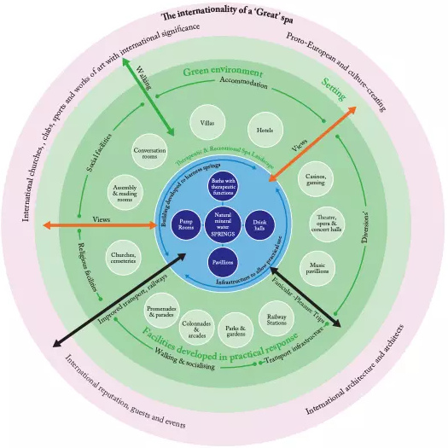

Slide 9
“‘Taking the cure’, either externally (by bathing) or internally (by drinking, and inhaling) involved a highly structured and timed daily regime and a combination of medical aspects and leisure, including entertainment and social activities (e.g. gambling, theatre, music, dancing) as well as taking physical exercise within an outdoor therapeutic spa landscape.
These parameters directly influenced the spatial layout of spa towns and the form and function of spa buildings or ‘spa architecture’. Urban parks and promenades allowed people taking the cure “to see and be seen” by others.” https://whc.unesco.org/en/list/1613/

Slide 10
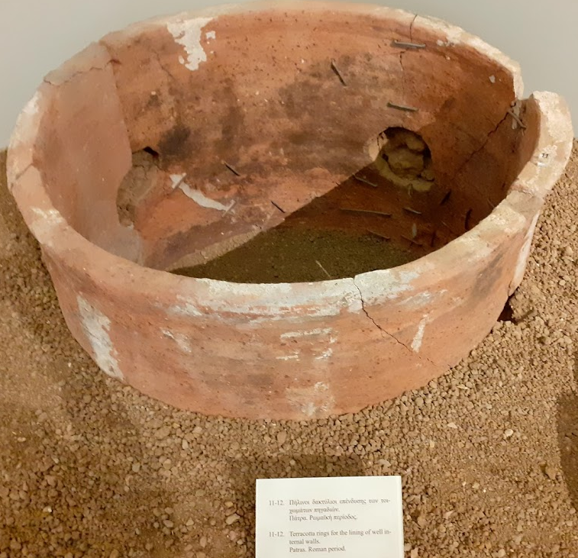
Origin of ancient spa tradition
https://historicthermaltowns.eu/history-and-culture/
https://historicthermaltowns.eu/spa-towns-as-places-for-history/
https://historicthermaltowns.eu/spa-towns-as-places-for-inspiration/

Slide 11
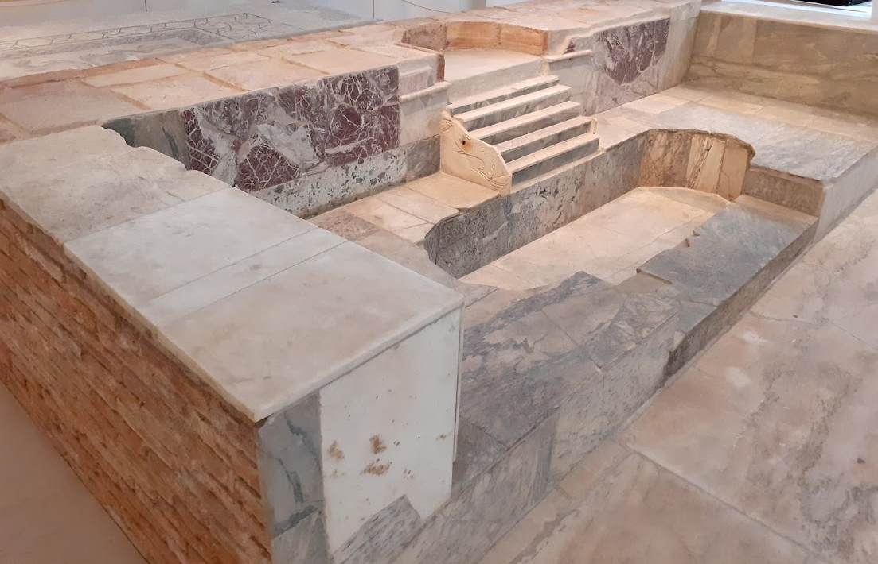
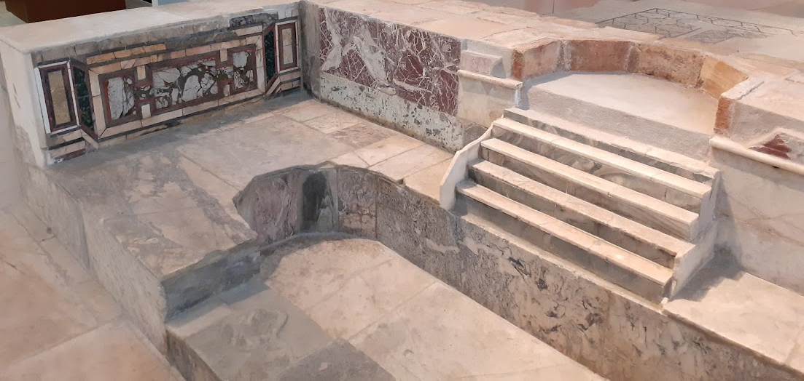

Slide 12
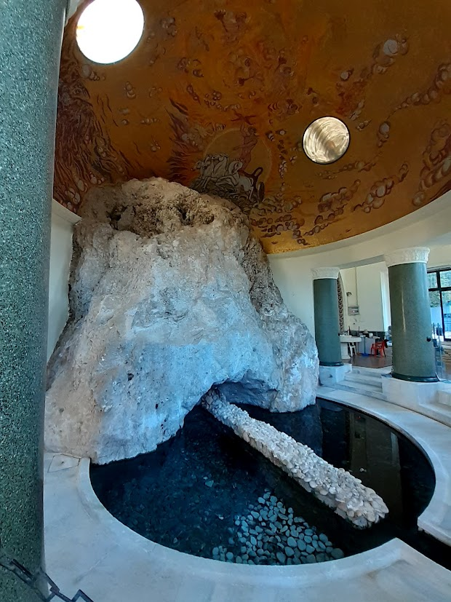
Origin of ancient spa tradition
Roman baths or balnea were luxurious public building complexes, usually built in central locations of the city.
Private baths existed as well alongside the public ones, belonging to wealthy urban villas. Complexes of a much larger scale were called thermae.
Bath taking included three different stages, with cold, tepid and warm water, in different rooms (frigidarium, tepidarium, caldarium). The water was heated with hot air circulation beneath the floors, which were supported by a series of short pillars, or in vents behind the walls.
Nymphania were public fountain buildings dedicated to the Nymphs – water-related deities.

Slide 13
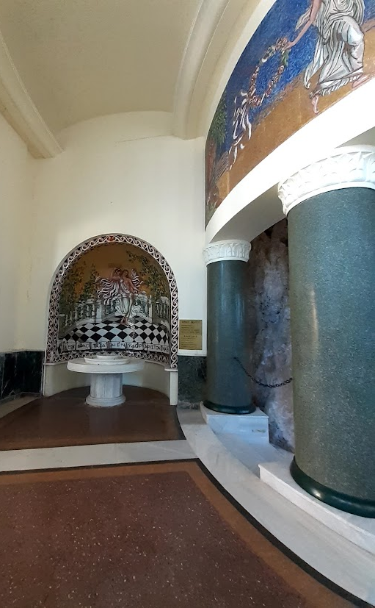
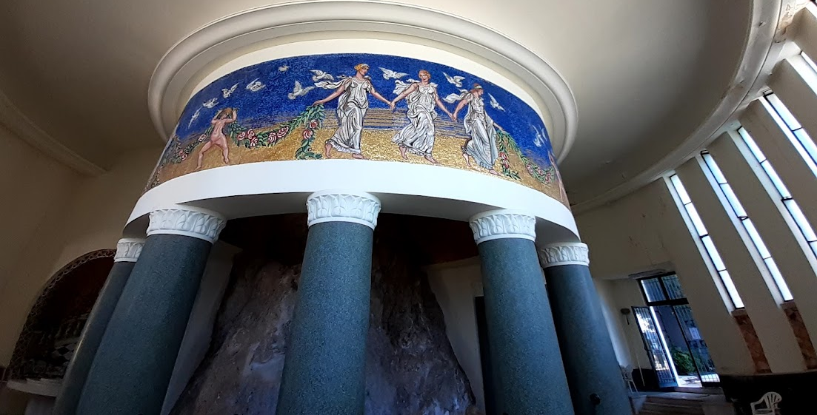

Slide 14
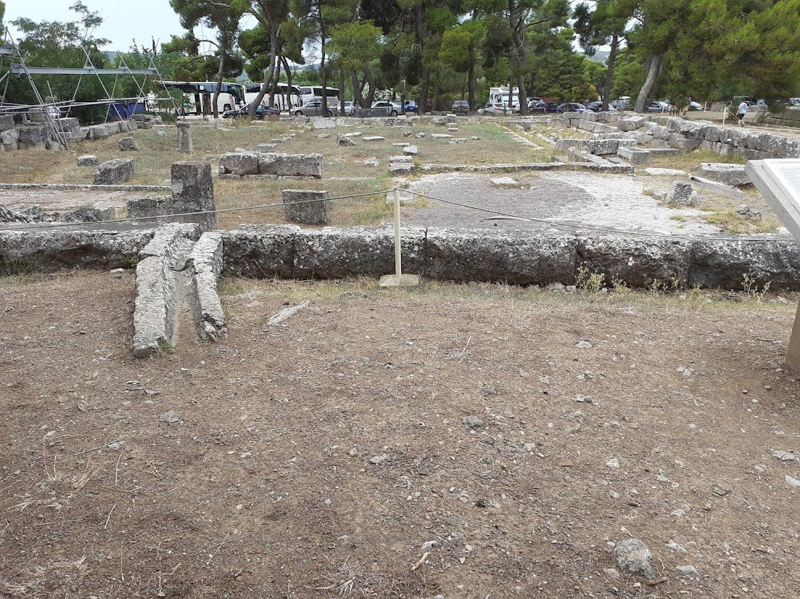
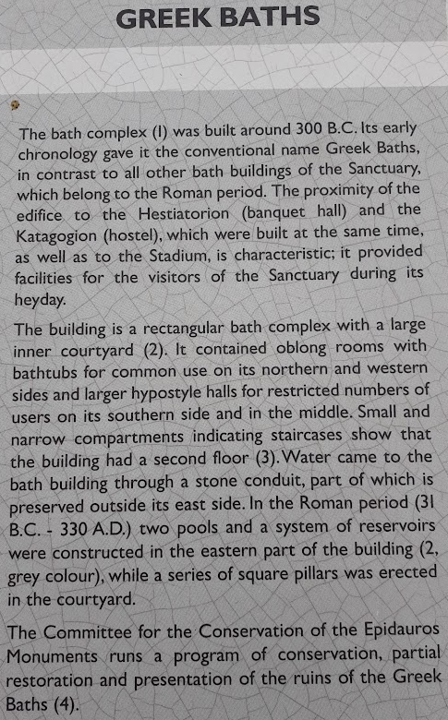

Slide 15
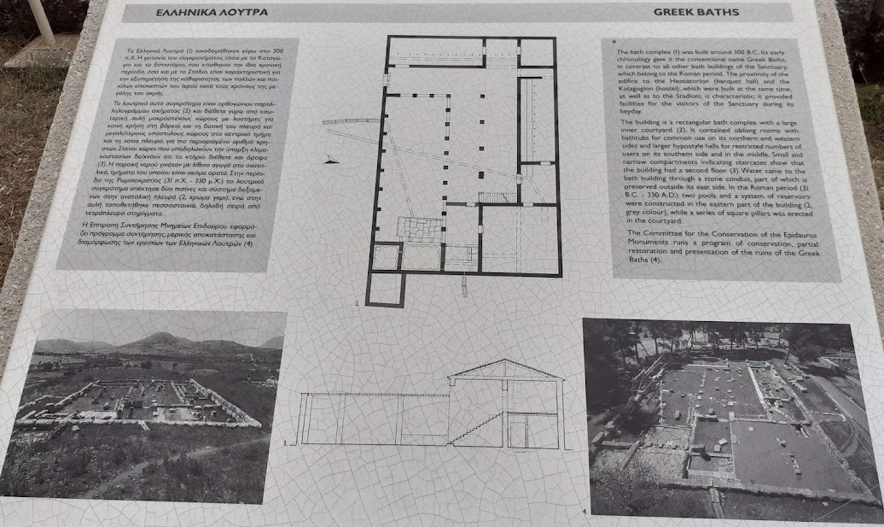

Slide 16
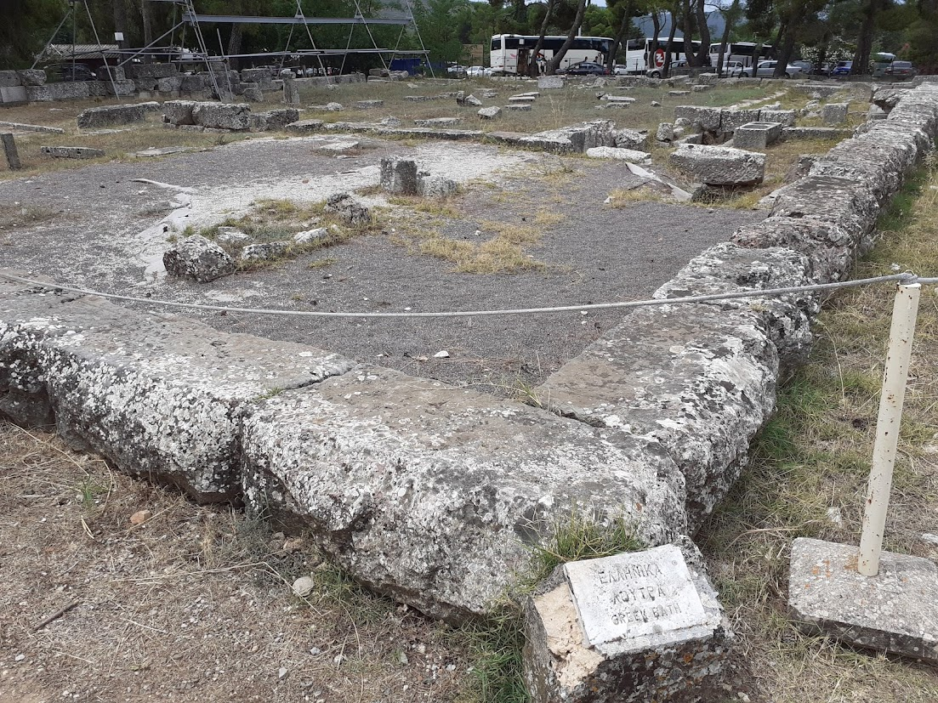

Slide 17
From spa tradition
Journal du Voyage en Italie, par la Suisse et l’Allemagne (1580) Michel de Montaigne
Northanger Abbey and Persuasion (Bath, 1818) Jane Austen
Marienbader Elegie (1823) (Marienbad Elegy) Goethe
Pickwick Club (Bath, 1837) Charles Dickens
(Fumée) (Baden Baden, 1867) Ivan Tourgueniev
Igrok (The Gambler) (1867) Fiódor Dostoievski
Die Welt von Gestern (Baden bei Wien, 1914) (The World of Yesterday) Stefan Zweig
Die Schwestern oder Casanova in Spa (1918) (The Sisters or Casanova in Spa) Arthur Schnitzler (1918)
Der Zauberberg (1924) (The Magic Mountain) Thomas Mann
Kurgast (Baden, 1925) (A Guest at the Spa) Hermann Hesse
(Badenheim) (1939) Aharon Appelfeld
L’Année dernière à Marienbad (Las Year in Marienbad) Alain Resnais (Marienbad, 1961)
La città delle donne (City of Women) Federico Fellini (1963)
El Balneario (1986) (The Spa) Manuel Vazquez Montalban
(Black eyes) (1987) Nikita Mikhalkov
À l’ombre des jeunes filles en fleurs (1999; In the Shadow of Young Girls in Flower) Marcel Proust

Slide 18
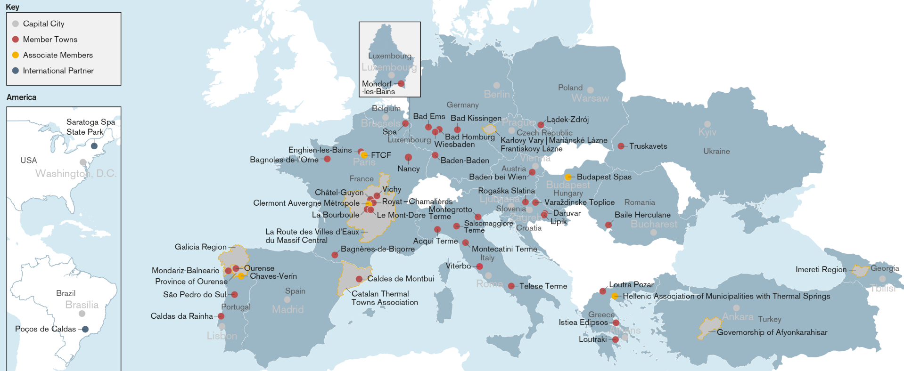
https://historicthermaltowns.eu/
https://historicthermaltowns.eu/our-members/

Slide 19
World Water Day: 22nd March
https://historicthermaltowns.eu/world-water-day/
The European Route of Historic Thermal Towns – one of 45 Routes certified by the Council of Europe
https://historicthermaltowns.eu/downloads/EHTTA-Cultural-Route-Leaflet-Map-English.pdf
https://historicthermaltowns.eu/downloads/Ehtta-Brochure-2021.pdf

Slide 20
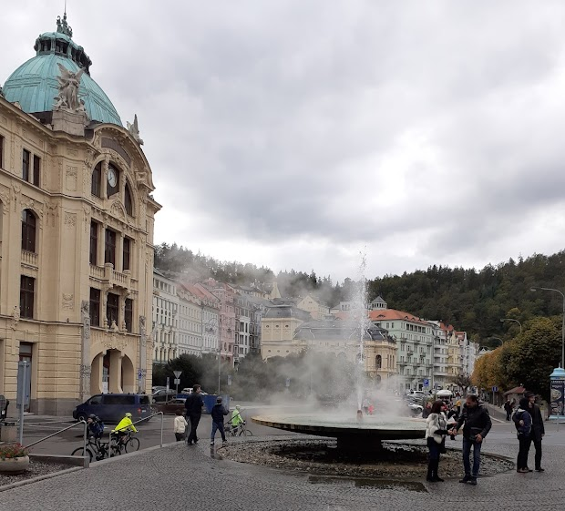
Critical periods in life
natural factum
cultural re-action
reason
habit
social tradition
take – carry – give
…

Slide 21
Musse und Kult (by Josef Pieper)
Original in German, English: book: Leisure. The Basis of Culture
https://books.google.cz/books?id=VKbcnmvM7N8C&lpg=PA9&pg=PP1#v=onepage&q&f=false
https://www.academia.edu/4182734/leisure_the_basis_of_culture
literature: https://www.citacepro.com/slozka/Za8sEwPT
Musse – from Muses
The first motto from Plato, Laws (653 c-d):
“But the gods, taking pity on mankind, born to work, laid down the succession of recurring Feasts to restore them from their fatigue, and gave them the Muses, and Apollo their leader, and Dionysus, as companions in their Feasts, so that nourishing themselves in festive companionship with the gods, they should again stand upright and erect.” (from the book, 2009)
“so the gods, in pity for the human race thus born to misery, have ordained the feasts of thanksgiving as periods of respite from their troubles; and they have granted them as companions in their feasts the Muses and Apollo the master of music, and Dionysus, that they may at least set right again their modes of discipline by associating in their feasts with gods.” Plato, Laws (653 c-d) in: Plato. Plato in Twelve Volumes, Vols. 10 & 11 translated by R.G. Bury. Cambridge, MA, Harvard University Press; London, William Heinemann Ltd. 1967 & 1968. http://data.perseus.org/citations/urn:cts:greekLit:tlg0059.tlg034.perseus-eng1:2.653
θεοὶ [653δ] δὲ οἰκτίραντες τὸ τῶν ἀνθρώπων ἐπίπονον [painful] πεφυκὸς γένος, ἀναπαύλας [rest, repose] τε αὐτοῖς τῶν πόνων [work] ἐτάξαντο τὰς τῶν ἑορτῶν [keep festival] ἀμοιβὰς τοῖς θεοῖς, καὶ μούσας Ἀπόλλωνά τε μουσηγέτην καὶ Διόνυσον συνεορταστὰς [sharer in a festival] ἔδοσαν, ἵν᾽ ἐπανορθῶνται [set up again, restore], τάς τε τροφὰς γενομένας ἐν ταῖς ἑορταῖς [keep festival] μετὰ θεῶν. Plato, Laws, in: Plato. Platonis Opera, ed. John Burnet. Oxford University Press. 1903. http://data.perseus.org/citations/urn:cts:greekLit:tlg0059.tlg034.perseus-grc1:2.653

Slide 22
Leisure
“Leisure ... is a mental and spiritual attitude – it is not simply the result of external factors, it is not the inevitable result of spare time, a holiday, a week-end or a vacation. It is an attitude of mind, a condition of the soul.... leisure implies (in the first place) an attitude of non-activity, of inward calm, of silence; it means not being 'busy,' but letting things happen”
“Leisure, then, as a condition of the soul – (and we must firmly keep to this assumption, since leisure is not necessarily present in all the external things like "breaks," "time off," "weekend," "vacation," and so on – it is a condition of the soul) – leisure is precisely the counterpoise to the image of the "worker," and we can now see how this pertains to all three aspects we have dealt with: work as activity, work as effort, work as social function. … Leisure is a form of that stillness that is the necessary preparation for accepting reality … Leisure is the disposition of receptive understanding, of contemplative beholding, and immersion – in the real.” [1952, p. 50]

Slide 23
Leisure
Leisure is not the attitude of the one who intervenes but of the one who opens himself; not of someone who seizes but of one who lets go, who lets himself go, and "go under," almost as someone who falls asleep must let him self go (you cannot sleep, unless you do so). And in fact, just as sleeplessness and restlessness are in a special way mutually related, just so the man at leisure is related to someone sleeping; as Heraclitus said of those who sleep, that they "are active and cooperative in the business of the world." The surge of new life that flows out to us when we give ourselves to the contemplation of a blossoming rose, a sleeping child, or of a divine mystery -- is this not like the surge of life that comes from deep, dreamless sleep? And as it is written in the Book of Job: "God gives us songs in the middle of the night" (35, 10), and as wise people know, God gives His blessings to his own, and what rejoices them, in sleep - in just the same way, do the greatest, most blessed insights, the kind that could never be tracked down, come to us above all in the time of leisure. In such silent openness of the soul, it may be granted to man for only an instant to know "what the world /holds in its innermost," so that afterwards the insights of that happy moment have to be re-discovered through the effort of "labor.“[1952, p. 52]

Slide 24
Leisure
“The point and the justification of leisure are not that the functionary should function faultlessly and without a breakdown, but that the functionary should continue to be a man – and that means that he should not be wholly absorbed in the clear-cut milieu of his strictly limited function; the point is also that he should continue to be capable of seeing life as a whole and the world as a whole; that he should fulfil himself, and come to full possession of his faculties, face to face with being as a whole” [1952, p. 57].

Slide 25
Seeing what is simply as being
“man's real wealth consists, not in satisfying his needs, not in becoming "the master and owner of nature," but in seeing what is and the whole of what is, in seeing things not as useful or useless, serviceable or not, but simply as being. The basis of this conception of philosophy is the conviction that the greatness of man consists in his being capax universe” [1952, p. 107].

Slide 26
Ratio and intellectus Active and passive/receptive thought
ratio or “the mode of discursive thought is accompanied and impregnated by an effortless awareness, the contemplative vision of the intellectus, which is not active but passive, or rather receptive”

Slide 27
Sources
https://www.greatspatownsofeurope.eu/
https://whc.unesco.org/en/list/1613/
Leisure. The Basis of Culture
https://books.google.cz/books?id=VKbcnmvM7N8C&lpg=PA9&pg=PP1#v=onepage&q&f=false
https://www.academia.edu/4182734/leisure_the_basis_of_culture
https://www.citacepro.com/slozka/Za8sEwPT

Slide 28
Bibliography
Reid, Louis Arnaud. 1952. “Leisure the Basis of Culture.” British Journal of Educational Studies 1 (1): 85-88. https://doi.org/10.2307/3119448.
Hill, E. F. F. 1953. “Leisure the Basis of Culture.” The Philosophical Quarterly (1950-) 3 (11): 192-192. https://doi.org/10.2307/2216896.
Yolton, John W. 1953. “Leisure the Basis of Culture.” The Philosophical Review 62 (1): 151-153. https://doi.org/10.2307/2182736.
Review. Pieper, Josef. "Leisure, the Basis of Culture." Books & Culture, January-February 2010, 39. Gale Literature Resource Center. (https://cuni.primo.exlibrisgroup.com/permalink/420CKIS_INST/1pop0hq/cdi_gale_lrcgauss_A218068790) https://link-gale-com.ezproxy.is.cuni.cz/apps/doc/A218068790/GLS?u=karlova&sid=bookmark-GLS&xid=be676fae.
Ildefonso, Givanni M. Review of Not a Laughing Matter: The Value of Leisure in Education, by Josef Pieper and Alexander Dru. Curriculum Inquiry 41, no. 1 (2011): 48–56. http://www.jstor.org/stable/41238065.
Hartland-Swann, J. Philosophy 28, no. 105 (1953): 177–80. http://www.jstor.org/stable/3747348.
Hill, Roland. Blackfriars 33, no. 385 (1952): 187–88. http://www.jstor.org/stable/43814132.

