Slide 1
Marketing analysis
Tourism marketing

Slide 2
Case study – part 3
Identify and characterize the target group of tourists (you can choose any segmentation attitudes)

Slide 3
Marketing
Define marketing?
The management process through which goods and services move from concept to the customer. It includes the coordination of four elements called the 4 P's of marketing:
(1) identification, selection and development of a product,
(2) determination of its price,
(3) selection of a distribution channel to reach the customer's place, and
(4) development and implementation of a promotional strategy.
Marketing is based on thinking about the business in terms of customer needs and their satisfaction. Marketing differs from selling.
Notes:
"Selling concerns itself with the tricks and techniques of getting people to exchange their cash for your product. It is not concerned with the values that the exchange is all about. And it does not, as marketing invariable does, view the entire business process as consisting of a tightly integrated effort to discover, create, arouse and satisfy customer needs." In other words, marketing has less to do with getting customers to pay for your product as it does developing a demand for that product and fulfilling the customer's needs.

Slide 4
Does have „marketing“ the same meaning in Tourism?
The marketing of tourism is simply applying the appropriate marketing concepts to planning a strategy to attract visitors to a destination
Marketing is an exchange that satisfies both the individual (the visitors) and the organization (city, TO, TA,…)

Slide 5
Marketing Environment
Macro Environment
Micro Environment
Economic
Growth or decline
Disposable income
Social
Values
Lifestyle
Demographic
Age
Family status
Ethnicity
Level of education
Culture
Business
Chamber of Commerce
Hospitality associations
Business owners
Civic Groups
Civic associations
Local leaders
Neighborhood groups
Ecological groups
Government officeholders
Mayor and city council
Departmental managers, …

Slide 6
Researching the External Environment
Sources for Macro
Sources for Micro
Tourism publications: competitive trends
Consus.gov: demographics changes
Travel magazines: social trends
General and business news
SLEPT(E)
Direct contact with tourists and other Stakeholders
Local newspaper
Local broadcast news
Community issues
PORTER

Slide 7
Analytical methods
SLEPT(E) = PEST(E)
PORTER
Political
Economic
Social
Technological
Environment
New entrants
Threat of substitutes
Buyers
Suppliers
Rivalry between existing competitors

Slide 8
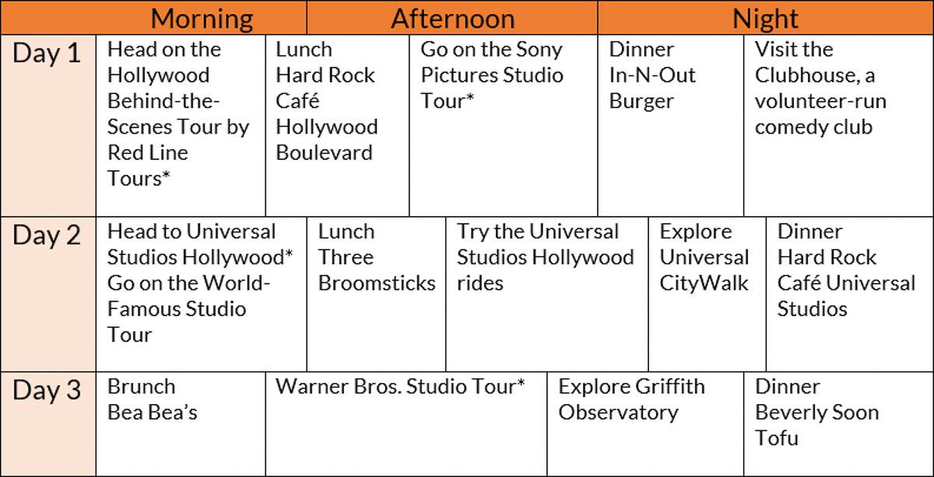
Studio Tour — Griffith Observatory

Slide 9
Case study – part 4
Make the itinerary (simply plan) for your product.

