Slide 1
Moses Mendelssohn
The father of Haskalah

Slide 2
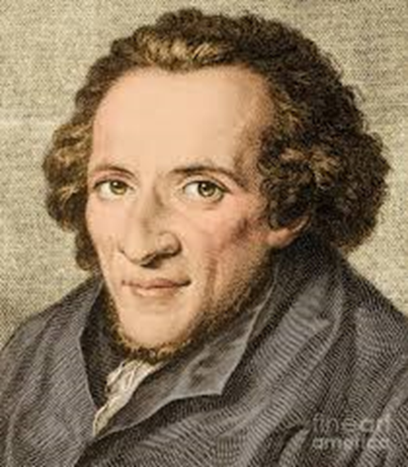
Life and Work
1729 Dessau – 1786 Berlin (poor family)
1754 – friendship with Lessing
1755 – Philosophical Conversations (anonymously)
1763 – On Evidence in the Metaphysical Sciences
1769 – Letter to Lavater
1780 – translation of Genesis
1781 – translation of Exodus
1783 – Jerusalem or On Religious Power and Judaism
1785 – Morning hours
1786 – To the friends of Lessing: An Appendix to Mr. Jacobi‘s Correspondence on the Doctrine of Spinoza

Slide 3
Metaphysics
Can have metaphysical truths the same evidence as mathematical truths?
The difference is in the content of the concepts – between quantity and quality
Certain truths (our thoughts about them are in agreement with themselves) versus actual truths (about facts outside of us)
Reason serves as a mediator between common sense (which is usually but not always right) and speculation (which needs to correct the common sense when it is not right)

Slide 4
Rational psychology and theology
Soul is simple and immortal and reason can prove because we know the character of our own consciousness.
God exists – but the proof for its existence from the order or beauty are not certain → we need the proof from the reason.
First proof from the reason: contingency. (I am therefore there is a God).
Second proof from the reason: conditions of nonexistence. (A God is thinkable therefore God exists).

Slide 5
Ethics
Major premise of moral syllogism: „Where the property of A is encountered, my duty requires me to do B.“ (theoretical)
Minor premise: „The present case has the property of A.“ (practical)
Universal law of nature: „Perfect yourself and others“
→ because of a common things in human
inclinations
→ because of a free will
→ because we are God‘s creation

Slide 6
Political theory
Church and state – exists in harmony because they have the same content: actions and convictions
Good citizen (who is in his peak represented by moral philosopher) will thus follow the same system as religious person
Only difference between church and state are the sanctions: state has the physical power and needs to force its power, church has the power of love and motivates by more noble gratification
Judaism has its special place because it reveals not only rational truths but also code of legal and moral law

Slide 7
Language
Spoken language is more important because it has social consequence.
Written language can on the contrary leads to dangerous isolation and even idolatry!
Language helps person to orient himself in the world – hebrew is the best because it is original language.
Judaism is spoken religion with heavy emphasis on oral tradition and continuing discussion.

Slide 8
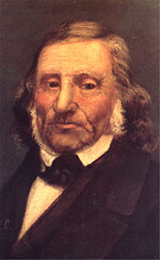
Second generation of Haskalah, or what came after Mendelssohn?
more radical – the „secular exodus“ from Jewish communities and so called „baptism epidemic“ – in the 19th century 20 000 Jews converted to christianity
1819 – Leopold Zunz – Wissenschaft des Judentums
Hokhmat Israel (Wisdom of Israel) – equivalent of Wissenschaft in Eastern Europe

Slide 9
Homework
Listen to the commented presentation. Read M. Mendelssohn, Jerusalem, section II, chapter 5 and 7, pp 34 – 37; 38 – 41. Explain in your own words (300 – 400 words) how Moses Mendelssohn describes revelation and how is enlightenment reflected in his conception?
Send me your paper via e-mail before 24th April

