Slide 1
Week 2 Theme: Birth of European Fairytale. Czech Fairytales in European Context. Similarity vs. Diversity

Slide 2
fairytale/fairy tale = conte de fées (fr.)
the term comes from France, 17th century
(„salons“ od Madame d´Aulnoy)
pohádka = das Märchen = folktale

Slide 3
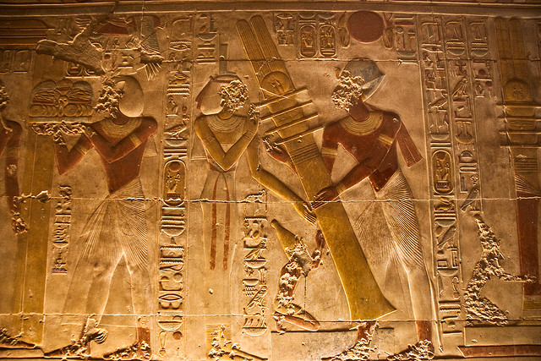
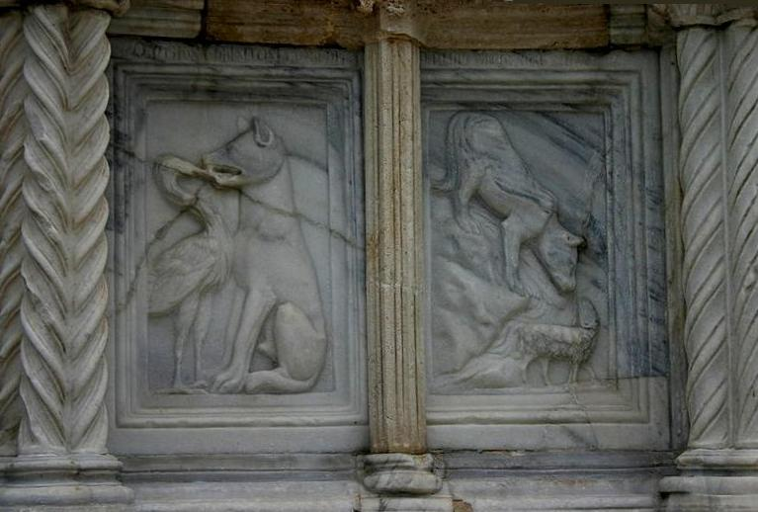
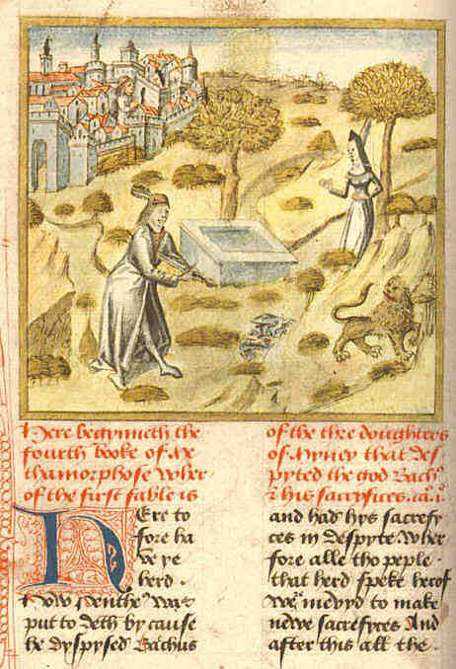
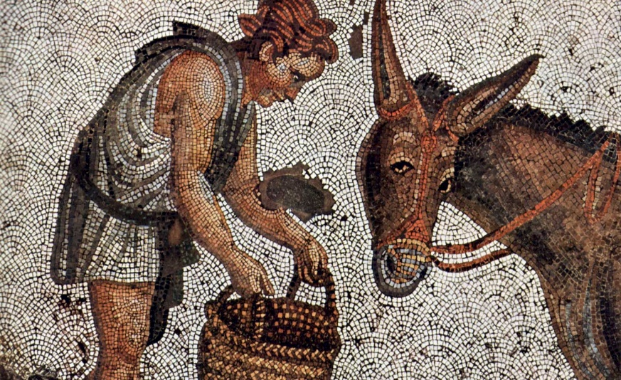
Ancient Age of Fairytales
1250 BC - Anpu and Bata/ The Tale of Two Brothers – recorded on papyrus in Egypt
6th cent. BC, Old Greek - Esop´s Fables
3th cent. BC, India - Fables of Bidpai
1st cent. BC - Ovid´s Metamorphoses (= Books of Transformations)
collection of narrative poems (based on folk and mythical motifs), all speak about some magic transformation and other fairytale themes
The Golden Touch = King Midas tale
2nd century AD - Apuleius: Golden Ass
ancient Roman novel (frame story with inset tales) using mythical and fairytale themes
story of Cupid and Psyche
Egypian papyrus with the Tale of Two Brothers
A detail of the 13th-century fontana in Perugia with the fables of The Wolf and the Crane and The Wolf and the Lamb
The first English translation of Ovid´s Metamorphoses (15th century)
Byzantine mosaic illustrating The Golden Ass

Slide 4
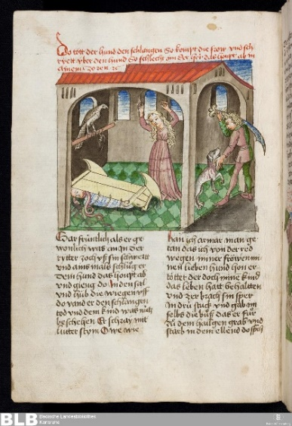
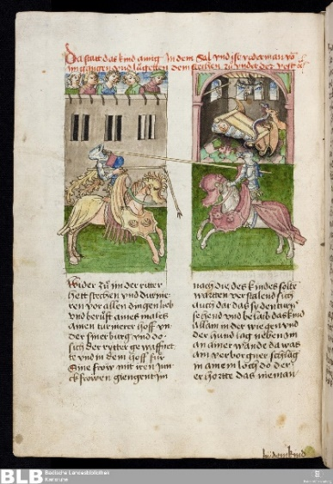
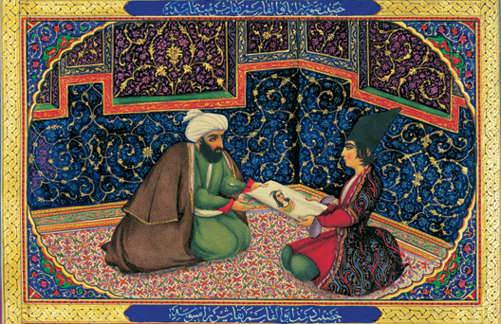
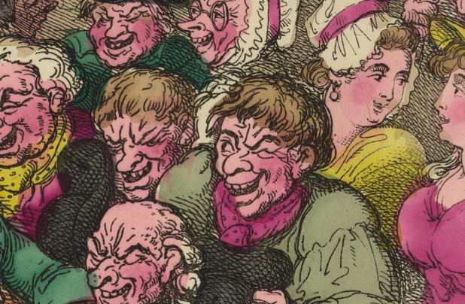
12th -14th cent. - Gesta Romanorum – Latin collection of
anecdotes, tales, religious legends and fairytales,
- everything turned into Biblical allegory
15th cent. in Europe- invention of movable print- press
many cheaply printed and widely spread anonymous
collections of popular readings
first versions of Tom Thumb, Jack the Giant Killer, Robin Hood…
15th -17th cent. - medieval and Renaisance Jest Books (known as
Facetiae)
numerous collections of short tales for masses – realistic, amusing, mocking, vulgar (anticlerical, scatological or sexual humor)
7th -16th cent.
One Thousand and One Nights
- a medieval anonymous collection
of folk tales, fables, anecdotes
and fairytales
based on Indian, Persian and Arabic folklore
Sindibad the Sailor, Alladin and his Magic Lamp,
Ali-Baba and the Forty Thieves

Slide 5
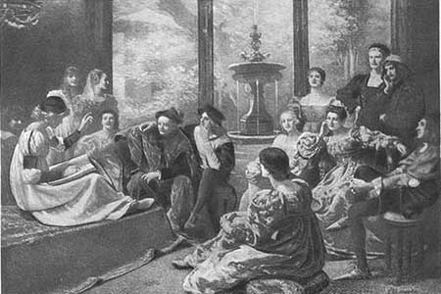
First European fairytale collections Italy, 16 century
1553 Pleasant Nights
(also Merry or Facetious Nights)
G.F.Straparola

Slide 6
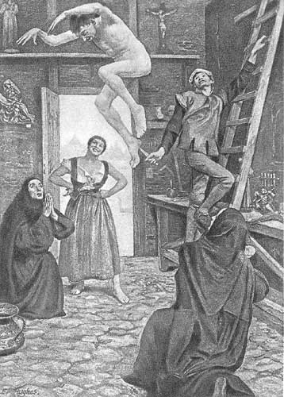
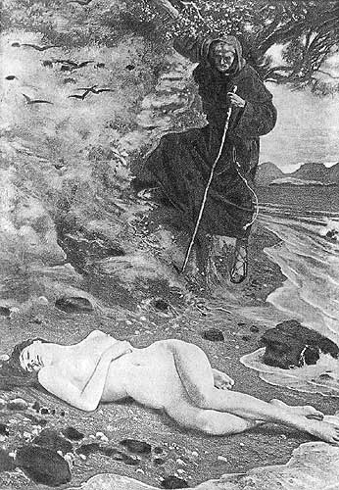
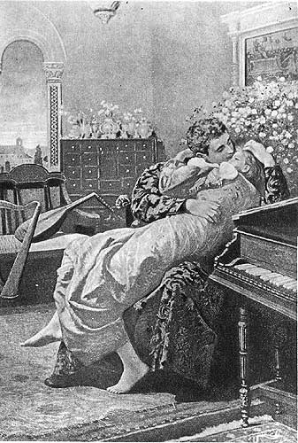
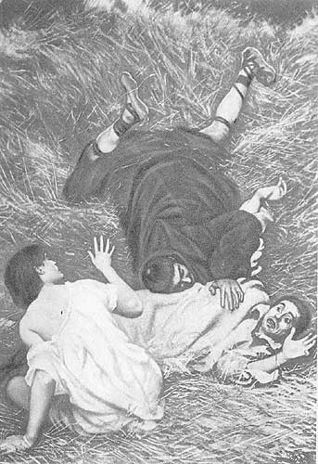
Straparola: Facetious Nights (1553)
http://www.surlalunefairytales.com/facetiousnights/illustrations.html
https://formysir.com/product/bk-straparola04/

Slide 7
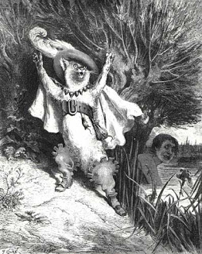
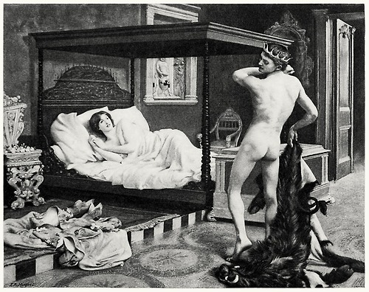
Straparola: Facetious Nights (1553)

Slide 8
Straparola: Facetious Nights (1553)
Puss in Boots The Pig King / Beauty and the Beast

Slide 9
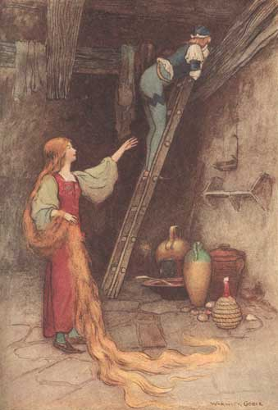
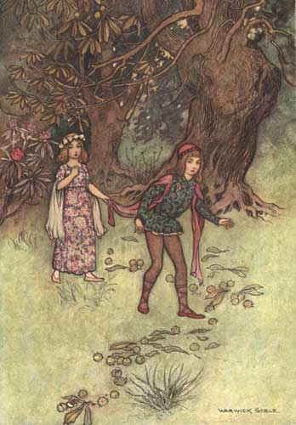
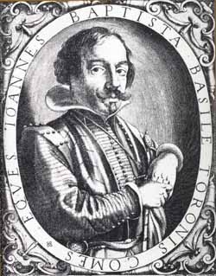
Italy, 17 century
1634 collection of Neapolitan fairytales ("Pentameron")
early variants of Rapunzelll, Cinderella, Puss in Boots, Sleeping Beauty, Hansel and Grethel ...
Giambattista Basile

Slide 10
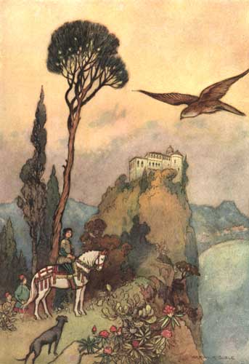
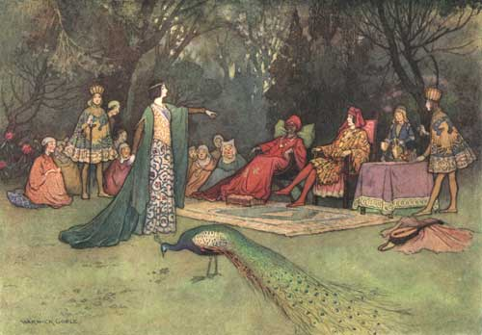
Basile: The Pentameron (1634, 1636)
Illustrations of Warwick Goble (1862-1943)

Slide 11
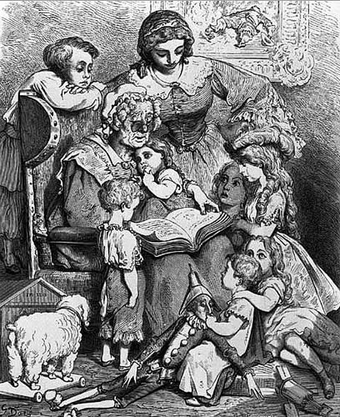
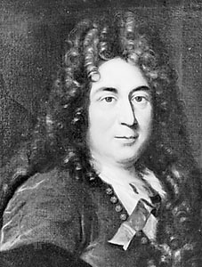
France, late 17 century
Charles Perrault
1697 - Tales of Mother Goose
published in Austria, Hungary, Germany, Poland, Russia
Little Red Riding Hood, Cinderella, Puss in Boots, The Sleeping Beauty, Little Thumb, Bluebeard
- long line of retelling in following fairytale tradition

Slide 12
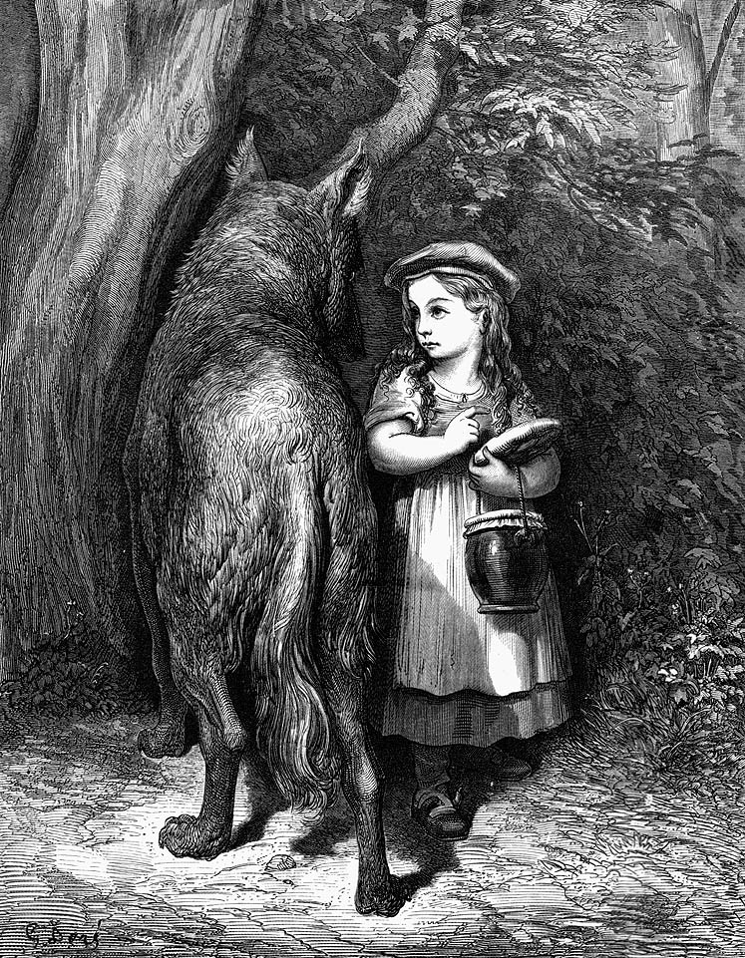
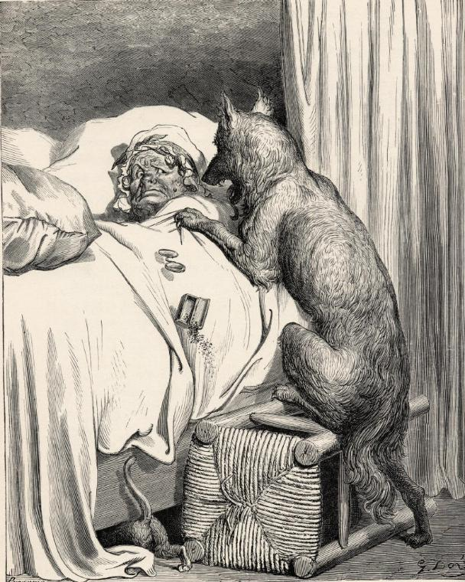
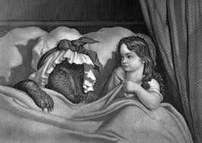
Charles Perrault: Tales of Mother Goose (1697).
Little Red Riding Hood
Illustrations of Gustave Doré (1832-1883)

Slide 13
Germany, 19th century

Slide 14
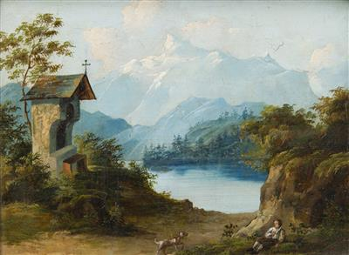
Germany, 19th century

Slide 15
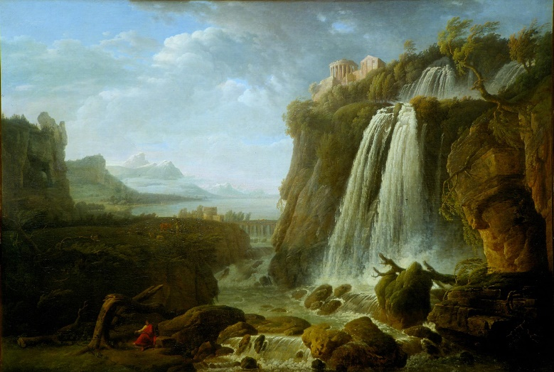
Germany, 19th century

Slide 16
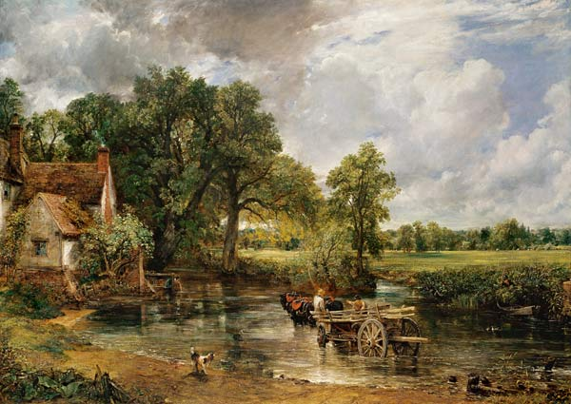
Germany, 19th century

Slide 17
Germany, 19th century
Romanticism:

Slide 18
Germany, 19th century
Romanticism:
withdrawal of reason, intellect and scientific rationalization (Enlightment)

Slide 19
Germany, 19th century
Romanticism:
withdrawal of reason, intellect and scientific rationalization (Enlightment)
emphasis on emotions, intuition, dreams, unconscious – irrational aspects of human mind (Counter- Enlightment)

Slide 20
Germany, 19th century
Romanticism:
withdrawal of reason, intellect and scientific rationalization (Enlightment)
emphasis on emotions, intuition, dreams, unconscious – irrational aspects of human mind (Counter- Enlightment)
glorification of nature and past (medievalism)

Slide 21
Germany, 19th century
Romanticism:
withdrawal of reason, intellect and scientific rationalization (Enlightment)
emphasis on emotions, intuition, dreams, unconscious – irrational aspects of human mind (Counter- Enlightment)
glorification of nature and past (medievalism)
elevation of folk art, ancient customs

Slide 22
Germany, 19th century
Romanticism:
withdrawal of reason, intellect and scientific rationalization (Enlightment)
emphasis on emotions, intuition, dreams, unconscious – irrational aspects of human mind (Counter- Enlightment)
glorification of nature and past (medievalism)
elevation of folk art, ancient customs
value of authenticity, spontaneity and heroic individualism

Slide 23
Germany, 19th century
Romanticism:
withdrawal of reason, intellect and scientific rationalization (Enlightment)
emphasis on emotions, intuition, dreams, unconscious – irrational aspects of human mind (Counter- Enlightment)
glorification of nature and past (medievalism)
elevation of folk art, ancient customs
value of authenticity, spontaneity and heroic individualism
Johann Gottfried Herder ideas

Slide 24
Germany, 19th century
Romanticism:
withdrawal of reason, intellect and scientific rationalization (Enlightment)
emphasis on emotions, intuition, dreams, unconscious – irrational aspects of human mind (Counter- Enlightment)
glorification of nature and past (medievalism)
elevation of folk art, ancient customs
value of authenticity, spontaneity and heroic individualism
Johann Gottfried Herder ideas:
- „collective spirit“

Slide 25
Germany, 19th century
Romanticism:
withdrawal of reason, intellect and scientific rationalization (Enlightment)
emphasis on emotions, intuition, dreams, unconscious – irrational aspects of human mind (Counter- Enlightment)
glorification of nature and past (medievalism)
elevation of folk art, ancient customs
value of authenticity, spontaneity and heroic individualism
Johann Gottfried Herder ideas:
- „collective spirit“
romantic philosophy of myth (myth regarded not as irrational belief of the past but as particular form of cognitive appropriation of reality

Slide 26
Germany, 19th century
Romanticism:
withdrawal of reason, intellect and scientific rationalization (Enlightment)
emphasis on emotions, intuition, dreams, unconscious – irrational aspects of human mind (Counter- Enlightment)
glorification of nature and past (medievalism)
elevation of folk art, ancient customs
value of authenticity, spontaneity and heroic individualism
Johann Gottfried Herder ideas:
- „collective spirit“
romantic philosophy of myth (myth regarded not as irrational belief of the past but as particular form of cognitive appropriation of reality
Nationalism

Slide 27
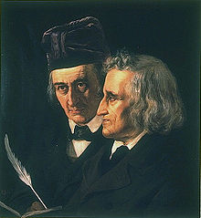
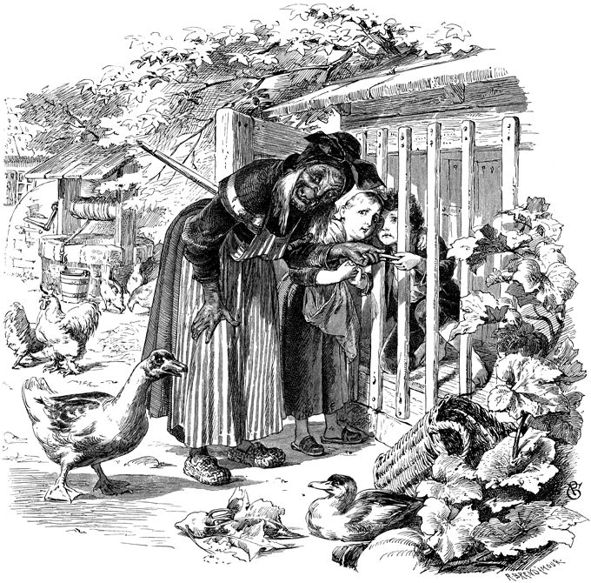
Germany, 19th century
Jacob and Wilhelm Grimm
1812 Children and Household Tales
Hansel and Grethel

Slide 28
Grimms Fairytales
The Juniper Tree
Frau Trude

Slide 29
Grimms Fairytales
Rapunzel
Rumpelstiltskin

Slide 30
Grimms Fairytales
The Frog King
The Thumbling

Slide 31
German vs. Czech fairytales

Slide 32
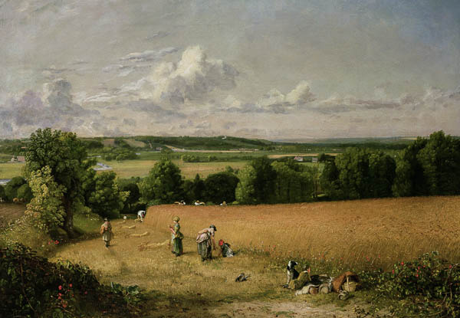
German vs. Czech fairytales

Slide 33
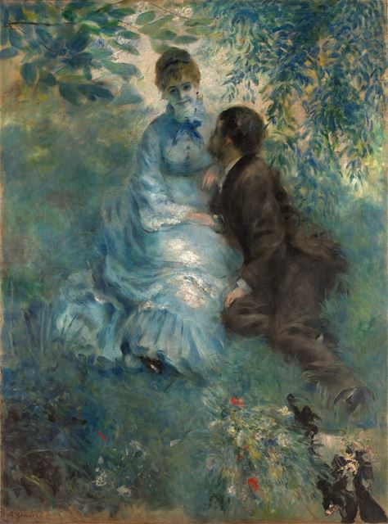
German vs. Czech fairytales

Slide 34
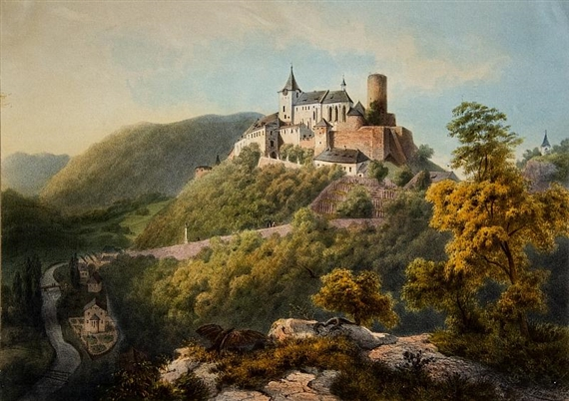
German vs. Czech fairytales

Slide 35
German vs. Czech fairytales
Late romanticism (1815-1848) – „biedermeier“

Slide 36
German vs. Czech fairytales
Early romanticism (cca 1790-1815)
Late romanticism (1815-1848) – „biedermeier“

Slide 37
German vs. Czech fairytales
Early romanticism (cca 1790-1815)
Late romanticism (1815-1848) – „biedermeier“

Slide 38
German vs. Czech fairytales
Early romanticism (cca 1790-1815)
Late romanticism (1815-1848) – „biedermeier“

Slide 39
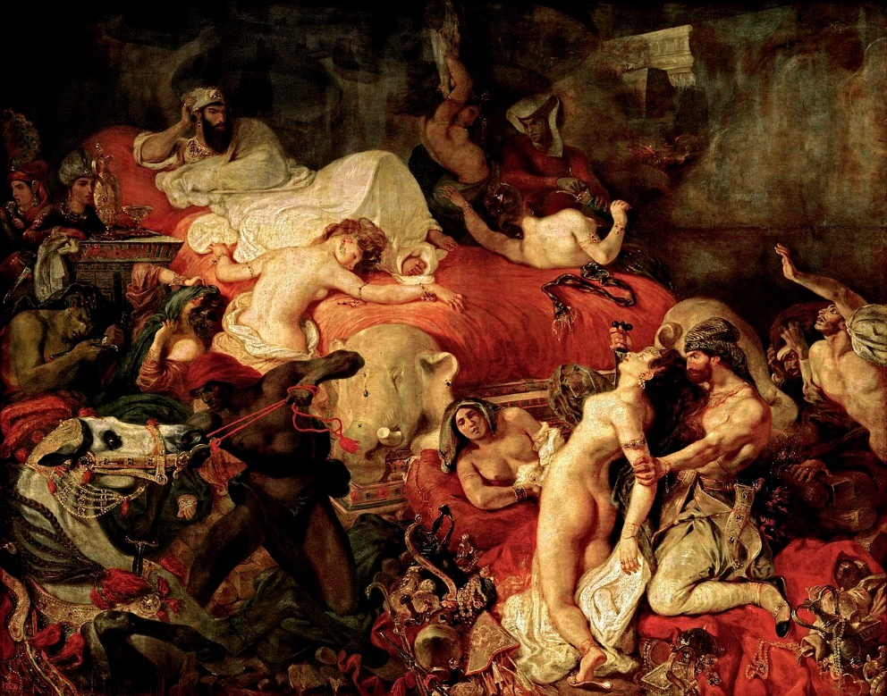
German vs. Czech fairytales
Early romanticism (cca 1790-1815)
Late romanticism (1815-1848) – „Biedermeier“

Slide 40
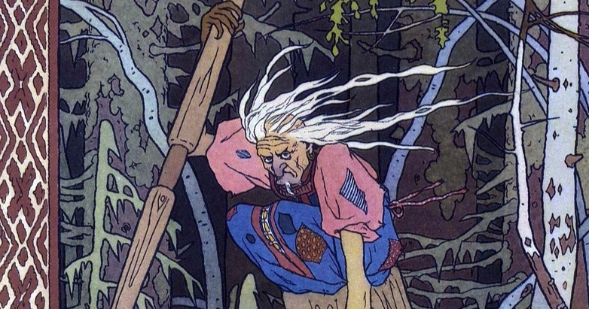
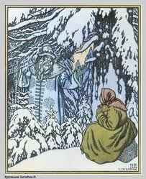
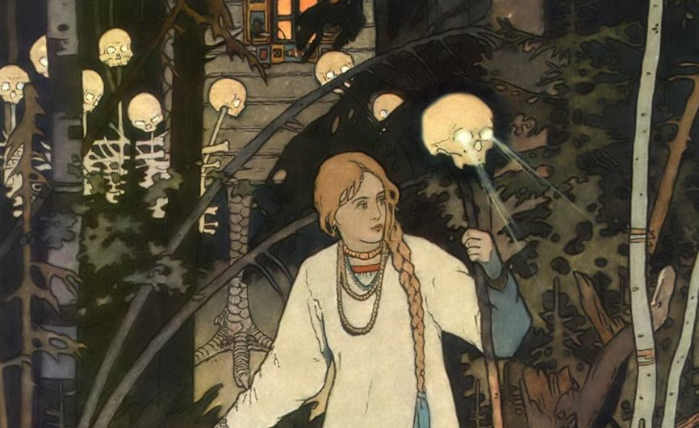
Russian Fairytales,19th century A. Afanasyev
Father Frost
Baba Yaga

Slide 41
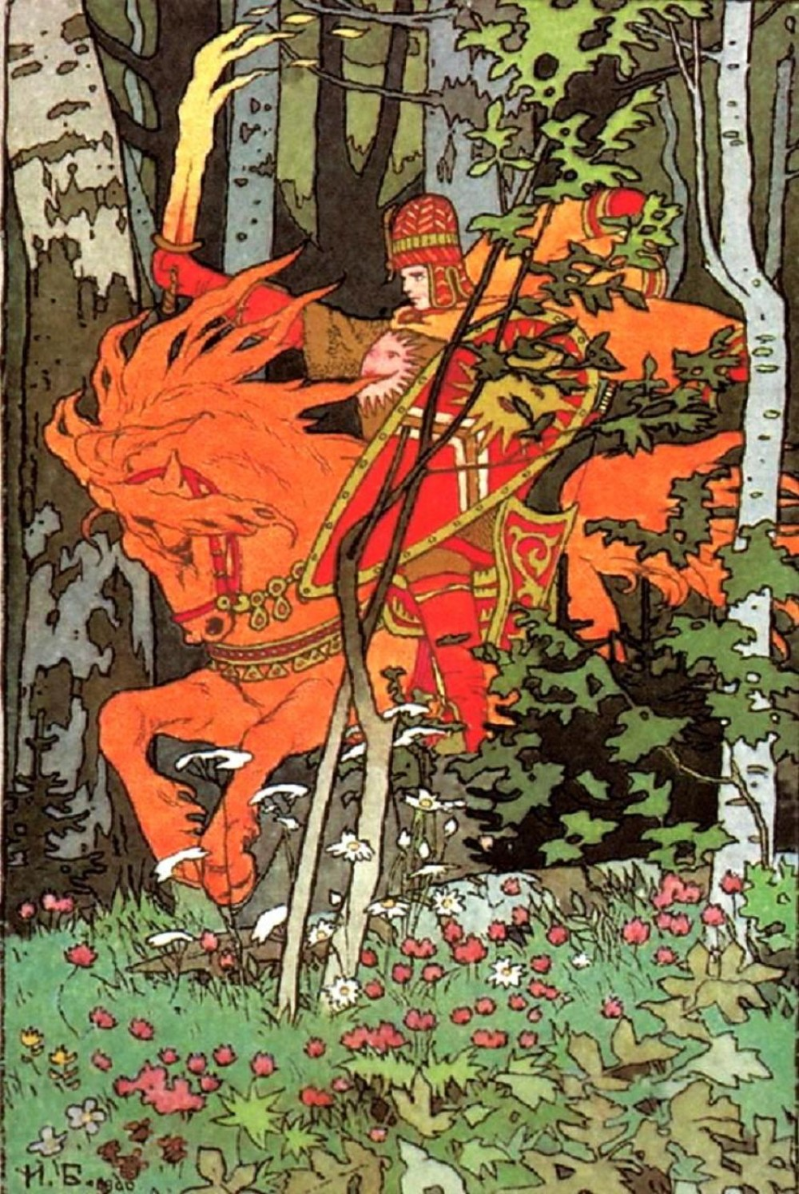
Russian Fairytales,19th century A. Afanasyev
Father Frost
Vasilissa the Beautiful
Baba Yaga

Slide 42
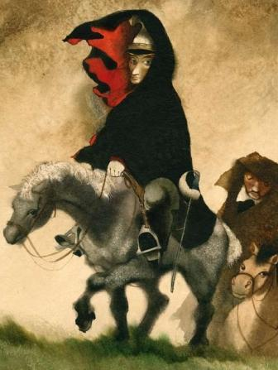
Outset of Czech Fairytales Czech Lands, 19th century

Slide 43
Outset of Czech Fairytales Czech Lands, 19th century
Influences and circumstances:
Romantic Movement

Slide 44
Outset of Czech Fairytales Czech Lands, 19th century
Influences and circumstances:
Romantic Movement
National Revival movement
J.G.Herder: the idea of collective-national
spirit

Slide 45
Karel Jaromír Erben
historian, poet, writer, folklorist
1853 A Bouquet of Folk Legends (Kytice)
1865 One Hundred Slavic Folktales and Legends in Original Dialects

Slide 46
Božena Němcová
writer and folklorist
active participant in Czech National Revival
unconventional, emancipated, feminist
1845 – 1848 National Stories and Legends
1857-1858 Slovak Fairy Tales and Legends
1855 The Grandmother

Slide 47
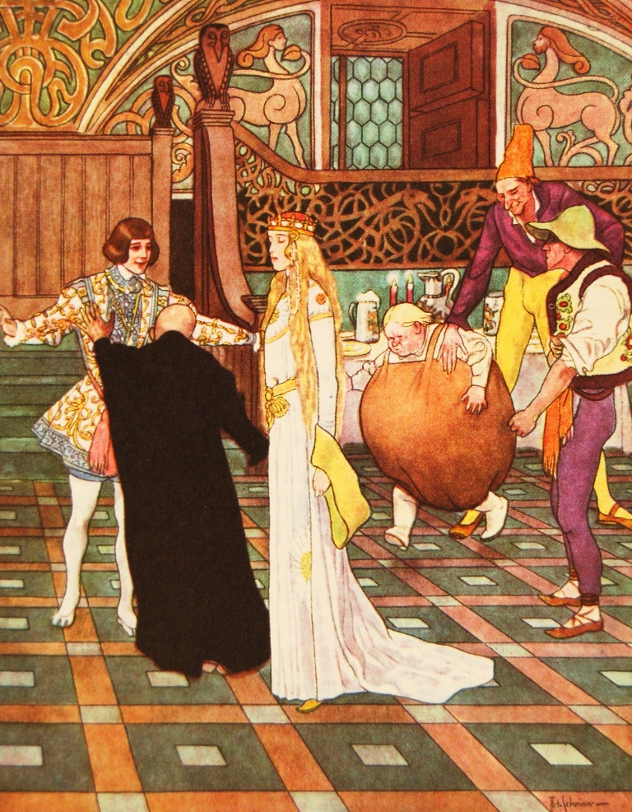
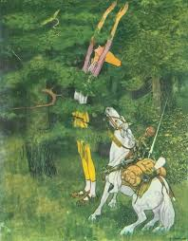
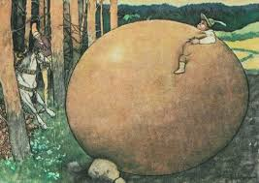
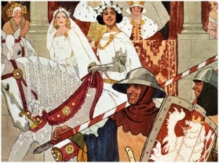
Erben´s Fairytales
Long, Wide and Sharpeyes

Slide 48
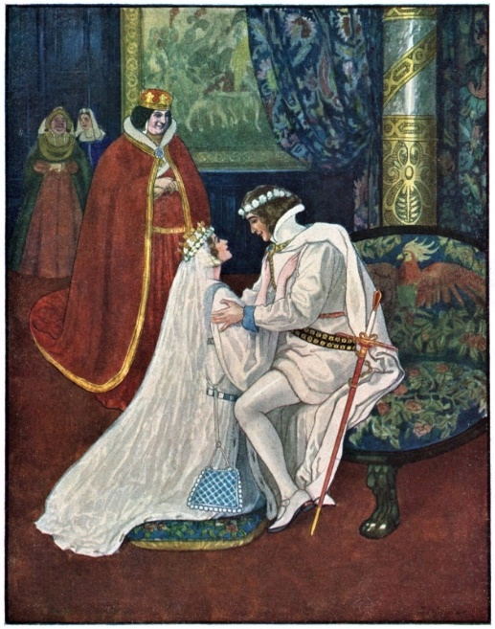
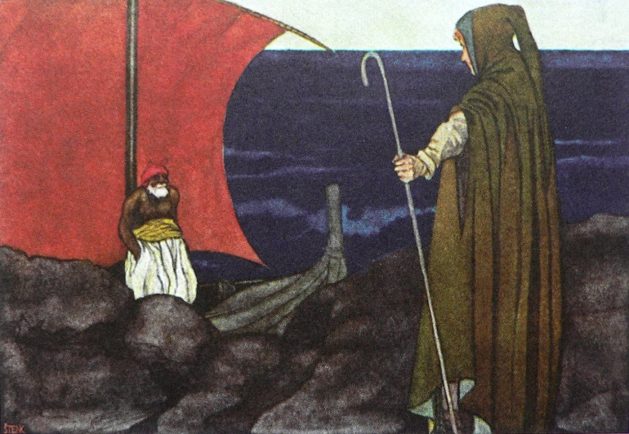
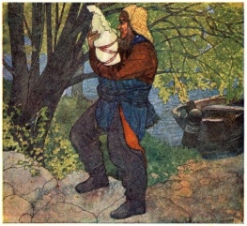
Erben´s Fairytales
The Three Golden Hairs
Illustrations of Artuš Scheiner (1863-1938)

Slide 49
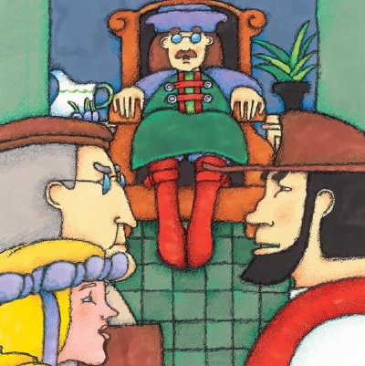
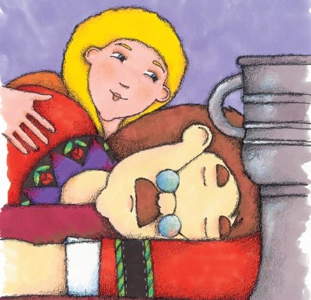
Fairytales of Němcová
The Clever Princess
Clever Manka

Slide 50
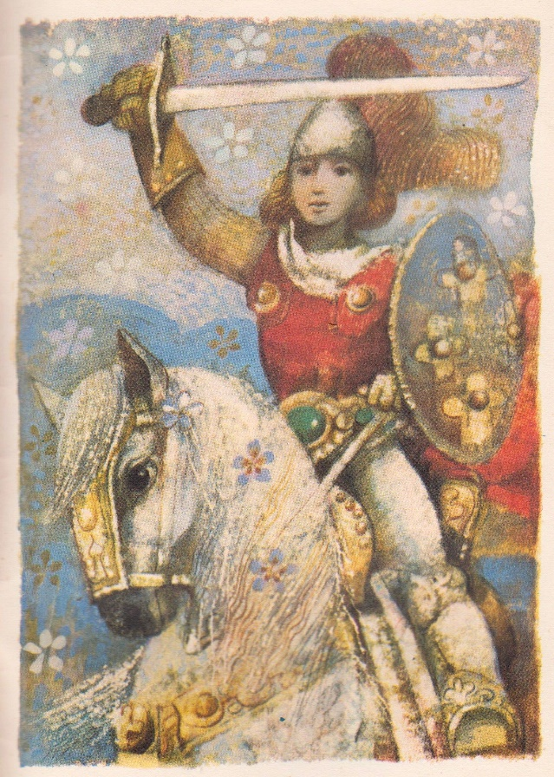
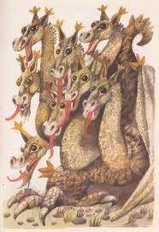
Fairytales of Němcová
Prince Bayaya
Illustrations of Karel Franta (1928-2017)

Slide 51
Erben vs. Němcová
Erben
Němcová
The Three Golden Hairs
Long, Wide and Sharp Eyes
The Clever Princess
Clever Manka
Prince Bayaya

Slide 52
Erben vs. Němcová
Němcová
Erben
The Three Golden Hairs
Long, Wide and Sharp Eyes
The Clever Princess
Clever Manka
Prince Bayaya
- emancipated woman, feminist
activ participant in Czech National Revival
strong democratic conviction
In her fairytales:
Strong, independent female figures (clever, bright, witty)
Hero who is not high-born but tries hard and succeds

Slide 53
Erben vs. Němcová
Němcová
Erben
The Three Golden Hairs
Long, Wide and Sharp Eyes
The Clever Princess
Clever Manka
Prince Bayaya
- scholar – historian and folklorist:
believes in mythological roots of fairytales and deep symbolism
In his fairytales:
Mythological type of a hero: male, predestinated,
Cosmological motifs
- emancipated woman, feminist
activ participant in Czech National Revival
strong democratic conviction
In her fairytales:
Strong, independent female figures (clever, bright, witty)
Hero who is not high-born but tries hard and succeds

Slide 54
Supernatural beings of Czech fairytales

Slide 55
Supernatural beings of Czech fairytales
Čert (translated as Devil)

Slide 56
The Devil´s Column in Vyšehrad park
- many other local explanatory tales with Devil figure

Slide 57
Supernatural beings of Czech fairytales
Čert - is this really Devil ?!?

Slide 58
Supernatural beings of Czech fairytales
Čert - is this really Devil ?!?
English „Devil“ = 1. ďábel 2. čert

Slide 60
Satyr / Faun
a mythological half human – half goat creature
companion of god Dionysos - associated with harvest and wine, music, ecstasy

Slide 61
Satyr / Faun
- sexual connotations

Slide 62
Satyr / Faun
- sexual connotations
The God Pan
ancient Greek god of the nature and wild
associated with sexuality and fertility

Slide 63
Satyr / Faun
- sexual connotations
The God Pan
ancient Greek god of the nature and wild
associated with sexuality and fertility

Slide 64
Drak (dragon)
- a typical Czech fairytale monster

Slide 65
Vodník (Waterman)
- a typical Czech supernatural being

Slide 66
Otesánek - famous Czech fairytale monster

Slide 67
Gypsy Fairytales
The Gypsy and the Priest

Slide 68
The Birth of European Fairytale - Summary

Slide 69
The Birth of European Fairytale - Summary
old roots, ancient origin

Slide 70
The Birth of European Fairytale - Summary
old roots, ancient origin
intercultural influences

Slide 71
The Birth of European Fairytale - Summary
old roots, ancient origin
intercultural influences
intertextual influences, mixing genres

Slide 72
The Birth of European Fairytale - Summary
old roots, ancient origin
intercultural influences
intertextual influences, mixing genres
big similarity

Slide 73
The Birth of European Fairytale - Summary
old roots, ancient origin
intercultural influences
intertextual influences, mixing genres
big similarity
obvious differences

Slide 74
The Birth of European Fairytale - Summary
Fairytales reflect:

Slide 75
The Birth of European Fairytale - Summary
Fairytales reflect:
„national mentality“ of specific nation/ethnic (German vs. Czech vs. Gypsy fairytales)

Slide 76
The Birth of European Fairytale - Summary
Fairytales reflect:
„national mentality“ of specific nation/ethnic (German vs. Czech vs. Gypsy fairytales)
historical circumstances of their origin(Czech vs. Gypsy fairytales)

Slide 77
The Birth of European Fairytale - Summary
Fairytales reflect:
„national mentality“ of specific nation/ethnic (German vs. Czech vs. Gypsy fairytales)
historical circumstances of their origin(Czech vs. Gypsy fairytales)
natural conditions of the place of origin (Russian fairytales)

Slide 78
The Birth of European Fairytale - Summary
Fairytales reflect:
„national mentality“ of specific nation/ethnic (German vs. Czech vs. Gypsy fairytales)
historical circumstances of their origin(Czech vs. Gypsy fairytales)
natural conditions of the place of origin (Russian fairytales)
literary fashion of the period (German vs. Czech fairytales)

Slide 79
The Birth of European Fairytale - Summary
Fairytales reflect:
„national mentality“ of specific nation/ethnic (German vs. Czech vs. Gypsy fairytales)
historical circumstances of their origin (Czech vs. Gypsy fairytales)
natural conditions of the place of origin (Russian fairytales)
literary fashion of the period (German vs. Czech fairytales)
individuality of the collectors (Erben vs. Němcová)

