Slide 1
Local Government in England

Slide 2
Caveat
The focus on these two sessions is about local government in England
Scotland and Wales have a different structure of sub-national government, as does Northern Ireland

Slide 3
Overview
Constitutional position of local government
Structures
Size
Who does what?
Personnel

Slide 4
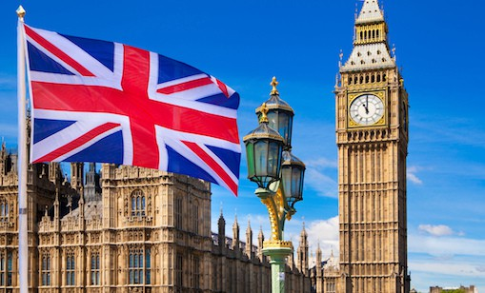
Constitutional position of local government
There isn’t one
The UK constitution is underpinned by Parliamentary sovereignty
Parliament can make, amend or repeal any legislation

Slide 5
Constitution
There is also the principle of ultra vires (beyond the law)
Councils may not act beyond their powers
Councils must implement laws passed by Parliament
Hazell v Hammersmith and Fulham LBC [1992] is an English administrative law case, which declared that local authorities had no power to engage in interest rate swap agreements because they were beyond the council's borrowing powers, and that all the contracts were void. Their actions were held to contravene the Local Government Act 1972.

Slide 6
Legislation
Local Government Act 1972 – introduced system of tiered local government
Local Government Act 1985 – abolished GLC and Metropolitan County Councils
Local Government Finance Act 1988 – introduced Community Charge/Poll Tax
Local Government Act 1988 – restrictions on council activities via competition (included s.28 on teaching in schools)
Local Government Finance Act 1992 – introduced Council Tax to replace Poll Tax
Local Government Act 1992 – Citizen’s Charter legislation into local government
Local Government (Amendment) Act 1993 – amended 1966 legislation on grants for councils
Local Government Act 1997 – powers for councils to enter contracts
Local Government Act 1999 – Best Value
Localism Act 2011 – changed powers of local government; devolution of powers to citizens
Local Government (Finance) Act 2012 – non-domestic rates and grants to local authorities
Local Government (Review of Decisions) Act 2015 – rules on reviewing decisions
Cities and Local Government Devolution Act 2016 – established Combined Authorities
Local Government (Disqualification) Act 2022 – disqualification as a councillor, etc

Slide 7
Structures
The structure of local government in England has been described as “a dog’s breakfast”
It is far from uniform, and is complicated further by a partial regional tier of government

Slide 8
Parliament
10 Combined Authorities
21 County Councils
99 unitary authorities, including 36 Metropolitan Boroughs
London Mayor and London Assembly
164 District/Borough councils
35 Police (Fire) and Crime Commissioners
33 London boroughs and the City of London Corporation
36 Local Economic Partnerships
As of April 2023
There are also around 9000 parish/town councils

Slide 9
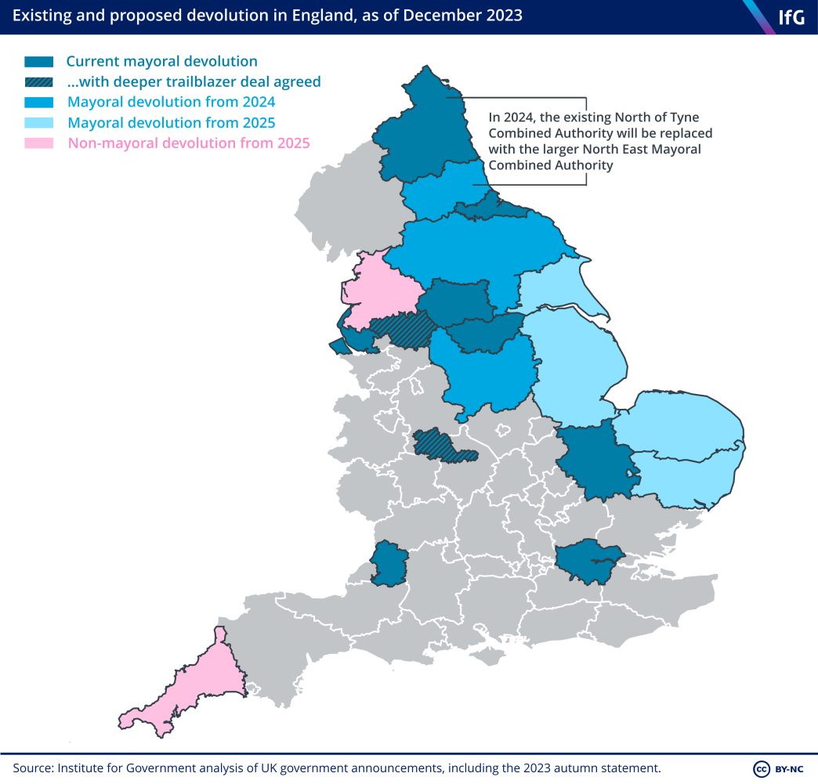

Slide 10
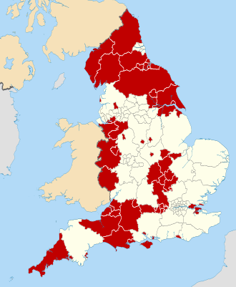
Unitary authorities in England, excluding Metropolitan borough and London boroughs

Slide 11
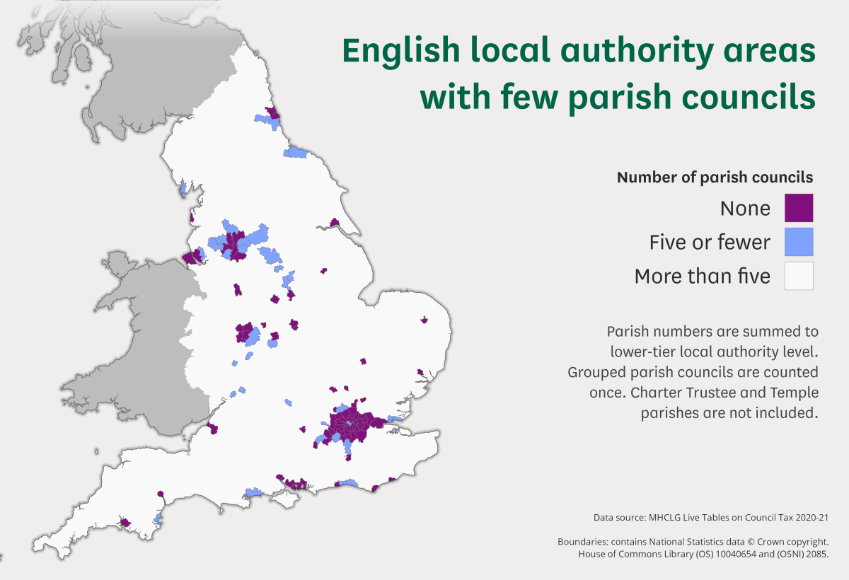

Slide 12
Size
In terms of population, England has the largest councils in Europe
There are 317 local authorities across England, and about 17 000 councillors
Average of 150 000 people per council
Kent County Council – 1.5 million residents, 81 Councillors
Isles of Scilly Council – 2 060 residents, 16 councillors
Rutland County Council – 41 210 residents, 27 councillors

Slide 13
Country | Population | Number of councils | Largest population | Smallest population
Czechia | 10.5 million | 6 258 | 1.3 million | 79
Slovenia | 2.1 million | 212 | 272 000 | 305
USA | 331.9 million | 89 004 | 8.5 million | 1 (Monowi, Nebraska)
India | 1.4 billion | 257 000 plus c. 645 000 grama panchayats | 12.5 million
New Zealand | 5.1 million | 78 | 1.44 million | 600
France | 67.5 million | 34 836 | 2.1 million | 1 (Rochefourchat)
Iceland | 372 000 | 64 | 129 886 | 37
Portugal | 10.3 million | 308 plus 3 091 parishes | 545 000 | 451
Poland | 38.5 million | 2 858 plus c. 41 000 parishes | 1.8 million | 1 279
Wales | 3.1 million | 22 plus 735 community councils | 362 400 | 58 800
Northern Ireland | 1.9 million | 11 | 342 000 | 116 835
Scotland | 5.5 million | 32 plus c. 1200 community councils | 626 000 | 22 190
England | 56 million | 317 plus c.9 000 parishes | 1.5 million | 2,060

Slide 14
Size
There is a push for larger unitary authorities
Government indicated a minimum population size of 350 000
The grounds for doing this are all economic; democratic ideas go out the window
The political and governance implications of unitary reorganisation | Local Government Association

Slide 15
Who does what?
There is a clear division of responsibilities
There is (another) caveat – councils may be responsible for ensuring the delivery of a service rather than its actual delivery
We will cover this in the next session

Slide 16
Service Provision
 | TWO TIER |  | UNITARY AUTHORITY
 | COUNTY | DISTRICT
Education | X |  | X
Highways | X | X | X
Transport | X |  | X
Social services | X |  | X
Housing |  | X | X
Fire & Rescue |  | X | X
Libraries | X |  | X
Strategic planning | X |  | X
Development control |  | X | X
Refuse collection |  | X | X
Refuse disposal | X |  | X
Recreation facilities |  | X | X
Licensing |  | X | X
Consumer protection | X |  | X
Council tax collection |  | X | X

Slide 17
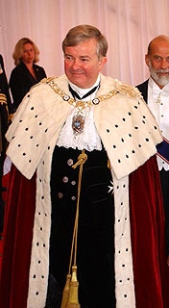
Personnel
Sadiq Khan
Michael Mainelli

Slide 18
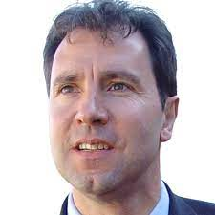
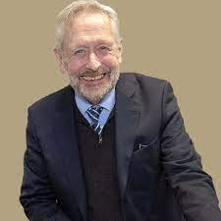
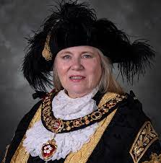
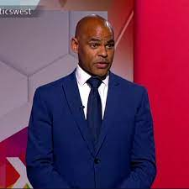
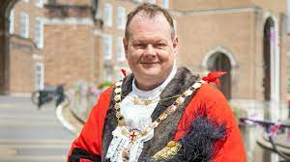
Personnel
14 councils in England have elected mayors
9 Combined Authorities have elected mayors
Dan Norris
Paul Goggin
Sir Peter Soulsby
Dr Susan Barton
Marvin Rees

Slide 19
Councillors
In 2022
40% of councillors were retired, and 32% were in full- or part-time employment
61% of councillors held other voluntary or unpaid positions, such as school governorships
64% of councillors held a degree or equivalent qualification; only 4% did not hold any qualification
59% of councillors were male, and 41% female
average age of councillors was 60; 16% were aged under-45; 42% were aged 65 or over
92% described their ethnic background as white
84% described their sexual orientation as heterosexual or straight
16% had a long-term health problem or disability which limited their daily activities
46% of councillors had a responsibility as a carer, most commonly looking after a child
Local government facts and figures: England - LGiU

Slide 20
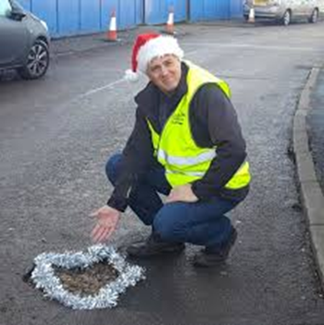
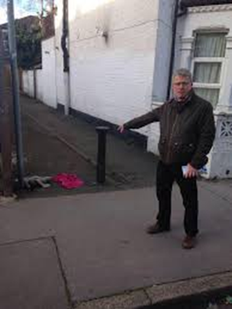
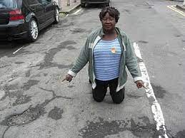
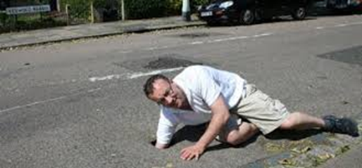
What do councillors do?

Slide 21
Conclusion
Sub-national government in England is a little chaotic
Centre dominates politically and constitutionally
Next time
Finance
Local governance

