Slide 1
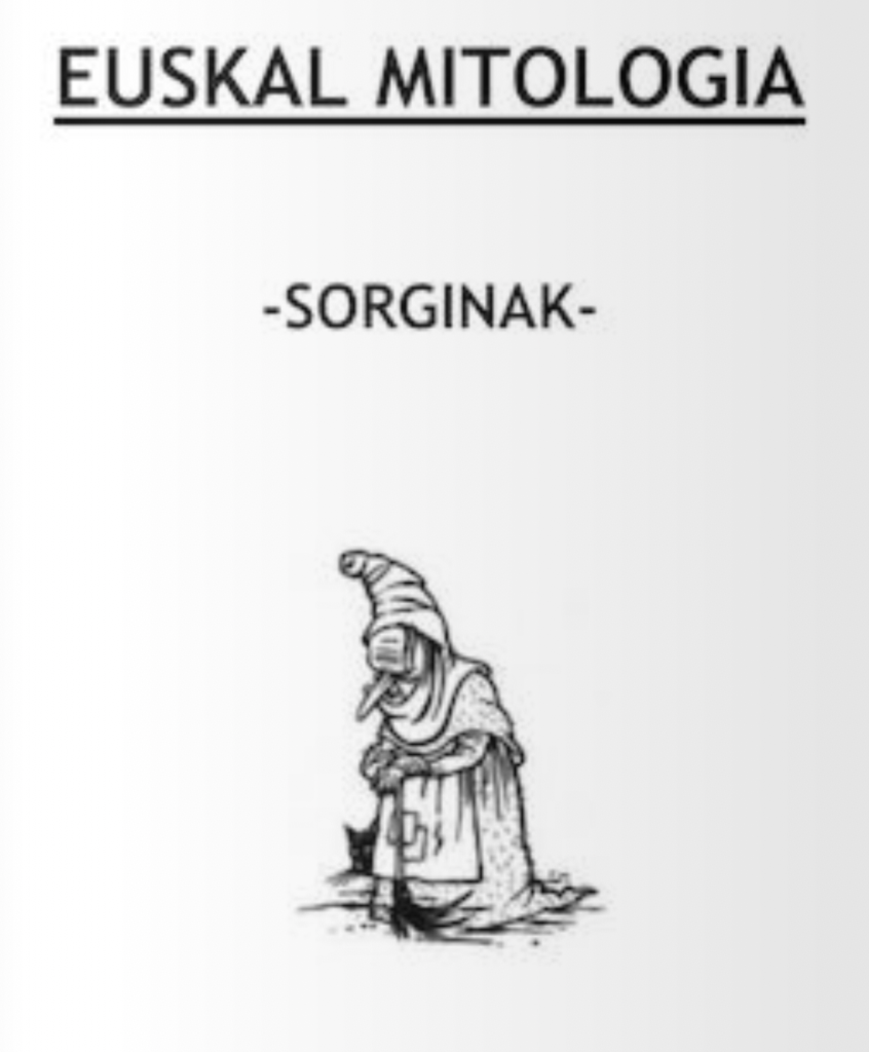
Sorginak

Slide 2
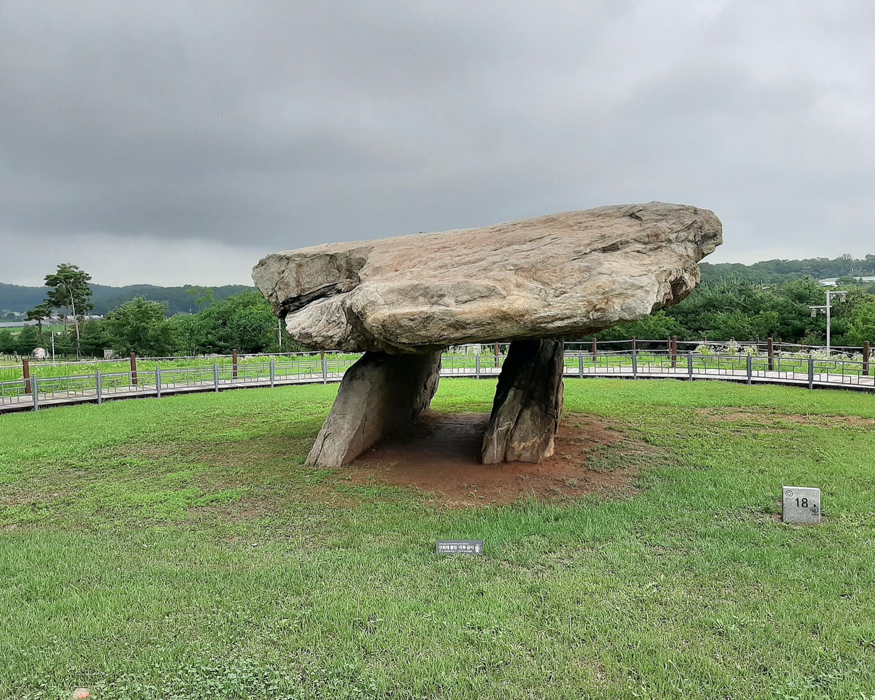
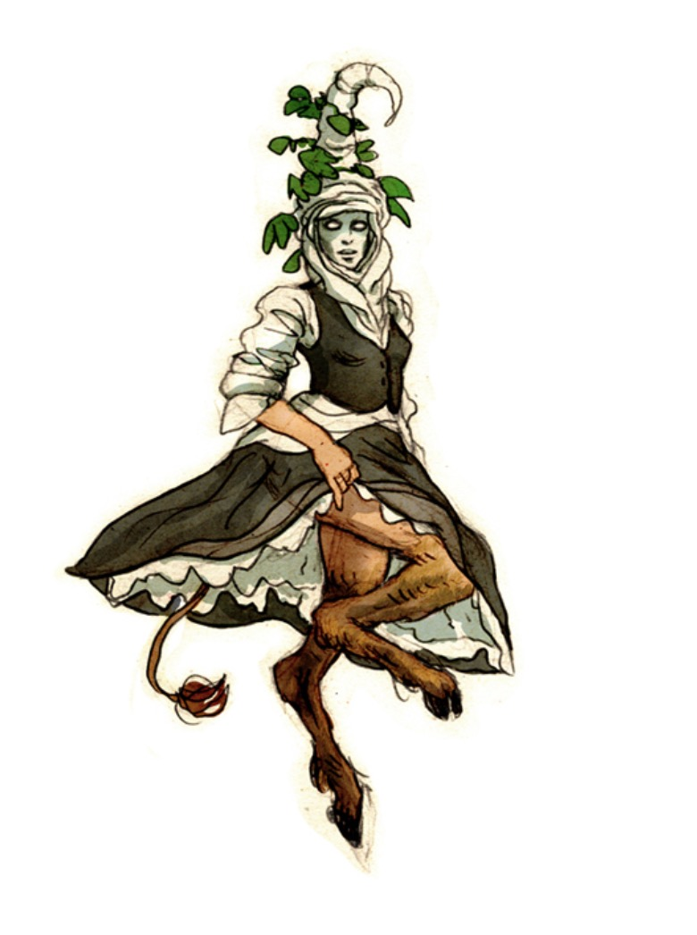
Sorginak (root form: sorgin) are the assistants of the goddess Mari in Basque mythology. It is also the Basque name for witches or pagan priestesses (though they could also be male), it being difficult to distinguish between the mythological and real ones.
Sorginak are said often to have built the local megaliths

Slide 3
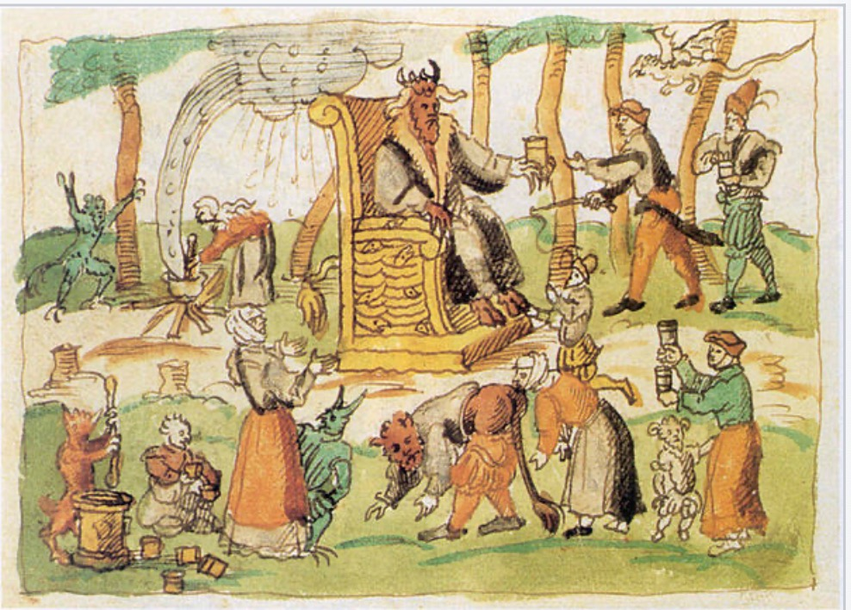
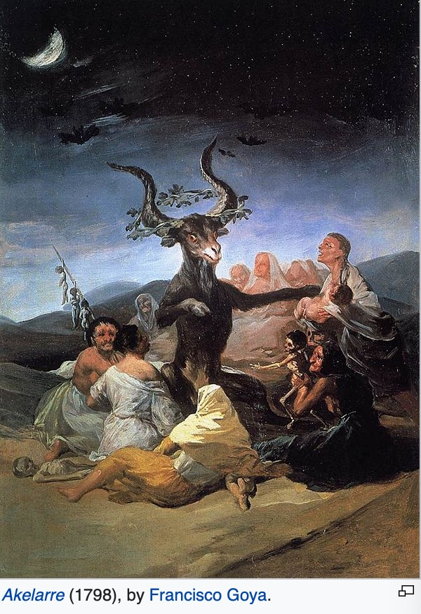
Sorginak, like other European witches, used to participate in the sabbat, called akelarre locally on Friday nights, when Mari and Sugaar are said to meet in the locally sacred cave to engender storms.
Sorginak witches are also known as spiritual guides, Channelers, they have the ability to channel their ancestors and get guided knowledge on how to heal others with guidance.

Slide 4
Etymology
The etymology of the name is disputed. The common suffix -gin (actor, from egin: to do) is the only agreement.
One theory claims that sor derives from sorte (fortune), and hence it would be rendered as fortune-teller.
The other states that sor is the radical of sor(tu) (to create), and hence sorgin means literally: creator.

Slide 5
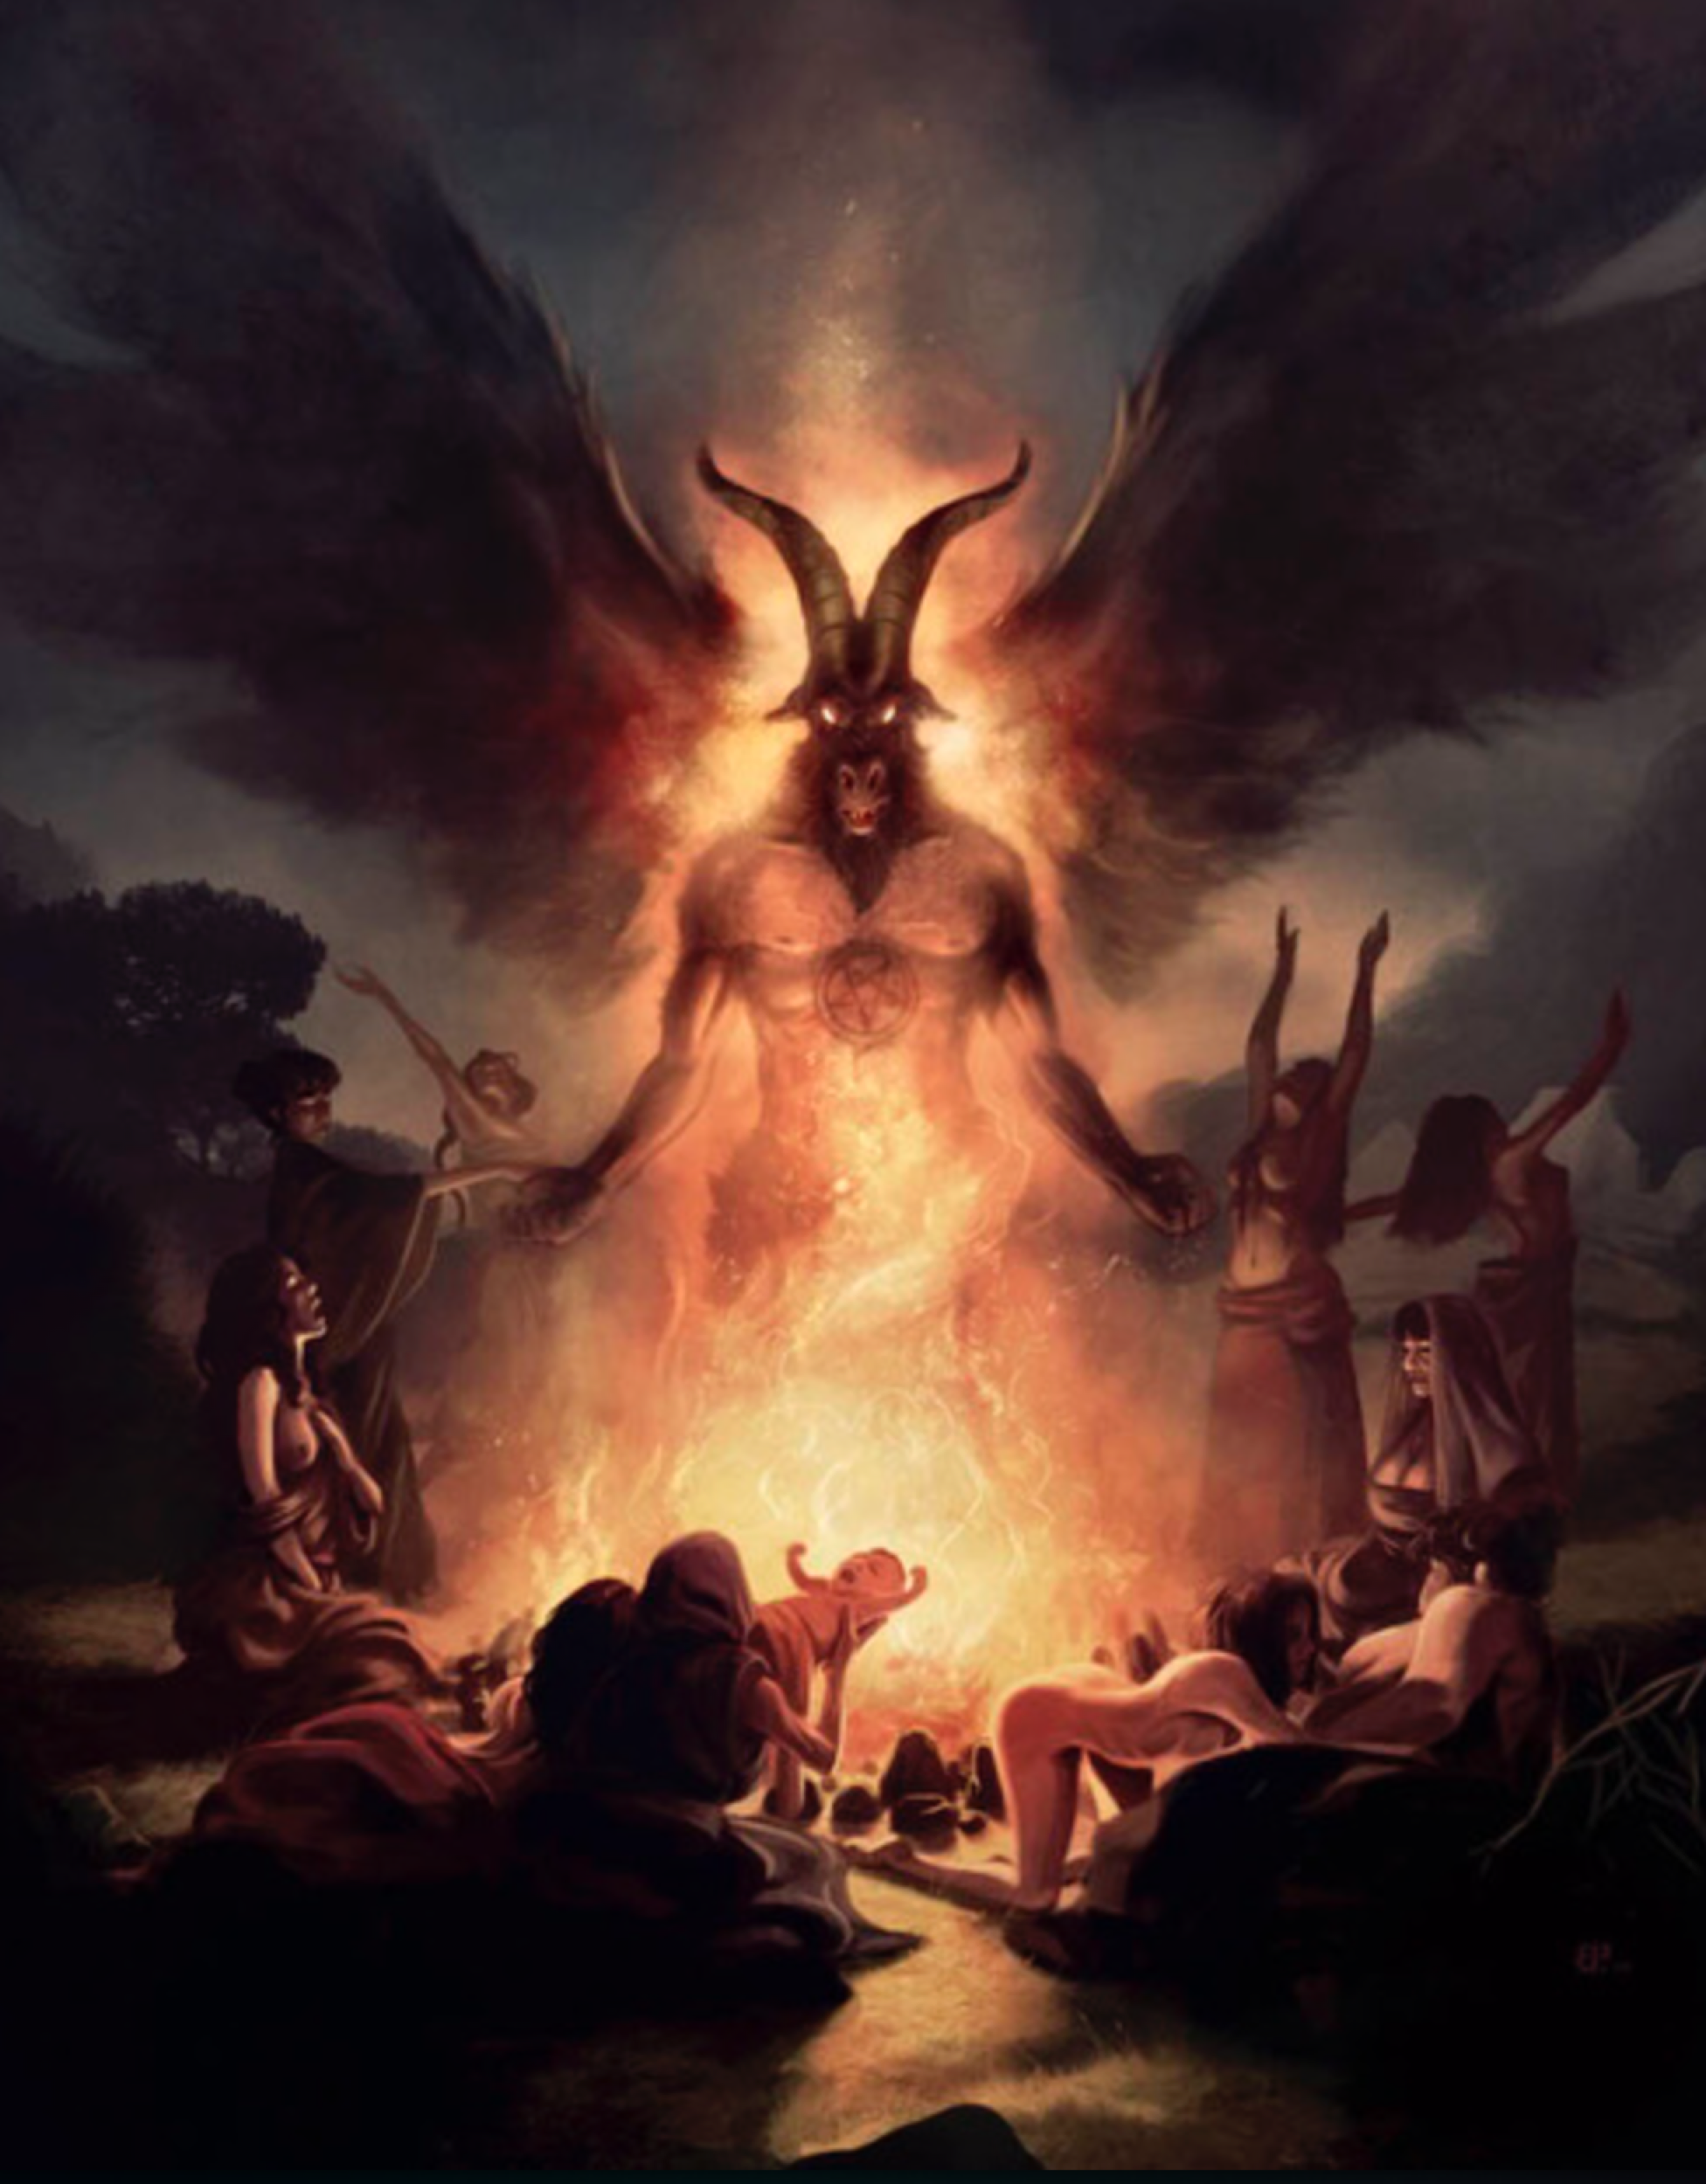
Most common references
Sorginak are often said to recite the following spell to travel to and back from the akelarre: Under the clouds and over the brambles, or variants of it. In many legends a failed witch (normally a man) says the spell inverted (Under the brambles and over the clouds) and arrives to the akelarre quite bruised.
Sorginak often are said to transform themselves into animals, most commonly cats. These cats are sometimes said to bother pious women that do not wish to go the akelarre. It has also been recorded that they collected monetary fines from the people that did not wish to go to their ecstatic gatherings or those witches that absented themselves from them.
Inquisitorial documents describe horrific practices of witches, like eating children or poisonings. But popular legends do not speak of these practices, instead mentioning kissing "the devil's arse" or an animal's genitals, occasional poisoning of crops, bothering modest women (in the shape of cats or other animals) and anointing their bodies with flying ointment (containing entheogenic, Solanaceous plants) to "fly" to and from the akelarre and perform other supposed feats.

