Slide 1
Bayesian hypothesis testing – Bayes factor

Slide 2
Orthodox vs. Bayesian probability
orthodox: probability = long run relative frequency
Bayesian: probability = degree of belief
(in math, probability is defined by axioms – by „how“ it behaves, not by „what“ it is)

Slide 3
Bayes theorem

Slide 4
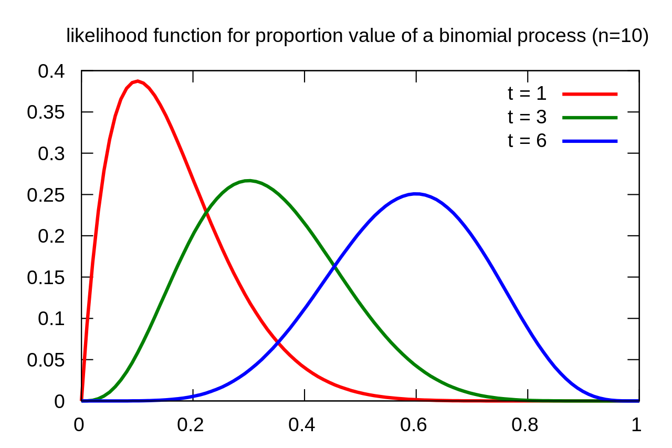
Likelihood

Slide 5
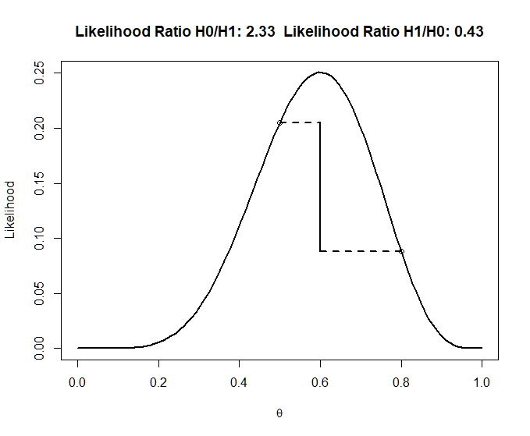
Likelihood ratio (0,21/0,088 = 2,39)
0,21
0,088
no prior knowledge
Notes:
#Calculate the likelihood ratio----
n<-3 #set total trials
x<-2 #set successes
H0 <- .05 #specify one hypothesis you want to compare with the likihood ratio
H1 <- .8 #specify another hypothesis you want to compare with the likihood ratio (you can use 1/20, or 0.05)
dbinom(x,n,H0)/dbinom(x,n,H1) #Returns the likelihood ratio of H0 over H1
dbinom(x,n,H1)/dbinom(x,n,H0) #Returns the likelihood ratio of H1 over H0
theta<- seq(0,1,len=100) #create theta variable, from 0 to 1
like <- dbinom(x,n,theta)
#png(file="LikRatio.png",width=4000,height=3000, , units = "px", res = 900)
plot(theta,like,type='l',xlab=expression(theta), ylab='Likelihood', lwd=2)
points(H0,dbinom(x,n,H0))
points(H1,dbinom(x,n,H1))
segments(H0, dbinom(x,n,H0), x/n, dbinom(x,n,H0), lty=2, lwd=2)
segments(H1, dbinom(x,n,H1), x/n, dbinom(x,n,H1), lty=2, lwd=2)
segments(x/n, dbinom(x,n,H0), x/n, dbinom(x,n,H1), lwd=2)
title(paste('Likelihood Ratio H0/H1:',round(dbinom(x,n,H0)/dbinom(x,n,H1),digits=2)," Likelihood Ratio H1/H0:",round(dbinom(x,n,H1)/dbinom(x,n,H0),digits=2)))
#dev.off()

Slide 6
Bayesian hypothesis testing
Notes:
https://static.jasp-stats.org/presentations/ICPS2015/ICPS15EJ.pdf

Slide 7
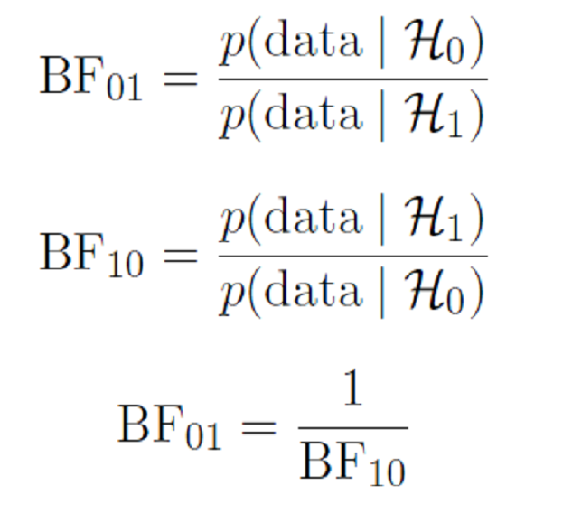
BF₁₀, BF₀₁

Slide 8
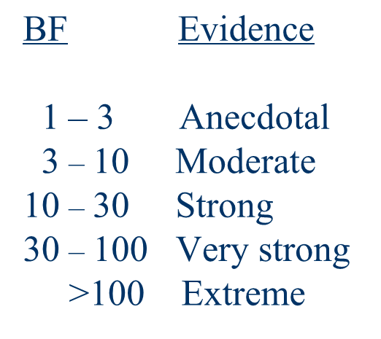
Strength of evidence

Slide 10
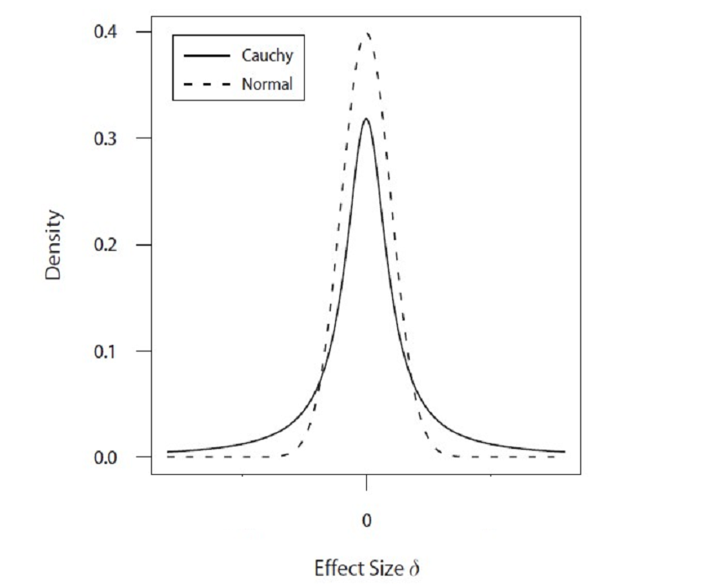
Cauchy distribution

Slide 11
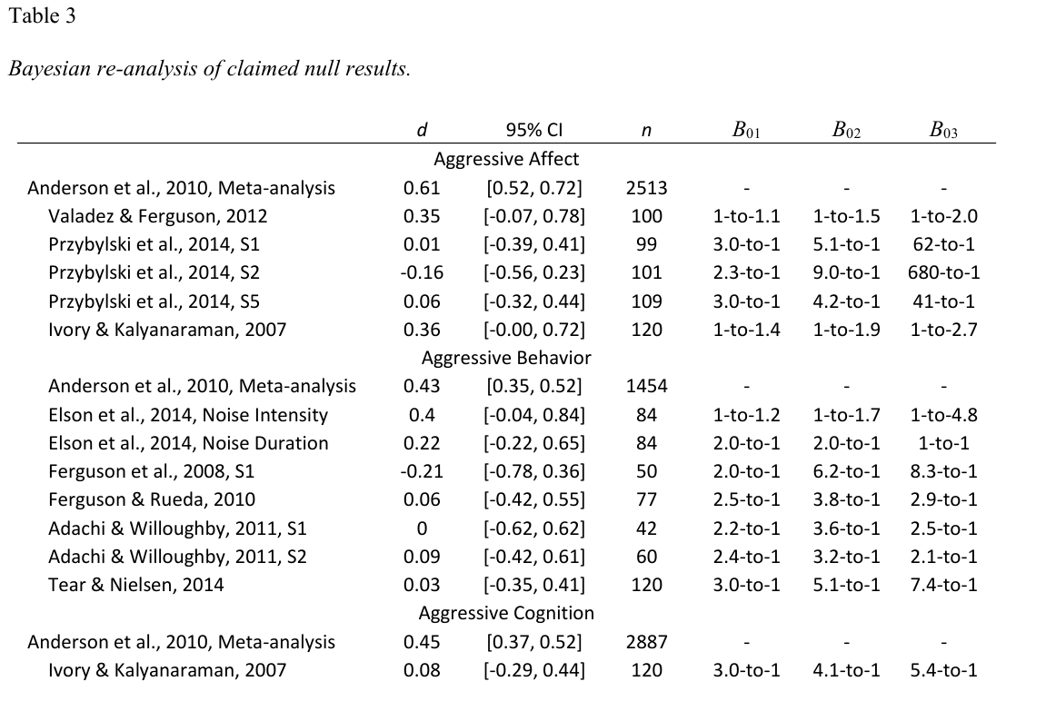
Notes:
B01 = evidence for H0: δ = 0 compared to HA1: δ ~ Cauchy(0.4). B02 = evidence for H0: δ = 0 compared to HA2: δ ~ Cauchy+(0.4). B03 = evidence for H0: δ = 0 compared to HA3: δ ~ Normal(μ, σ), with μ and σ taken from Anderson et al. (2010).

Slide 12
Bayesian statistics 2
practical application

Slide 13
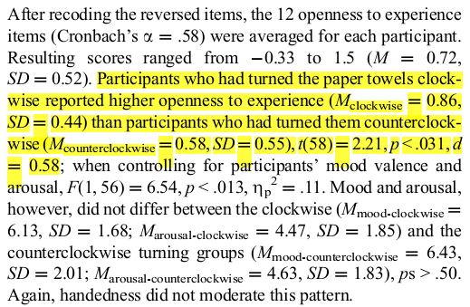
Turning the Hands of Time: Clockwise Movements Increase Preference for Novelty
Experiment 2 results:

Slide 14
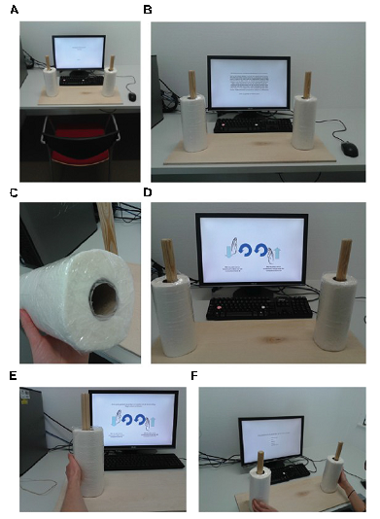
Turning the hands of time again: a purely confirmatory replication study and a Bayesian analysis
(nice paper abour pre-registration & Bayesian analysis)

Slide 15
Point H0/HA

Slide 16
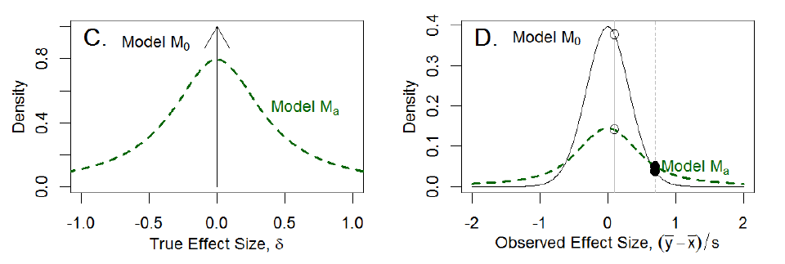
Cauchy – H0 as a distribution
Cauchy distribution has 1 parameter
e.g., Cauchy(0.4) means that are HA expectations are that true effect is between d = -0.4 and 0.4 with probability 0.5

Slide 17
Examples in JASP
„Kitchen rolls“

Slide 18
Dienes‘s Bayes Calculator
http://www.lifesci.sussex.ac.uk/home/Zoltan_Dienes/inference/Bayes.htm

