Slide 1
Income distributions

Slide 2
Probabilistic models of income distributions
Piotr Łukasiewicz, Arkadiusz Orłowski
2003

Slide 3
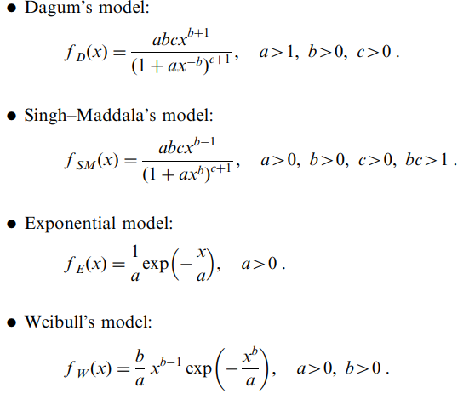
Data and Models
2000
US: 1800 classes (600$)
PL: direct data (in $)
Invidual households
MLE

Slide 4
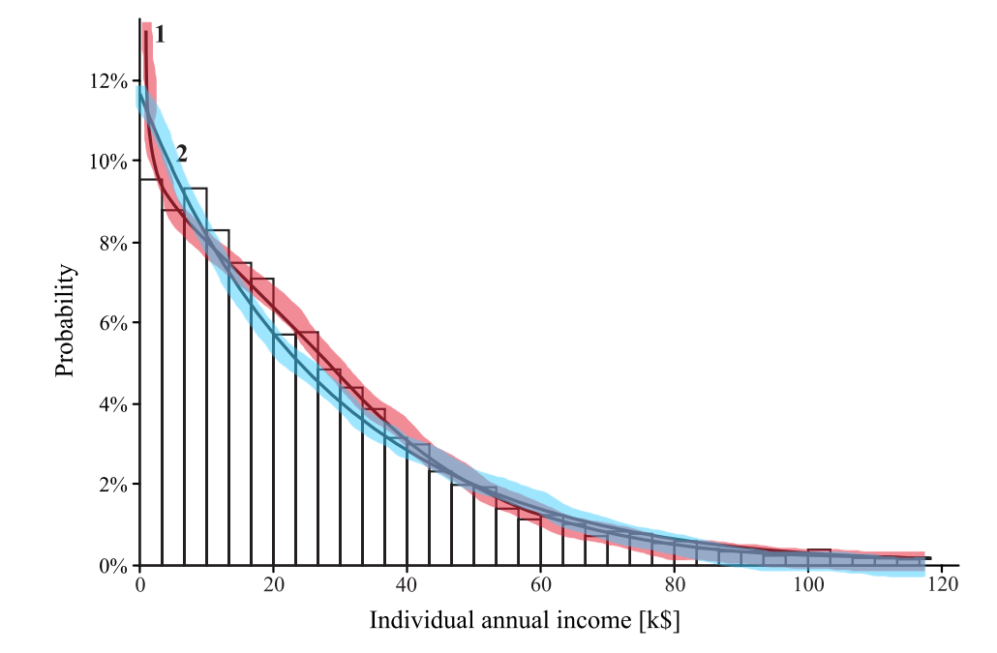
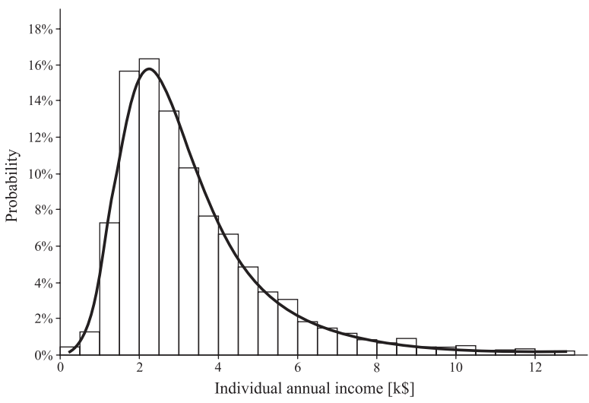
US vs. Poland

Slide 5
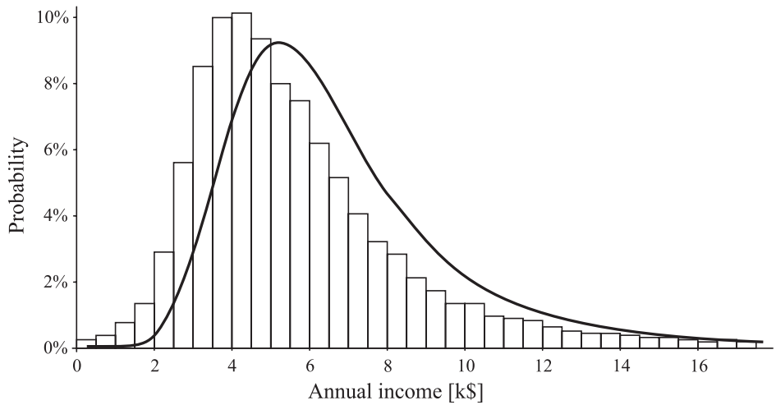
Two-earners household
Convolution of Dagums

Slide 6
Results
Dagum distribution provides good fit for one-earner household income in both the United States and Poland
In the United States, two-earners household income distribution can be modeled as a convolution of Dagum distributions, indicating statistical independence between earners' incomes
In Poland, convolution models failed to properly capture household income distribution, suggesting strong statistical dependence between earners.
This could be due to different socioeconomic factors, e.g. labor market structures, gender income asymmetry, …

Slide 7
Parametric Modelling of Income Distribution in Central and Eastern Europe
Michał Brzeziński
2013

Slide 8
The GB2 distribution
By McDonald (1984)
Dagum (q=1), Singh-Maddala (p=1), log-normal (q→∞, a→0)
The moment of order k st ap<k<aq:

Slide 9
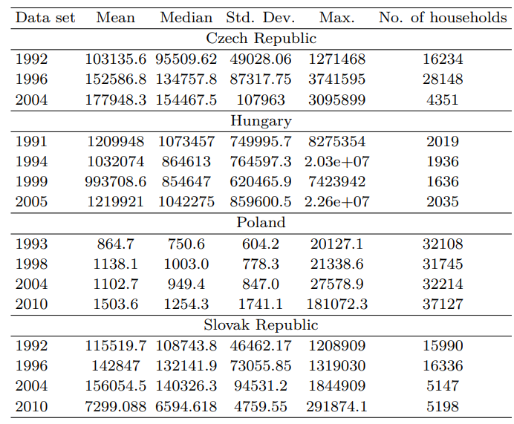
Data
PL: yearly data from PCSO
CZ, SK, HU: $±5$ years intervals from LIS
Disposable in national currency
Transformation: normalized, inflation corrected, nonpositive values excluded
MLE

Slide 10
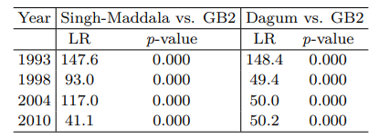
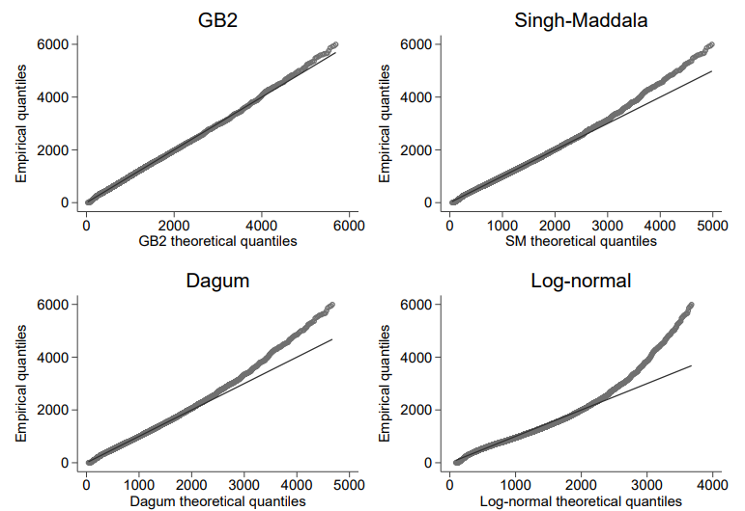
Estimators and LR’s for Poland

Slide 11
Summary
Poland: GB2 is the best model for all years—significantly outperforms Dagum and Singh-Maddala
Czechia: Dagum fits well in 1996 (p=1); Singh-Maddala may be better in later years
Slovakia: GB2 outperforms Singh-Maddala except 1992; GB2 only better than Dagum in 1996
Hungary: GB2 is best in most years, except 1992/1999

Slide 12
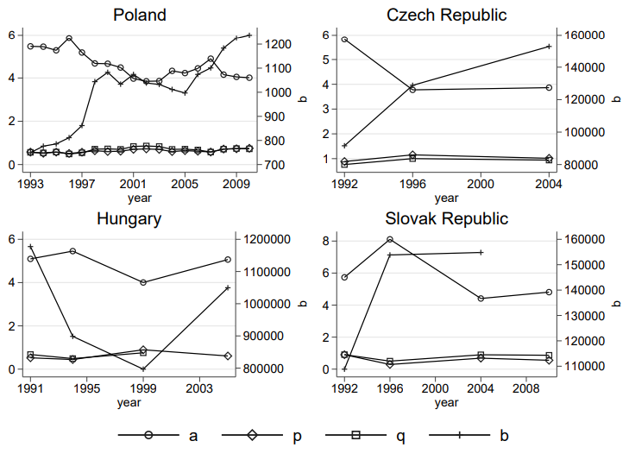
Evolution of parametres

Slide 13
Lorenz curve, Gini coefficient
X is a r.v. with c.d.f. F, EX exist, then Lorenz curve is
$$L_{X}\left(p\right)≔\frac{1}{EX}\int_{0}^{p}{F^{−1}\left(t\right)dt}$$
the Gini coefficient is $G=1−2\int_{0}^{1}{L\left(p\right)dp}$
X Lorenz-dominates Y, if $L_{Y}\left(p\right)≤L_{X}\left(p\right)$
X, Y ~ GB2 and $a_{X}≤a_{Y}$, $a_{X}p_{X}≤a_{Y}p_{Y}$ and $a_{X}q_{X}≤a_{Y}q_{Y}$, then Y Lorenz-dominates X

Slide 14
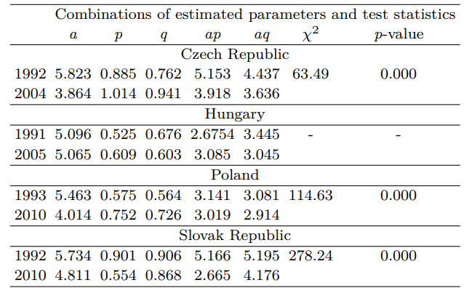
Inequality

Slide 15
Conclusion
Slovakia: recorded the lowest inequality indices among the countries in this paper
Czechia, Poland, Slovakia: all experienced rising income inequality during the transition to a market economy, evidenced by Lorenz dominance and fattening distribution tails
Hungary: no clear Lorenz dominance; however, an increase in the ap parametre suggests a shift from lower to upper income classes rather than straightforward polarization

