Slide 1
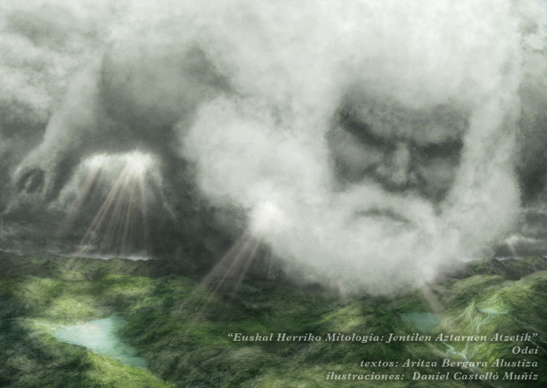
Hodei / Odei („cloud“)
Nature spirit responsible for thunders and lightning; animistic genie of thunder
Appears in the form of a storm cloud
Other names : Ortzantz, Ozkarri
He has a sister Laino / Laño (the fog)
In some legends he appears as a malicious son of Mari
Hodei probably replaced the older sky god named Ortzi / Urtzi
A possible connection with Thor or Celtic mythology
Mostly negative entity (destroys crops & scares humans)
Popular rituals used to calm Hodei:
burning laurel branches
lighting blessed candles
placing an upturned axe at the entrance of the home

Slide 2
Phrases:
common in the rural vocabulary; the two main senses of the word odei appear:
thunder
spirit of the storm or of the storm cloud.
when it is heard to thunder: Odeiak jo du (the thunder clap has sounded)
when it thunders strongly: Odei asarrea (the thunder clap is angry)
when dark clouds appear: Odeia dator (the thunder clap or the tormentous cloud come)
Odei dago (it is stormy weather)
Juztulodai (thunder cloud)
Odeiaixe (wind of Odei or of the thunder clap) - an expression for an east wind that brings storms in Guesalibar

