Slide 1
p-Curve analysis

Slide 2
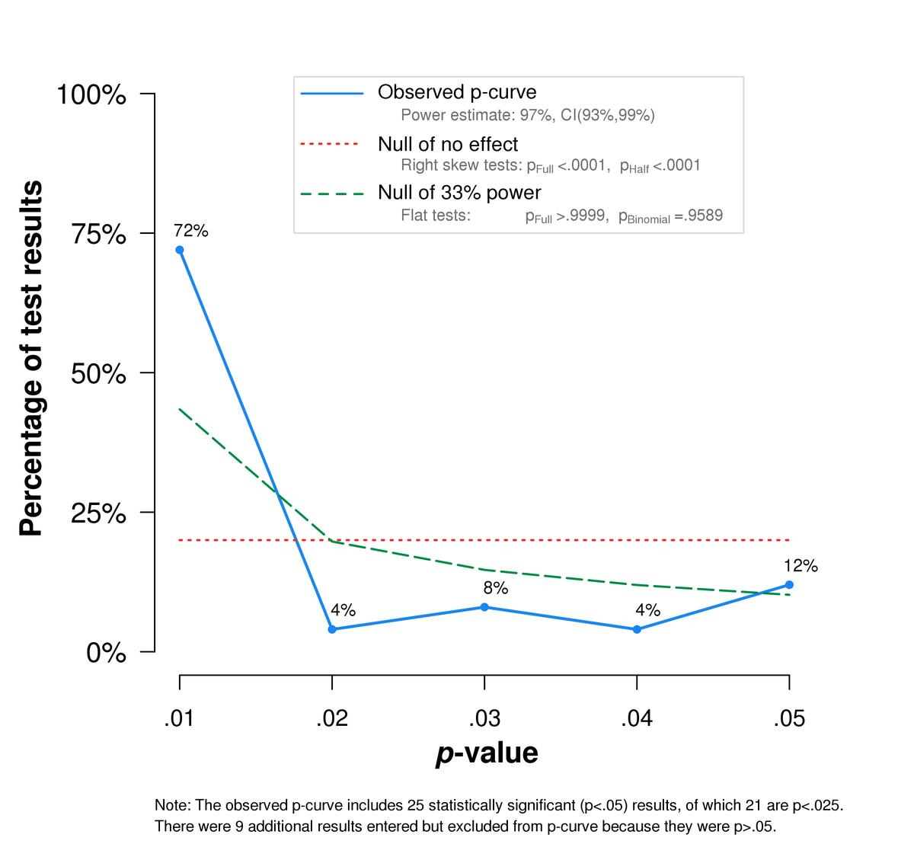

Slide 3
How can we find out if there is good evidence for an effect?
meta-analysis?
but – GIGO (garbage in, garbage out!)
i.e., if publication bias is rampant, meta-analytical estimates can be widely misleading...
what about techniques for correcting the bias?
well...

Slide 4
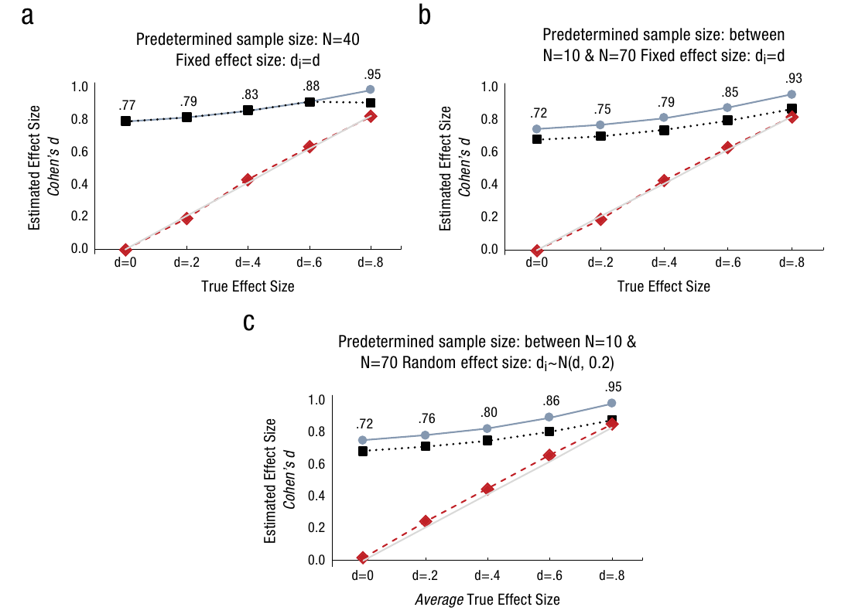
Notes:
Impact of selectively reporting significant studies. Each marker reports an effect size estimate (Cohen’s d) based on a meta-analysis per- formed on about 5,000 statistically significant simulated studies. In Panel A, all studies have 20 observations per cell and assume a fixed effect size. In Panel B, the same number of statistically significant studies with each sample size between n = 5 and n = 35 per cell are included in the meta- analysis. Panel C is the same as Panel B, except effect sizes are drawn from a normal distribution with mean d, standard deviation σ = .2. Trim and Fill and p-curve estimates are based exclusively on p < .05 results.

Slide 5
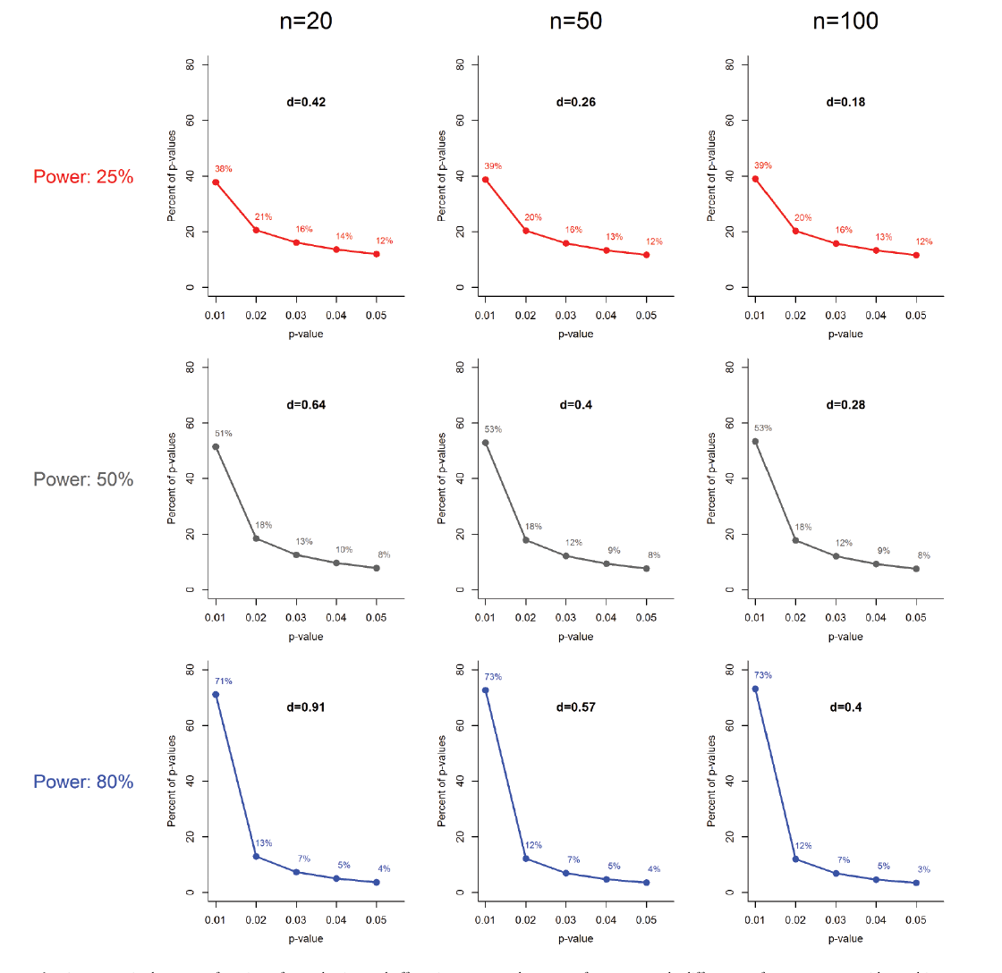
Notes:
expected p curves for various powers showing that the shape depends solely on the power

Slide 6
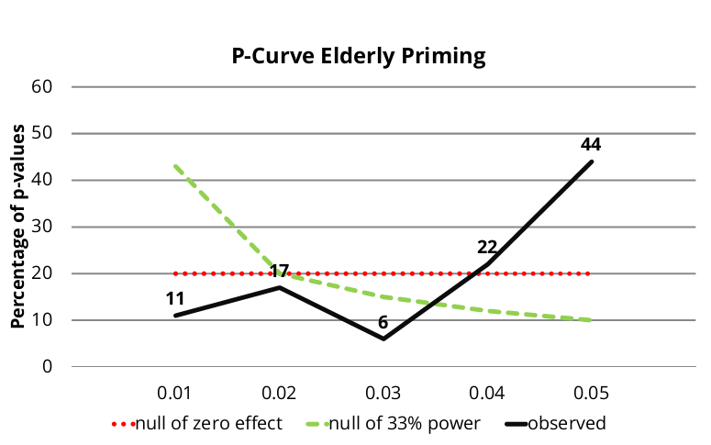

Slide 7
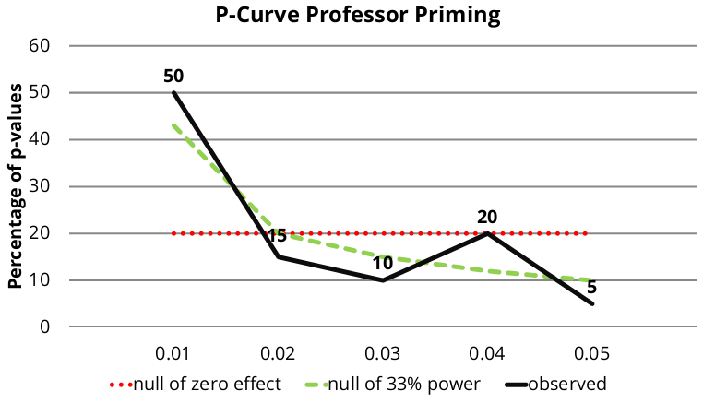

Slide 8
all test must concern the same hypothesis / effect
only slight heterogenity is allowed
usually you can get information about this from the meta-analysis
only results with the same sign are entered
it would not make sense to caluclate p-curve with e.g. rs = + 0.5 and - 0.5 – they are clearly not testing the same effect

Slide 9
p-curve is a test of evidence, not of the theory itself
(i.e. absence of evidence is not an evidence of absence of the effect in question)
it is also not a test of publication bias

Slide 10
