Slide 1
Europe and Russia
Ekaterina Ananyeva
PhD candidate

Slide 2
1. What are the priorities of RFP towards the EU and why?
2. Identify the main ideas (or interests) directing RFP in the EU
3. List the main partners of Russia within the EU (countries) and explain the choice

Slide 4
Crude data
Russia – third trading partner of the EU
EU is Russian main trade partner
EU exports to Russia: machinery and transport equipment, chemicals, medicines and agricultural products
EU investment to Russia: 75%
71% of Russian would like to normalize relations with the West (broadly defined)

Slide 5
Russia – part of Europe?
Europe – main partner and FP focus since Peter the Great
Russia participated in almost all wars and coalitions
Emperors` family bonds, cultural ties
Place for dissidents to hide from Russian police
BUT: adherence to its own statehood traditions
USSR: Europe = capitalism and imperialism
Special bilateral relations vis-à-vis states with Communist parties

Slide 6
Back to ‘the common European home’
Helsinki human rights accords (1975)
Perestroika and Russian high hopes → participation in European institutionalisation:
Accession to the Council of Europe (1996)
The European Court of Human Rights (1996)
The Parliamentary Assembly of the Council of Europe (PACE)
BUT: further integration stalled → four “common spaces”
Problems with the Road Map and EU extension to Central Europe
Current support of pro-Russian parties in the EU (Hungary, Bulgaria, France)

Slide 7
Does the EU want Russia?
No single position on Russia (old VS new members)
Individual members VS common position
‘special’ individual relations between Putin, Chirac, Berlusconi, and Schröder
Issues of energy and energy security (case against Gazprom)
Soft power wars
Current sanctions regime

Slide 8
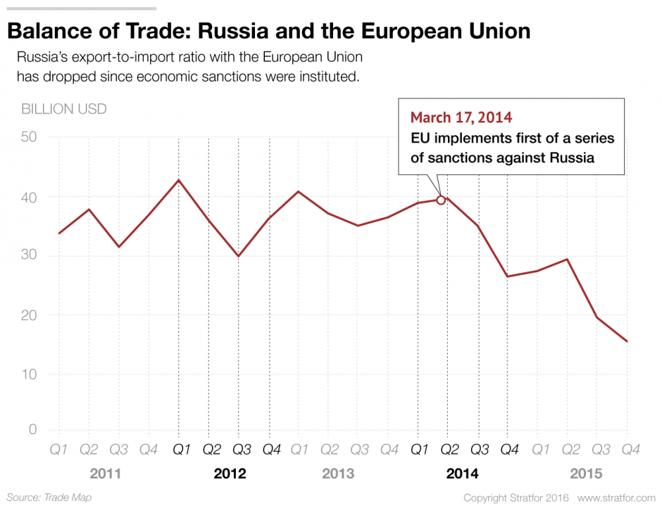

Slide 9
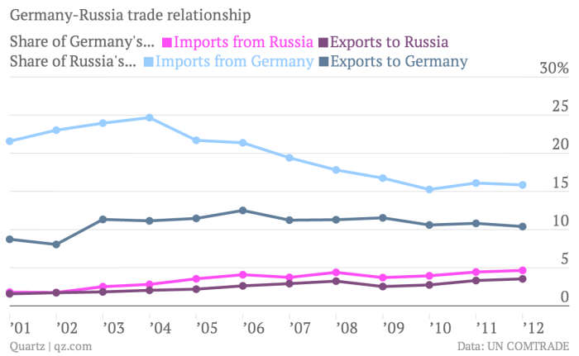
Preference for bilateral relations. Germany
Ostpolitik (Willy Brandt)
German business – driver
Role of Schröder and the Nord Stream

Slide 10
Summary
Historical aspirations to be full part of Europe
Strong trade ties
EU dependency on Russian energy resources
Competing for post-Soviet states
Russian support of pro-Russian/nationalist parties in the EU
Mutual fear or mutual dependence?

Slide 12
Discussion
https://youtu.be/WAvqG9bio4M?t=3m do you consider sanctions regime successful?
https://www.youtube.com/watch?v=PalnPevyOrA conflict zone with RU ambassador in the EU

