Slide 1
WS 1 – 2017 Molecular docking

Slide 2
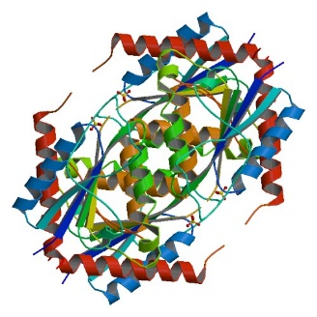
Computer Aided Drug Design (CADD)
Structure-based drug design (SBDD)
3D structure of target is known
or can be reliably modelled (homology modelling)
Ligand-based drug design (LBDD)
3D structure of target not available
Optimization is based on known active compounds (ligands), their structural features and physico-chemical properties

Slide 3
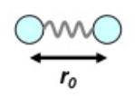
Molecular mechanics
simulation of molecules and their interactions
based on classical Newton mechanics
each atom is treated as single particle
no electrons
each particle is assigned:
radius (van der Waals radius)
polarizability
charge
bond – treated as a spring (harmonic oscillator)

Slide 4
Molecular mechanics
parameters for individual atom and bond types are defined by a FORCE FIELD
MM2, MM3, MM4
MMFF
AMBER, CHARMM, OPLS
APPLICATIONS
energy minimization (small molecule, protein, protein-ligand complex, …)
generation of conformers
molecular dynamics
Notes:
AMBER (Assisted Model Building and Energy Refinement) - widely used for proteins and DNA.
CHARMM (Chemistry at HARvard Molecular Mechanics) - originally developed at Harvard, widely used for both small molecules and macromolecules
OPLS (Optimized Potential for Liquid Simulations) (variations include OPLS-AA, OPLS-UA, OPLS-2001, OPLS-2005) - developed by William L. Jorgensen at the Yale University Department of Chemistry.
MMFF (Merck Molecular Force Field)- developed at Merck, for a broad range of molecules.

Slide 5
Molecular Docking
defined as fitting a small molecule (= ligand) into the binding site of a target model (receptor)
pairing of each binding group in the ligand with its complementary group in the binding site
ideal bonding distance for each potential interaction is defined
rigid fit → placement → fit optimization (= energy minimization on the ligand-target complex)
Patrick GL: An Introduction to Medicinal Chemistry, Oxford University Press, New York 2009, 4th Ed.

Slide 6
Docking - terminology
Term | Definition
Receptor | The "receiving" molecule, most commonly a protein or other biopolymer.
Ligand | The complementary partner molecule which binds to the receptor. Ligands are most often small molecules but could also be another biopolymer
Pose | A candidate binding mode
Binding mode | The orientation of the ligand relative to the receptor as well as the conformation of the ligand and receptor when bound to each other.
Scoring | The process of evaluating a particular pose by scoring function.
Ranking | The process of classifying which ligands are most likely to interact favorably to a particular receptor based on the docking score.
Docking assessment | Procedure to quantify the predictive capability of a docking protocol

Slide 7
Docking - workflow
Protein selection & preparation
Ligand selection & preparation
(Grid generation)
Docking
(Refinement of ligand-receptor complexes)
Analysis of binding modes and important ligand-receptor interactions

Slide 8
Search function
goal -> find all possible positions of ligand in the defined site of the receptor
sampling of the conformational space
position = translation + orientation + conformation

Slide 9
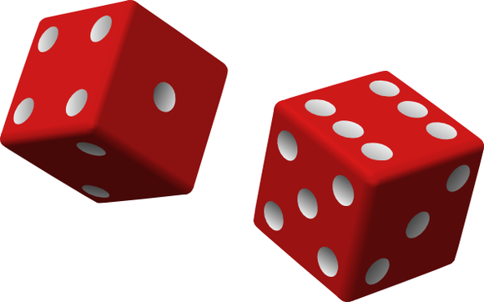
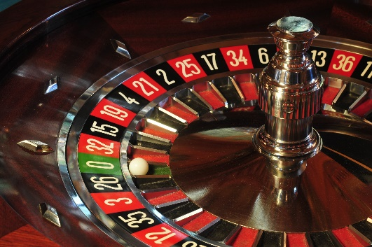
Search Algorithms
Monte Carlo
based on random number generator
translation + orientation + conformation generated randomly
+ thorough search of conformational space
- high CPU time

Slide 10
Search Algorithms
Tabu Search
modified Monte Carlo
keeps track of what positions have already been samples (no duplication)
Simulated Annealing
no duplication
positions around well scoring positions are sampled more thoroughly
positions around low scoring positions are sampled less thoroughly
+ similar effectiveness to Monte Carlo in significantly reduced time;
no duplications
- higher memory usage

Slide 11
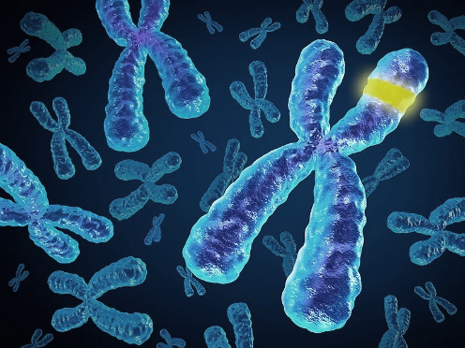
Search Algorithms
Genetic Algorithms
based on Darwin genetics
translation + orientation + conformation is transformed into GENES
combination of genes with favourable interactions gives rise to 2nd generation
random mutation to genes

Slide 12
Scoring functions
goal -> estimate ligand-target binding energy (affinity); i.e. score the positions obtained by search algorithm
crucial phase of docking – source of failures

Slide 13
Scoring functions
Shape based
MM Forcefield based - van der Waals interactions, electrostatic interactions, strain energy, desolvation energy
Empirical - hydrophobic-hydrophobic contacts, hydrophobic-hydrophilic contacts, number oh H-bonds
Knowledge-based - statistical observations of intermolecular close contacts in large 3D databases

Slide 14
Docking – Flexibility
LIGAND – usually treated as flexible, all rotatable bonds allowed to rotate
RECEPTOR (active site)
Rigid
Partially flexible
The more rotatable bonds, the more CPU time you need to dock. EXPONENTIALLY.
RIGID DOCKING = rigid ligand & rigid receptor (known conformations or rigid structures)
2. flexible ligand & rigid receptor
3. INDUCED-FIT DOCKING flexible ligand & flexible receptor
Flexibility of receptor simulates induced-fit.

Slide 15
Docking – Flexibility
flexibility of receptor might be introduced by several approaches
rotamer library of hydroxyls, thiols and other groups important for H-bonds (Schrödinger Glide)
rotamer library of AA’s side-chains
selected AA side-chains are fully rotatable exactly in the same way as ligand (AutoDock Vina)
induced fit is simulated by MM minimization step after docking (MOE)

Slide 16
Docking software
AutoDock 4.0 - open-source, The Scripps Research Institute
AutoDock Vina – open-source program for molecular docking. Designed and implemented by Dr. Oleg Trott in the Molecular Graphics Lab at The Scripps Research Institute. Video tutorial.
DOCK - University of California San Francisco
Glide – Schrodinger
FlexX – BioSolveIT GmbH
MOE - Chemical Computing Group
GOLD - ​​The Cambridge Crystallographic Data Centre (CCDC)
https://en.wikipedia.org/wiki/Docking_(molecular)#List_of_protein-ligand_docking_software
https://www.click2drug.org/index.html#Docking

Slide 17
Quality measures of docking
Redocking of original ligand (RMSD << 2 A)
Correlation of docking score to ln K_{i}
Enrichment

Slide 18
Use of Grids (Grid Potentials) in Docking Programs - DOCK, AutoDock
placing a molecule into a 3D lattice or grid, intersections are grid points
different properties (steric, electrostatic) can be measured, tabulated at each point and shown as a field (by connecting points with the same value
in docking, interactions (HB, vdW, ionic) with amino acid are measured and stored in tables for every atom of the ligand
Fig. 17.14 Measuring fields around a molecule by placing a probe atom at grid points
Patrick GL: An Introduction to Medicinal Chemistry, Oxford University Press, New York 2009, 4th Ed.

Slide 19
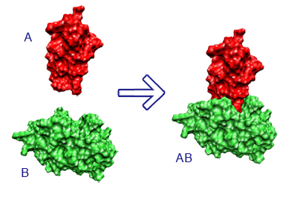
Special applications of docking
Consensus docking = use of several docking engines, then compare results
Consensus scoring = poses generated by one docking engine are scored also by other scoring functions; the final score is a consensus
Ensemble docking = multiple structures of the protein target (different pdbs) are used; simulation of protein flexibility
Blind docking = binding site is not known, the docking is focused on the whole target
Covalent docking = during docking, a defined ligand-receptor covalent bond is created
Protein-protein docking = both ligand and receptor are proteins
HTVS = High Throughput Virtual Screening – based on docking, but may include other CADD techniques (e.g. descriptor filters, pharmacophore models, etc.)

Slide 20
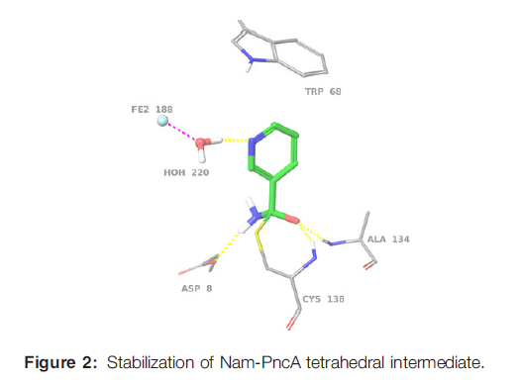
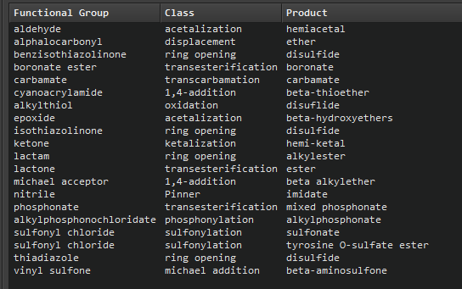
Covalent docking
simulation of covalent complex of ligand-receptor
covalent (suicide inhibitors)
substrates of metabolizing enzymes

Slide 21
Virtual Screening by docking - HTVS
complementary to biological screening (HTS)
aimed at identifying new lead compound
priority for biological screening can be given to the structures from a chemical library binding to the target in silico
Find weak binders in pool of non-binders
Many false positives (96-100%)
Consensus Scoring reduces rate of false positives
able to process large number of ligands usually from 10.000 to millions

Slide 22
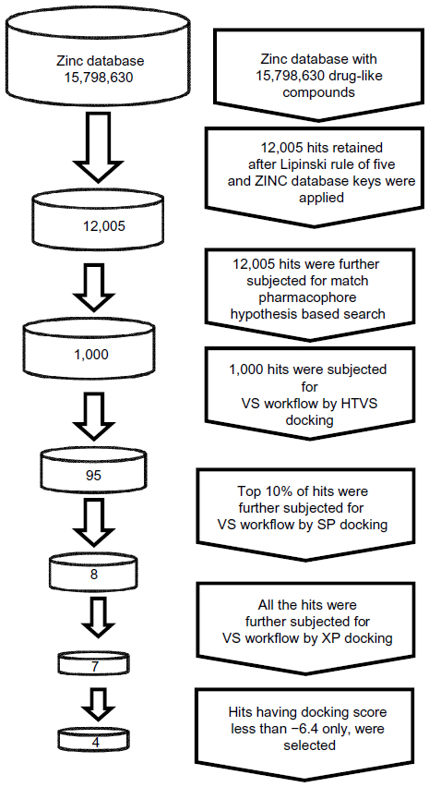
HTVS - workflow
in this case combined with pharmacophore model
Bhansali SG, Kulkarni VM
http://dx.doi.org/10.2147/RRMC.S50738

