Slide 1
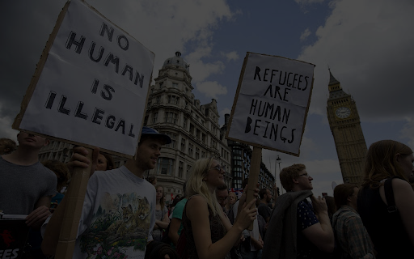
Migration Crisis
Alexia, Alba and Sebastián

Slide 2
Summary
I- 2015 Migration Crisis
II- How did the crisis affect the EU ?
III- New Pact on Migration
IV- Today’s situation, the rise of irregular crossing of the mediterranean

Slide 3
2015 Migration Crisis

Slide 4
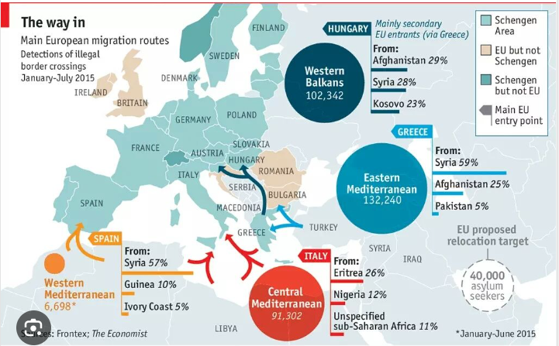
How are they trying to get there?

Slide 5
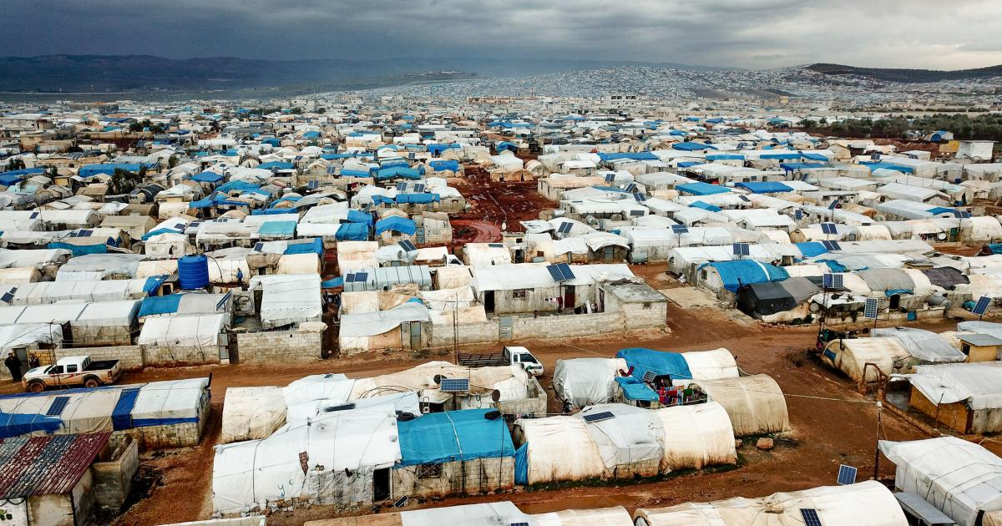
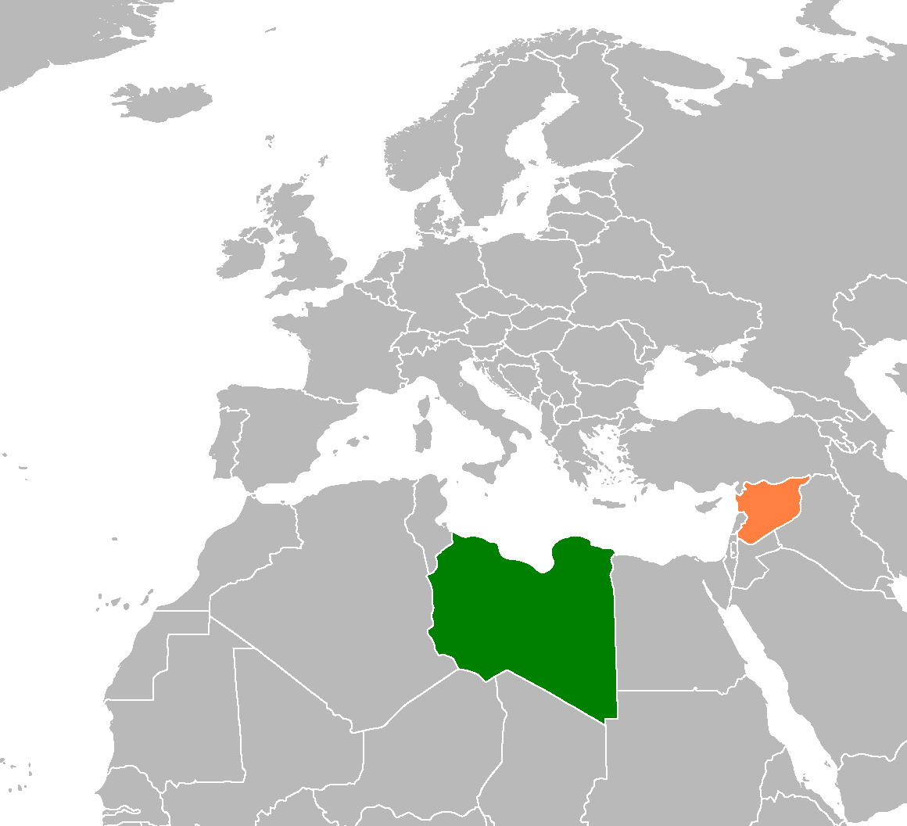
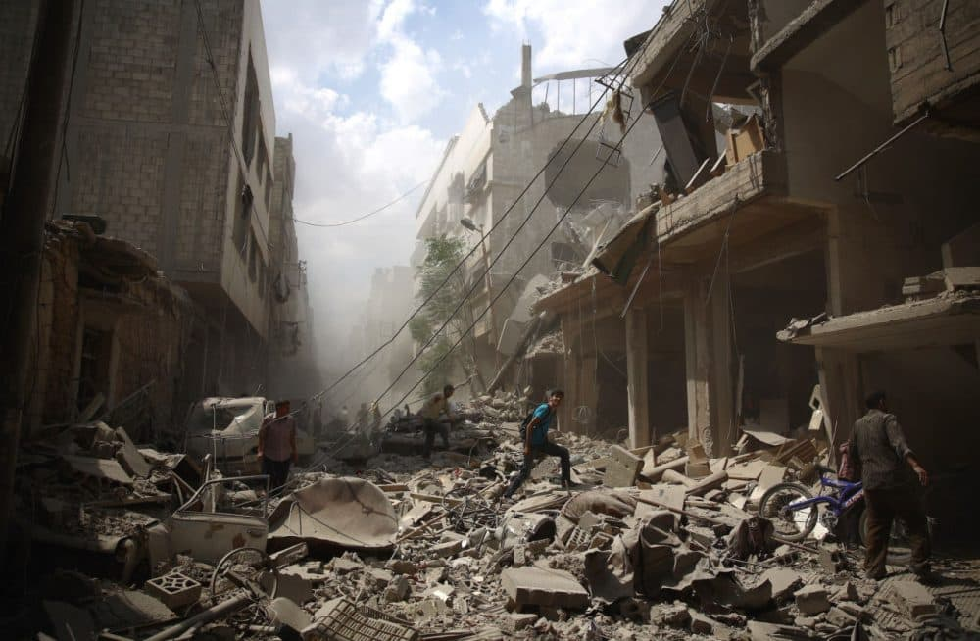
How did it happen?
Fleeing Civil wars
Fleeing poverty and conflict
Escaping poor economic conditions

Slide 6
How are they trying to get there?

Slide 7
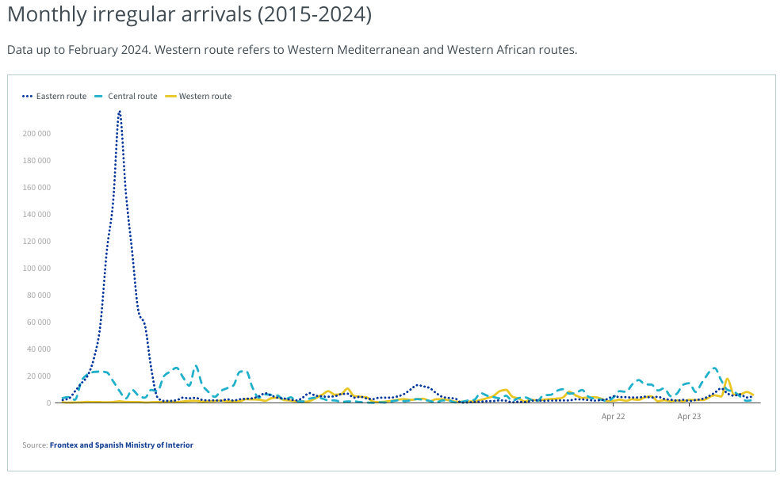
Some data
https://dtm.iom.int/europe/arrivals

Slide 8
Some vocabulary
*IDP: internally displaced person

Slide 9
How did the crisis affect the UE?

Slide 10
Frontex operations
Asylum seekers
Provisional camps
EU-Turkey agreement
O

Slide 11
Spain as a Frontier Country and France as a Destination Country
Search and rescue operations
Collaboration with Frontex
Bilateral agreements
Legal and Policy Framework
Reception and Processing centers
Integration programs
legal and leI
Border control and security measures
Asylum procedures
Reception and processing centers
Humanitarian assistance
International cooperation
Integration policies

Slide 12
Emergency recolocation by EU in September 2015

Slide 13
Towards a new pact on migration and asylum?

Slide 14
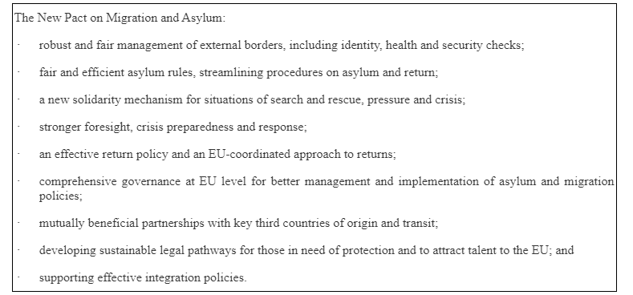
New Pact on Migration and Asylum (European Commission 2020)

Slide 15
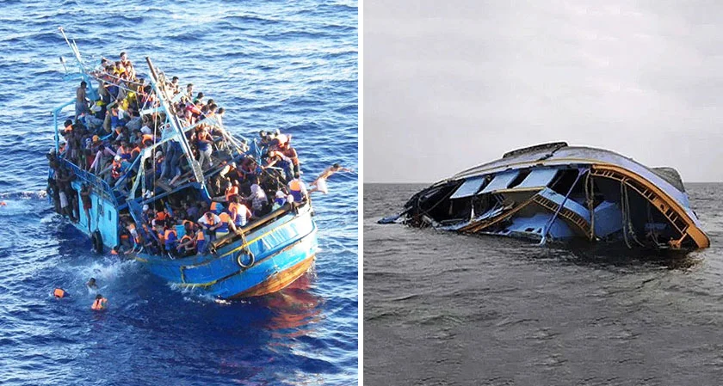
Today’s situation, the rise of irregular crossing of the mediterranean
“We have all these eyes in the sky, but we don’t have hands on the sea.” (regarding Frontex functioning)
“According to data from Frontex, the EU's border agency, there were more than 1.8 million illegal border crossings, the highest number ever recorded.
Since then, the number of illegal border crossings has decreased significantly. In 2023, about 355,300 people entered the EU irregularly, the highest number since 2016”

Slide 16
Questions
The management of the crisis by the EU seems to address a temporary problem. Do you think we are dealing with an extraordinary situation or an permanent/structural one?
What may be considered the flaws of the policy on migration and asylum from the crisis of 2015 to the current situation?

