Slide 1
Communication impairment and disorders

Slide 2
Communication impairment and disorders
Speech – the ability to use verbal as well as non-verbal language means in a communication and interaction
=) Disrupted communication ability – not only spoken speech, but also its graphical form, non-verbal means and other channel of a communication)
Mainly it is the sphere of a logopedy
- according to some opinions, we can put here also special educational needs
Necessary conditions to a right communication by a spoken speech:
Good hearing
Correct funtion of a brain
Functional motor aktivity of speech organs (breathing, voice and articulation organs)
Sufficient capacity of the inteligence

Slide 3
Ethiology
Many of different causes
Very often a connection with a delayed development or a damage of a central neural system (the prognosis can be good when CNS is maturating)
Result of a hearing impairment =) a compensation of a cause =) good prognosis
Damage of speech organs (cleft etc.) =) surgical intervention and consequent logopedic care
Psychic factors =) a need of elimination of a primar problem
Often also as a symptom of different handicap

Slide 4
Diagnostics
Proper and right diagnostics has to respect natural stadia of a speech ontogeny
Problems are noticed mainly by a family
Medicine ward: speech-language pathology, ORL
Logopaedic diagnostics – assesment of all spheres of a language
-phonetic and phonological (pronunciation and voice)
- lexical and semantic (vocabulary and understanding to a sense)
- morphological and syntactical (grammar and sentence construction)
- pragmatic (the use to a communication in a social environment)
The border of a physiological taciturnity (incommunicativeness) - cca 3rd year of an age!

Slide 5
Genereal about a speech ontogeny
Before speech stages
Period of screaming and crying (until the end of 6th week) – physiological reflex, further a signal sense
Period of gurgling (until the end of 2nd month) – simple voices, mainly vowels (= good mood
Period of babbling (until the end of 1st year) – imitation, preparation to an articulation
Treshold of understanding – reaction to an understanding to a sense of a speech of other peopple, primary a reaction to a speech melody
Treshold of speeking – first understable words, effort and attempts to a speaking
Developmental stages of a speech
Emotionally volitive period (until the end of 2nd year) – expression of feelings and needs, one-word sentences
Asociativelly reproductive period (until the end of 3rd year) – connection of words togehter with things, using of a simple grammar
Stage of logic terms (until the end of 4th year) – abstraction, generalisation, questions „Why?“, „What is it?“, a conciousness of an own identity (concept of me), very progressive development of a speech
Speech intellectualisation – right ¨content as well as formal expression, grammar improvement and adopting of new terms

Slide 6
Classification
Central defects and disorders
Developmental dysphasia
Aphasia (a disruption of already developer ability – brain trauma, injuries etc.)
Babbling (connected with a minor brain damage – it can be detect by EEG)
Stuttering (tonic spasms of muscels of speech organs, often alse a minor brain damage )
Neurotic defects and disorders
Mutisms (in the case of a serious psychic trauma)
Selective (effective) mutismus (in relation to a specific person)
Surdomutism (neurotical loss of a speech, often connected with a lip-reading)
Speech organs defects
Mumbling – pathologically lowered resonance (barrier in a nose or a nasopharynx)
Palatolalia – as a consequence of a palate cleft
Articulation disorders
Dyslalia – pathological form of a pronunciation of some phones or their omiting
Dysartia – general articulation disorder (eg. In the case of cerebral palsy etc., speech functions are affect, but not a brain)
Voice disorders
Dysphonia – pathological changes of vocal cords
Change of voice (mutation)
Symptomatical defects and disorders – defects and disorders of a speech caused by a different impairment (hearing impairment, mental retardation etc.)

Slide 7
Therapy and compensation
Mainly logopedy – development from a middle of 20th century
System of a practical logopedic care – school and health system
School speech therapist – in primary and also in special schools
Clinical speech therapist – in medical facilities
Different prognosis of a correction
Different forms of communication – also alternative and augmentative forms
Hightened risk of a social isolation!
PC advantages and benefits
Education – mainly in common school

Slide 8
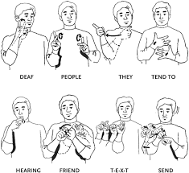
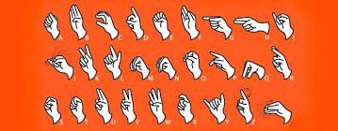
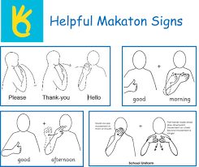
Alternative forms of communication
Many systems of communication – they are similar as well as far from common spoken speech
Gestics and pantomime
Sign language
Pictograms (understable to all)
Independent artificial language systems (Bliss, Makaton)
Touch commucation systems
Basic sign of all artificial communication systems – simplicity!

Slide 9
Common recommendations
An accurate diagnosis may require the input of several specialists. Family physicians, neurologists, and speech-language pathologists may administer tests. Common tests include:
1 - a complete physical examination
2 - psychometric testing of reasoning and thinking skills
3 - speech and language tests
4 - magnetic resonance imaging (MRI)
5 - computed tomography (CT) scan
6 - psychiatric evaluation

Slide 10
Specifics of a life of people with a communication impairment
Many of forms and levels of impairment =) different ways of influencing and treatment
Variable tolerance in a society (for instance „rotacism“ is commonly ver tolerted and not percieved as a handicape)
In the case of more serious impairment the surrounding is disoriented!
Psychic factors – most important (psychic integrity)
Commonly, there shouldn´t be used alternative forms of a communication, but in serious cases the approach is the should be the opposite one!
Individual approach is needed
Frequent problem - logofobia

Slide 11
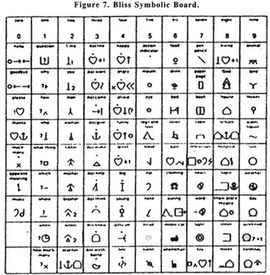
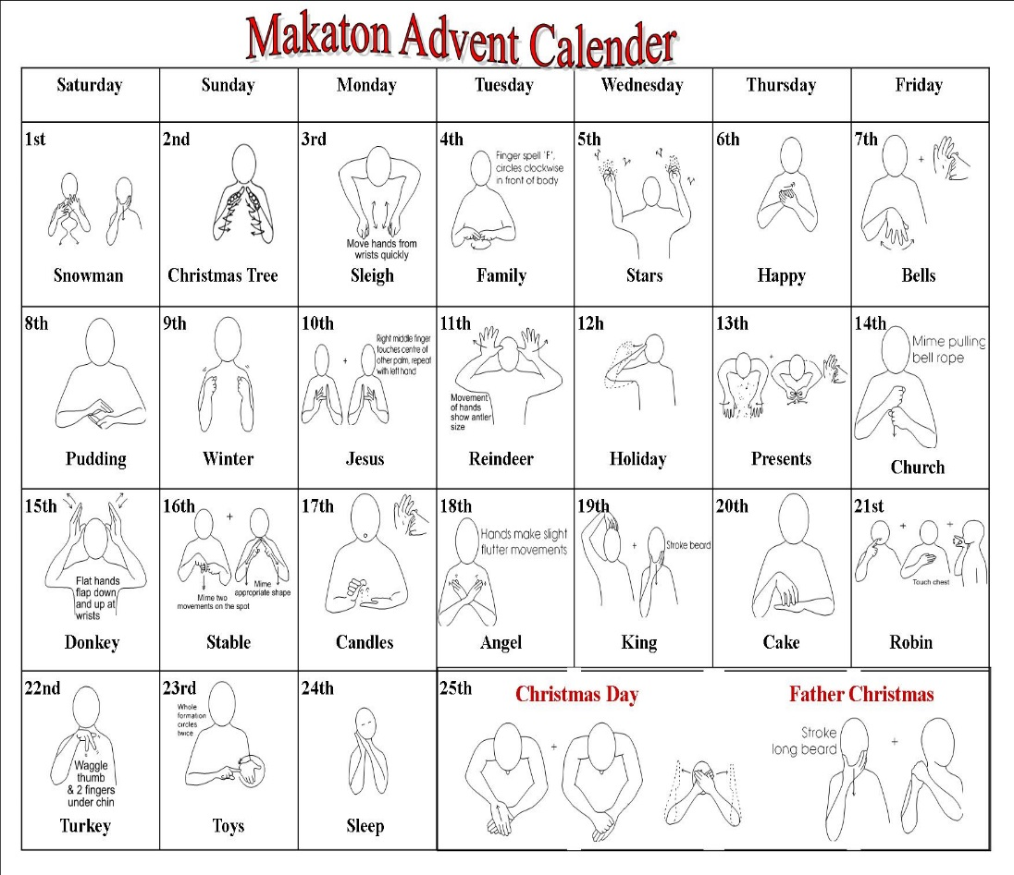
Bliss and Makaton
back

Slide 12
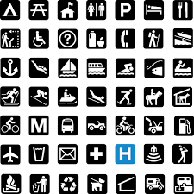
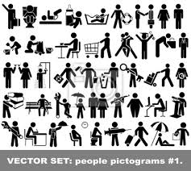
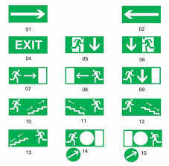
Pictograms

