Slide 1
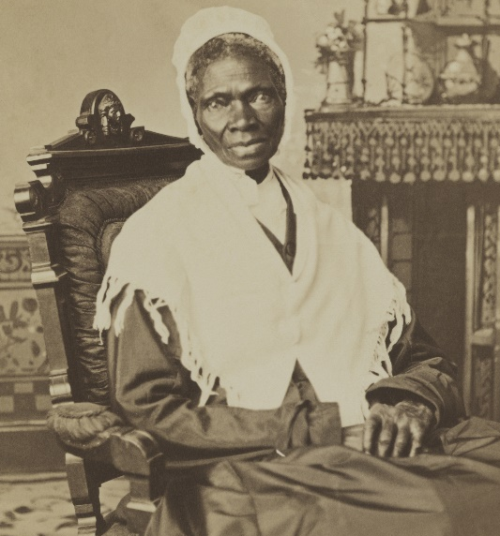
American Women Literature: Beginnings – WW1
Introduction
Influence of the British Emancipation Movement: Mary Wollstonecraft‘s A Vindication of the Rights of Woman had an impact on the works of Susanna Rowson (1762-1824), a pioneer American novelist, actress, and dramatist, especially in her Miscellaneous Poems (1804) and novel Charlotte: A Tale of Truth (1791, later as Charlotte Temple), as well as on the utopian dialogue Alcuin (1798) by Charles Brockden Brown (see the presentation American Gothic).
Domestic Roots:
Religious sects – especially the Shakers (actually The United Society of Believers in Christ’s Second Coming) founded in New England by Ann Lee. Private diaries: Spiritual Autobiography and Diary (1981) of Rebecca Cox Jackson (1795-1871), a unique record of the religious and existential experiences of a woman who left a male-dominated Southern Methodist Church and later founded a mostly-female community of African-American Shakers in Philadelphia. Stressing friendship between women and criticizing patriarchal power and authority (images of brutality and murder) in Shakers‘ communities.
- Abolitionism - Isabella Baumfree (or Van Wagener), known as Sojourner Truth (c. 1797-1883), an emancipated slave, gave a famous speech “May I Say A Few Words?” at the Women‘s Rights Convention in Akron, OH, in 1851. Using street preachers‘ rhetoric and biblical reminiscences: “And how came Jesus into the world? Through God who created him and woman who bore him. Man, where is your part? But the women are coming up, blessed be God, and a few of the men are coming with them. But man is in a tight place, the poor slave is on him, woman is coming on him, and he is surely between a hawk and a buzzard.”
Top: Susanna Rowson
Bottom: Sojourner Truth

Slide 2
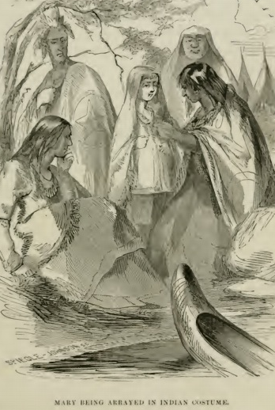
Mainstream and Working Class; Captivity Narratives
Mainstream Women Writers in the First Half of the 19th Century:
Lydia Huntley Sigourney (1791-1865), a follower English romantic poetess Felicia Hemans. The main topics of her poetry (Zinzendorf and Other Poems, 1836) are death, responsibility and religion. She is a representative of Victorian sentimentality and domesticity. She was also an author of ladies conduct manuals and celebrated as educator (a number of ladies societies and clubs bear her name).
Eliza Leslie (1787-1858), an author of ladies‘ manuals and very popular cookery books.
Catharine Maria Sedgwick (1789-1867), an author of historical romances including Hope Leslie, or, Early Times in the Massachusetts (1827), a counterpart of J. F. Cooper’s novels.
Beginnings of Working Class Writing:
- Lowell Offering (1842-45; later New England Offering [1847-1850]) a periodical which published the writings of women operatives in the textile mills of Lowell, MA. The editor was a mill worker Harriet Farley (1817 – 1907). The writers deal not only with issues of the equality of the sexes and of social injustice, but also - sometimes with shrewd humour - with the everyday troubles of the mill women.
Captivity Narratives:
A Narrative of the Life of Mrs. Mary Jemison (1824) - an Irishwoman captured by the Indians in her early teens and acculturated as a Seneca Indian; her account undermines stereotypes of Indian “savagery” and their behaviour toward women.
Top: Catharine Maria Sedgwick; Bottom: Illustration to Mary Jemison‘s Narrative

Slide 3
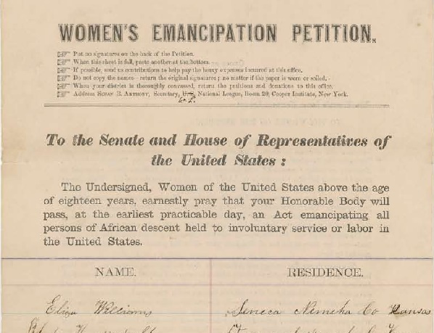
Margaret Fuller and Elizabeth Cady Stanton
While Fuller (1810-50) is the initiator of American feminist movement, Stanton (1815 -1902) is the principal architect of women rights movement in the U.S.
Fuller was educated by her father and was known for language proficiency (Latin, Italian, German) and wide reading (Goethe, Emerson). From 1835 she had to take care of the family, but she also taught and organized debate societies. She became one of the Transcendentalists and edited Emerson‘s journal The Dial between 1840-42. She was admired by many Transcendentalists (H.D. Thoreau) and their friends (Nathaniel Hawthorne).
As a journalist, she attracted attention by the travelogue Summer on the Lakes (1844) describing her trip to the Great Lakes and criticizing the destructive impact of the American civilization on the Indians. As the first woman in America she became a professional journalist, a full-time staff writer for New York Tribune. She reviewed literature but also covered the revolutions of 1848 in Europe and the beginnings of the Italian Risorgimento. She married a revolutionary leader (Count Giovanni Angelo Ossoli from Rome) but tragically died during shipwreck on their return to the U.S.
Her most important book Woman in the Nineteenth Century (1845) argues for the equality of the sexes in intellectual life and urges women to be emotionally and socially independent. She refuses to make sharp distinctions between genders and sees men and women as parts of a single harmonious human being.
Stanton started as an Abolitionist with W.L. Garrison, etc. (see previous presentation), and organized the first Women Rights Convention in Seneca Falls, NY (1848): published a manifesto in the form of the Declaration of Independence – Declaration of Sentiments and Resolutions. In 1869 she founded a radical National Women Suffrage Association. She radically rewrote The Bible – Woman‘s Bible (1895, 1898) and published also the History of Woman Suffrage (1881). She kept close contacts with African-Americans – especially Frederick Douglass.
Right: A women‘s petition for the abolition of slavery created by Elizabeth Stanton (1864).

Slide 4
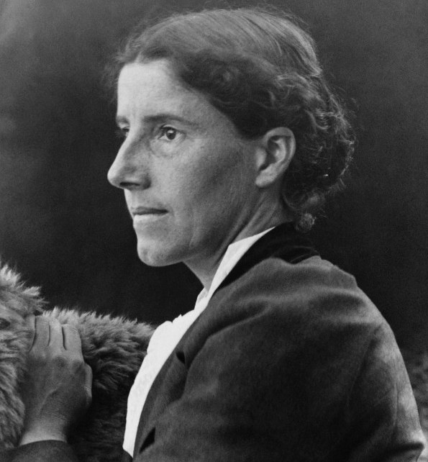
Turn of the Century: Charlotte Perkins Gilman
The period between 1890 and 1920, is characterized by important changes in women literature which affect genre forms especially in prose. These shifts include:
the fusion of political women’s writing and modern fiction techniques, e.g., inner monologue foreshadowing stream of consciousness, fragmented narrative perspective, and laconic, suggestive, emotionally restrained style (Gilman)
interpenetration of naturalism, psychological techniques, and the women’s “problem novel” in the works of Kate Chopin, Edith Wharton and Willa Cather.
Charlotte Perkins Gilman (1860-1935)
political and woman rights activist, the editor of The Forerunner magazine (1909-16), and the author of Women and Economics (1898) criticizing the contemporary position of women in marriage and society, and of Herland (1915), a feminist utopian novel.
Her best literary work is a short story “The Yellow Wallpaper” (1892) based on her own atrocious experience of puerperal depression (after childbirth) treatment by the “rest cure.” Treated by her husband, a physician, who separated her from the baby, shut her in absolute isolation and prohibited her all physical and mental activity. This drove Gilman almost to madness and later caused her divorce, loss of her child and exposure to public scorn.
The heroine of the story is degraded into a passive object of her husband’s ‘loving’ care which however serves only as a cover-up for the impersonal power of medicine manipulating her vital functions. Forced to stay in bed she concentrates on the elusive pattern of a tattered yellow wallpaper on the walls of her room. This pattern becomes a complex symbol, representing not only the repression the heroine is exposed to (the power of science and of the whole male-governed social order), but also the shattered state of her psyche: the pattern appears to represent a figure of a woman behind the bars. The symbolic act of the heroine‘s tearing the wallpaper off the walls marks the beginning of her search of a new identity, independent from her husband, from medical discourse or from patriarchal society and its symbolic language. Crawling over the body of her husband symbolizes crossing the threshold on her way to emancipation.
Top: Gilman in 1900
Bottom: San Jose State
University film adaptation (2015)

Slide 5
Turn of the Century: Chopin, Cather and Wharton
Kate Chopin (1851-1904)
Born in St. Louis, MO, (her mother was from a French creole family) and married to New Orleans, LA. She became one of the leading figures of regional “creole” literature of New Orleans. Her major work is the novel Awakening (1899) whose heroine, Edna Pontellier, refuses her traditional social role of a mother and has a frustrating love affair. She fails in her search for a new identity and social position, and commits suicide.
Willa Cather (1873-1947)
Born in Virginia but brought to Nebraska by her parents at the age of 9. Her father failed as a farmer and became a real-estate agent. Willa studied at University of Nebraska and became an editor, journalist and literary critic. She never married and had a long-term lesbian relationship with Edith Lewis. In Nebraska she became familiar with Czech immigrant women, one of whom Annie Sadílek Pavelka, became a model for the heroine of the novel My Ántonia (1918), her first great literary success (F.S. Fitzgerald allegedly regretted that his Great Gatsby did not reach the qualities of Cather‘s novel). The first theme of numerous Cather‘s novels is the courage and responsibility of young women in the difficult conditions of prairie farming, their faith in the fertility of soil, and their ability to survive extreme hardships while taking care of the family. The second theme is the shaping of the woman artist in the novel The Song of the Lark (1915) which in part takes place in the newly settled areas of Colorado and Arizona. Both types of novels create an almost mythical link between the soil, or landscape, and a woman figure.
Edith Wharton (1862-1937)
Born in a wealthy New York City family dealing in real estate. Widely travelled in Europe, was fluent in French, German and Italian. In her best novels, The House of Mirth (1905) and The Age of Innocence (1920), often compared with H. James‘ works, she creates complex female characters, Lily Bart and Ellen Olenska, and analyzes their elusive and vulnerable love relationships where illusions, ideals and dreams often substitute for reality. But she was also a penetrating critic of the social conventions of her time, including social roles and the function of money, and knew the lives of women who worked as professionals or factory operatives.

