Slide 1
Learning disabilities

Slide 2
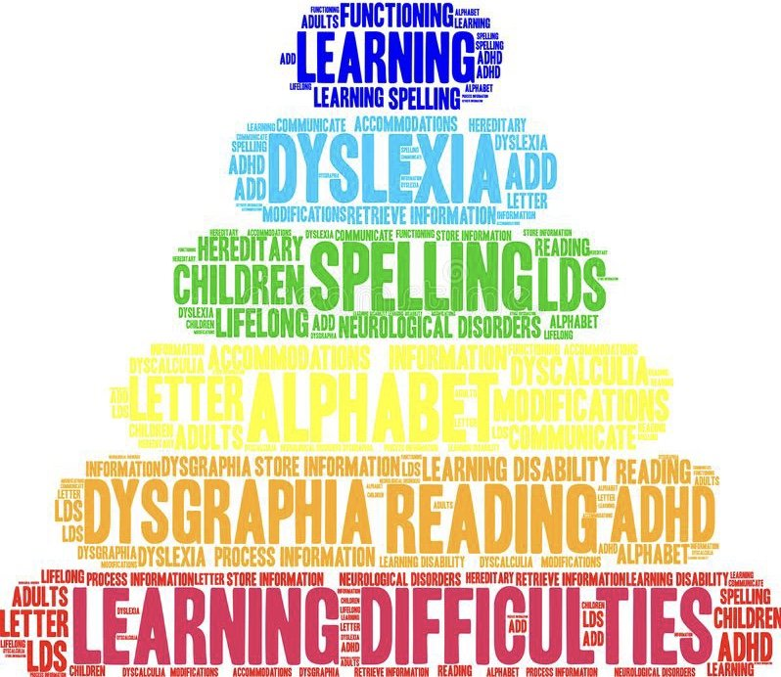
Learning disabilities
The three main types of learning disabilities
Each type of learning disability can include several different disorders
Learning disabilities are not based on less hearing, visual problems…..
How can we know that child has learning disabilities?

Slide 3
The following questions
Does my child have trouble learning the alphabet, rhyming words, or connecting letters to their sounds?
Is my child having difficulty understanding what he or she reads?
Is my child having difficulty with spelling?

Slide 4
What is dyslexia?

Slide 5
Dyslexia
Dyslexia is a slight disorder of the brain
But does not affect intelligence
Over 20% of the population has dyslexia
Dyslexia in adults can manifest in different and unexpected ways.

Slide 6
Some Sights of dyslexia in adults
Difficulty recalling past conversations: often accused of “not listening”
Trouble remembering names
Resisting readings loud during meetings
Rereading emails

Slide 8
!
1. Dyslexia is very common.
2. Kids who have dyslexia are just as smart as other kids.
3. There are proven methods for teaching kids with dyslexia to read and improve skills.

Slide 9
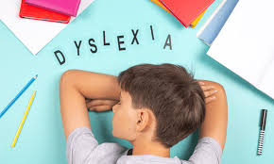
Personal
Experience

Slide 10
What is dysgraphia?

Slide 11
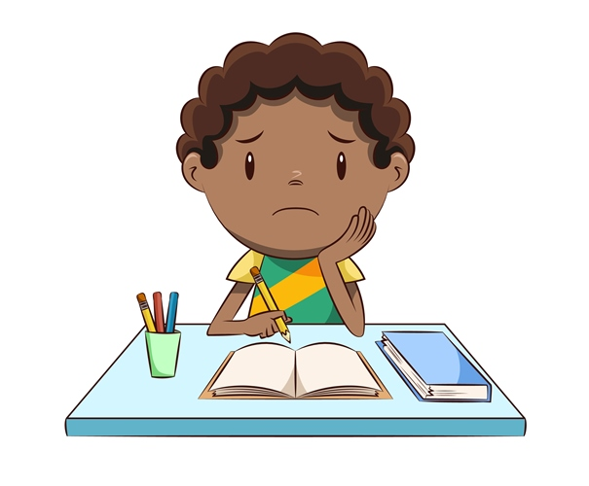
Dysgraphia
Problem with handwriting and spelling
Research has shown that orthographic coding in working memory is related to handwriting and is often impaired in dysgraphia.
Personal experience

Slide 12
What is dyscalculia?

Slide 13
Dyscalculia
Dyscalculia is a learning disability in math.
Dyscalculia is as common in girls as in boys.
Unfortunately a lot of teachers overlook dyscalculia as just being “bad at math.”
Personal experience

Slide 14
What is dyspraxia?

Slide 15
Dyspraxia
Problems with movements and coordinations
Motor learning difficulties
Language problems

Slide 17
Thank you for you attention
https://www.youtube.com/watch?app=desktop&v=wqFYWLDNy5s

Slide 18
Sources
Neesy dyslexia [online]. [cit. 2024-04-22]. Dostupné z: https://www.nessy.com/en-us/dyslexia-explained/understanding-dyslexia/7-dyslexia-difficulties.
Literacy matters [online]. [cit. 2024-04-22]. Dostupné z: https://myliteracymatters.com/what-is-dyslexia.
Sonic learning [online]. [cit. 2024-04-22]. Dostupné z: https://soniclearning.com.au/symptoms-of-dyslexia-by-age.
Mind tools [online]. [cit. 2024-04-22]. Dostupné z: https://www.mindtools.com/a2rrhk8/dyslexia-in-the-workplace.

