Slide 1
Literatures on the British Isles 1: Renaissance – Restoration 9. The House Divided: Versions of Religious Poetry and Puritan Prose
Martin Procházka

Slide 2
Lecture Outline
Downfall of the traditional cosmic order
Notions of the Baroque
Metaphysical Poetry (John Donne, George Herbert, Henry Vaughan, Richard Crashaw). Figurative Language and Religious Doctrine.
Cavalier Poetry (Robert Herrick, John Suckling, Thomas Carew, Richard Lovelace)
Puritan Introspection: Autobiography and Allegory (John Bunyan).

Slide 3
John Donne: “An Anatomy of the Worldˮ, 1611
And new Philosophy cals all in doubt,
The Element of fire is quite put out;
The Sunne is lost, and th’earth, and
no mans wit
Can well direct him, where to looke
for it.
And freely men confesse that this world’s spent,
When in the Planets, and the Firmament
They seeke so many new; they see that this
Is crumbled out againe to his Atomis.
‘Tis all in pieces, all cohærence gone;
All iust supply, and all Relation.
[substitute, analogy]
Albrecht Dürer, Melancholy (1514)

Slide 4
Downfall of the Traditional Cosmic Order
The Order of Similitude (Michel Foucault, The Order of Things, Les mots et les choses, 1966)
The role of resemblance (between faces and stars, the Earth and the sky). Four types of resemblances:
1. two things sharing the same place, and being in contact: proximity in space or convenientia (convenire – come together).
2. two remote things: stars and plants. Stressing mutual influences of things (astrology) and their conflict resulting in the subjection of one thing by another (the ascent of the man to cosmic wisdom, but also disasters and calamities) – aemulatio (imitation but also zeal, contest, strife, jealousy).
3. resemblance of relations - analogia. The relation between the sky and its stars is analogous to that between the earth and its diamonds. All analogies intersect in Man as a microcosm - related to the Universe as macrocosm (tempests compared to attacks of epilepsy).
4. forces and modifications of qualities - sympathia, antipathia - attraction and repulsion between things and elements, but also transformation of things and elements: for instance, burning changes fire into water (steam in the smoke) and air.
Robert Fludd, Utriusque Cosmi Historia… (The History of Both Cosmoses…, 1617-24):
“Man is a whole world of its own, called microcosm for it displays a miniature pattern of all the parts of the universe. Thus the head is related to the Empyreal, the chest to the ethereal heaven and the belly to the elementary substance.”

Slide 5
Notions of the Baroque
History of the Concept
Although the term (from Portuguese barocco – a pearl of irregular shape) originally referred to visual perception, it started to refer to disharmonic music, using polyphony and frequent changes of melody and tempo: “Baroque music is that in which the harmony is confused, and loaded with modulations and dissonances.” (Jean-Jacques Rousseau, 1768). Baroque architecture, painting and sculpture are often connected with the Catholic Counterreformation, which began at the Council of Trent (1545-63). However, there is also a Protestant (Lutheran) Baroque (Germany), while the Calvinists were refusing the Baroque because of their iconoclasm (hatred of religious pictures, statues).
Gianlorenzo Bernini, The Ecstasy of
St Theresa (1647-52)
My face in thine eye, thine in mine appears, And true plain hearts do in the faces rest ; Where can we find two better hemispheres Without sharp north, without declining west? Whatever dies, was not mix'd equally ; If our two loves be one, or thou and I Love so alike that none can slacken, none can die.
John Donne, “The Good Morrow”, in Songs and Sonnets (1633)

Slide 6
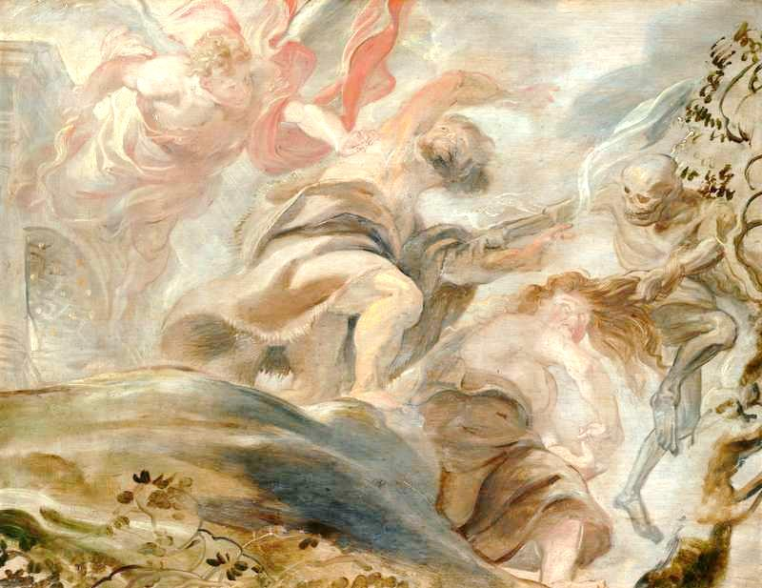
Baroque and Mannerism
The general definition of Baroque “movement imported into mass” by the Swiss-born art historian Heinrich Wölfflin (1864–1945) is sometimes objected against by theoreticians of Mannerism. While Mannerism focuses on the play of illusion in art (trompe l‘œil), the Baroque is said to emphasize the power and certain materiality of artistic effects. This is contradicted by philosophical theories of the Baroque (Gilles Deleuze, The Fold: Leibniz and the Baroque, 1988) emphasizing the complexity and dynamic nature of structures (the fold), and the new ways of their formalization (e.g., infinitesimal calculus, invented by the philosopher Gottfried Wilhelm von Leibniz, 1646-1716).
Are the “Metaphysical Poets” (Donne, et al.) Mannerist of Baroque? The latter term is more adequate because they do not reject the sovereign authority of God, but try to renew the shattered order of the world by individual creativity, which includes artistic play. This sometimes leads to conflicts between religious doctrine and artistic creation.
Right: top: Peter Paul Rubens: Expulsion from the Garden of Eden (1620); bottom: Tintoretto: St Mark‘s Body Brought to Venice (1562-6)

Slide 7
Metaphysical Poets
The term was coined by the 18th century lexicographer, critic and poet, Dr Samuel Johnson (1709-84) in his Lives of the Most Eminent English Poets (1779-81). Johnson referred to the judgement of the poet and critic John Dryden (1631-1700): [Donne] “affects the metaphysics, not only in his satires, but in his amorous verses, where nature only should reign; and perplexes the minds of the fair sex with nice speculations of philosophy, when he should engage their hearts, and entertain them with the softnesses of love.” And Johnson added: “The most heterogeneous ideas are yoked by violence together; nature and art are ransacked for illustrations, comparisons, and allusions; their learning instructs, and their subtilty surprises; but the reader commonly thinks his improvement dearly bought, and, though he sometimes admires, is seldom pleased.” The poets were rediscovered and praised by the Modernists, especially T.S. Eliot (1888-1965), whom they inspired to formulate a theory of “split sensibility” and “double tradition” (rationalist and sentimentalist) in the work of later poets (starting with John Milton).

Slide 8
John Donne (1572-1631): Life
Born in London to the Warden of the Ironmongers Company. His father (who died soon after his birth) was of Welsh origin and a secret Roman Catholic (recusant). His mother (also a recusant) was the daughter of John Heywood, a playwright from the circle of Thomas More. Donne studied at Oxford and Cambridge, but could not obtain a degree because he refused to take The Oath of Supremacy. In 1591 he was admitted to study law and from 1592 he pursued his studies in Lincoln‘s Inn. Donne‘s brother Henry was imprisoned for hiding a Catholic priest and died in the Newgate Prison. After finishing his studies Donne travelled widely and fought with Lord Essex and Sir Walter Raleigh against Spaniards at Cadiz and Azores. After his return he became Secretary to Sir Thomas Egerton, Lord Keeper of the Great Seal, and he secretly married his second wife‘s niece Anne More. Although he was imprisoned, the marriage was later legalized and they had 12 children. He was twice elected MP and wrote a number of poems for his patron, Sir Robert Drury of Hawstead. King James I forced Donne to become an Anglican priest. In 1615 Donne took holy orders, obtained a honorary doctorate of divinity from Cambridge and became Royal Chaplain. In 1621 he was appointed Dean of St. Paul‘s Cathedral.
John Donne, ca 1595

Slide 9
John Donne: Works
Songs and Sonnets (1633) were published posthumously but written between 1592-1605 during Donne‘s studies in Lincoln‘s Inn and his turbulent life afterwards, including his love and secret marriage to Anne More. Some poems, however, might have originated even later : “A Nocturnal upon St Lucy‘s Day” is being connected with Donne‘s testament (1627). Some poems were written for his wife, others for the Countess of Bedford or for one of the first English Renaissance poetesses, Mary Herbert, Countess of Pembroke (1561-1621), the sister of Sir Philip Sidney. Most poems have conventional love themes but these are thoroughly transformed
by deep reflections on themes of love, individual identity and death
by the play of figurative language, mostly bold paradoxical metaphors and catachreses (words employed against their common use “We'll build in sonnets pretty rooms”).
The principal theme is the disintegration of the Renaissance cosmos into chaos and the search of a new subjective order based on the paradoxes produced by a creative play. This play, however, undermines not only accepted doctrines, but also the boundaries of dream and reality and reveals the deceitful nature of idealized erotic love (frequent in Elizabethan sonnets) together with the fear of nothingness.
Later works include satires, Holy Sonnets (1633), long reflective poems, e.g., “An Anatomy of the World” (1611) and a collection of religious meditative prose Devotions upon Emergent Occasions (1624) of which the most famous is Meditation XVII “No man is an island” which provided a title to Ernest Hemingway‘s novel For Whom the Bell Tolls.

Slide 10
From “The Canonization”
Call us what you will, we are made such by love; Call her one, me another fly, We're tapers too, and at our own cost die,
And we in us find the eagle and the dove.
The phœnix riddle hath more wit
By us; we two being one, are it.
So, to one neutral thing both sexes fit.
We die and rise the same, and prove
Mysterious by this love.
We can die by it, if not live by love,
And if unfit for tombs and hearse
Our legend be, it will be fit for verse;
And if no piece of chronicle we prove,
We'll build in sonnets pretty rooms;
As well a well-wrought urn becomes
The greatest ashes, as half-acre tombs, And by these hymns, all shall approve Us canonized for Love.

Slide 11
Metaphysical Poets: Herbert, Vaughan, Crashaw
George Herbert (1593-1633) a devotional poet and an Anglican priest of Welsh origin. His poems were written in English, Latin and Greek. The English poetry is included in The Temple (1633) and uses complex intellectual metaphors. Poems have also visual qualities – representing the shapes of an altar, “Easter wings”, etc. He was also a prose writer (devotions, aphorisms) and a composer of hymns.
Henry Vaughan (1621-1695) a Welsh poet and physician. He called himself “Silurist”, according to a pre-historic Celtic tribe inhabiting the region (today the Brecon Beacons National Park, north of Cardiff), which he captured in his secular poetry Olor Iscanus (The Swan of Usk, 1651). The two volume collection of poems Silex Scintillans (The Flashing Flint, 1650, 1655) is considerably influenced by George Herbert and focuses on devotional themes (and displays an influence of Vaughan‘s knowledge of alchemy). A book of religious prose is Mount of Olives, or, Solitary Devotions (1652).
Richard Crashaw (1613-1649), an Anglican cleric and poet who converted to Catholicism. Supported the reforms of Archbishop Laud re-introducing traditional church rituals, banned during the Reformation. After Oliver Cromwell‘s seizure of Cambridge he emigrated to the Papal State. Died in Loreto in Italy. His poetry reflects the influences of Spanish religious mysticism (St John of the Cross or St Theresa of Ávila). He is the author of 3 collections of religious poems Epigrammatum Sacrorum Liber (A Book of Sacred Epigrams, 1634), Steps to the Temple (1646, 1648) and Carmen Deo Nostro (A Hymn to Our Lord, 1652).

Slide 12
George Herbert: "Easter Wings"
Lord, who createdst man in wealth and store,
Though foolishly he lost the same,
Decaying more and more,
Till he became
Most poore:
With thee
O let me rise
As larks, harmoniously,
And sing this day thy victories:
Then shall the fall further the flight in me.
My tender age in sorrow did beginne And still with sicknesses and shame. Thou didst so punish sinne, That I became Most thinne. With thee Let me combine, And feel thy victorie: For, if I imp my wing on thine,
Affliction shall advance the flight in me.

Slide 13
Cavalier Poets
Poets who came from (or were close to) the Royalists in the Civil War (1642-1660). In contrast to contemporary religious poetry they emphasized the pleasures of life, including courtly and erotic love, but also secular virtues. Their philosophy was hedonistic (influence of Epicureanism) and their models were the Classical Roman poets, Horace, Vergil and Ovid. They were admired by Charles I.
The most important representatives are:
Robert Herrick (1591-1674), the author of Hesperides (1648; in Greek mythology the nymphs of the evening, guarding golden apples beyond the western Ocean). His work includes about 2500 poems, many on the “carpe diem” (seize the day) theme, some of them interesting formal experiments, such as the monometer (a poem with one-foot lines): “Thus I / Pass by / And die,/ As one / Unknown / And gone.”
Richard Lovelace (1617-57) an ardent Royalist who fought in the Civil War and was imprisoned twice. His best poems include “To Althea, From Prison” (1642) and “To Lucasta, Going to Warres” (1640). The posthumous volume of poems is entitled Lucasta (1660).
Sir John Suckling (1609-1641) fought in Scotland under Charles I (1639). A late Caroline dramatist (The Goblins, Aglaura, both 1638) and a poet Fragmenta Aurea (Golden Fragments, 1646).
Thomas Carew [ke:ri](1595-1640) the author of sensuous lyrics: “A Rapture” (1640) and mostly occasional poems of diverse genres: songs, pastorals, elegies, addresses. Many of them addressed to an unidentified mistress called Celia.

Slide 14
Puritan Introspection: Autobiography and Allegory - John Bunyan
Puritan doctrines of Predestination, God‘s Will and Grace (see Lectures on American Literature) prompted believers to look constantly for the signs of God‘s favour or displeasure. This was the major aim of introspection which was the only, yet by no means reliable, way of tracing the believer‘s own internal development, whose main aim was spiritual regeneration. This became a topic of many spiritual autobiographies describing the believers‘ conversions. The most important of these autobiographies is John Bunyan‘s (1628-88) Grace Abounding to the Chief of Sinners, which laid a foundation for the major religious allegorical novel of the 17th century, The Pilgrim‘s Progress (1678, 1684).
John Bunyan, by Thomas Sadler

Slide 15
The Pilgrim’s Progress (1678, 1684)
The first volume describes the dangerous journey of Christian and his friends (Faithful and Hopeful) to the Heavenly City. The individual stages of this journey are severe trials of the pilgrims (Faithful is executed in Vanity Fair, representing contemporary materialist society; Hopeful helps Christian to get out of the Doubting Castle).
The second volume describes a similar journey of Christian‘s wife, Christiana, and their children accompanied by Greatheart, an allegory of Love. They can overcome the obstacles much easier, because they are accompanied by Christian love and magnanimity.
While the allegory of the first volume focuses on the trials of individual faith, the second volume emphasizes domestic life and relations among neighbours. The allegorical narrative overcomes its narrowly didactic perspective and draws realistic portraits of the author‘s contemporaries. Therefore the novel can be seen as a predecessor of early 18th century novels, especially Robinson Crusoe (1719).
Reading the Allegorical Narrative as God‘s Signs:
Christian Visits Interpreter‘s House

