Slide 1
Nové Město pražské
Obrazový doprovod k semináři 22. 3. 2022

Slide 2
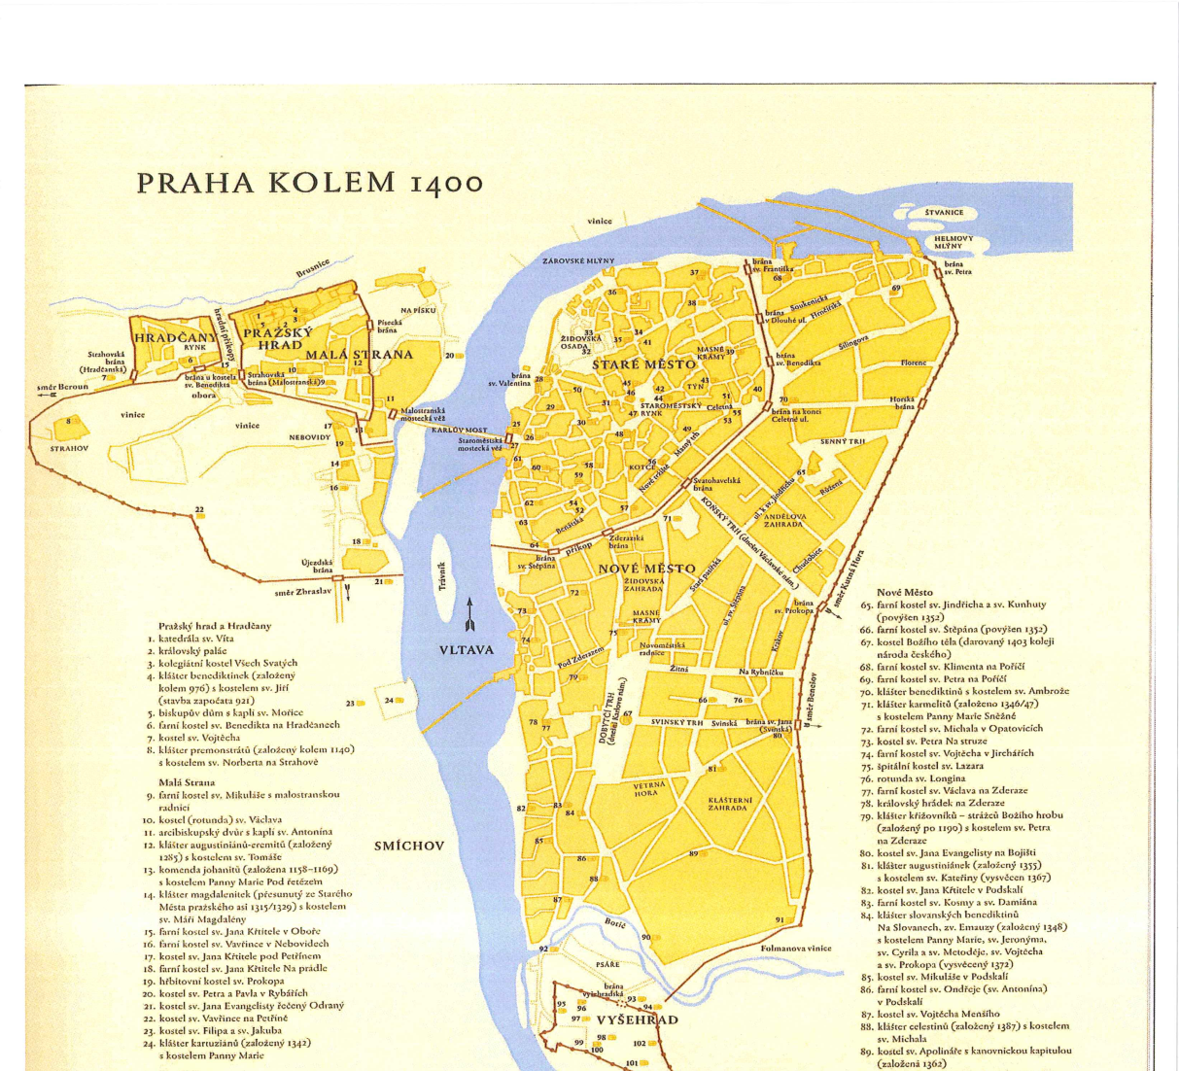
Prague around 1400
Old Town
New Town
Lesser Town
The Castle
Vyšehrad Castle

Slide 3
Hartmann Schedel, Nuremberg Chronicle, 1493 (oldest pictural representation of Prague)

Slide 4
Aegidius Sadeler, 1606
above: whole panorama of Prague)
left: New Town with the Big/Cattle Market and its dominant - Corpus Christi chapel

Slide 5
St. Charlemagne‘s Church
(Karlov)
St. Stephen
New
Town
Hall
Saint Catherine
St. Apolinarius
Corpus Christi chapel
Cattle Market
Emmaus monastery

Slide 6
Charles Square (Cattle Market): the largest square in Europe

Slide 7
Emmaus monastery in the Middle Ages

Slide 8
Emmaus monastery after baroque reconstruction and today

Slide 9
Prague as a New Jerusalem?
Paul Crossley – Zoe Opačić, Prague as a New Capital
- concept of translatio imperii
(Rome – Constantinople – Prague)
- international character of Charles IV foundations in New Town

