Slide 1
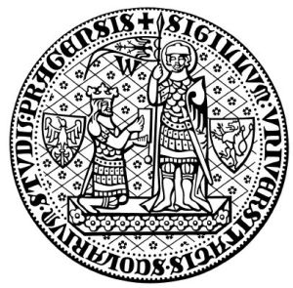
The Constitutional Sociology of Europe:
Politics, Law and Society
Paul blokker, PhD
Institute of Sociological studies, Charles University
27 March, 2018

Slide 2
Constitutional Sociology
2
Notes:
2

Slide 3
Constitutional Sociology
Summary last class - A range of constitutional orders with different constitutional identities and relations to cultural identities (Germany, France, UK, US, Spain, Romania, EU);
Revolutionary versus incremental constitutions
Poland: a Constitutional Coup?: The rising of the conservative right, with its project of a ‘Fourth Republic’
3
Notes:
3

Slide 4
Constitutional Sociology
Final Exam
-The student will be evaluated at the end of the course by means of a written essay, to be handed in at the end of the semester (exact date will be stipulated);
The written essay will be of
BA: a minimum of 2.000 words, and needs to contain a bibliography with at least 5 academic resources.
MA: a minimum of 3.000 words, and needs to contain a bibliography with at least 10 academic resources.
4
Notes:
4

Slide 5
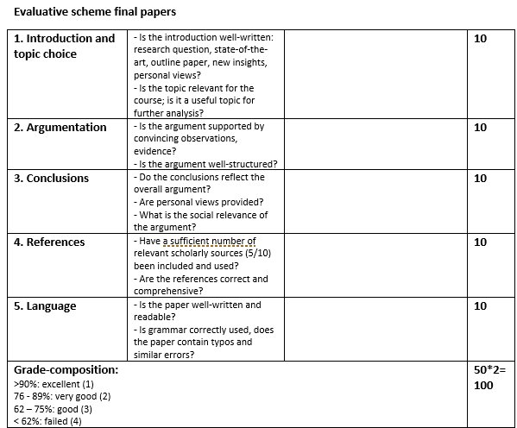
Constitutional Sociology
Final Exam
-
5
Notes:
5

Slide 6
Constitutional Sociology
Final Exam
-Possible topics:
The emergence of a European constitution: sociological aspects (legitimacy, jurisdiction, solidarity);
National resistance to transnational law (e.g. UK (Tories, UKIP), Hungary, Poland;
Durkheim and the law;
The revolution that failed: Iceland’s citizen constitution (social movements and constitution-making);
Analysis of constitutions and national identities/Peoples
6
Notes:
6

Slide 7
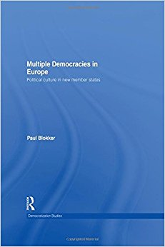
Constitutional Sociology
Final Exam
-Examples:
Analysis of constitutions from a political/cultural sociological perspective
Constitutional texts as reflecting different democratic models (liberal, communitarian, republican, socialist)
Constitutions as reflecting different constructions of peoplehood
7
Notes:
7

Slide 8
Constitutional Sociology
Final Exam
-Examples:
8
Notes:
8

Slide 9
Constitutional Sociology
Final Exam
-Examples:
9
Notes:
9

Slide 10
Constitutional Sociology
Final Exam
-Examples:
10
Notes:
10

Slide 11
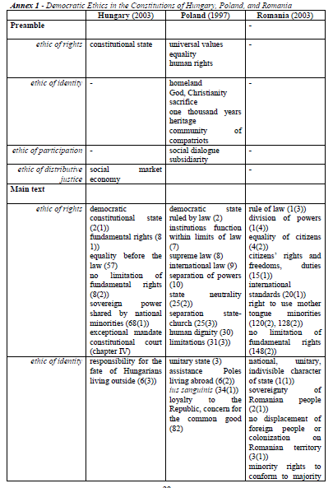
Constitutional Sociology
Final Exam
-Examples:
11
Notes:
11

Slide 12
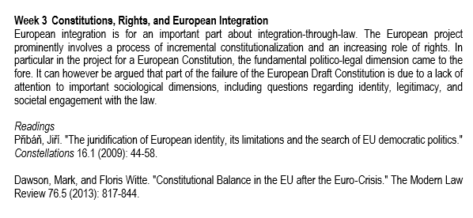
Readings
Constitutional Sociology

Slide 13
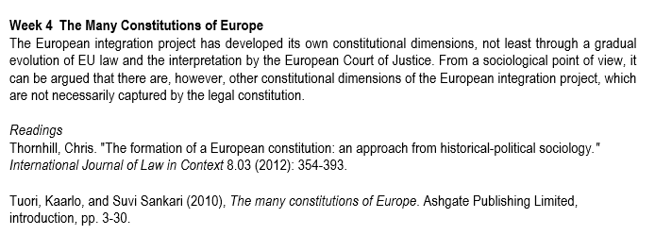
Readings
Constitutional Sociology

Slide 14
Objectives 1. The nature of the European Constitution; 2. Process of integration-through-law 3. Tensions between EU and national level/resistance;
Constitutional Sociology

Slide 15
Introduction
Constitutional Sociology
Is there a European Constitution?

Slide 16
Introduction
Constitutional Sociology
What are fundamental principles on the EU level?

Slide 17
The EU’s Constitutional Model - Even if political constitutions have been rejected various times in EU history, the EU can be said to have a de facto constitution based on EU law; - The EU process is often referred to as ‘integration-through-law’;
Constitutional Sociology

Slide 18
The EU’s Constitutional Model - EU law has acquired a constitutional nature due to important cases ruled by the European Court of Justice (CJEU), which have led to EU law having primacy and direct effect in the European system; - In this regard, the EU constitution is an incremental or a ‘grown’ constitution.
Constitutional Sociology

Slide 19
The EU’s Constitutional Model - One major attempt to ‘make’ a constitution was the attempt in the early 2000s, in the form of the Convention on the Future of Europe (Scholl 2006); - The draft produced by the Convention was however rejected by two referenda in France and the Netherlands in 2005;
Constitutional Sociology

Slide 20
The EU’s Constitutional Model
Constitutional Sociology

Slide 21
The EU’s Constitutional Model - The European attempt to create a constitution is fraught with complexity, not least due to the impossibility of a European ethnos, but, as some have argued, equally due to the difficulty of creating a European demos (the no-demos thesis, Grimm 1995);
Constitutional Sociology

Slide 22
The EU’s Constitutional Model - But it could be equally argued that the European project of a constitution ought to be one of projecting a united ‘people’ into the future; - This is for instance the argument of Juergen Habermas, in his notion of ‘post-nationalism’ and ‘constitutional patriotism’ (Habermas 1998);
Constitutional Sociology

Slide 23
The EU’s Legal Foundations - Magic triangle: direct effect; supremacy, and preliminary ruling (Vauchez 2008); - The 3 principles together create an EU polity with a clear rationale and sense of unity, but also promote further Europeanization;
Constitutional Sociology

Slide 24
The EU’s Legal Foundations - ‘Integration-through-law’ is understood as the key driving force behind European integration; - When the early political push for European integration subsided, the integration-through-law process guaranteed its continuity;
Constitutional Sociology

Slide 25
The EU’s Legal Foundations - ‘Integration-through-law’ is not only the result of EU institutions – the European Court of Justice in particular – pushing integration forward; - Increasingly it is argued that other actors too – interest groups, multinational companies, NGOs – contribute to the story;
Constitutional Sociology

Slide 26
The EU’s Legal Foundations - A key – sociological – question is: how has this legally driven process come about? (Vauchez 2008); - How did the idea of legal integration emerge and how has it been normatively been promoted?
Constitutional Sociology

Slide 27
The EU’s Legal Foundations - Foundational Myths: Van Gend and Loos (1963) Establishing the direct effect of EU law Costa v. ENEL (1964) Establishing the supremacy of EU law
Constitutional Sociology

Slide 28
European Society by Jurisdiction - Which have been the deeper structural transformations that underpin the process of European integration and the creation of a ‘European society by jurisdiction’? (Munch 2008) - Which deeper transformations of solidarity, legal order, and justice – emerging with a ‘European society’ - have taken place in the process of European integration?
Constitutional Sociology

Slide 29
European Society by Jurisdiction - We already explored Durkheim’s view of the relation between law, the division of labour in society, and social integration - In Durkheim’s view, a regulatory/restitutive form of law becomes predominant in modern societies - It is increasing societal specialization that underpins a regulatory/restitutive form of law
Constitutional Sociology

Slide 30
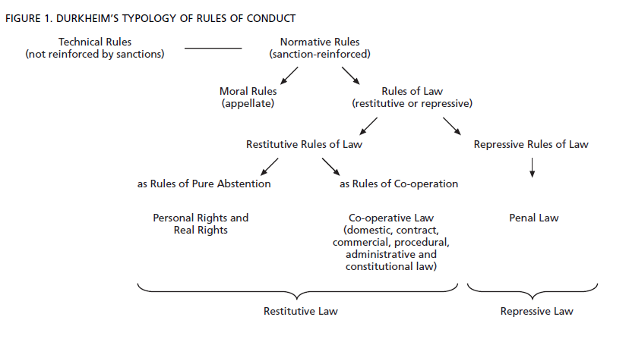
Constitutional Sociology

Slide 31
European Society by Jurisdiction - European integration can be understood as a novel level of specialization or division of labour, not anymore within national societies but between and beyond societies - The increased (economic) activities beyond borders lead to insecurity, anomie, distributive conflicts and erosion of consensus regarding the meaning of justice (Munch 2008: 520)
Constitutional Sociology

Slide 32
European Society by Jurisdiction - Resistance to such change - from the national to the transnational – is normal and has to be overcome if the integration process is to succeed - How can this overcoming of resistance be explained?
Constitutional Sociology

Slide 33
European Society by Jurisdiction - The EU’s constitutional edifice can be understood as the construction of a legal order that is to sustain the ‘basic relationships of solidarity’ beyond the national contexts of the member states - In Durkheimian terms, relationships of solidarity sustained by a legal order are crucial of economic exchange to be possible without distraction into violent conflict (Munch 2008: 521)
Constitutional Sociology

Slide 34
European Society by Jurisdiction - Such orders of solidarity and a legal nature do not emerge by themselves from market transactions as spill-over effects, but are constructed by political, legal and social forces - The EU order can be understood as containing both the internal, mechanical solidarity of nation-states and the construction of an organic solidarity grounded in a European division of labour
Constitutional Sociology

Slide 35
European Society by Jurisdiction - Forces that have constructed such an order include managers, scientists, politicians, civil servants, lawyers, and increasingly even NGOs and social movements; - Transnational elites establish organisations and institutions that underpin a supranational legal order and basic solidarity
Constitutional Sociology

Slide 36
European Society by Jurisdiction - The more a transnational order advanced, the more transnational forces enjoy an advantage vis-à-vis national forces - European integration-through-law includes a fundamental conflict between transnational and national forces
Constitutional Sociology

Slide 37
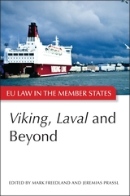
European Society by Jurisdiction
Constitutional Sociology

Slide 38
European Society by Jurisdiction - From a Durkheimian perspective, the supranational legal order can be understood as being based on the ‘cult of the individual’, reaching beyond national traditions - The EU order is experiencing a ‘rights revolution’, advancing individual autonomy by emancipating the individual from traditionally established national constraints (e.g. free mobility, non-discrimination)
Constitutional Sociology

Slide 39
European Society by Jurisdiction - National communities lose homogeneity, while individuals are strengthened - Transnational ties between individuals are strengthened - The new European society is based on a new type of solidarity (network, organic) and the legal order is focussed on the cult of the individual
Constitutional Sociology

Slide 40
European Society by Jurisdiction - In Durkheim’s terms, repressive law (the collective imposes its values on the individual) is being replaced by restitutive law (the protection of individual’s rights) - The transnational legal order is based on: a. formal institutions b. a leading idea and conception of control c. a dominant European legal community/juridical technique d. legitimation of new order (Munch 2008: 523)
Constitutional Sociology

Slide 41
European Society by Jurisdiction - The EU’s legal/constitutional order is based on the ‘magic triangle’ of ‘direct effect, supremacy, and preliminary ruling’ (Vauchez 2008) Direct effect: EU law can be upheld in national courts of law Supremacy: EU law is prior to national (constitutional) law Preliminary reference: procedure allowing national judge to refer a case that involves EU law to the CJEU, bypassing national higher courts
Constitutional Sociology

Slide 42
European Society by Jurisdiction - The EU’s incremental constitutional order emerges from the principles of ,direct effect’, ‘supremacy’, and ‘preliminary reference’, that themselves are the result of judicial entrepreneurs, judicial activism (Van Gend en Loos, Costa v. ENEL), and an approach of judicial rationalism - Judges from the European Court, their référendaires (assistants), lawyers, and national courts promoted specific interpretations of ‘landmark decisions’ so a to promote European integration-through-law
Constitutional Sociology

Slide 43
European Society by Jurisdiction - It is important to consider that in the early 1960s, political integration seemed to have halted, while the legal project of harmonisation of national laws was equally stalled - In other words, the European Commission as well as national member states/the European Council lost momentum - The project of integration-through-law, driven forward not least by the ECJ stepped in as an alternative way of integrating Europe
Constitutional Sociology

Slide 44
European Society by Jurisdiction - This legal integration particularly played out as a project of market integration, expanding the legal rules and rights related to the creation of the Common Market - Important cases regarding the Market include the famous Cassis de Dijon case (1979), that settled the principle of ‘mutual recognition’ of national laws, as an alternative to the harmonization of national laws in the context of the Market
Constitutional Sociology

Slide 45
European Society by Jurisdiction - Integration-through-law has focused on: - removing barriers - enhancing Market access - guaranteeing free mobility and non-discrimination - intensification of competition
Constitutional Sociology

Slide 46
National resistance - A highly significant matter in the context of membership of the EU is the relation between national constitutional law and EU law. - A key debate, and not only in the New Member States, regards the so-called Solange story, Solange referring to a series of judgments of the German Constitutional Court, in which it defined the relationship between EU law and the German Basic Law, as well as its own role in guarding this relationship.
Constitutional Sociology

Slide 47
National resistance - Solange means ‘as long as’ and refers to the observation by the German Constitutional Court (made in its 1974 Solange I ruling) that as long as EU law did not provide a level of protection equivalent to that provided by the German Basic Law, as well as a similar grounding in democratic legitimacy, the Court would continue to review EU law according to the standards of the Basic Law.
Constitutional Sociology

Slide 48
National resistance - It has to be noted that since its Maastricht ruling, the German Court admitted that EU law now provided an equivalent standard of rights protection as that of national constitutional law, and hence review would not be necessary anymore - The Solange story is a more widespread attitude among courts in EU Member States (similar positions have for instance been taken up by the Italian, Czech, Hungarian, and Polish Courts), defending the qualified supremacy of national constitutional law
Constitutional Sociology

