Slide 1
Group Dynamics characteristics, stages, types

Slide 2
Inroduction
People may underestimate the importance of society and group memberships on their lives.
Dynamic=Force - It refers to the forces operating in the group.
Its concerned with dynamic interaction of individuals in face to face relationships.
As a leader (owner of a pharmacy), understanding the group dynamic is essential in order to both compose & guide the individuals within a group for the purpose of successfully & efficiently completing an assignment.
Notes:
People may underestimate the importance of society and group memberships on their lives. Whilst people sometimes undertake solo journeys large much of our experiences of life involves being engaged with others and groups.

Slide 3
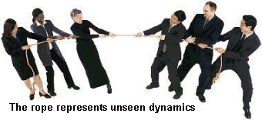
Inroduction
Kurt Lewin, 1890-1947
Notes:
Kurt Lewin, a social psychologist and change management expert, is credited with coining the term "group dynamics" in the early 1940s. He noted that people often take on distinct roles and behaviors when they work in a group. "Group dynamics" describes the effects of these roles and behaviors on other group members, and on the group as a whole. More recent researchers have built on Lewin's ideas, and this work has become central to good management practice.
A group with a positive dynamic is easy to spot. Team members trust one another, they work towards a collective decision, and they hold one another accountable for making things happen. Researchers have found that when a team has a positive dynamic, its members are nearly twice as creative as an average group.
In a group with poor group dynamics, people's behavior disrupts work. As a result, the group may not come to any decision, or it may make the wrong choice, because group members could not explore options effectively.

Slide 4
What is A Group?
A group refers to two or more people who share a common meaning and evaluation of themselves and come together to achieve common goals. In other words, a group is a collection of people who interact with one another; accept rights and obligations as members and who share a common identity.

Slide 5
Introduction
Within an organization we do find number of groups.
Formal or informal groups. People work in groups quite frequently and in many different areas of their life e.g. at work, school/college, sport, hobbies.
The managers need to understand Group Dynamics that can enable managers to adopt the right approach of interacting with them.
What is Group Dynamics?
Group dynamics deals with the attitudes and behavioural patterns of a group. Group dynamics concern how groups are formed, what is their structure and which processes are followed in their functioning. Thus, it is concerned with the interactions and forces operating between groups.

Slide 6
What is a Formal Group?
A formal group is formed when people come together to accomplish specific goals and objectives. An official group has particular structures and roles where responsibilities of members of the group are defined.
Notes:
A formal group is formed when people come together to accomplish specific goals and objectives. An official group has particular structures and roles where responsibilities of members of the group are defined.
Activities carried by a formal group have specific guidelines, which members of the group are supposed to adhere to and follow to ensure good coordination.
Some of the common formal groups that exist within the organization or community include schools, church, hospitals, government, and civic organizations.

Slide 7
What is an Informal Group?
An informal group is formed when two or more people come together to accomplish a specific task which is mainly socially geared. The main idea behind the establishment of the informal group is the satisfaction of both personal and psychological needs.
Notes:
An informal group is formed when two or more people come together to accomplish a specific task which is mainly socially geared. The main idea behind the establishment of the informal group is the satisfaction of both personal and psychological needs.
Informal groups are not subjected to any rules and regulations in the company, and the members of this group willingly belong to this group. There are no explicit guidelines that govern the operations of an informal group.

Slide 8
Difference Between Formal Groups and Informal Groups
Notes:
Formal groups are formulated when two or more members of an organization are assembled by the management with the purpose of achieving a specific goal.
Informal groups are formed by two or more members with the purpose of satisfying their personal and psychological needs.
There exist rules and regulations within a formal group with an official leader who is supposed to enforce the laws and regulations while at the same time offering direction and guidance to the group.
An informal group does not follow a defined pattern, rules, or guidelines and no official leader controls the group. Any person can assume leadership at any given time.
Other differences between formal and informal groups include some members, behavior, relationship between members, and structure among others

Slide 9
Characteristics of a Group
Regardless of the size or the purpose, every group has similar characteristics:
2 or more persons (if it is one person, it is not a group)
Formal social structure (the rules of the game are defined)
Common fate (they will swim together)
Common goals (the destiny is the same and emotionally connected)
Face-to-face interaction (they will talk with each other)
Interdependence (each one is complimentary to the other)
Self-definition as group members (what one is who belongs to the group)
Recognition by others (yes, you belong to the group).

Slide 10
Characteristics of a Group
Regardless of the size or the purpose, every group has similar characteristics:
Notes:
Size: To form a group, it must be having at least two members. Practically, the number of group members ranges from 15 to 20. The more the members in the group, the more complex it is to manage.
Goals: Every group has certain goals, that are the reasons for its existence.
Norms: A group has certain rules, for interacting with the group members.
Structure: It has a structure, based on the roles and positions held by the members.
Roles: Every member of a group has certain roles and responsibilities, which are assigned, by the group leader.
Interaction: The interaction between the group members can occur in several ways, i.e. face to face, telephonic, in writing or in any other manner.
Collective Identity: A group is an aggregation of individuals, which are separately called as members, and collectively called as a group.
Furthermore, a group climate is an emotional setting of the group, that relies on participative spirit, coordination, trust and bonding among the members, open communication and other similar factors.

Slide 11
Reasons for Group Formation
Notes:
Personal Characteristics: Individuals with similar beliefs, attitudes and values are more likely to form groups.
Opportunity for interaction: If the employees of an organization, are given an opportunity to interact with one another, they find that they have many things similar, which also creates a group.
Interest and goals: When individuals share common interest and goals, it requires cooperation and coordination for its achievement, which also results in the formation of groups.
Influence and power: Last but not the least, a group has more influence and power, as compared to an individual, which also promotes its formation.
In general, groups are created out of individual need satisfaction, which can be personal, social or economical. Meaning that the members need to associate with the group in order to fulfil their basic needs.

Slide 12
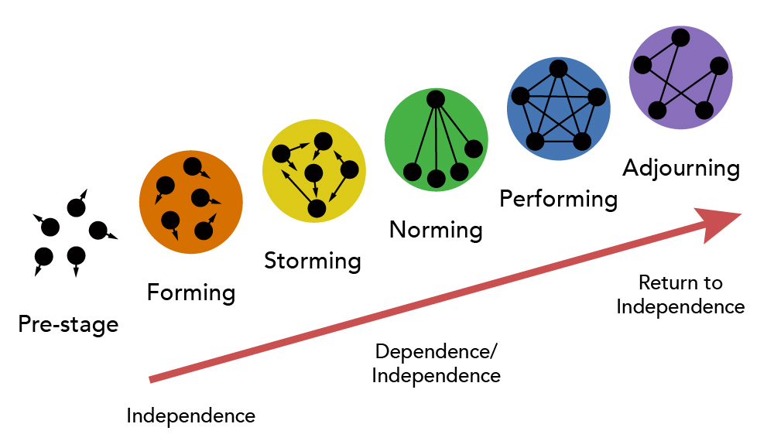
Process/Stages of Group Development/Evolution:
There is a process of five stages through which groups pass through: forming, storming, norming, performing, and adjourning.
Notes:
Group Development is a dynamic process. How do groups evolve? There is a process of five stages through which groups pass through. The process includes the following stages: forming, storming, norming, performing, and adjourning

Slide 13
Stages of Group Development
Forming:
The first stage in the life of a group is concerned with forming a group. This stage is characterized by members seeking either a work assignment (in a formal group) or other benefit, like status, affiliation, power, etc. (in an informal group). Members at this stage either engage in busy type of activity or show apathy.
Storming:
The next stage in this group is marked by the formation of dyads (two people) and triads (three people). Members seek out familiar or similar individuals and begin a deeper sharing of self. Continued attention to the subgroup creates a differentiation in the group and tensions across the dyads / triads may appear. Pairing is a common phenomenon. There will be conflict about controlling the group.
Notes:
Forming: At this stage, the formation of a new group begins, wherein the members come together and get to know each other through the interactions. Here the individuals are excited and anxious to know about the scope of the task and the ways to approach it. Generally, the individuals come with a desire to get accepted by others and avoid controversy or conflicts.
Storming: Once the forming stage is over, the individuals will start interacting with each other in the context of the task to be achieved. The conflict and competition among the group members will be highest at this stage.The most dominant group members come in the front while the confrontational members remain silent and continue to be in the security or calm stage (forming). The issues related to the leadership, responsibility, strategies, rules, authority, evaluation, reward system, etc. arises at the storming stage.

Slide 14
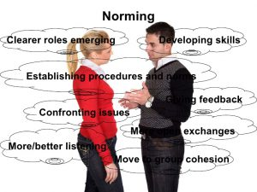
Stages of Group Development
Norming:
The third stage of group development is marked by a more serious concern about task performance. The dyads/triads begin to open up and seek out other members in the group. Efforts are made to establish various norms for task performance.
Members begin to take greater responsibility for their own group and relationship while the authority figure becomes relaxed. Once this stage is complete, a clear picture will emerge about hierarchy of leadership. The norming stage is over with the solidification of the group structure and a sense of group identity and camaraderie.
Notes:
Norming: Once the role of every member is cleared along with the authority and responsibility of each, the team members start settling in a group. Here, everybody works cohesively towards the target and appreciate each other’s experience and skills.

Slide 15
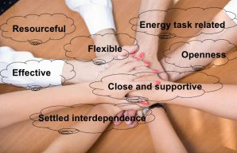
Stages of Group Development
Performing:
This is a stage of a fully functional group where members see themselves as a group and get involved in the task. Each person makes a contribution and the authority figure is also seen as a part of the group. Group norms are followed and collective pressure is exerted to ensure the Process of Group effectiveness of the group.
The group may redefine its goals Development in the light of information from the outside environment and show an autonomous will to pursue those goals. The long-term viability of the group is established and nurtured.
Notes:
Performing: At this stage, synergy gets created between the team members, where everyone works towards the accomplishment of a goal. This stage is characterized by flexibility and interdependence. The team members know each other so well that they can handle any complex problem that comes before the team.Also, the roles and responsibilities of member changes according to the situation frequently, because at this stage everyone is equally a task-oriented and people-oriented and thus can perform efficiently.

Slide 16
Stages of Group Development
Adjourning:
In the case of temporary groups, like project team, task force, or any other such group, which have a limited task at hand, also have a fifth stage, This is known as adjourning.
The group decides to disband. Some members may feel happy over the performance, and some may be unhappy over the stoppage of meeting with group members. Adjourning may also be referred to as mourning, i.e. mourning the adjournment of the group.
Notes:
Adjourning: This is the last stage of group development, where the group is terminated, and the group members are separated from each other. Every group is created for a purpose, and once the purpose is fulfilled the group is adjourned.Some authors call this stage as “mourning or deforming,” because, the sense of loss is felt by the group members, at the time of separation from each other.
Thus, the researchers study about the group development to determine the changes that occur within the group

Slide 17
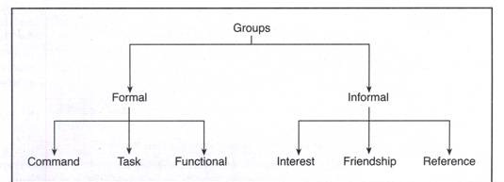
Types of Groups:
One way to classify the groups is by way of formality – formal and informal. While formal groups are established by an organization to achieve its goals, informal groups merge spontaneously. Formal groups may take the form of command groups, task groups, and functional groups X Informal groups consist of interest, friendship and reference groups.

Slide 18
Types of Groups
1. Command Groups:
Command groups are specified by the organizational chart and often consist of a supervisor and the subordinates that report to that supervisor. An example of a command group is a market research firm CEO and the research associates under him (headmaster + teachers).
2. Task Groups:
Task groups consist of people who work together to achieve a common task. Members are brought together to accomplish a narrow range of goals within a specified time period. Task groups are also commonly referred to as task forces. The organization appoints members and assigns the goals and tasks to be accomplished.
Examples of assigned tasks are the development of a new product, the improvement of a production process, or designing the syllabus under semester system. (elections)

Slide 19
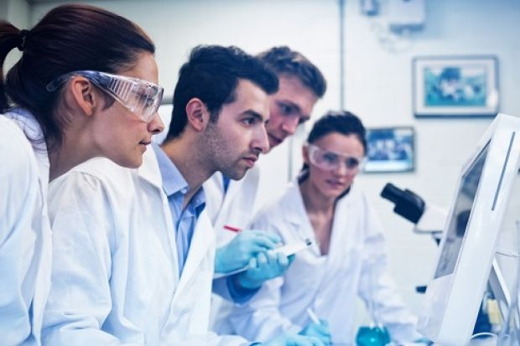
Types of Groups
3. Functional Groups:
A functional group is created by the organization to accomplish specific goals within an unspecified time frame. Functional groups remain in existence after achievement of current goals and objectives. Examples of functional groups would be a marketing department, a customer service department, or an accounting department.

Slide 20
Types of groups
Informal groups are formed naturally and in response to the common interests and shared values of individuals – they are not appointed by the organization and members can invite others to join from time to time.
Informal groups can have a strong influence in organizations that can either be positive or negative. For example, employees who form an informal group can either discuss how to improve a production process or how to create shortcuts that jeopardize quality. Informal groups can take the form of interest groups, friendship groups, or reference groups.

Slide 21
Types of Groups
1) Interest Groups:
Interest groups usually continue over time and may last longer than general informal groups. Members of interest groups may not be part of the same organizational department but they are bound together by some other common interest.
The goals and objectives of group interests are specific to each group and may not be related to organizational goals and objectives. An example of an interest group would be students who come together to form a study group for a specific class.
2) Friendship Groups:
Friendship groups are formed by members who enjoy similar social activities, political beliefs, religious values, or other common bonds. Members enjoy each other’s company and often meet after work to participate in these activities. For example, a group of employees who form a friendship group may have a yoga group.

Slide 22
Types of Groups
3) Reference Groups:
A reference group is a type of group that people use to evaluate themselves. The main objectives of reference groups are to seek social validation and social comparison. Social validation allows individuals to justify their attitudes and values while social comparison helps individuals evaluate their own actions by comparing themselves to others. Reference groups have a strong influence on members’ behaviour. Such groups are formed voluntarily. Family, friends, and religious affiliations are strong reference groups for most individuals.

Slide 23
Group Shift:
Group shift is basically a change in riskiness of a decision. After reviewing the groups decision which could be more toward conservatism or greater risk, you will ultimately change your own (private) decision based on the majority. Therefore moving from your original decision to that of the group decision even though your final answer might be in fact different from your own beliefs, is known as group shift.
When people are in groups, they make decision about risk differently from when they are alone. In the group, they are likely to make riskier decisions, as the shared risk makes the individual risk less.
Notes:
An example of groupshift is when the fans of a sports team celebrate the win of their team and their celebration turns to destruction of property. What appears to happen in groups is that the discussion leads to a significant shift in the positions of members toward a more extreme position in the direction in which they were already leaning before the discussion; so conservative types become more cautious and the more aggressive types take on more risk.

Slide 24
Group Shift: Causes of Group Shift
Group diffuses responsibility: A diffusion of responsibility throughout the group seems to give members of these groups a free rein to act as they see fit. The emotional bonds that are created within the group serve to decrease anxiety within the group and the actual risk of the situation seems less.
Social status in groups is often associated with risk-taking, leading people to avoid a low risk position.
High risk-takers are more confident and hence may persuade others to take greater risks.
As people pay attention to a possible action, they become more familiar and comfortable with it and hence perceive less risk.
As groups get larger, trends in risk-taking are amplified.

Slide 25
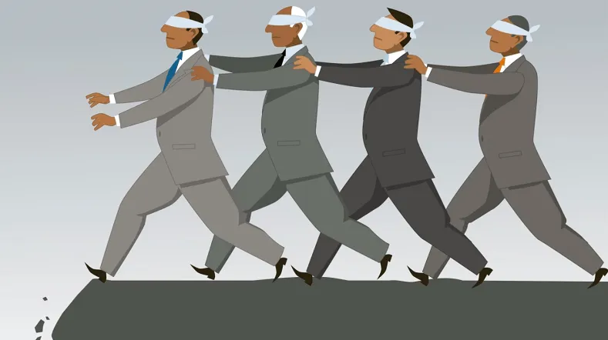
Group thinking
Groupthink is a psychological phenomenon that occurs within a group of people in which the desire for harmony or conformity in the group results in an irrational or dysfunctional decision-making outcome.
Notes:
The attack on Pearl Harbor is an excellent example of groupthink. Despite the interception of Japanese messages, US naval officers based in Hawaii did not seriously take warnings from Washington about a potential offensive attack somewhere in the Pacific Ocean. The officers thought that the Japanese would not dare to attack the US. Nobody challenged the idea and instead rationalized why an attack was unlikely to happen.

Slide 26
Factors Affecting Group Behaviour:
The success or failure of a group depends upon many factors: group member resources, structure (group size, group roles, group norms, and group cohesiveness), group processes (the communication, group decision making processes, power dynamics, conflicting interactions, etc.) and group tasks (complexity and interdependence).
1. Group Member Resources:
The members’ knowledge, abilities, skills; and personality characteristics (sociability, self- reliance, and independence) are the resources the group members bring in with them. The success depends upon these resources as useful to the task.

Slide 27
Factors Affecting Group Behaviour:
2. Group Structure:
Group size can vary from 2 people to a very large number of people. Small groups of two to ten are thought to be more effective because each member has ample opportunity to take part and engage actively in the group. Large groups may waste time by deciding on processes and trying to decide who should participate next.
Evidence supports the notion that as the size of the group increases, satisfaction increases up to a certain point. Increasing the size of a group beyond 10-12 members’ results in decreased satisfaction. It is increasingly difficult for members of large groups to identify with one another and experience cohesion.

Slide 28
Factors Affecting Group Behaviour:
3. Group Roles:
In formal groups, roles are always predetermined and assigned to members. Each role shall have specific responsibilities and duties. There are, however, emergent roles that develop naturally to meet the needs of the groups.
These emergent roles will often substitute the assigned roles as individuals begin to express themselves and become more assertive. Group roles can then be classified into work roles, maintenance roles, and blocking roles.
Work roles are task-oriented activities that involve accomplishing the group’s goals. They involve a variety of specific roles such as initiator, informer, clarifier, summarizer, and reality tester.
Maintenance roles are social-emotional activities that help members maintain their involvement in the group and raise their personal commitment to the group. The maintenance roles are harmonizer, gatekeeper, consensus tester, encourager, and compromiser.

Slide 29
Factors Affecting Group Behaviour:

Slide 30
Factors Affecting Group Behaviour:
Blocking roles are activities that disrupt the group. Blockers will stubbornly resist the group’s ideas, disagree with group members for personal reasons, and will have hidden agendas. They may take the form of dominating discussions, verbally attacking other group members, and distracting the group with trivial information or unnecessary humour.
Role conflicts arise when there is ambiguity (confusion about delegation and no specific job descriptions) between the set role and the received role which leads to frustration and dissatisfaction, ultimately leading to turnover; inconsistency between the perceived role and role behaviour (conflict between work roles and family roles); and conflicting demands from different sources while performing the task.

Slide 31
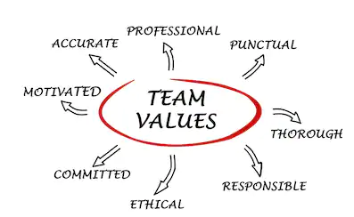
Factors Affecting Group Behaviour:
4. Group Norms:
Norms define the acceptable standard or boundaries of acceptable and unacceptable behaviour, shared by group members. They are typically created in order to facilitate group survival, make behaviour more predictable, avoid embarrassing situations, and express the values of the group. Group members who do not conform to the norms will be punished by being excluded, ignored, or asked to leave the group.

Slide 32
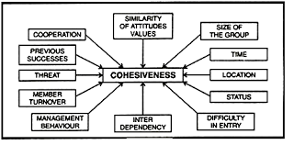
Group Cohesiveness:

Slide 33
Group Processes
Decision-making by a group is superior, because group generates more information and knowledge, generates diverse alternatives, increases acceptance of a solution, and increases legitimacy.
Decisions take longer time, minority is dominated, pressure is applied to conform to group decisions, and none is responsible for the decisions. Group processes also include communication, conflict management, and leadership that we shall discuss in details in the chapters to follow hereafter

Slide 34
Principles of Group Leadership
4 utmost principles (The Wolf Of Wall Street shows Jordan Belfort)
UBER CULTURE
Everyone Understands what’s expected of them and behaves accordingly and consistently as a result
Systems and processes are Built to reinforce and support those values and behaviours
People are Engaged, Empowered and Encouraged to deliver them
People are Rewarded and Recognised for doing that!

Slide 35
Principles of Group Leadership
Based on Jordan Belford experince:
1. Vision - “Goals have no power” - Having a vision is seeing the world the way it is – not worse, and then visualizing how you can make it better. Better in the sense of benefiting the people around you.
2. State Management - If you are angry, negative or moody you will not be able to access your own resources and, most likely, underperform. But if you learn how to control your emotional biases, you will also have control over the situation. Most of the times you will need certainty, clarity and courage to excel.

Slide 36
Principles of Group Leadership
Based on Jordan Belford experince:
3. Break Limiting Beliefs - limiting belief is preventing you from making the step to success. Visualizing your success is already a step further in achieving it.
4. Employ a Strategy - The most effective strategy you can come up with, according to Belfort, is one that uses persuasion. Set your standards high..

Slide 37
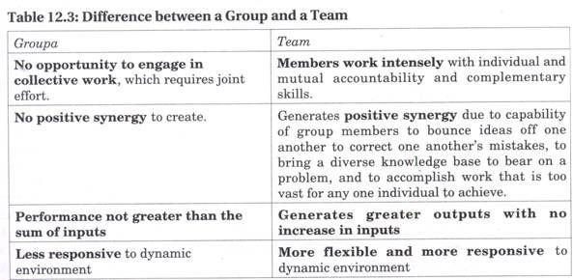
Turning Groups into Effective Teams:
All teams are groups but not all groups are teams. Teams often are difficult to form because it takes time for members to learn how to work together.

Slide 38
Turning Groups into Effective Teams:
Team-building helps to increase intra-group and inter-group effectiveness to bring members together, make them share their perception of each other and understand each other’s point of view.
Teams can be of four types – problem-solving teams (only making suggestion), self-managed teams (operate without a manager), cross-functional teams (a group of experts from different specialities), and virtual team (members collaborate online).
In terms of size, teams may be institutional (comprising of hundreds of members) and operational (a small, cooperative group, in regular contact and contributes responsibly to achieve task at hand).

Slide 39
Turning Groups into Effective Teams
To show business results and profitability, ways are explored by the executives to improve their productivity:
1. Clear Expectations:
The managers must clearly tell the team members of the expected performance and the team members must understand the reason for its creation. For it the organization must support the team with resources of people, time and money
2. Commitment:
Team members must participate in the team, feel that the team mission is important, and show commitment to accomplishing the team mission and expected outcomes. Commitment will come if team members perceive their service as valuable to the organization and to their own careers.

Slide 40
Turning Groups into Effective Teams
3. Competence:
Team members must have the knowledge, skill and capabilities, the resources, strategies and support needed to accomplish its mission to address the issues for which the team was formed.
4. Control:
The team must have not only enough freedom and empowerment to feel the ownership necessary to accomplish its charter, but also the accountability. There has to be a defined review process.
5. Collaboration:
The team should understand group processes and work effectively and cooperatively with other members of the team. For it they have to understand the roles and responsibilities of team members, team leaders, and team recorders.

Slide 41
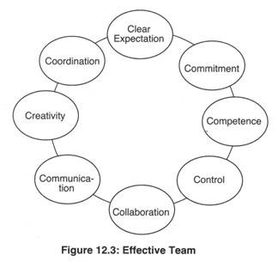
Turning Groups into Effective Teams
6. Communication:
To make team members clear about the priority of their tasks, and receive regular feedback, team members must clearly and honestly with each other. Diverse opinions be welcome and conflicts be taken up positively.
7. Creativity:
The team should value creative thinking, unique solutions, and new ideas; and reward members who take reasonable risks to make improvements.
8. Coordination:
Teams should understand the concept of internal customer to whom they provide a product or a service. Team efforts need to be coordinated by a central leadership team that assists the groups to obtain what they need for success.

Slide 42
Informal Group:
In every organisation along with formal groups there exists informal groups which emerge naturally due to the response and common interests of the members who can easily identify with the goals or independent activities of the informal groups.
An informal group can be defined as a group that evolves spontaneously, not shown in the organization’s structure, with the objective of fulfilling personal and social need of its members.

Slide 43
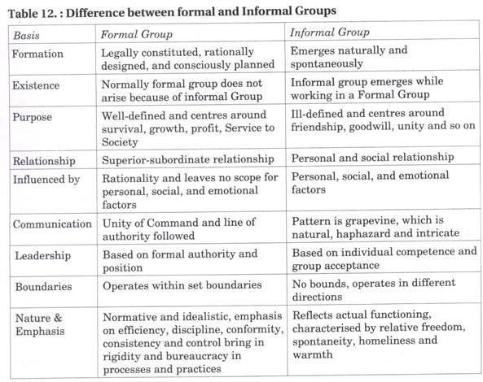
Informal Group vs. Formal Group:
The two are different in very many ways.

Slide 44
Benefits of Informal Groups:
The benefits of an informal group are as follows:
1. Blending with formal group allows people to work for the formal organisation.
2. Informal work group lightens the workload for the formal manager.
3. Brings satisfaction and stability to the organisation as a whole.
4. Provides a useful channel of communication.
5. Encourages managers to plan and act more carefully.

Slide 45
Limitations of Informal Groups:
The limitations are as follows:
1. Resistance to Change because they do not want to deviate from existing norms and learn new ways.
2. Informal group provides most fertile ground for Rumour Mongering because of maliciousness, lack of proper communication systems and processes and ambiguous circumstances.
3. Since a member of an informal group is also a member of a formal group, at times it creates role conflict.
4. Creativity of group member (s) is restricted because of strong pressure for conformity applied by the group.

Slide 46
Thank you for your attention

