Slide 1
The Idea of Europe
The Idea Of Europe
Mariam Ezugbaia
Jakub Koprda
Julia Domagalska

Slide 2
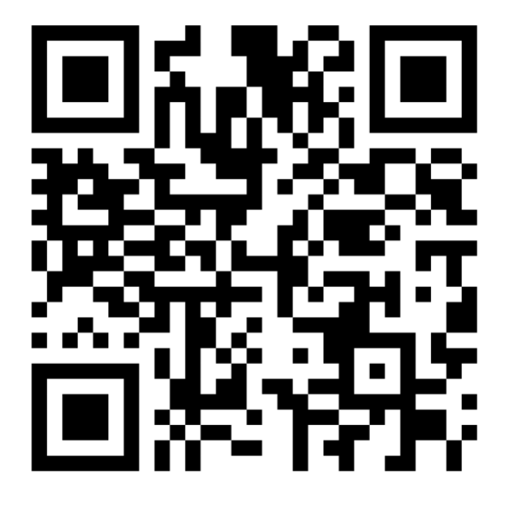

Slide 3
What is identity?

Slide 4
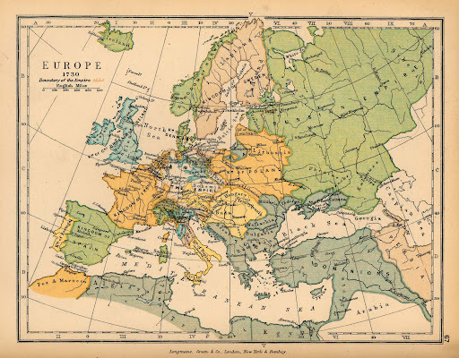
Origins of the European identity

Slide 5
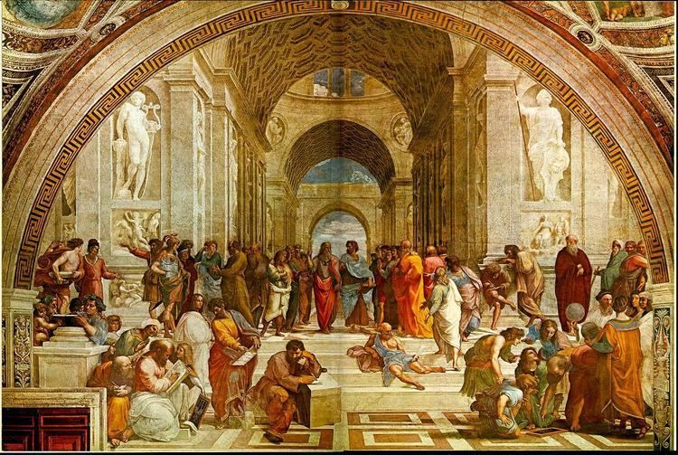
Classical antiquity - Greek and Roman influence
Cultural, philosophical, and political legacies

Slide 6
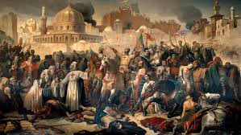
The Middle Ages
The Holy Roman Empire and the Crusades

Slide 7
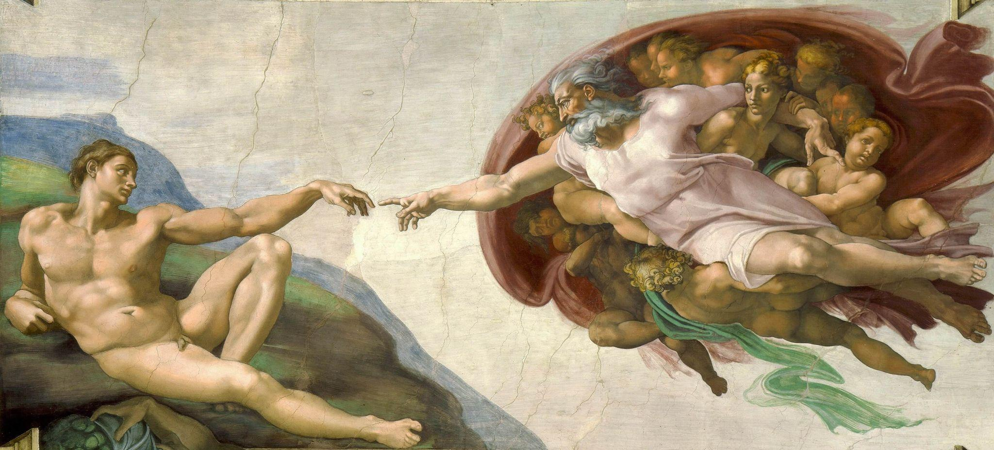
The Renaissance
The revived interest in classical antiquity and humanism

Slide 8
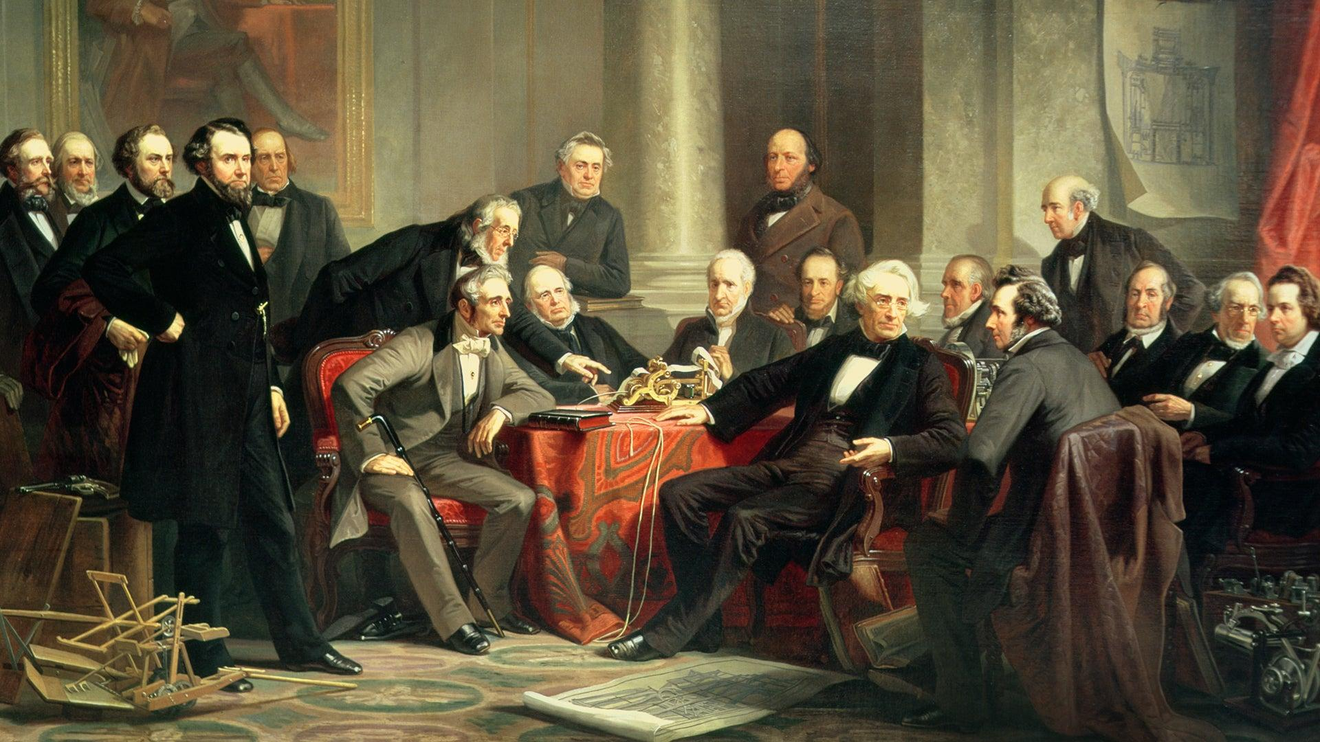
Age of Enlightenment
Ideas of reason, science, and individual rights

Slide 9
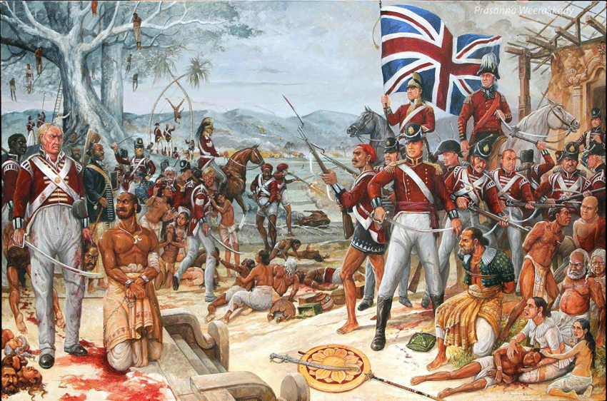
European colonialism
Global expansion of european culture

Slide 10
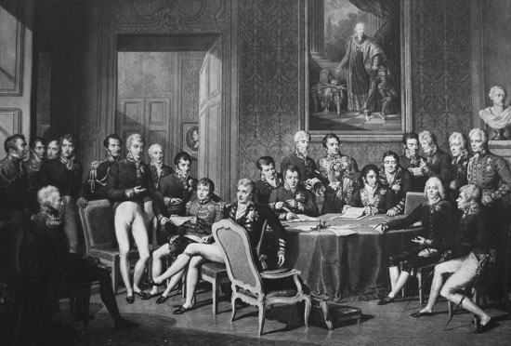
Congress of Vienna
Redrawing Europe

Slide 11
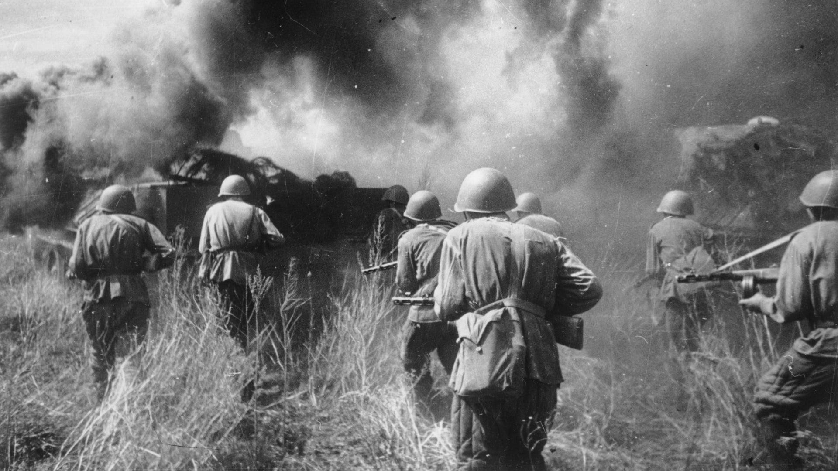
20th century conflicts
Solidifying the European identity

Slide 12
National identity?

Slide 14
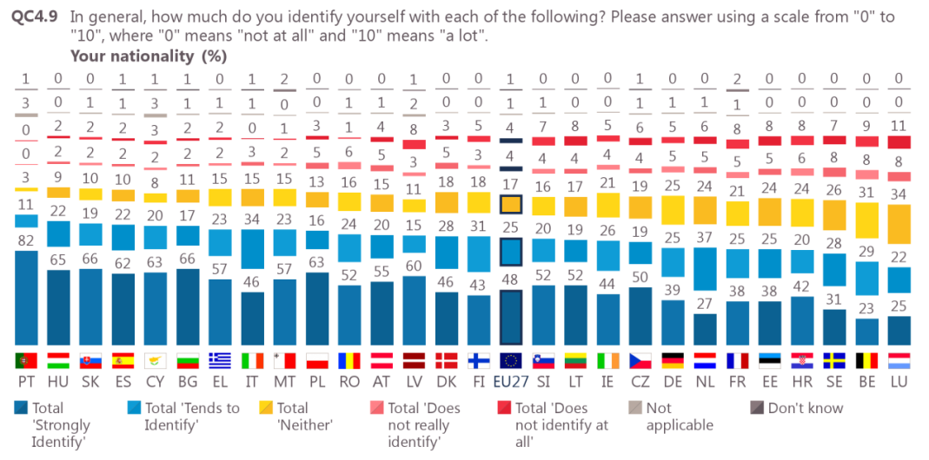

Slide 15
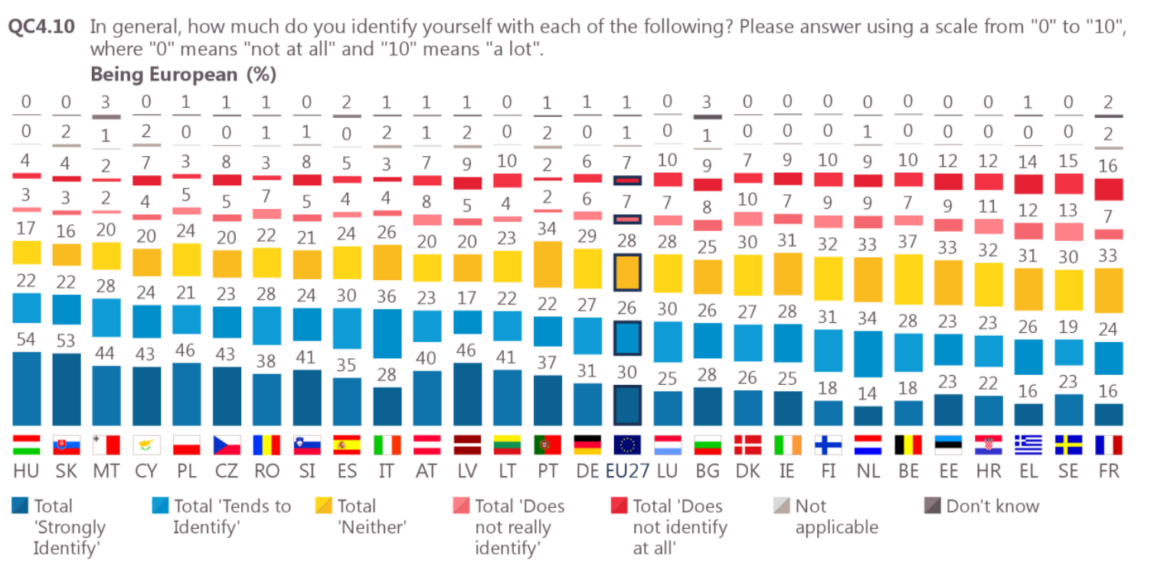

Slide 16
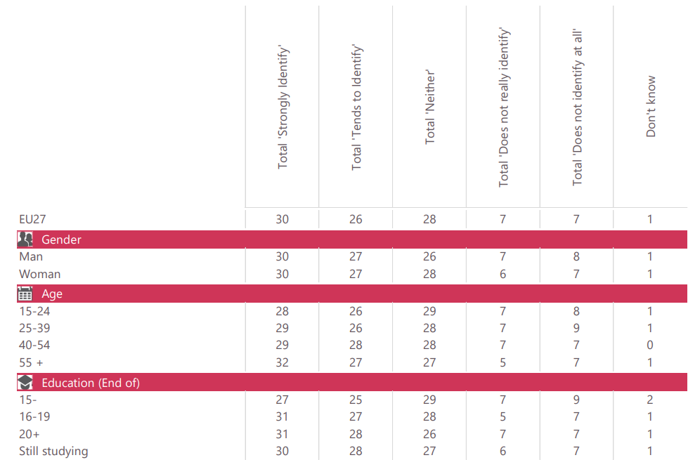

Slide 17
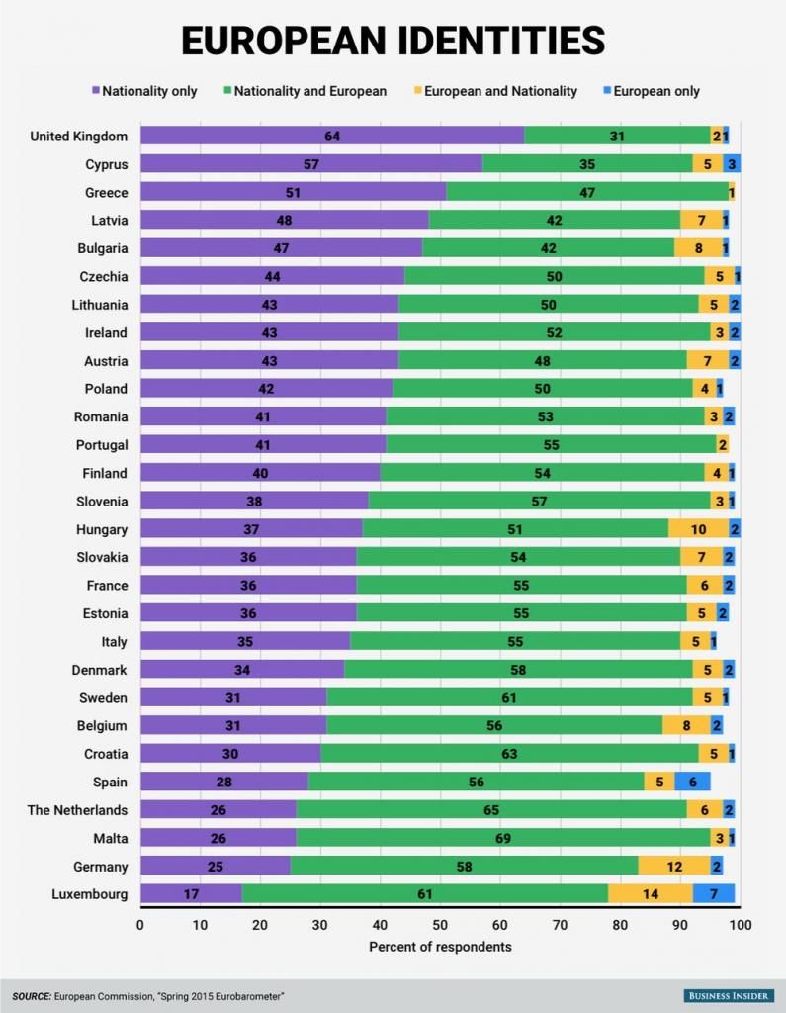

Slide 18
the outcome?

Slide 19
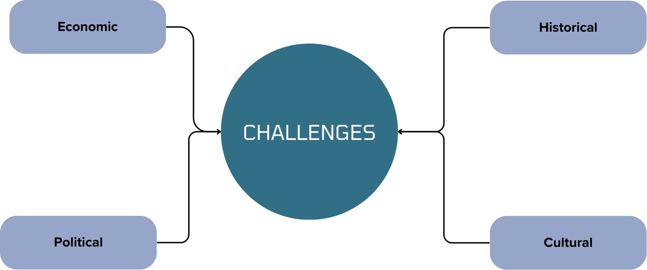
Challenges and Future Developments

Slide 20
Thank You For Your Attention

Slide 21
Place for discussion:
Do we actually need the European identity?

