Slide 1
Tourism Marketing
How to promote….
Petra Koudelková

Slide 2
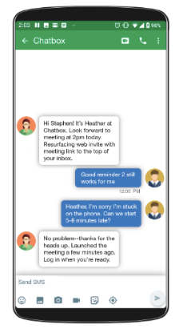
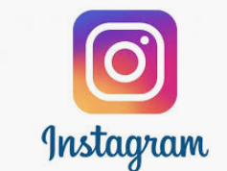
Promotion of Restaurant
Web – necessity in hotel restaurant
Text: short
Pictures: many
Language mutation
Social media
Facebook(menu)
linkedIn – not necessary
Gastro portals
Clear and nice view of the building
Local advertisement-
Leaflets
WOM
Vouchers (sales, gifts, etc)
Outdoor presentation
Menu
Label

Slide 3
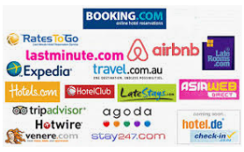
Hotels
Web
Online media (linkedIn, Facebook, Twitter, Instagram or Snapchat)
Online catalogues
Invest to booking portal: Booking.com, TripAdvisory and similar servers
You must find Niche on the market and dominate it

Slide 4
Hotels
Content marketing for solving problems: Content marketing is one of the best and most effective ways to increase your hotel bookings.
First step in this practice is to find out all of the different questions or problems your target audiences have and create detailed content solving those problems. This will help to build their trust in your hotel or brand and will increase the chances of converting them into customers.
Communicate directly with your customers on social media
Make a virtual tour of Hotel or/and create digital guide : By providing a virtual tour, you’ll give your prospects an idea of what they should expect so that they can visualize the value of what you can provide immediately.
Use CRM system: Knowing how to best serve your customers and communicate with them is key to having them come back.
Create special pavckages for events: Family and friends reunions. Offsite meetings. Weddings.

Slide 5
Create cohesive branding both online and offline
Use holiday-themed emails to take advantages of peak period
Make easy to book a room on your website
Publish newsletter with special sales or email with special offers (e.g. NHotel)

