Slide 1
Ukrainian Propaganda in the Russia-Ukraine War
Prof Paul Baines for Charles University, ERASMUS Visit February 23

Slide 2
Biography
Highlights
Professor of Political Marketing since 2011
Deputy Dean (Strategic Projects)
Non-Executive Director, Business Continuity Institute
Councillor, Anstey Ward, Charnwood Borough Council / Mayor of Charnwood 2021-2022, Cabinet Lead for Investment (2022+)
Co-editor of SAGE Handbook of Propaganda (SAGE Publications, 2019).
Co-author of Foundations of Marketing 2E (Oxford University Press, 2021) and Marketing 6E (Oxford University Press, 2022)
Co-editor of Major Works in Propaganda, Vols. I-IV (SAGE Publications, 2012); Major Works in Political Marketing Vols.I-III (SAGE Publications, 2011).
Biography
Paul Baines is Professor of Political Marketing and Deputy Dean (Strategic Projects) at the University of Leicester, and Visiting Professor, Aston and Cranfield Universities. Paul has delivered undergraduate, postgraduate and executive courses and classes in universities around the world, including in USA, Canada, Malaysia, Sweden, Finland, Ireland, Holland, Saudi Arabia, and the UAE. He is a Fellow of the Market Research Society (MRS) and the Institute of Directors. For over two decades, Paul’s research has particularly focused on political marketing, public opinion, and propaganda. He has co-written and co-edited 20 books on marketing topics, including the best-selling Marketing now in its 5th edition with Oxford University Press. Paul’s consultancy work includes experience working with government departments on strategic communication research projects, as well as with many small, medium, and large private enterprises, including Glassolutions Saint-Gobain, IBM, 3M, and many more. Paul is a regular commentator in both the press and broadcast media on political marketing topics. He is director of Baines Associates Limited, a strategic marketing/research consultancy and a non-executive Director of the Business Continuity Institute, a professional body for organizational resilience executives.

Slide 3
Learning Outcomes
By the end of this session you will be able to:
Define propaganda and its associated military terms.
Understand how Ukraine has developed its propaganda approach.
Understand how Russia has developed its propaganda approach.
Be able to apply strategic communication concepts to the evolution of Ukraine’s efforts in this area.

Slide 4
What is Propaganda?
"The essence of propaganda consists in winning people over to an idea so sincerely, so vitally, that in the end they succumb to it utterly and can never escape from it."
Joseph Goebbels, 1897-1945
Name of Author(s) | Propaganda Definition
Bernays (1928/2005:52) | “Modern propaganda is a consistent enduring effort to create or shape events to influence the relations of the public to an enterprise, idea or group”.
Ellul (1973:25) | “The aim of modern propaganda is no longer to modify ideas, but to provoke action. It is no longer to change adherence to a doctrine, but to make the individual cling irrationally to a process of action. It is no longer to lead to a choice, but to loosen the reflexes. It is no longer to transform an opinion, but to arouse an active and mythical belief”.
Jowett and O’Donnell (2012:7) | "Propaganda is the deliberate, systematic attempt to shape perceptions, manipulate cognitions, and direct behaviour to achieve a response that furthers the desired intent of the propagandist”.
Taylor (2003:6) | “The deliberate attempt to persuade people to think and behave in a desired way”.
Merriam Webster Dictionary (2012) | “The spreading of ideas, information or rumour for the purpose of helping or injuring an institution, cause or person”.
Oxford Dictionaries (2012) | “Information, especially of a biased or misleading nature, used to promote a political cause or point of view”.
Oxford Dictionary of the US Military (2012) | “Any form of communication in support of national objectives designed to influence the opinions, emotions, attitudes, or behaviour of any group in order to benefit the sponsor, either directly or indirectly”`.

Slide 5
What is Propaganda?
Der Jude Poster Advertising Goebbel’s Propaganda Film
You know it when you see it!

Slide 6
Types of Propaganda
Type of Propaganda | Explanation
Propaganda of Enlightenment | Negation of false information.
Propaganda of Despair | The inducement of fear of death and disaster.
Propaganda of Hope | Presenting to the enemy the hope of a better life if they cease hostilities or surrender.
Particularist Propaganda | Seeking to divide the enemy into individual groups and attacking them separately.
Revolutionary Propaganda | Aiming to break down an enemy from within.
Integration Propaganda | Aims at unifying and reinforcing society.
Agitation Propaganda | The fomenting of revolution within society.
Atrocity Propaganda | Material containing graphic images of an adversary’s savage or barbaric behaviour towards the target audience to arouse their sympathies towards the propagandist.
Sociological Propaganda | Ideological penetration into a target audience through sociological context.
Political Propaganda | Ideological penetration into a target audience through its political context.
Vertical Propaganda | That propaganda which makes use of the mass media.
Horizontal Propaganda | That propaganda made by a central organisation which disseminates it for use by small groups.
Can also be black, white and grey
Sources: Bruntz (1972), Ellul (1965)

Slide 7
Some Modern Military Terms
Term | Definition | Source
Perception management | “Actions to convey and/or deny selected information and indicators to foreign audiences to influence their emotions, motives, and objective reasoning as well as to intelligence systems and leaders at all levels to influence official estimates, ultimately resulting in foreign behaviours and official actions favourable to the originator’s objectives. In various ways, perception management combines truth projection, operations security, cover and deception, and psychological operations”. | US Department of Defense (DoD, 2002, cited in Brown, 2002).
Information operations | “The integrated employment of electronic warfare (EW), computer network operations (CNO), psychological operations (PSYOP), military deception (MILDEC), and operations security (OPSEC) in concert with specified supporting and related capabilities, to influence, disrupt, corrupt, or usurp adversarial human and automated decision making while protecting our own”. | US Department of Defense (JP 3-13, 2006).
Psychological operations | “Planned operations to convey selected information and indicators to foreign audiences to influence their emotions, motives, objective reasoning, and ultimately the behaviour of foreign governments, organizations, groups, and individuals. The purpose of psychological operations is to induce or reinforce foreign attitudes and behaviour favourable to the originator’s objectives. Also called PSYOP.” | US Department of Defense (JP 3-13, 2006).
Influence activities | “The capability, or perceived capacity, to affect the character or behaviour of someone or something.” | UK Ministry of Defence (JDP 3-40, 2009).
Strategic Communication | ”A systematic series of sustained and coherent activities, conducted across strategic, operational and tactical levels, that enables understanding of target audiences, identifies effective conduits, and develops and promotes ideas and opinions through those conduits to promote and sustain particular types of behaviour.” | Tatham (2008).
Propaganda | "The deliberate, systematic attempt to shape perceptions, manipulate cognitions, and direct behaviour to achieve a response that furthers the desired intent of the propagandist”. | Jowett and O’Donnell (2012:7).
 | “Any form of communication in support of national objectives designed to influence the opinions, emotions, attitudes, or behaviour of any group in order to benefit the sponsor, either directly or indirectly”`. | Oxford Dictionary of the US Military (2012).

Slide 8
Planning a Propaganda Campaign
Stage 1: Strategic campaign planning – includes the development of the campaign’s objectives, initial research and analysis of the population and its constituent groups. This process identifies which behaviours are targeted for change and the people who exhibit those behaviours. Baseline measures of effectiveness (MoE) are developed.
Stage 2: Target group identification – incorporates a process of determining which groups within the target population related to a problem behaviour are most accessible and susceptible to influence. This group is then targeted for the communication intervention.
Stage 3: Target audience analysis – this stage incorporates qualitative and quantitative analyses of the target audiences’ behavioural and attitudinal characteristics.
Stage 4: Campaign design – incorporating the construction of the message, the channel through which the message will be disseminated, by which source.
Stage 5: Campaign execution – incorporating actual dissemination of the message, by a particular source through a particular channel.
Stage 6: Evaluation: incorporating an assessment of whether or not the campaign was effective by evaluating its performance against the MoEs developed in Stage 1.

Slide 9
Backdrop
Would have expected Russia to win propaganda war. Notable successes:
Interference in 2016 US Presidential
Active Measures campaigns during Cold War including Operation Infektion
Protocols of the Elders of Zion (anti-semitic propaganda) in early 20 century.
Distinctive Features of the Contemporary Model for Russian Propaganda
High-volume and multichannel
Rapid, continuous, and repetitive
Lacks commitment to objective reality
Lacks commitment to consistency.
Source: Paul & Matthews (2016)

Slide 10
How Does Propaganda Undercut Perceptions of Reality?
People are poor judges of true versus false information—and they do not necessarily remember that particular information was false.
Information overload leads people to take shortcuts in determining the trustworthiness of messages.
Familiar themes or messages can be appealing even if they are false.
Statements are more likely to be accepted if backed by evidence, even if that evidence is false.
Peripheral cues—such as an appearance of objectivity—can increase the credibility of propaganda.
Source: Paul & Matthews (2016)

Slide 11
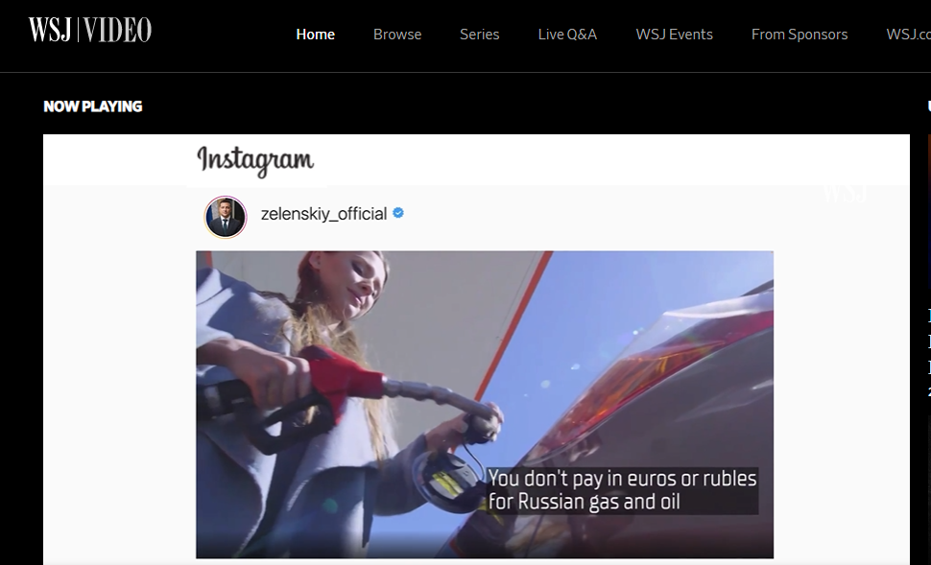
An Overview of Ukrainian Propaganda - WSJ
https://www.wsj.com/video/cute-dogs-bono-and-ads-ukraines-pr-strategy-to-rally-global-support/379763DE-79D2-4285-93C1-9588651E5AC9.html (5’42’’)
Broadcast appearance on WSJ Video, with Emily Siu, “Cute dogs Bono and ads: Ukraine’s PR strategy to rally global support”, 11th July 2022. https://www.wsj.com/video/cute-dogs-bono-and-ads-ukraines-pr-strategy-to-rally-global-support/379763DE-79D2-4285-93C1-9588651E5AC9.html

Slide 12
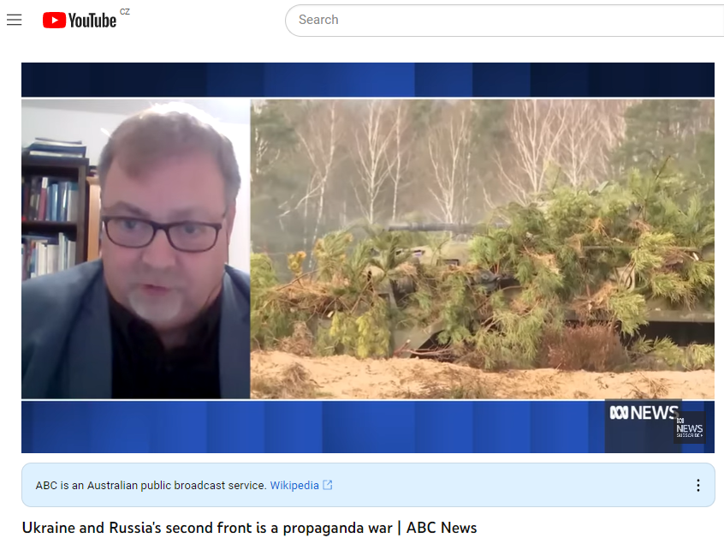
Ukrainian and Russia Propaganda in Brief: My Own Perspective
https://www.youtube.com/watch?v=JW1Vvdm32vw (8’10’’)
Broadcast appearance on ABC News (Australia), with Joe O’Brien, on Ukrainian propaganda in Ukraine-Russia war, 09.30am, 19th October 2022. https://www.youtube.com/watch?v=JW1Vvdm32vw

Slide 13
Ukrainian vs Russian Propaganda
Ukraine
Russia
Shore up domestic morale to take up arms and willingly accept conscription.
Stop citizens from posting material useful to Russia for BDA.
Psychological operations to taunt Russia with military successes (e.g. photos of burnt out tanks, PR about Russian generals KIA).
IT army by Ministry of Digital Transformation to encourage citizens to take down/contact Russian population to make them aware of war.
Highlight Russian casualty rate. Estimated 111k in first 10 months. Keep quiet about own casualties.
Diplomatic effort to guilt trip Western governments into sending guns, artillery, tanks and ammunition.
Key effort to stop Western countries buying Russia oil & gas which bankrolls Russian war effort.
Highlighted Ukrainian bravery in ad campaign (How Ukraine Is Winning the Propaganda War | WIRED)
That Ukraine is part of a wider Russia, no independent national identity.
Deception operation to hide invasion as an exercise (but ‘prebutted’/exposed by Western Intelligence)
It’s a ‘special military operation’ (smo) NOT a war. Law passed to make it illegal amongst public to say otherwise.
The SMO is about ‘denazifying’ Ukraine and protecting ethnic Russians in Ukraine.
Shore up domestic morale to support ‘partial mobilisation’.
Deny casualty rate. Forbes suggests rate as high as 270,000 KIA/MIA/WIA (7th Feb ‘23).
Label cause of war as NATO expansion. Some success here particularly in non-aligned countries, e.g. India
D - I – M - E

Slide 14
Russian Domestic Public Opinion on War
Source: What Secret Russian State Polling Tells Us About Support for the War - The Moscow Times based on unpublished Russian government opinion polling data.

Slide 15
Russian Domestic Opinion – Need for War
Source: What Secret Russian State Polling Tells Us About Support for the War - The Moscow Times based on unpublished Russian government opinion polling data.

Slide 16
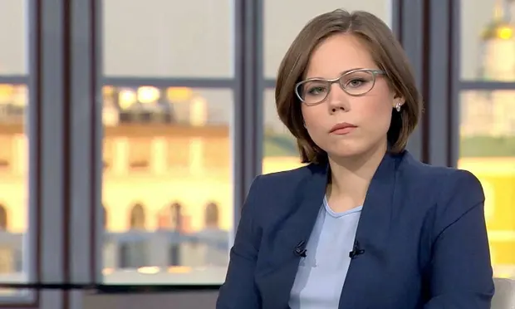
More on Russian Disinformation
According to Russia, Ukraine was planning a ‘dirty bomb’ attack on Russia to help support new line that SMO is now a counter-terrorism operation and a ‘war of the people’s choice’.
Evidence is Ukraine’s attack on Crimean bridge, and car bomb attack killing daughter Daria Dugina of prominent Russian ultranationalist, Alexander Dugina. FSB says Ukraine at fault. Ukraine denies it and says FSB behind the attack.

Slide 17
Russian’s Feelings About Military Action in Ukraine
See: https://carnegieendowment.org/2022/09/07/my-country-right-or-wrong-russian-public-opinion-on-ukraine-pub-87803

Slide 18
Public Opinion – A Global Perspective
Source: https://www.ipsos.com/sites/default/files/ct/news/documents/2023-01/Global%20Advisor%20-%20War%20in%20Ukraine%20.pdf

Slide 19
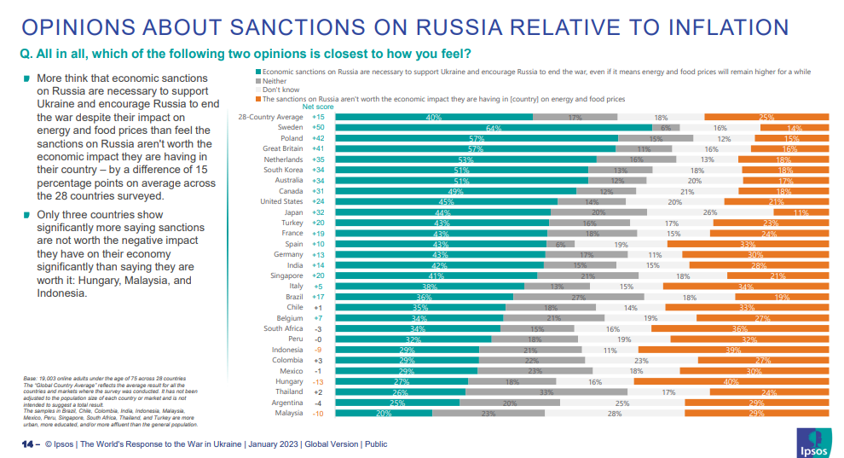
Is the War Worth it? (For our country)

Slide 20
Outcome
Spectacularly ineffective on Russian side:
Holds circa 16% of Ukrainian territory but has lost 6x more men in 1 year than in 11 years in Afghanistan 1979-1990.
Some positive increase in domestic public opinion in advance of 2024 Russian presidential. Probably successful here but depends on next year.
Finland/Sweden join NATO (held back at moment by Turkey but for how long). Unthinkable before invasion.
Drop in GDP in 2022 -5.6% (OECD), -3.3% (World Bank), -0.3% (IMF) on 2018 GDP.
270,000 KIA/MIA/WIA.

Slide 21
What Now for Ukrainian Strategic Communication from here?
Russian counteroffensive expected, doubling down….
Thousands of Russian troops piling into Donbas, but poorly equipped and trained.
Wagner head indicates it may take 2 years to take Luhansk and Donestk regions.
BUZZ GROUP: Work in groups of 3-4 to discuss how Ukraine’s StratCom policy should now evolve.

Slide 22
Learning Outcomes Revisited
By the end of this session you will be able to:
Define propaganda and its associated military terms.
Understand how Ukraine has developed its propaganda approach.
Understand how Russia has developed its propaganda approach.
Be able to apply strategic communication concepts to the evolution of Ukraine’s efforts in this area.

Slide 23
Further Reading
Books:
Baines, P.; Rosengren, S. and Antonetti, P. (2022). Marketing 6e, Oxford: Oxford University Press.
Baines, P.; O’Shaughnessy, N. & Snow, N. (2020). SAGE Handbook of Propaganda. London, SAGE Publications.
Worcester, R.; Mortimore, R.; Baines, P. & Gill, M. (2016). Explaining Cameron’s Comeback. London: Indie Books.
Baines, P. & O’Shaughnessy, N.J. (ed.) (2013), Propaganda, Vols.I-IV, London: Sage Publications.
Newspaper articles:
Baines, P. (2022). West is hampering Ukraine – Kyiv has every right to target Russian territory. Express, 10 June. Retrieve from: https://www.express.co.uk/comment/expresscomment/1623613/ukraine-news-live-war-russia-putin-nuclear-latest-invasion-updates-NATO
Baines, P. (2022). Футболка Зе проти «золотої» куртки Путіна у Лужниках: хто виграє інфорвійну (trans. Ze's T-shirt against Putin's "golden" jacket in Luzhniki: who will win the information war?) The PAGE, 3 June. Retrieve from: https://thepage.ua/ua/politics/ukrayina-proti-rosiyi-hto-vigraye-informacijnu-vijnu
Baines, P. (2022). Хто перемагає в інформаційній війні між росією та Україною — професор Пол Бейнс (trans. Who is winning the information war between Russia and Ukraine?) SPEKA Media, 3 June. Retrieve from: https://speka.media/spekcek/xto-peremagaje-u-informaciinii-viini-miz-rosijeyu-ta-ukrayinoyu-pkmnxv
Baines, P. (2022). Ukrainian propaganda: how Zelensky is winning the information war against Russia? The Conversation, 11 May. Retrieve from: https://theconversation.com/ukrainian-propaganda-how-zelensky-is-winning-the-information-war-against-russia-182061

