Slide 1
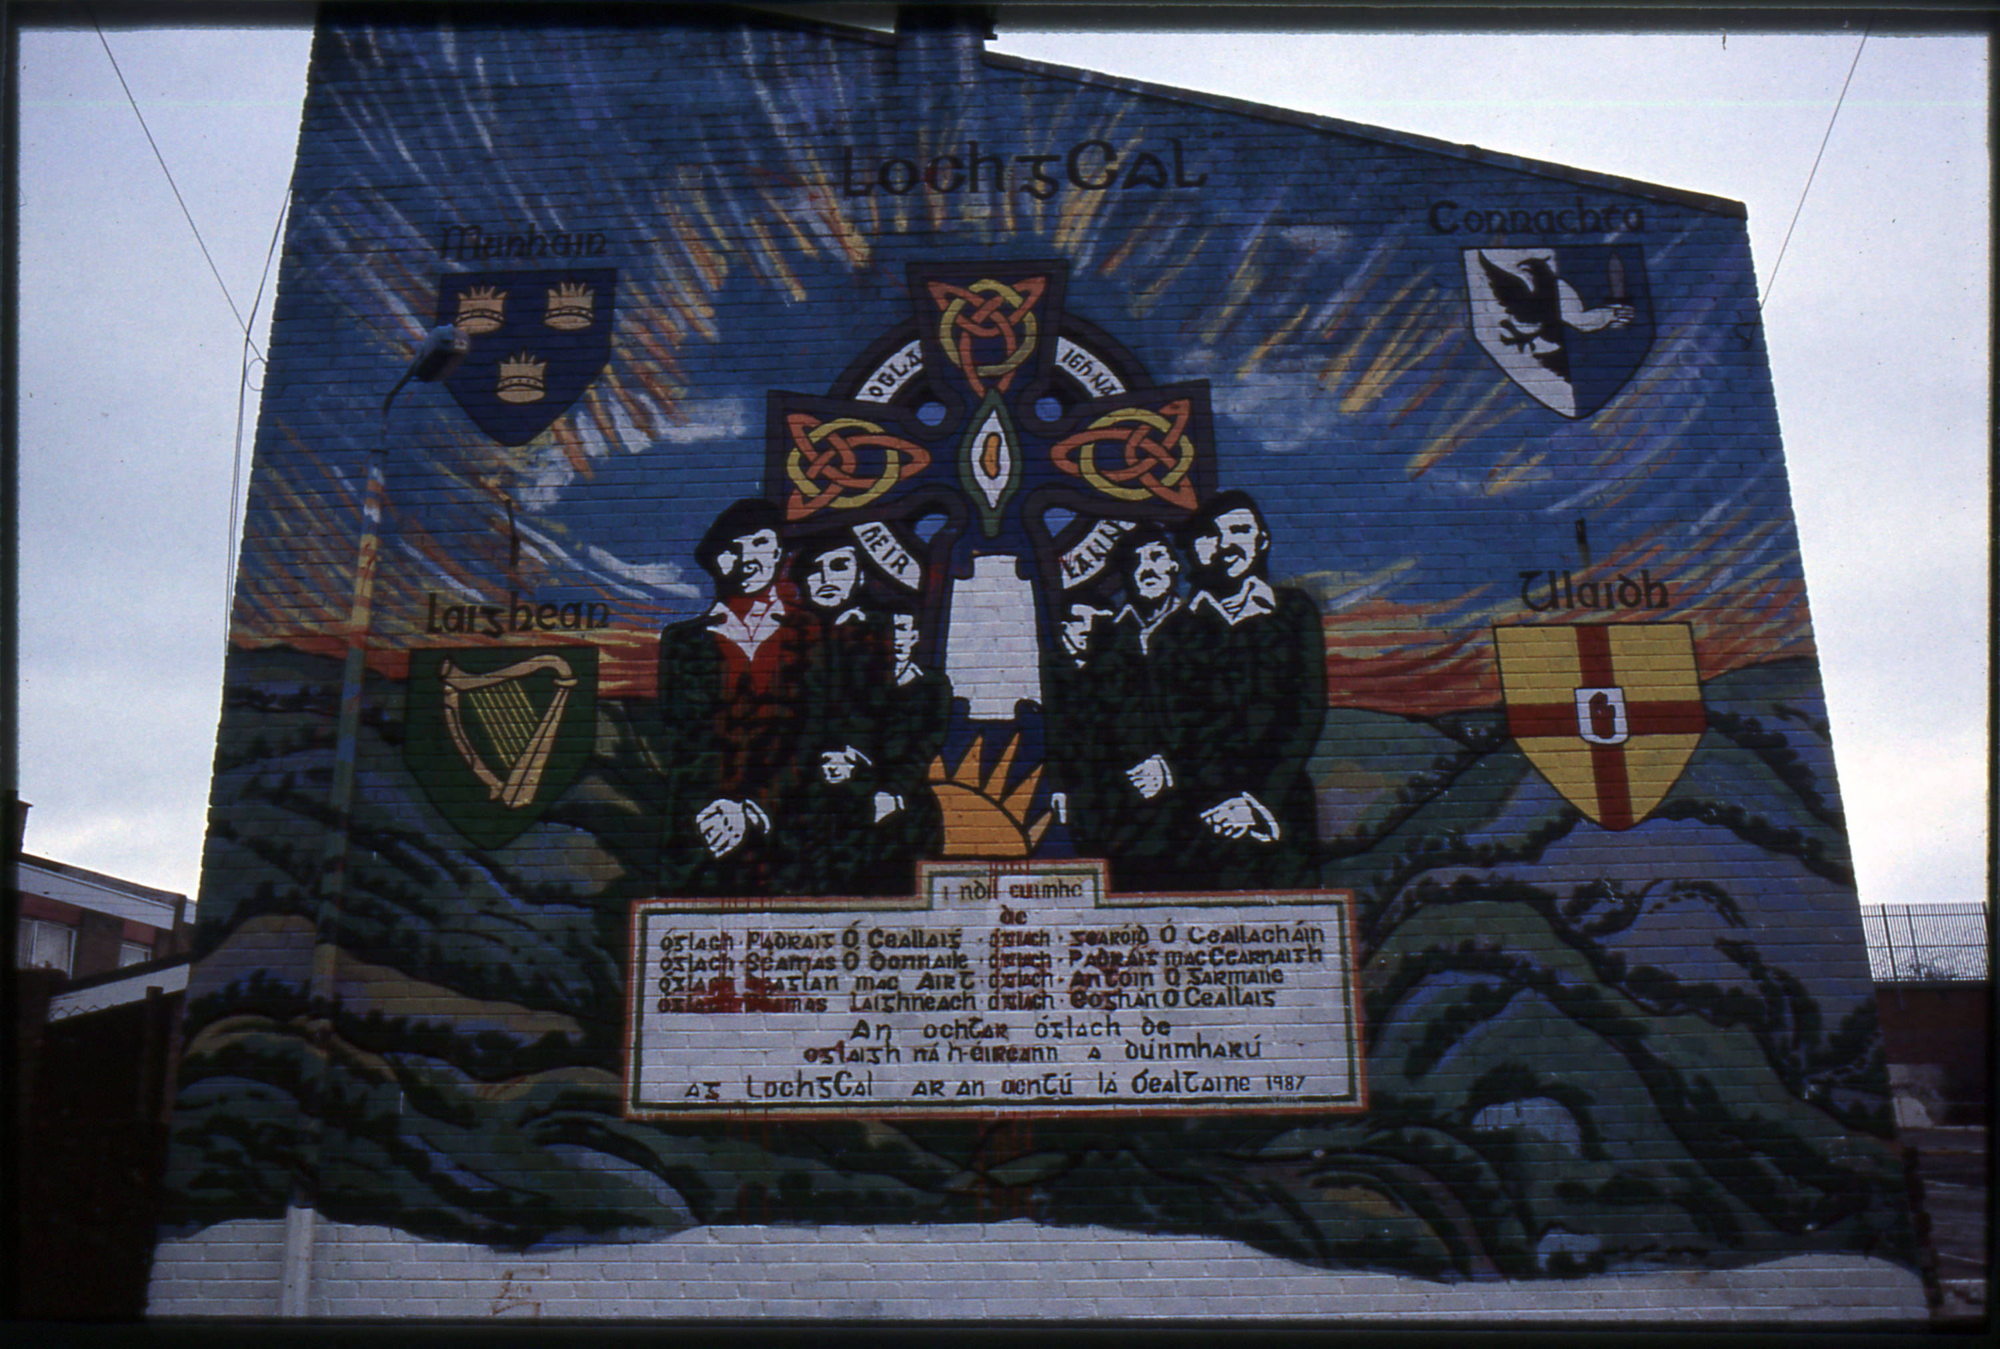
Murals (of Northern Ireland)
Vojtěch Halama

Slide 2
Murals in modern/contemporary history
Mural = a painting on a wall
Usually outdoor, large-scale, elaborate, political/cultural
Mural x graffiti
Mural x advertisment
Political/cultural mural x street art?
Modern politial/cultural murals x traditional indoor murals

Slide 5
Murals in Northern Ireland
Northern Ireland = two dominant „ethnic“ groups
contesting identities (ethnicity, politics, religion, culture)
Nationalists („Catholics“) x Unionists („Protestants“)
The Troubles (1969–1998) = violent triangular conflict (radicals)
Republicans x Loyalists x British army
Post-conflict situation (1998–) = reconsiliation x ongoing tensions
Murals = mainly tools of „ideological war“
ideological mobilisation, legitimization
Effective platform for „heritage“ – selective, present-centred, continuity of narratives

Slide 6
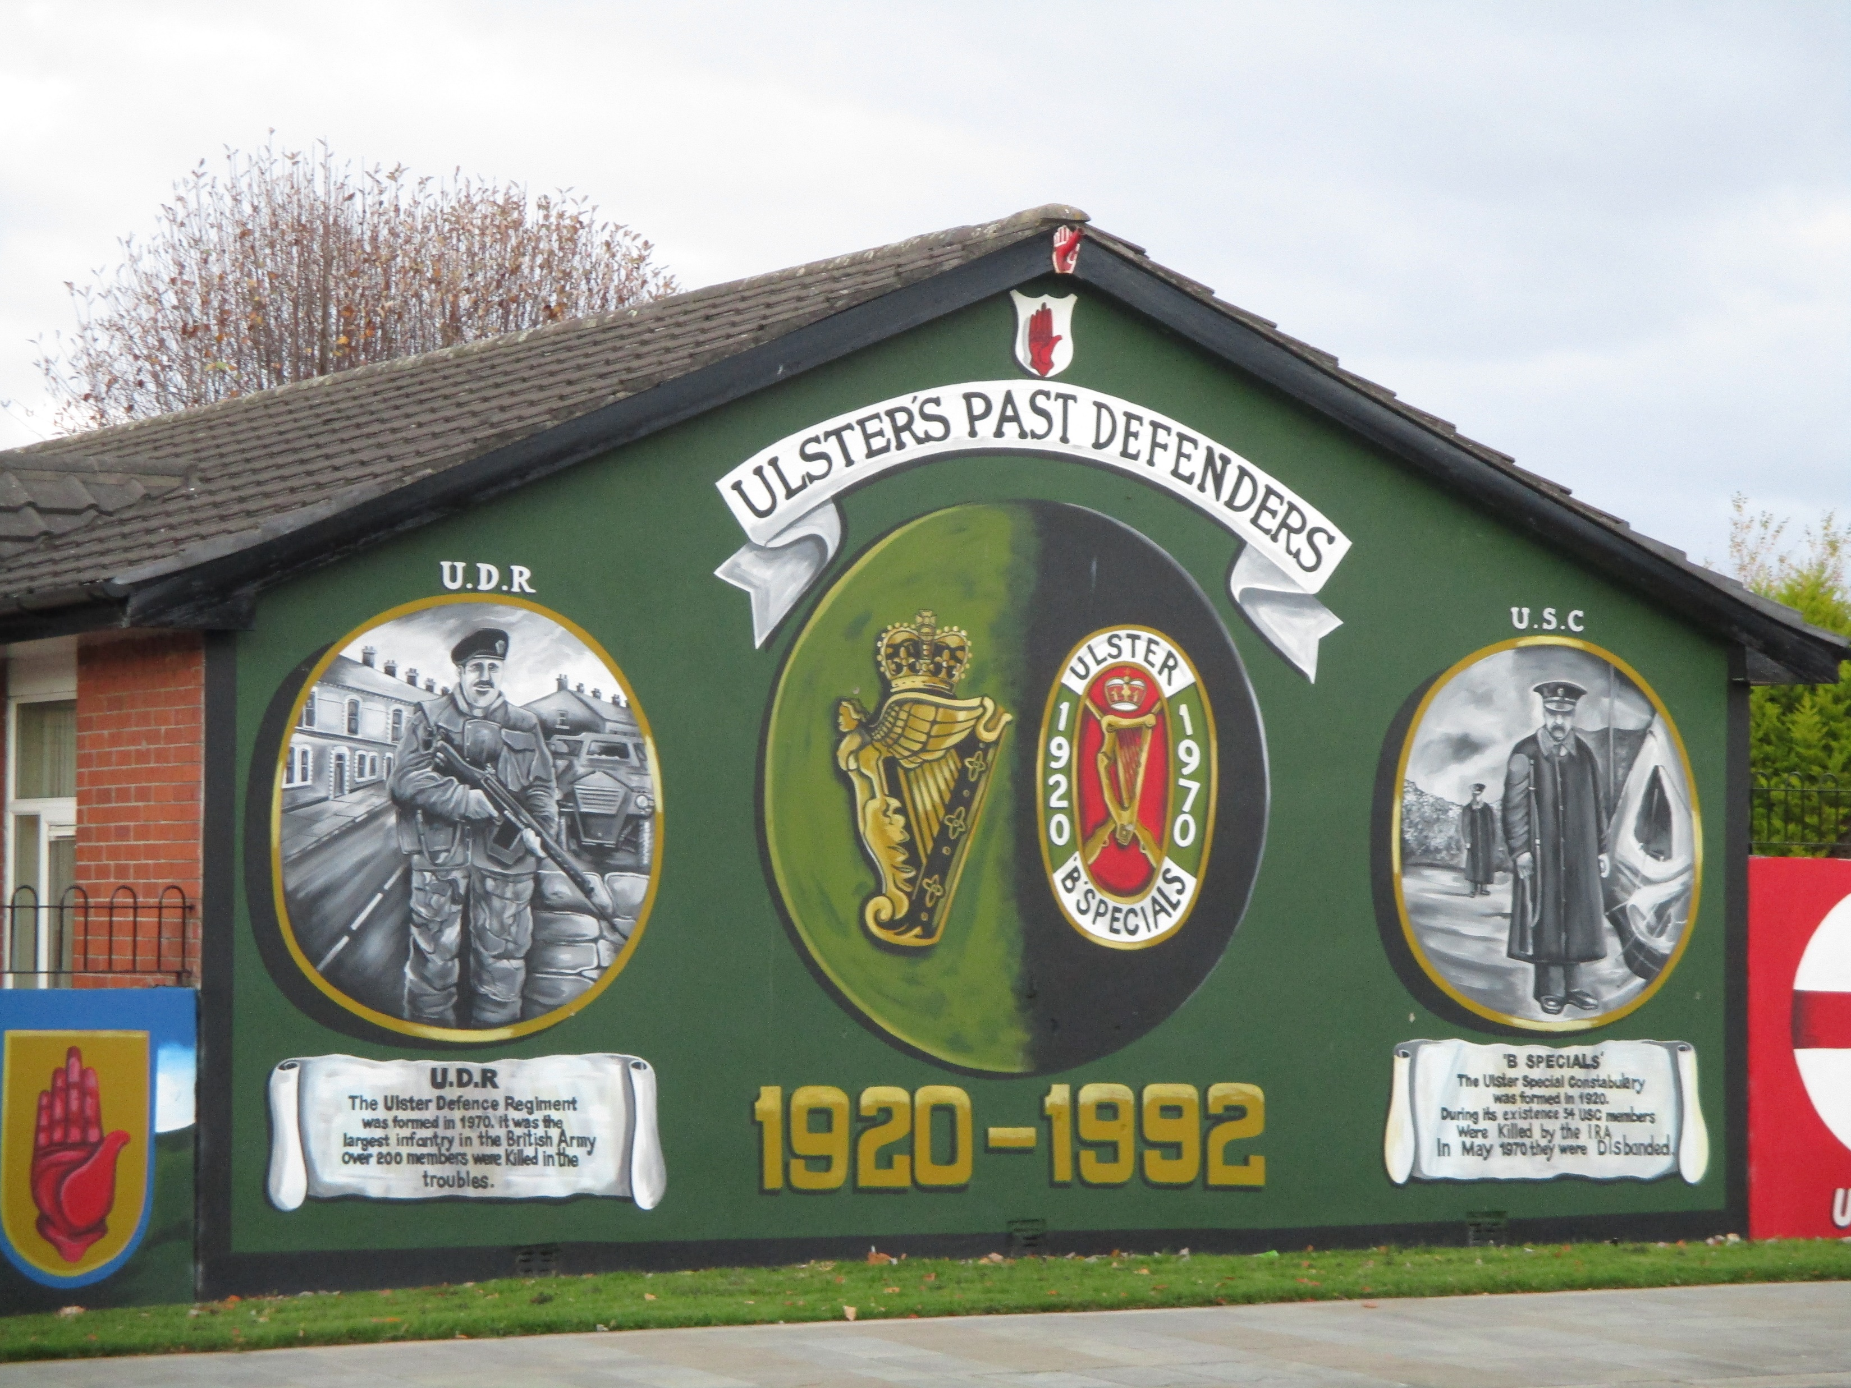
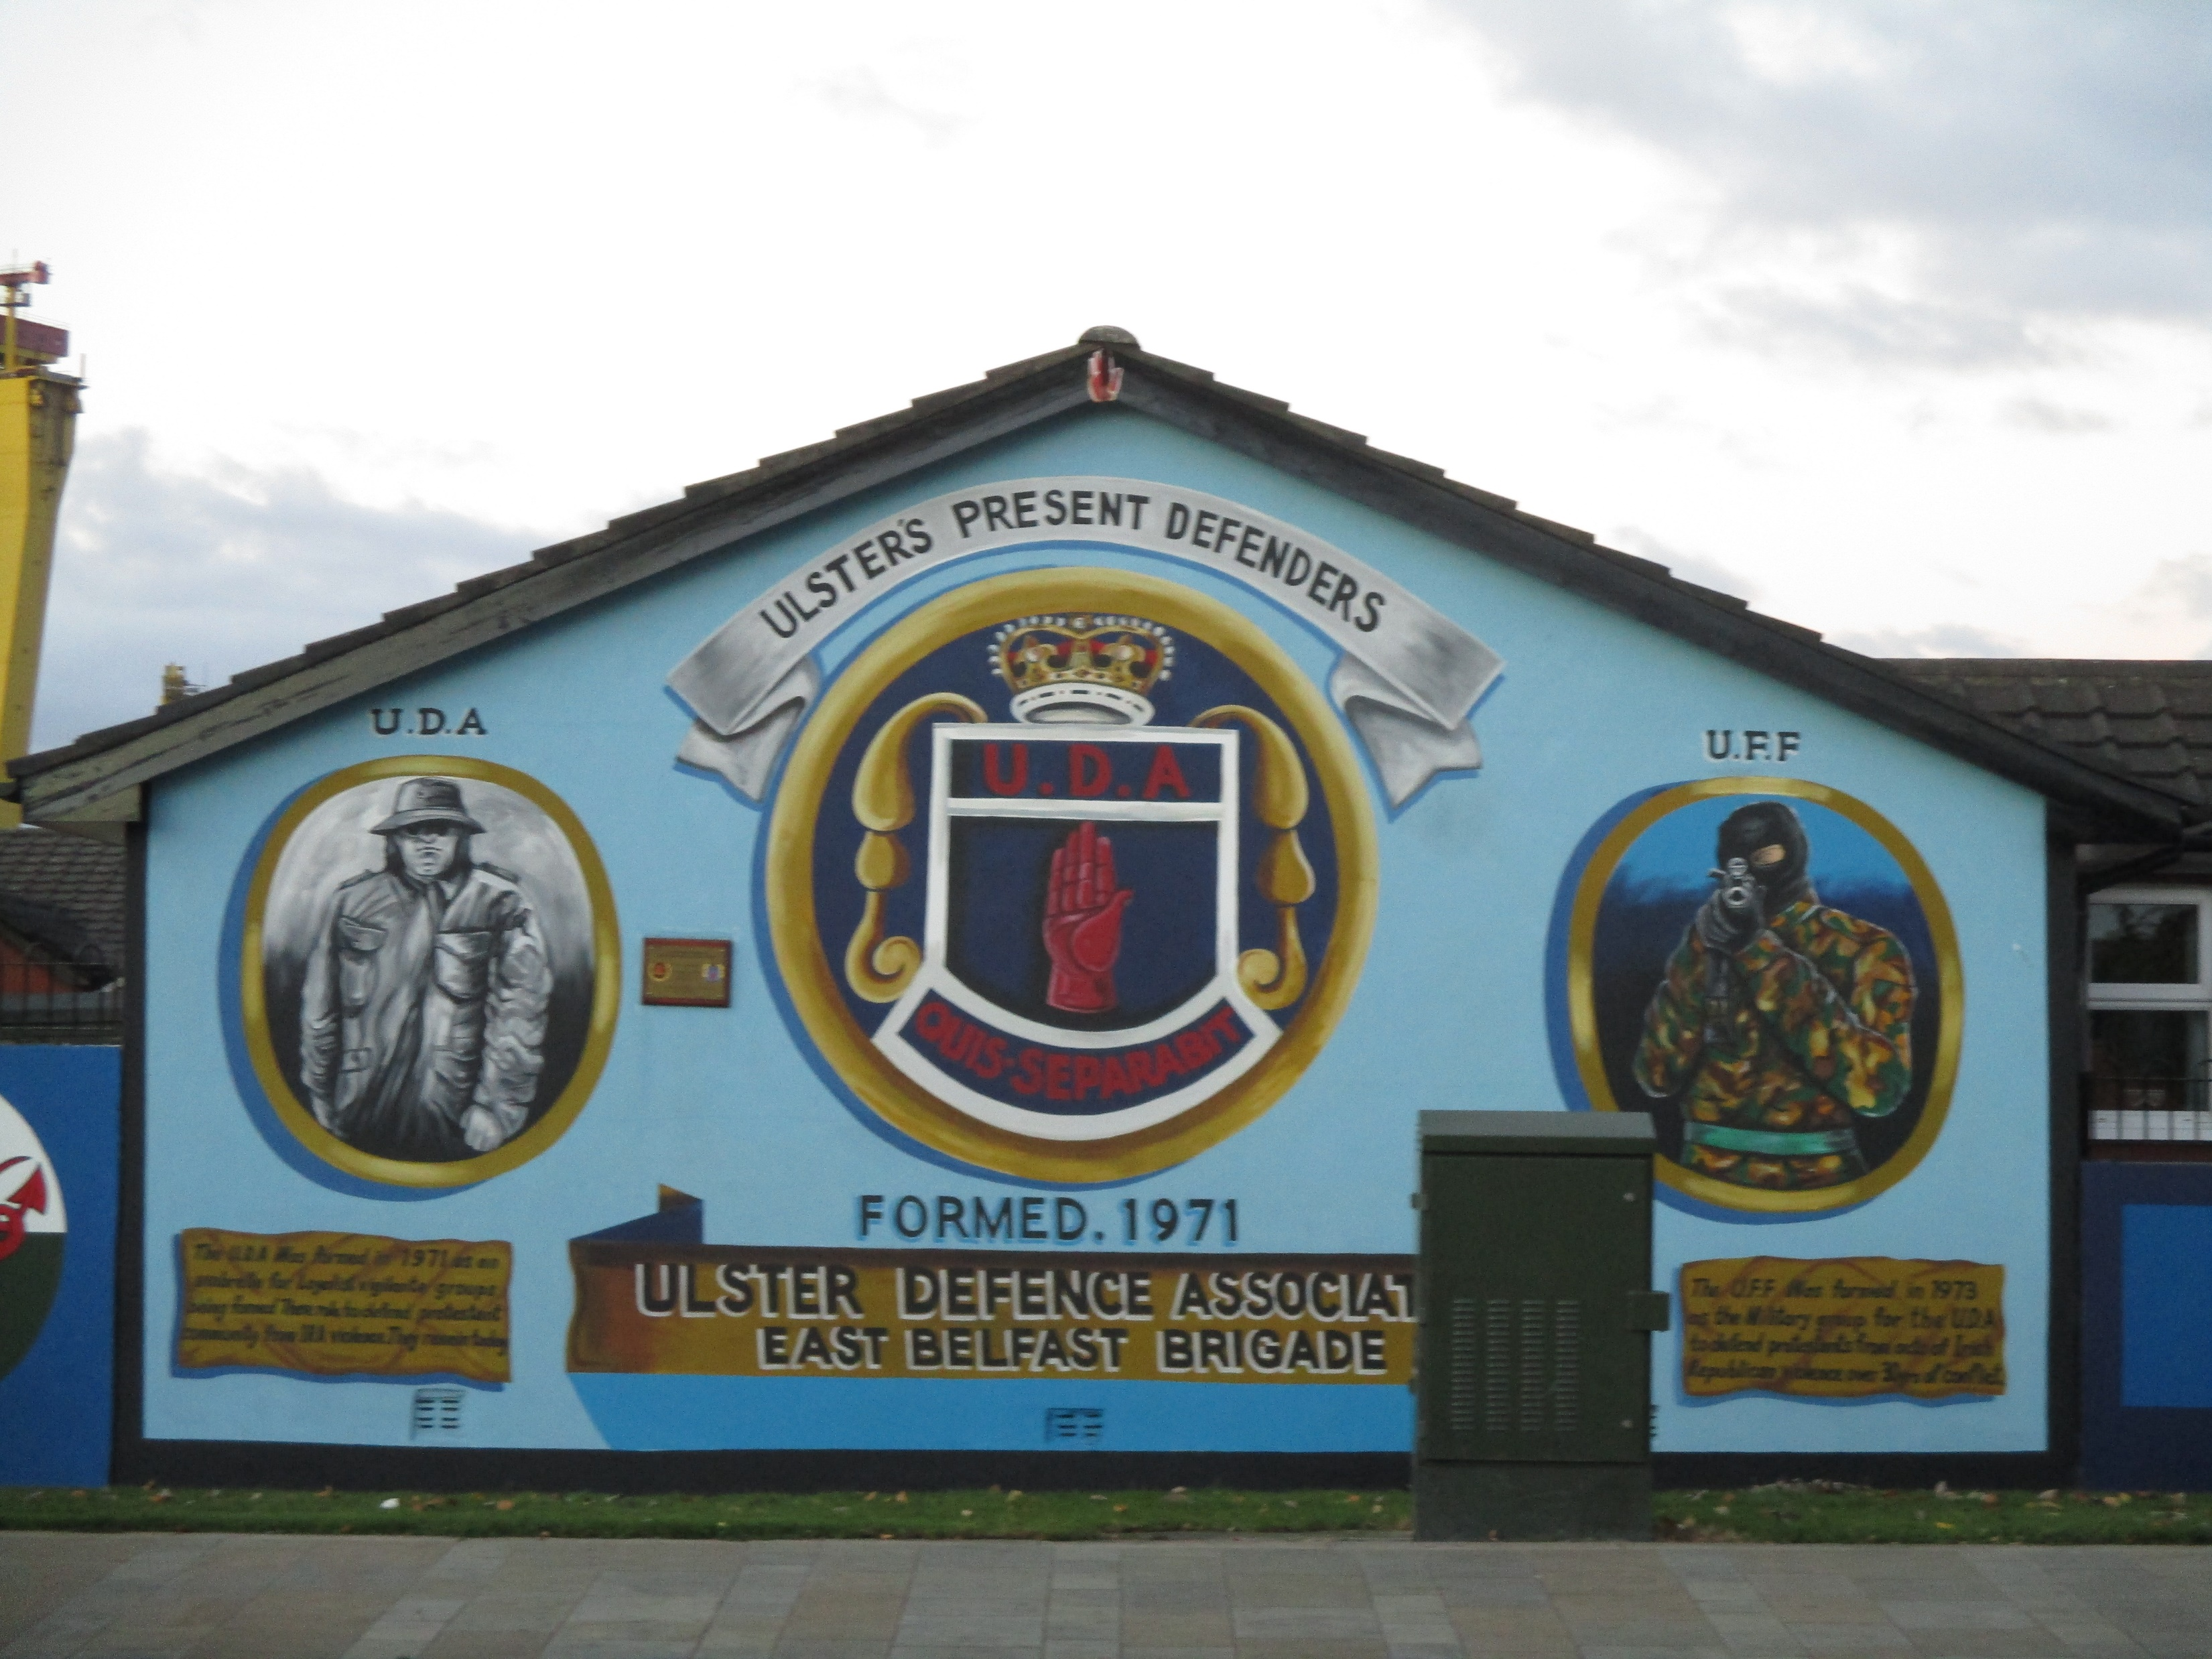
ROSS, Howard Marc, Cultural Contestation in Ethnic Conflict, Cambridge, 2007.
JARMAN, Neil, Material Conflicts: Parades and Visual Displays in Northern Ireland, Oxford, 1997.
SANTINO, Jack, Signs of War and Peace. Social Conflict and the Uses of Symbols in Public in Northern Ireland, Basingstoke, 2001.
FORKER, Martin – MCCORMICK, Jonathan, Walls of history: the use of mythomoteurs in Northern Ireland murals, in: Irish Studies Review, 17:4, 2009, s. 423–465.

Slide 7
Murals in Northern Ireland
Territorial function
Forming local identity and collective memory
Ideological and political appeal, legitimization
ideological mobilisation of local community + „drawing support“
Articulated message + ideological influencing
Bill Rolston:
Politics and Paintings: Murals and Conflict in Northern Ireland, Cranbury, 1991.
Drawing Support (I-IV), Belfast, 1992, 1998, 2003, 2013.
GOALWIN, Gregory, The Art of War: Instability, Insecurity, and Ideological Imagery in Northern Ireland’s Political Murals, 1979–1998, in: International Journal of Politics, Culture and Society, 26, 2013, s. 189-215.

Slide 8
Reading murals in Northern Ireland
Roland Barthes (Mythologies, 1957): Signifier + Signified = Sign
Symbols on murals – signifying an idea
Specific meaning of symbols, colours, text confined to NI
BUCKLEY, Anthony (ed.), Symbols in Northern Ireland, Belfast, 1998.
BRYAN, Dominic – GILLESPIE, Gordon, Transforming Conflict: Flags and Emblems, Belfast, 2005.
Time of creation/repainting!
Spatial context!
Autorship!

Slide 10
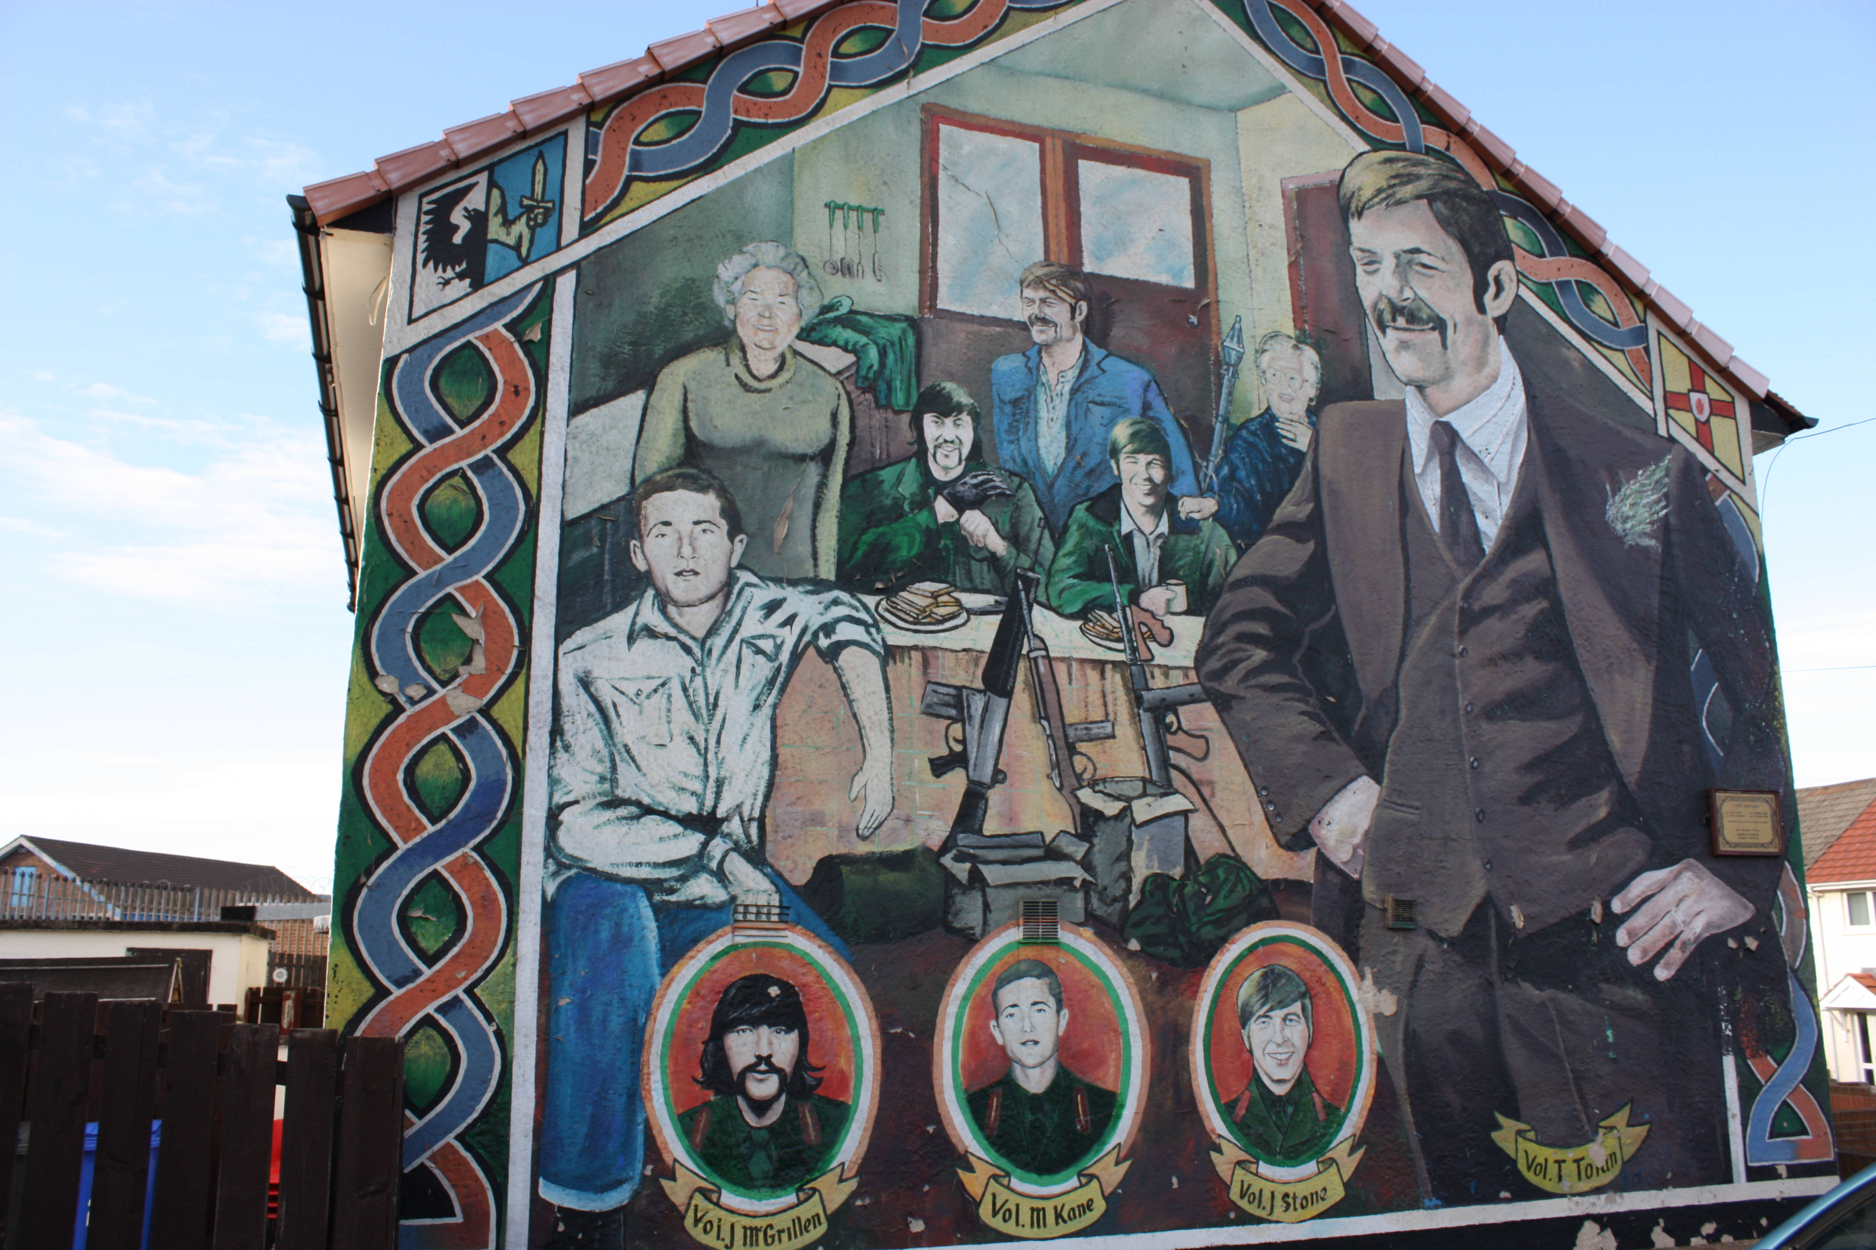

Slide 13
