Slide 1
Position Paper Sweden
Tereza Klimešová
Valentin Schnabl
Dema Hajeb
Nirsan Sriskantharajah
Patrik Kratochvíla

Slide 2
Contents
Introduction
Climate Policy of Sweden
Sweden and the European Green Deal
Key issues in alternative
Conclusion

Slide 3
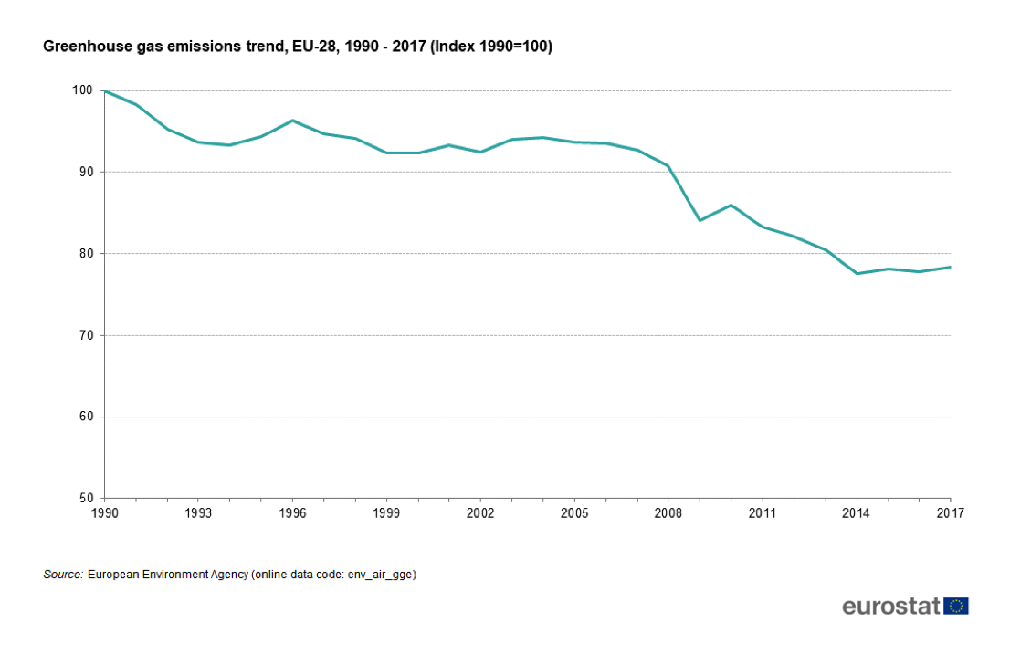
Introduction
Paris Agreement (2014)
Inefficient
European Green Deal (2019)
Main target: zero net emissions of greenhouse gases by 2050

Slide 4
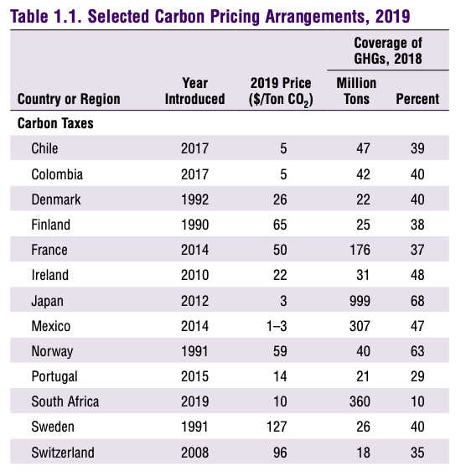
Climate Policy of Sweden
Environmental Protection Agency (1967)
Carbon tax since 1991
Governmental support of sustainable biofuels
Fuel Change Reform (2018)
The market availability of biofuels granted by legislation
Source:IMF. Fiscal Affairs Dept. (2019). Fiscal Monitor: How to Mitigate Climate Change.
Retrieved from: Fiscal Monitor, October 2019 : How to Mitigate Climate Change

Slide 5
Climate Policy of Sweden
New Climate Act (2018)
By 2030, Sweden’s energy use efficiency will be 50% higher than that of 2005
100% renewable electricity production by 2040
Zero net emissions of GHG by 2045

Slide 6
Climate Policy of Sweden
Tax reliefs for power-intensive companies in exchange of new energy plans to reduce energy use
Educated population
“Energy advisors” for households

Slide 7
Sweden and the European Green Deal
Revision of EU Commission’s funding plan
Decreasing emissions with the current financial resources
More efficient ways of “Greening”
Carbon-taxation
Carbon tariff

Slide 8
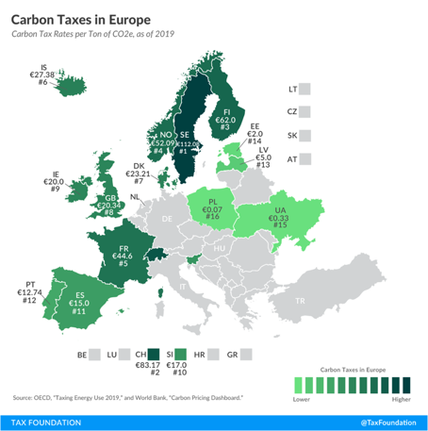

Slide 9
Sweden and the European Green Deal
Sweden climate-neutral by 2040
EU requires more ambitious targets
Limit EU emissions by 65% by 2030
Increasing credibility
Historic failures
“Nature doesn’t bargain and you cannot make deals with physics” (Greta Thunberg, 4.3.2020)

Slide 10
Key issues with alternatives
“Every country reaching the climate targets at their own pace”
2° target
historic observations
market forces
Cohesion funding
Just Transition Mechanism
EU’s bargaining power

Slide 11
Conclusion
Deteriorating climatic conditions
Current agreements are failing
Much will depend on collaboration of EU and national governments
EGD too big to fail

Slide 12
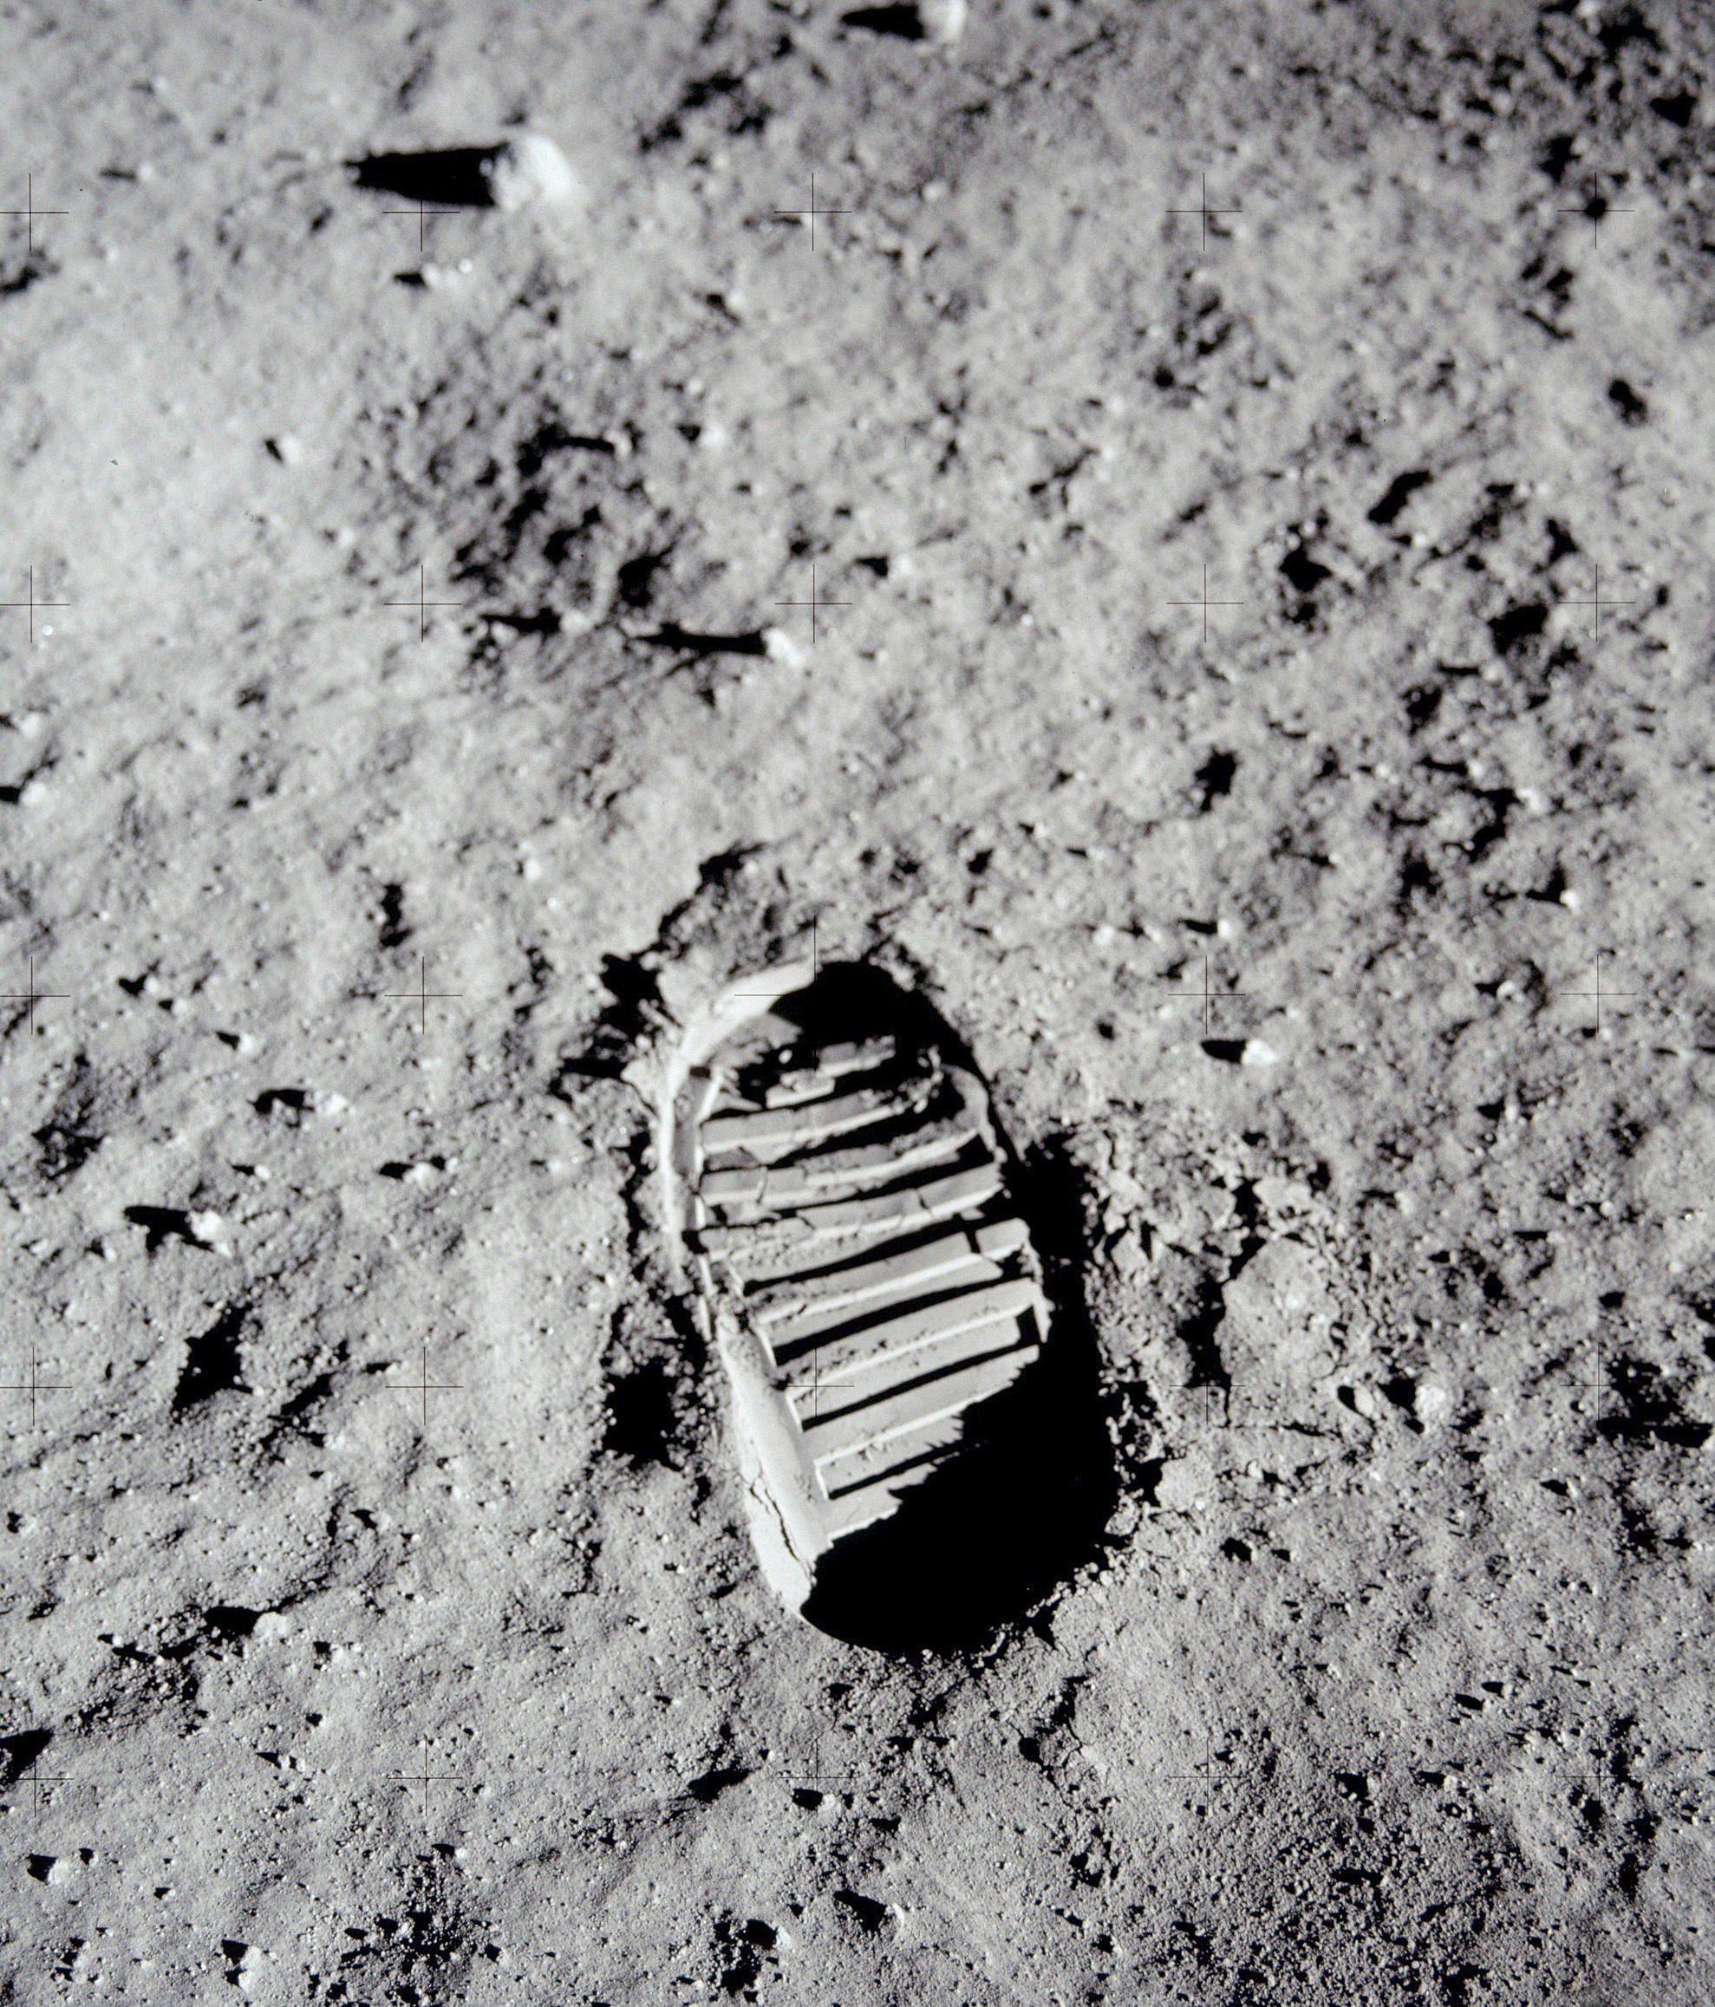
Foto by: BUZZ ALDRIN/NASA / VIA AP
via: https://www.kgou.org/post/preserving-footprints-moon-historian-and-author-discusses-apollo-s-legacy
Accessed: 29.03.2020

Slide 13
Sources
[1] David Mackie and Jessica Murray, Risky Business: The Climate and the Macroeconomy [pdf.], JPMorgan, Economic Research 2020
[2] Deal, T. E. (2019). COMMUNICATION FROM THE COMMISSION TO THE EUROPEAN PARLIAMENT, THE EUROPEAN COUNCIL, THE COUNCIL, THE EUROPEAN ECONOMIC AND SOCIAL COMMITTEE AND THE COMMITTEE OF THE REGIONS. COM.
[3] United Nations Climate Change, What is the Paris Agreement? [online], UNFCCC Sites and Platforms. Retrieved from: https://unfccc.int/process-and-meetings/the-paris-agreement/what-is-the-paris-agreement
[4] ETC, MISSION POSSIBLE: REACHING NET-ZERO CARBON EMISSIONS FROM HARDER-TO-ABATE SECTORS BY MID-CENTURY [pdf.], NOVEMBER 2018
[5] Patrick Herhold and Emily Farnworth, The Net-Zero Challenge: Fast-Forward to Decisive Climate Action [pdf.], World Economic Forum, Switzerland 2020
[6] Celine Herweijer et al., Emissions Relapse: Tracking the progress G20 countries have made to decarbonise their economies [pdf.], PwC UK 2019
[7] Sweden, (2020). Sweden tackles climate change [online]. Retrieved from: https://sweden.se/nature/sweden-tackles-climate-change/#
[8] Energy, M. o. (2018). Sweden’s draft integrated national energy and climate plan. Government Offices of Sweden.

Slide 14
[9] IMF. Fiscal Affairs Dept. (2019). Fiscal Monitor: How to Mitigate Climate Change. Retrieved from: https://www.imf.org/en/Publications/FM/Issues/2019/10/16/Fiscal-Monitor-October-2019-How-to-Mitigate-Climate-Change-47027
[10] Government Office of Sweden (2019). Press release. Inquiry appointed on phasing out fossil fuels and banning sales of new petrol and diesel cars. Retrieved from: https://www.government.se/press-releases/2019/12/inquiry-appointed-on-phasing-out-fossil-fuels-and-banning-sales-of-new-petrol-and-diesel-cars/
[11] Jennifer Rankin and Fiona Harvey, What is the European Green Deal and will it really cost €1tn? [online], The Guardian 2020. Retrieved from: https://www.theguardian.com/world/2020/mar/09/what-is-the-european-green-deal-and-will-it-really-cost-1tn
[12] Union, E. (2017). Europa. Retrieved from An Official Webpage of the European Union: Retrieved from: https://europa.eu/european-union/about-eu/eu-budget/expenditure_en
[13] TAGLIAPIETRA, G. C. (2020). A trillion reasons to scrutinise the Green Deal Investment Plan. THE BRUEGEL NEWSLETTER.
[14] Palme, N. R. (2020). Sveriges Radio. Retrieved from Radio Sweden Your best source of news from Sweden. Retrieved from:
https://sverigesradio.se/sida/artikel.aspx?programid=2054&artikel=7387102
[15] Jennifer Rankin, European Green Deal to press ahead despite Polish targets opt-out
[online], The Guardian 2020. Retrieved from: https://www.theguardian.com/environment/2019/dec/13/european-green-deal-to-press-ahead-despite-polish-targets-opt-out
[16] Morgan, S., 2020. Euractiv. [Online], Retrieved from: https://www.euractiv.com/section/climate-environment/news/polands-just-transition-bonus-cut-50-under-latest-eu-budget-proposal/

