Slide 1
GaLTzagorri

Slide 2
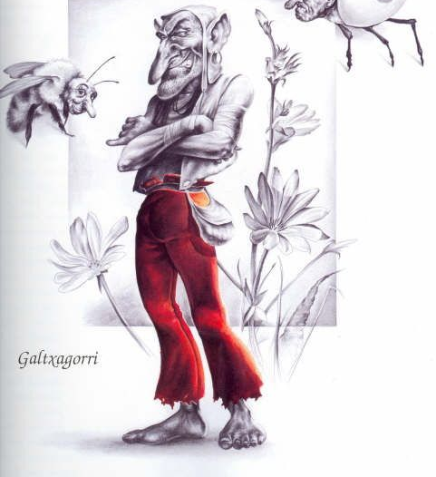
GaLTzagorri / GALTXAGORRI
their name means the red-pants
a specific type of iratxoak (imps)
other names: Aidetikako (in Sare), Aiharra, Haio (in Labort), Beste Mutilak (in Guernica y Luno), Patuek (in Múgica)

Slide 3
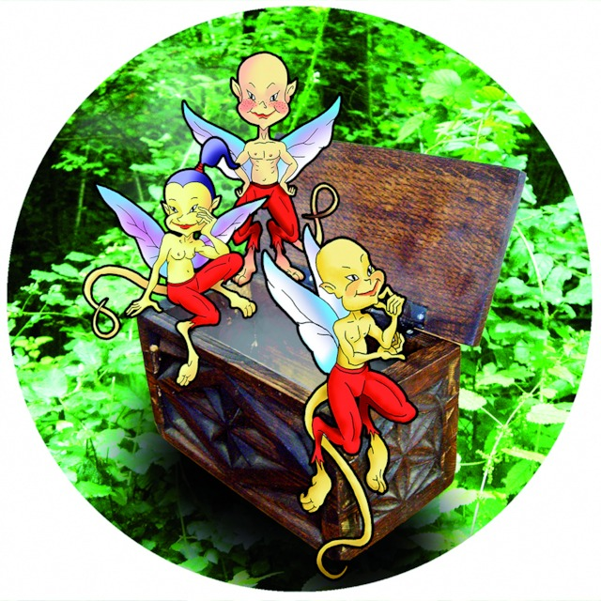
Galtzagorri / GALTXAGORRI
tiny creatures who serve humans over night
live in a box and wear red pants
23 June, eve of Saint John’s day, is the day to capture them
when a wizard does something extraordinary it has been done thanks to the help of the Galtxagorriak

Slide 4
Legends
A legend from the village of Kortezubi where man asked them to bring a sieve full of water
A legend from Zarautz where Galtxagorriak helped a man to win an ox race

