Slide 1
Blood
Lecture from the Medical Physiology
Marie Žaloudíková
Department of Physiology, Second Faculty of Medicine, Charles University

Slide 2
Composition of blood
8% body weight, 5-6 l, transporting medium
functions: 1. Respiratory
2. Homeostatic a) water, ions, pH
b) temperature
3. Excretoric
4. Chemical control
5. Immunity
6. Nutritional
formed elements + plasma

Slide 3
Composition of blood

Slide 4
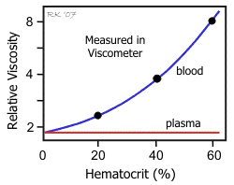
Influence of blood composition on the flow influence of hematocrit

Slide 5
Composition of plasma
Water 91%
Dissolved substances 9%
Blood gases
Organic 8%
Inorganic 1%
Elektrolytes
(Na+, K+, HCO3-, Ca2+)
Proteins !!! 7%
cholesterol
glucose
hormones
vitamins

Slide 6
Erythrocate sedimentation rate

Slide 7
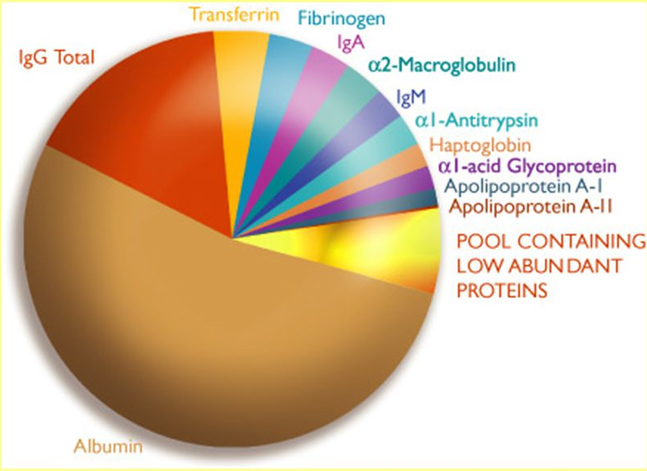
Main plasmatic proteins
Functions of plasma proteins:
Transport
Colloid osmotic pressure
Buffering action
Immunity
Clotting

Slide 8
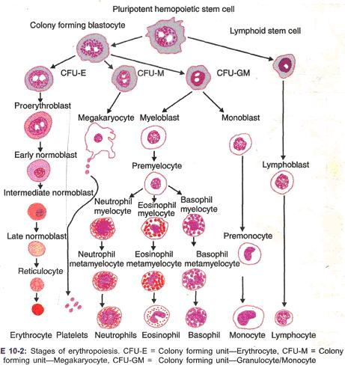
Blood elements - development

Slide 9
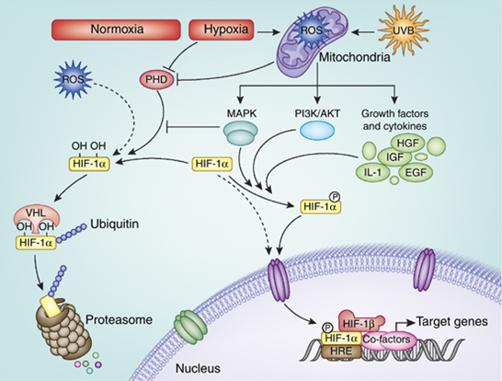
Regulation of erytropoesis
Hb 130-170 g/l, various types (A, F) – affects the dissociation curve

Slide 10
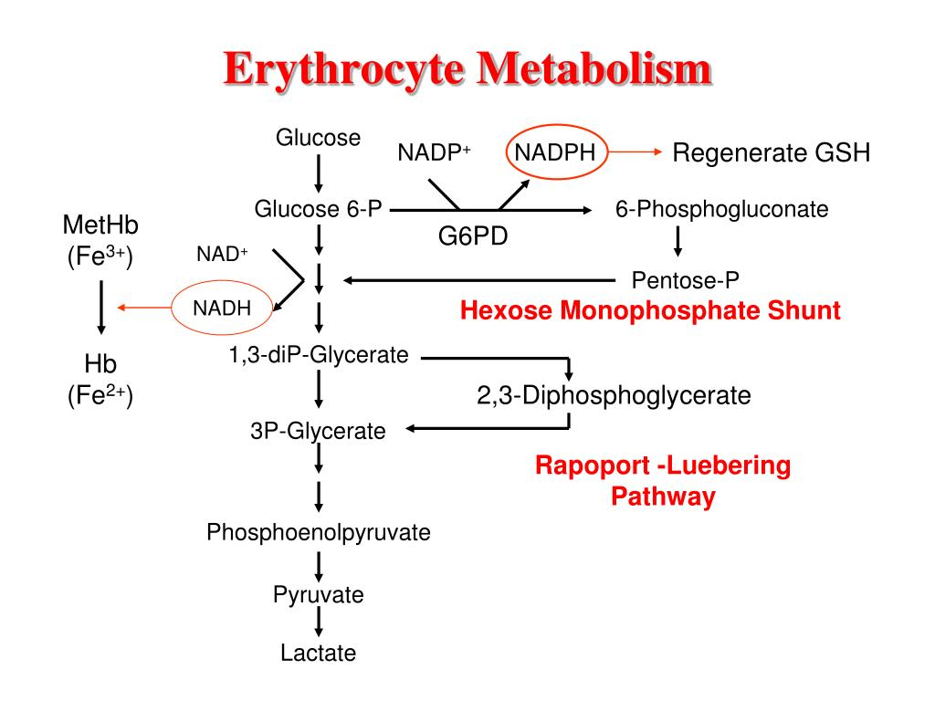
Specifics of red blood cells metabolism
ATP
Membrane stability
Cationt pumps
Glutathion syntase

Slide 11
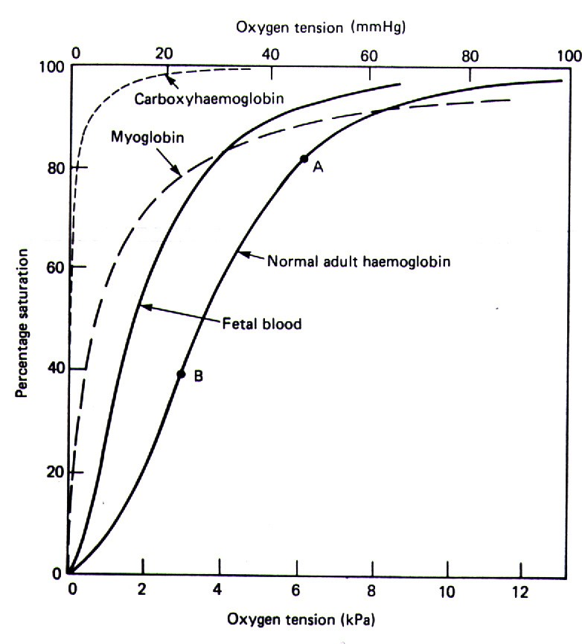
Specifics of erythrocytes
Haemoglobin
Main functions:
Transport of O₂ a CO₂
Buffer
Transport of NO
Hb – 135 –170 g/l
Physiological types: A, F – various affinity to oxygen!
Pathological forms:
carboxyhaemoglobin, methaemoglobin
Degradation product: bilirubin - ! newborn

Slide 12
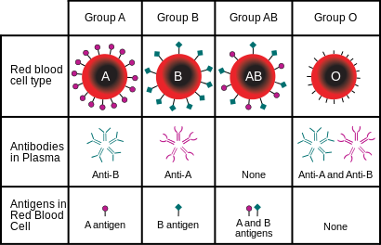
Blood groups
A,B,0 spontanneously produced aglutinins
Rh (C,D,E) aglutinins produced after exposure

Slide 13
Rh incompatibility – serious problem in pregnancy

Slide 14
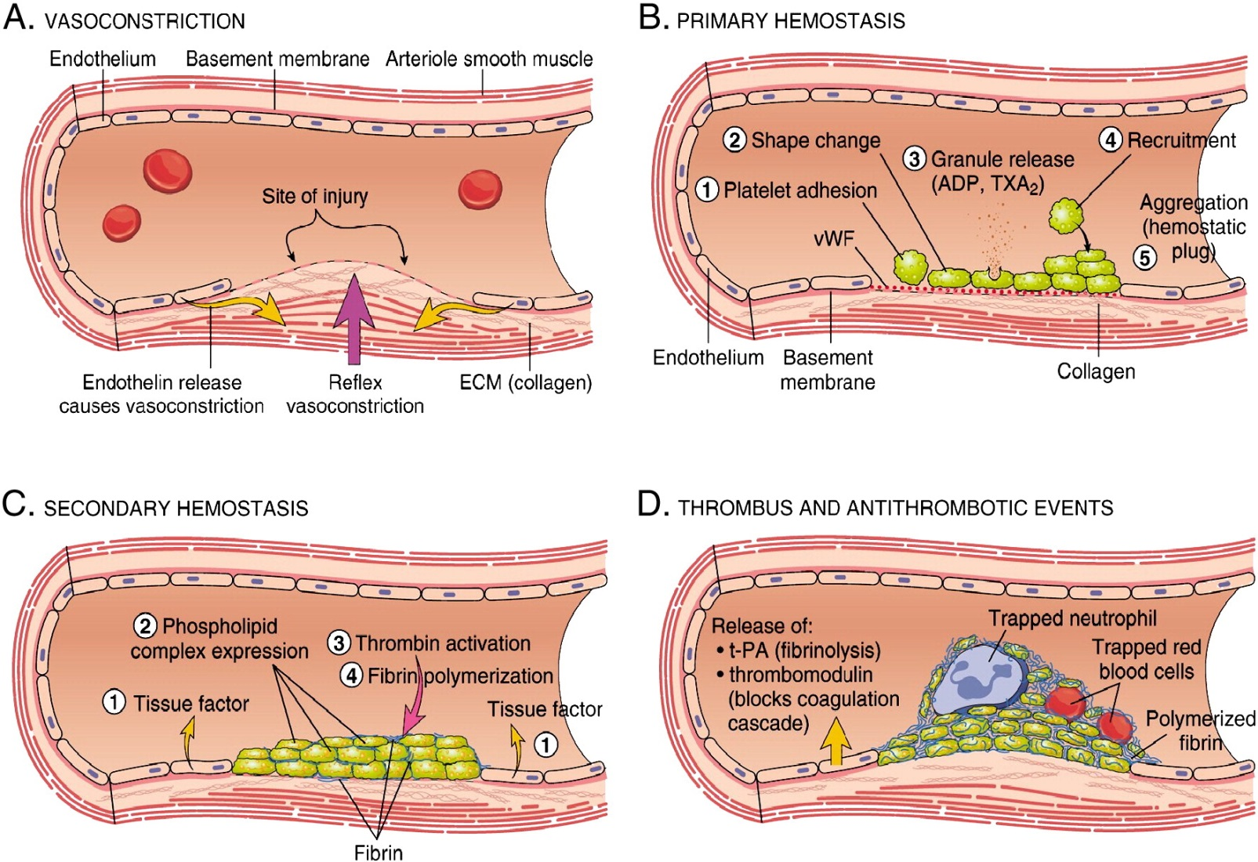
Hemostasis

Slide 15
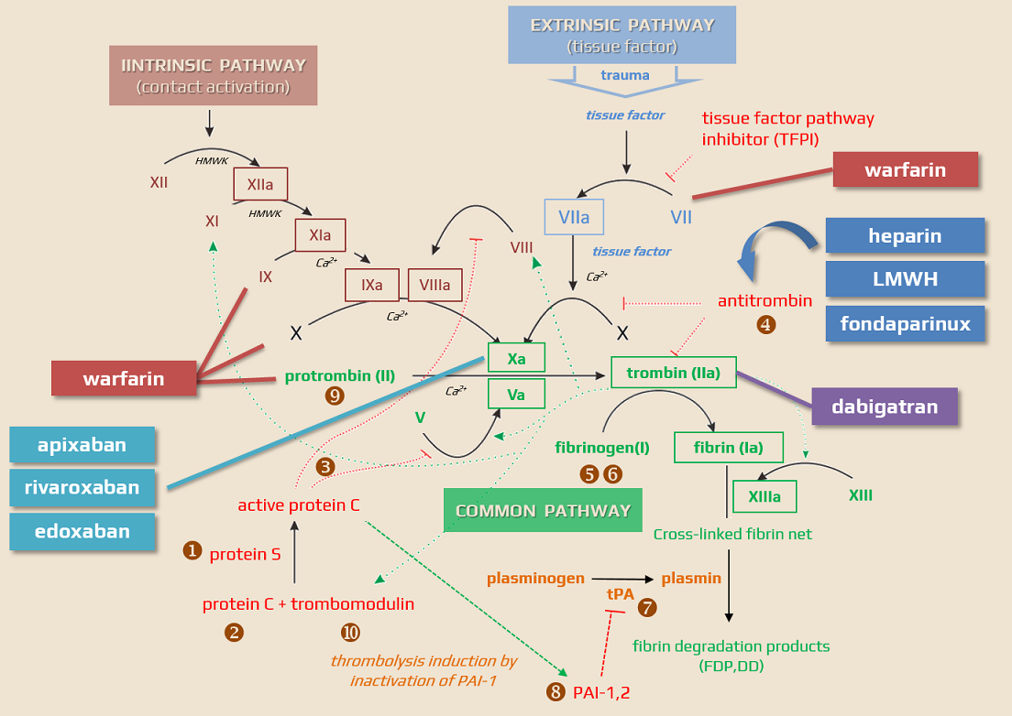
Coagulation cascade

Slide 16
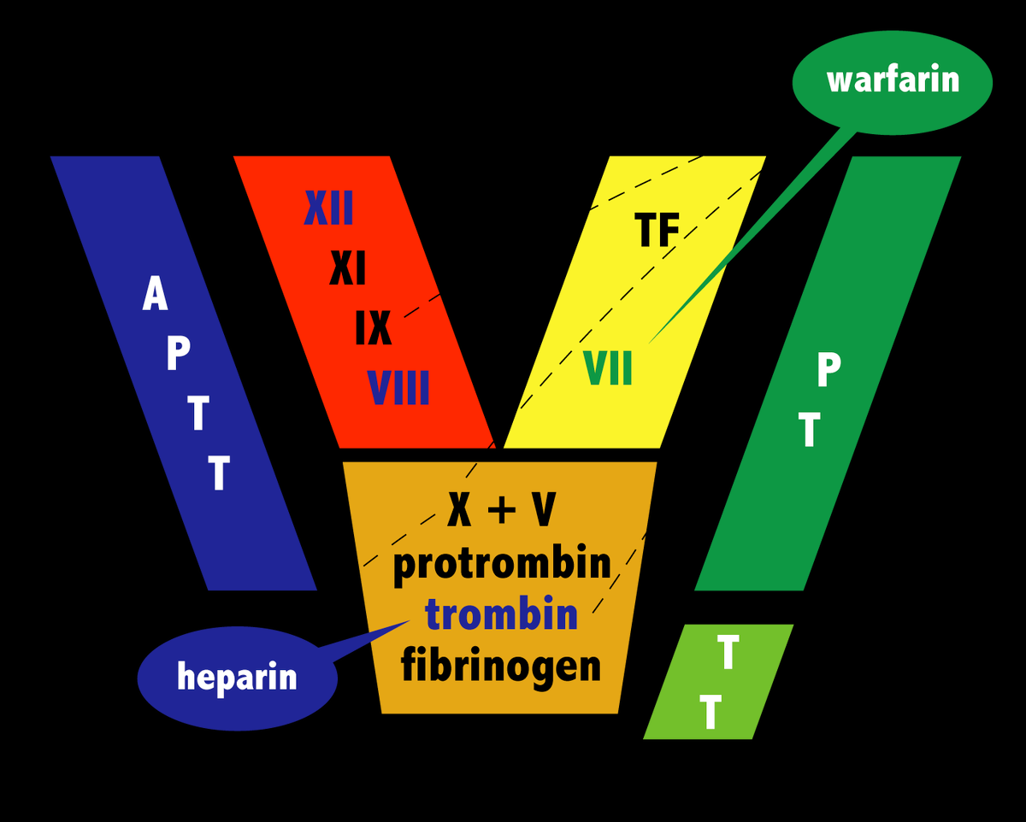
Clotting tests
Intrinsic pathway
Extrinsic pathway

Slide 17
Thank you for you attention

