Slide 1
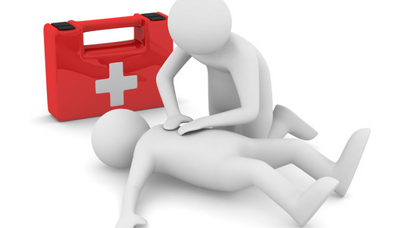
CARDIOPULMONARY RESUSCITATION

Slide 2
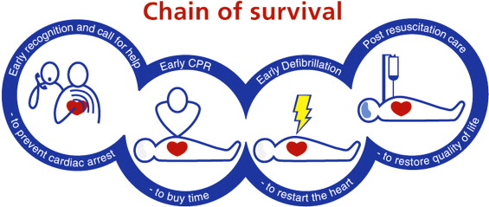
CARDIOPULMONARY RESUSCITATION
- emergency lifesaving procedure
- to restore and maintain breathing and circulation
- to provide oxygen to heart, brain and other vital organs
- combination of chest compressions and rescue breaths
Basic life support - BLS
provided by lay first aiders
on site of accident
no special tools available
Advanced life support - ALS
follows basic life support
provided by specially trained professionals
special medical equipement
transport

Slide 3
ADULT BASIC LIFE SUPPORT
- start if person is unconscious and not breathing normally
SEQUENCE OF STEPS
check for danger
check for response
unresponsive - turn on back
open airway - head-tilt chin-lift
check for breathing (10 seconds)
not breathing normally
call EMS
send for AED
start CPR
Follow C-A-B rule
alternate 30 chest compressions and 2 rescue breaths
30 : 2

Slide 4
C-A-B RULE
C - Chest Compressions
30 compressions
compression rate 100-120/min
compression depth at least 5 cm (no more than 6 cm)
allow full chest wall recoil
minimize interruptions
A - Airway
open airway - head-tilt chin-lift
B - Breathing
2 rescue breaths (mouth to mouth)
1 breath every 6 seconds
duration of 1 breath 1 second
normal tidal volume (500 ml)

Slide 5
COMPRESSION VENTILATION RATIO
30 : 2
https://www.youtube.com/watch?v=MeHeg8I7xuY

Slide 6
CHEST COMPRESSION-ONLY CPR
- alternative for those who are unwilling, unable, untrained to perform full CPR
compression rate 100-120/min
compression depth at least 5 cm (no more than 6 cm)
allow full chest wall recoil
no interruptions

Slide 7
CHILD AND INFANT BASIC LIFE SUPPORT
- start if child is unconscious and not breathing normally
SEQUENCE OF STEPS
check for danger
check for response
unresponsive - turn on back
open airway - head-tilt chin-lift
check for breathing (10 seconds)
not breathing normally
5 initial rescue breaths
start CPR
call EMS after 1 minute of CPR
continue CPR
After 5 initial rescue breaths follow C-A-B rule with compression- ventilation ratio 30 : 2.
30 : 2

Slide 8
NEW BORN INFANT BASIC LIFE SUPPORT
- start if new born infant (under 1 month) is unconscious and not breathing normally
SEQUENCE OF STEPS
check for danger
check for response
unresponsive - turn on back
open airway - chin-lift (neutral head position)
check for breathing (10 seconds)
not breathing normally
5 initial rescue breaths
start CPR
call EMS after 1 minute of CPR
continue in CPR
After 5 initial rescue breaths follow C-A-B rule with compression- ventilation ratio 3 : 1.
3 : 1

Slide 9
HAND PLACEMENT
COMPRESSION DEPTH
ADULT
2 hands on lower half of breastbone
at least 5 cm
CHILD OVER 1 YEAR
2 hands or 1 hand on lower half of breastbone
at least 1/3 of chest diameter (about 5 cm)
NEWBORN AND CHILD UNDER 1 YEAR
2 fingers in center of chest just below nipple line
at least 1/3 of chest diameter (about 4 cm)

Slide 10
WHEN TO STOP CPR?
vital functions re-established
casualty under professional care
vital functions not re-established after 30-60 minutes of CPR
rescuer physically exhausted
WHEN NOT TO START CPR?
rescuer in danger
signs of death
injuries incompatible with life
final stage of fatal disease

Slide 11
SIGNS OF DEATH
pallor mortis - paleness (15-120 min. after death)
livor mortis - setting of blood in lower part of body (1 houh after death)
algor mortis - reduction in body temperature
rigor mortis - stiffness (2-4 hours)
decomposition
Clinical death - cardiac arrest - reversible
Biological death - brain death (electrical activity of brain ceased)
3-5 minutes after cardiac arrest

Slide 12
AUTOMATIC EXTERNAL DEFIBRILATOR - AED
- electronic portable device that is able to diagnose potentially life-threatening cardiac arrythmias and is able to treat them by application of brief electroshocs through electrodes placed on chest wall
get AED
switch on
follow voice commands
remove clothing
apply pads
follow voice commands
DO NOT interrupt CPR!

Slide 13
AGONAL GASPING
- abnormal uneffective breathing
- present in up to 40% of sudden cardiac arrest victims in first minutes
indication to start CPR and get AED
DO NOT confuse with normal breathing!

