Slide 1
Art and Politics
Ideology and utopia

Slide 2
Art and Society
Art as a social critique and social redemption
Public galleries, concert halls, mass media etc.
Modern disconnection of the close link between art/beauty and goodness/truth/morality
Question whether art supports the prevailing social order and is therefore ideological

Slide 3
Ideology
Descriptive meaning
Set of ideas, perspectives, attitudes, rituals, values of a certain community
Social practices, including non-discursive (behavior, gestures)
Part of all activities with symbolic value (political, economical, religious, cultural etc.)
Ideology as a worldview
- Shared by certain social groups

Slide 4
2. Pejorative meaning
False conciousness
Wrong epistemic status of certain ideas (interests of a certain group are presented as interests of the society as a whole)
The aesthetic experience presents itself as disinterested and universal, but in fact expresses only the interests and values of a privileged social group

Slide 5
- justification or legitimization of institutions or social practices
- disguise of social contradictions
- culture industry (Hollywood movies, popular music etc.) as a false illusion of harmony
- suppresed origin of ideology/false conciousness

Slide 6
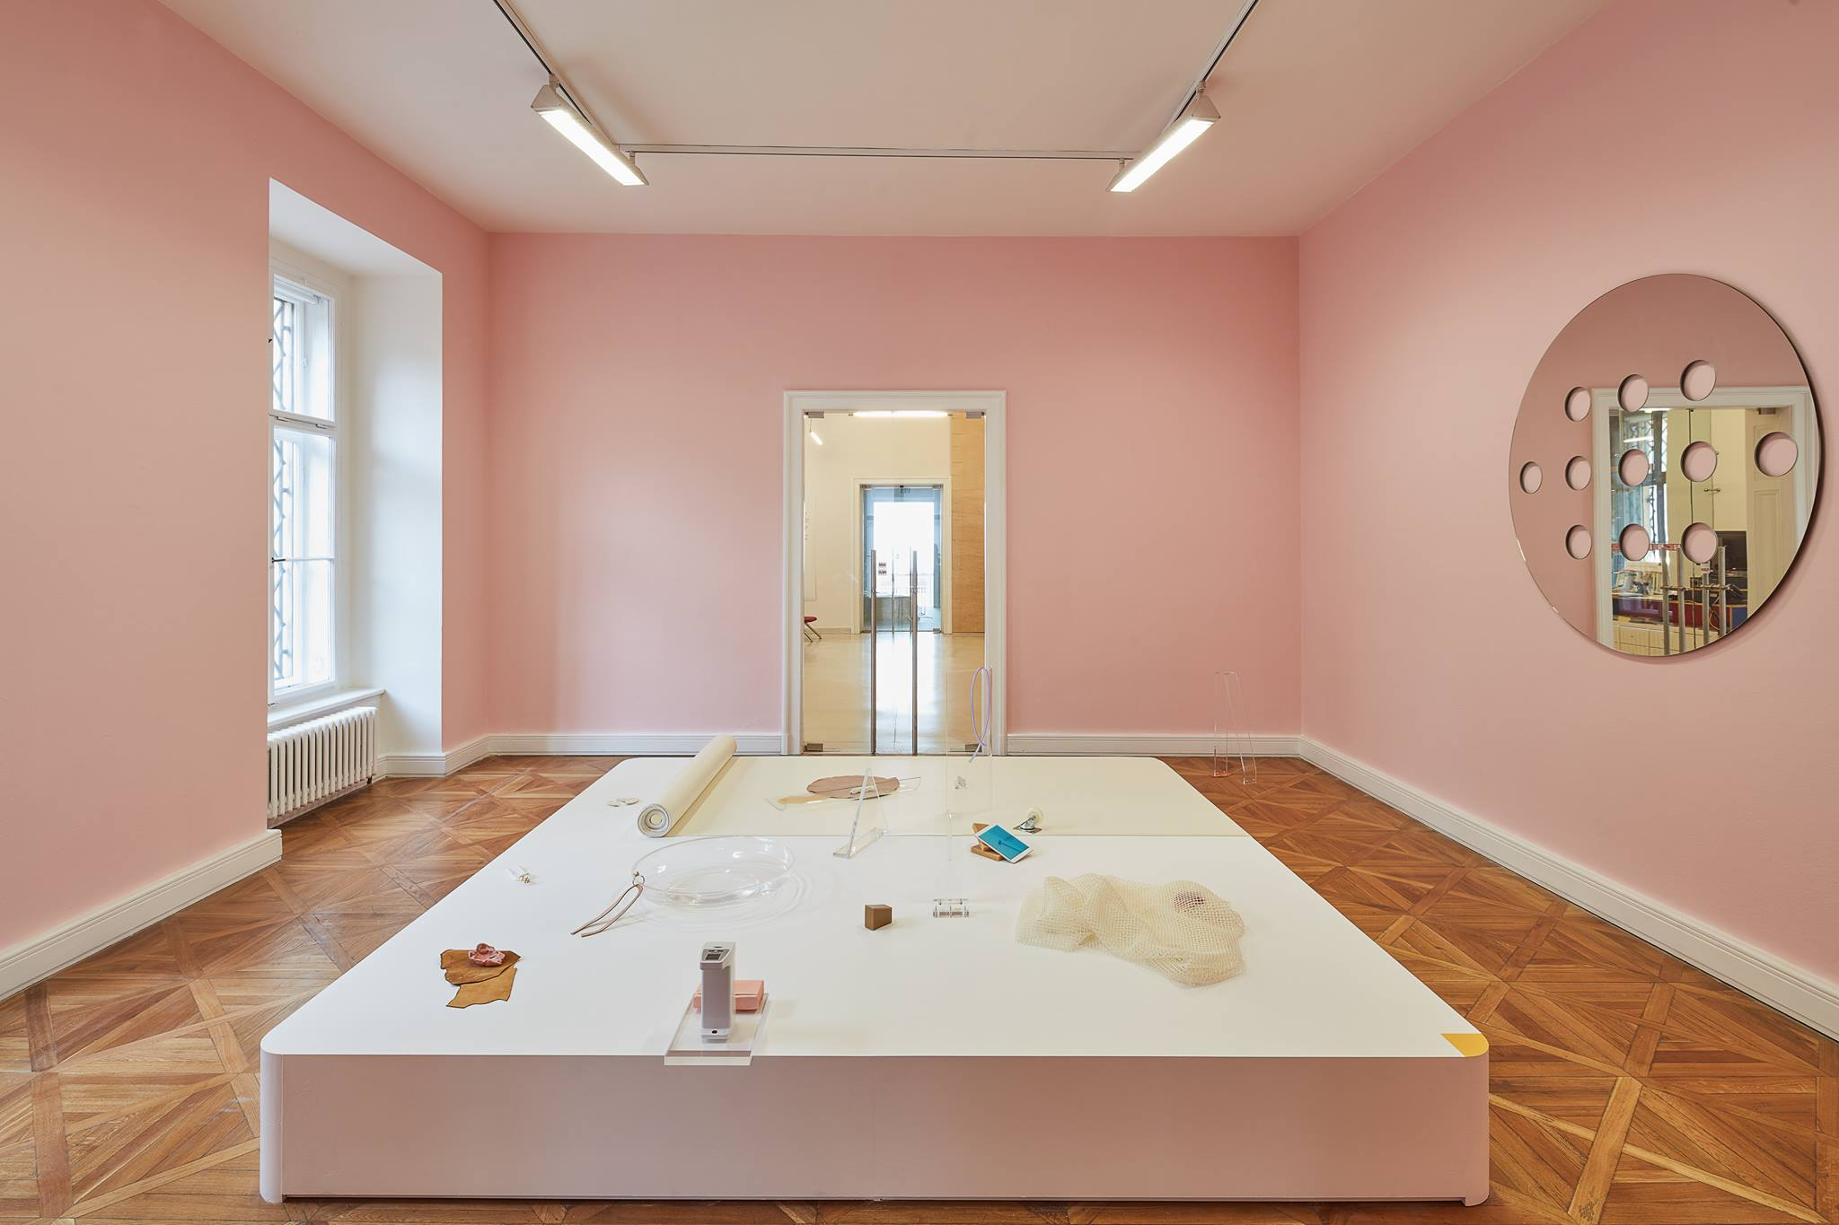
Jindřich Chalupecký Award 2017

Slide 7
3. Positive meaning
Necessary part of social life – searching for an optimal form as a political program
Necessary for coherence of society

Slide 8
Utopia
Forming of current needs and desires in a future state
Anticipatory aspect
Necessary for developmnet of society
Danger of becoming ideology
Ideological and utopical aspects are usually connected, especially in the case of art – art can be not only means of prevailing social order, but also its implicit criticism

Slide 9
Problem of criticism of ideology as a distorted (perceiving of) reality
Loss of our right of deciding about our lives – our world as something imposed on us
Ideology as a historically emerged social pathologies

Slide 10
Ideology and art
Extreme positions – art as fully ideological or art as fully anti-ideological
The aesthetic theory as ideological? How to save art from being subsumed under other (ideological) categories, without aesthetics?
Correlation between social conditions and art

