Slide 1
Review of Germany‘s position paper
Tereza Klimešová
Patrik Kratochvíla
Nirsan Sriskantharajah
Valentin Schnabl
Dema Hajeb

Slide 2
Strong points
Directing the EU’s focus primarily on the expense side of the budgetary decisions
EU as a global leader in climate change problem-solving efforts
Emphasis on renewable energy as an important way to reduce CO2 emissions

Slide 3
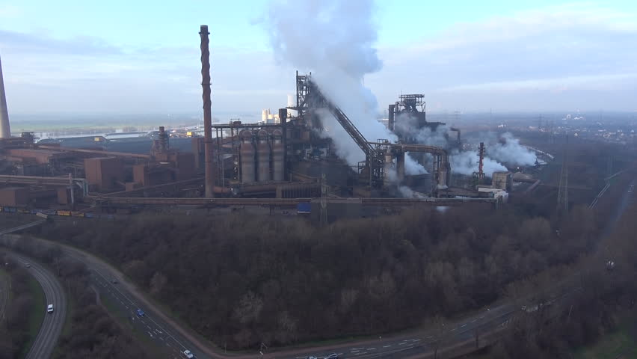
WEAK points
The so-called „Unholy Trinity“ problem
Lack of coordination in own initiatives in sufficient implementation of climate policies
Still relatively coal-dependent economy, despite increases in renewables

Slide 4
THANK YOU FOR YOUR ATTENTION

