Slide 1
FRANZ ROSENZWEIG
And the interconnection

Slide 2
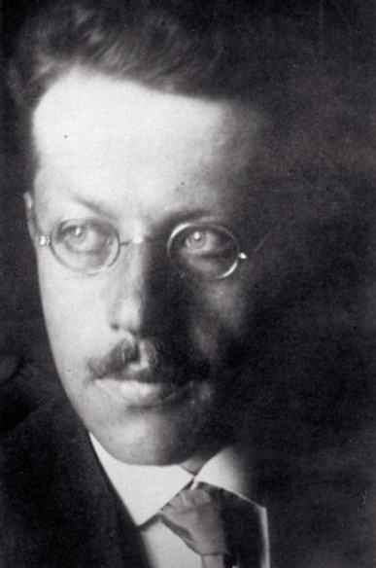
Life and work
Born in 1886, Kassel, assimilated family
1906 University of Freiburg – philosophy (mainly Hegel) and history
Early 1910 – Baden-Baden; project of renewal Hegelianism
Fall of 1910 – Berlin and dissertation Hegel und der Staat (defended in 1912, published in 1920)
1913 – rethinking the origins of German Idealism (founding of Hegel‘s fragment called „An Aesthetic“, Franz‘ doubts about the authorship)
1913 – Leipzig, crucial friendship with lecturer Eugen Rosenstock – after the life-changing discussion Franz almost converted to Christianity but instead he rediscovered Judaism → 1914 study at Berlin Hochschule für die Wissenschaft des Judentums, friendship with Hermann Cohen and common project The Academy for the study of Judaism
1914 – first essay in Jewish theology „Atheistic Theology“ – the new Jewish theology is criticized as atheistic
1914 – 1918 – serving as anti-aircraft in First World War; political work „Globus: Studies towards the World-Historical Doctrine of Space“
1920 – opening of „The New Jewish Lehrhaus“ – institute for Jewish adult education
1921 – philosophical magnus opus „Stars of redemption“, firstly published
1921 – Franz wrote „The Little Book of Healthy and Sick Human Understanding“ as a popular introduction to philosophy hated it and declined the publishing. The Book was published after forty years!
Illness – 1922 diagnosed with Amyotrophic Lateral Sclerosis, → the loss of speech and ability to write;1923 purchasing of special typewriting machine
Translations – 1924 „Sixty Hymns and Poems of Judah HaLevi“; 1925 collaboration with Martin Buber on German translation of Bible
1925 – essay „The New Thinking“
1929 death

Slide 3
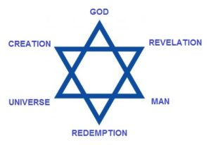
The star of redemption
Complicated yet systematic work
Fusion of philosophy and theology
Three fundamental kinds of being – God, world and self
Three courses of connection between them – creation, revelation and redemption
Together they create a united Star of David

Slide 4
Mortality in the star
Death brings every element – that means every kind of being - close to Nothing
Every element generates its identity from its own particular experience of Nothing
Two paths that leads out of Nothing: a.) the affirmation of what is “not-nothing”
path of the „Yes“
b.) negation of that very nothing
path of the „No“
↓
unity of those paths is called „And“ of „Yes“ and „No“

Slide 5
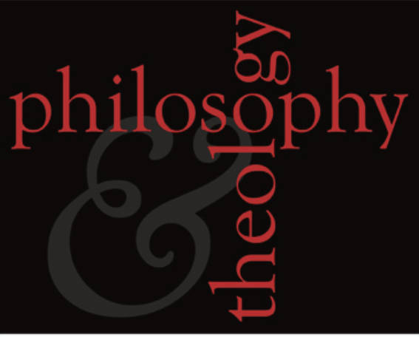
Theology in the Star
Theology brings into actuality the elements created by philosophy through connecting into relations
Creation: the divine is turning into relation with the world
Revelation: the divine is turning into relation with the self
Redemption: the self is turning into relation with the world
Only through these relations the elements are actual and their identity is realized
They need to open up and transform themselves in order to enter the relations by the reversal of „Yes“ and „No“
Creation is experienced as past, revelation as present and redemption as future

Slide 6
The role of jewish and christian communities
Life in those communities allows us to see the unity of All in the future
Jewish people anticipate the ultimate redemption of the world through their intimate relation to the divine
Christianity causes the actual redemption of the world in the history through the message of love
Vision of redemptive unity of the All through the image of the Star of David – the Star of Redemption

Slide 7
New thinking
Concept depicted in The Star and in the essay The New Thinking
Old thinking‘s errors: * Abstracting from time
* Reductive reasoning
* Thinking from the standpoint of the Absolute
Whole horizont of the new thinkers: ~ relations to the thing through the past
~ awareness of the self through the present
~ relations to the others through the common goal in the
future
New thinking is possible for philosophy only through the marriage with theology

Slide 8
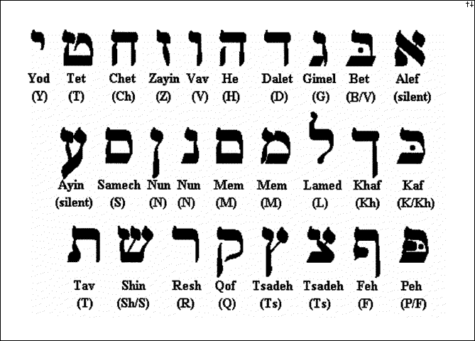
Theory of translation
Translation is an introducing of the foreign text into your primary language and thus transforming this language
The future is the redemptive unity of all languages – translator‘s work actually leads to the redemption
„All the speech is translation“ – you are translating your thoughts for the other person in order to communicate with him and to connect with him

Slide 9
Homework
Listen to this presentation. Read the beginning of the Introduction from The Star of Redemption (pp 9 – 12; about death and about the philosophy of the all). Explain in your own words (300 – 400 words) the importance of death for a man and its relation to the philosophy (or philosophy’s relation to the death). Did you notice the shift in language between Jewish rationalism and Jewish existentialism when you read e.g. Mendelssohn and now you are reading Rosenzweig? Send me your paper via e-mail before 8th May.
jana.tomesova@ff.cuni.cz

